Slide 1
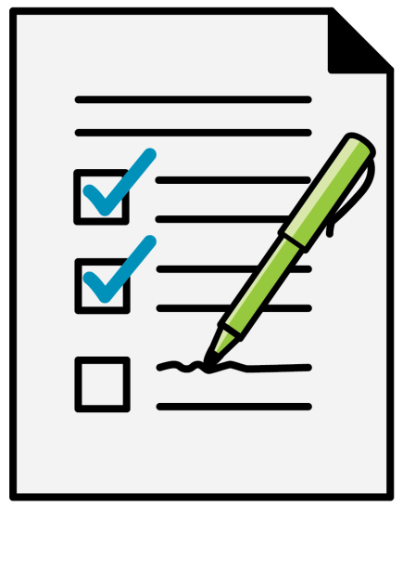
Planning for the Unexpected
Preparing for future health problems or disasters:
Gives you control
Relieves stress of decision-making from caretakers and family members
Saves money and helps avoid financial setbacks
Allows time to gather information and compare options
Notes:
PLANNING FOR UNEXPECTED LIFE EVENTS
Planning ahead:
Gives you control and options for your situation
Relieves the stress of decision-making from caretakers/family members
Saves money and helps you avoid financial disaster or setback
Allows time for gathering information, comparing options, and determining which options help achieve what is most important

Slide 2
Preparing for
Future Health Problems
Prepare a Plan: review income and expenses
Make sure trusted family members know where to find necessary documents
Set up direct deposit for income and benefit checks
Consider automatic payment of important, recurring bills
Notes:
Preparing for possible future health problems
The majority of people who need long-term care are older adults. However, the need for long-term care can come at any age due to disabling diseases, car accidents, brain injuries, strokes, and other disabling events.
Families and individuals who plan ahead before a disability will be in a better position to cope in the event of a disability. Consider taking these steps before you or a family member becomes ill or disabled:
Prepare a plan. Start with reviewing your income and expenses.
Make sure trusted family members know where to find personal and financial documents in an emergency.
Set up direct deposit for income and benefit checks.
Direct deposit delivers your Social Security or Supplemental Security Income (SSI) benefit or other income sources into your bank, savings and loan, or credit union account quickly and safely.
Consider automatic payment of important, recurring bills.

Slide 3

Preparing for Future Health Problems (cont.)
Consider a durable power of attorney
Make sure you are properly insured
Maintain a healthy lifestyle
Notes:
Consider automatic payment of important, recurring bills.
Consider a durable power of attorney. As we mentioned in the section on power of attorney, this legal document gives one or more people the authority to handle finances and remains in effect if you become incapacitated.
Make sure you are properly insured. Speak with a financial planner or an insurance agent you trust. Review your policy regularly because your needs can change.
Maintain a healthy lifestyle.
Experts also recommend a health care power of attorney (also known as a health care proxy, advance directive or by another name, depending on the state) designating a family member or other trusted person to make decisions about medical treatment. Health care powers of attorney are intended to ensure that someone’s wishes regarding medical care are honored.

Slide 4
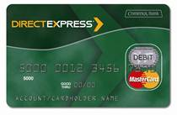

Receiving Social Security Benefits
Social Security and Supplemental Security Income (SSI) benefit payments:
Direct Deposit
Direct Express® Debit Card
Notes:
Direct Deposit of your Social Security Benefit
Let’s go into a little more detail about direct deposit of your Social Security and Supplemental Security Income (SSI) benefit payments. Applicants filing for these benefits must now choose either direct deposit or the Direct Express® debit card. Currently entitled beneficiaries and recipients who had been receiving payment by check generally had to switch to direct deposit to a checking account or a pre-paid card they select or to the Direct Express® debit card.
Currently entitled beneficiaries and recipients who had been receiving payment by check have had to switch to direct deposit to a checking account or a pre-paid card they select or to the Direct Express® debit card.
The U.S. Treasury sends an electronic message to your bank, savings and loan, or credit union crediting your account with the exact amount of your Social Security or SSI benefit. You can withdraw money, put some in savings or pay bills – the ordinary things you do with your money. The difference is, your check isn’t printed or mailed. For more information, visit the Department of the Treasury’s Go Direct® website godirect.org.

Slide 5
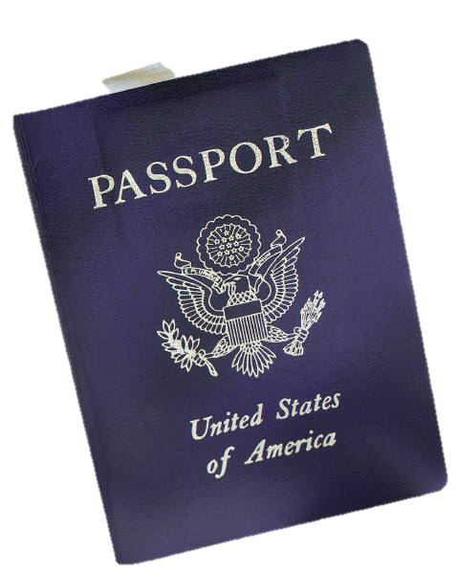
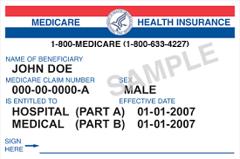
Preparing Financially for a Disaster
What you may need:
Forms of identification
Driver’s license or government-issued ID
Insurance cards
Social Security card
Passport
Birth certificate
Notes:
How to Be Financially Prepared for Disasters
Natural or man-made disasters can strike without warning and can happen anywhere. These include floods, fires, earthquakes, tornadoes, hurricanes, chemical spills or similar events that can force people to evacuate their homes. Even minor disasters can damage or destroy property or other belongings. They can also seriously impair your ability to conduct essential financial transactions for a period of time. In addition to planning for your personal safety and basic needs (e.g., shelter, food, and water), you should be ready to deal with financial challenges, including how to pay for supplies or temporary housing if necessary.
What to have ready
Consider keeping the following documents, bank products, and other items in a secure place and readily available in case of an emergency:
Forms of identification: These primarily include driver’s licenses (or state identification cards for non-drivers), insurance cards, Social Security card, passport, and birth certificate.

Slide 6

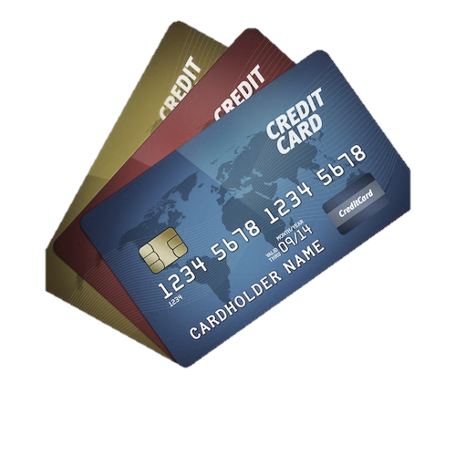

Other Items You May Need
Cash
ATM cards, debit cards, credit cards
Checkbook (blank checks and deposit slips to last at least a month)
Phone numbers for financial services providers
Important account numbers
Key to safe deposit box
Notes:
Your checkbook with enough blank checks and deposit slips to last at least a month.
ATM cards, debit cards (for use at ATMs and merchants), and credit cards: Do not assume that merchants and ATMs in areas affected by a disaster will immediately be functioning as usual. Have other options available for getting cash and making payments.
Cash.
Telephone numbers for your financial services providers: These include local and toll-free numbers for your bank, credit card companies, brokerage firms (for stocks, bonds, or mutual fund investments) and insurance companies.
Important account numbers: These include bank and brokerage account numbers, credit card numbers, and homeowner’s or renter’s insurance policy numbers. You may want to copy the front and back of your credit cards (and keep them in a safe place).
The key to your safe deposit box.

Slide 7
Protecting Your Documents
Make backup copies of important documents
Make an electronic image for easy storage
Give a copy to loved ones or tell them where to find documents in an emergency
Store backups at a distance from home in case disaster affects entire community
Make a record of all credit/debit cards
with the account and contact numbers
to report lost/stolen cards
Notes:
What to keep and where to keep it
After you have gathered your most important financial items and documents, protect them as well as you can while also ensuring you have access to them in an emergency. Here is a reasonable strategy for many people:
Make backup copies of important documents.
Make an electronic image of your documents so you can more easily store the information.
Give a copy of your documents to loved ones or let them know where to find the documents in an emergency.
Store your backups at some distance from your home in case the disaster impacts your entire community.
Make a record of all credit/debit cards with the account and contact numbers to report lost/stolen cards.

Slide 8
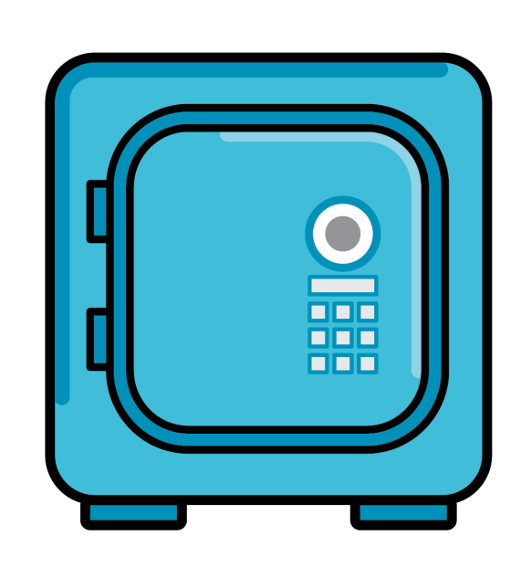
What to Keep; Where to Keep It
Store in a safe deposit box
Birth certificate and originals of important contracts
Keep at home, preferably
in a fireproof safe
Passport, medical care directives, and will
    Seal important documents in airtight,
    waterproof bags or containers
Notes:
Determine what to keep at home and what to store in a safe deposit box at your bank.
A safe deposit box is best for protecting items of value and certain papers that could be difficult or impossible to replace, but not anything you might need to access quickly. What should you put in a safe deposit box? Examples include a birth certificate and originals of important contracts. What is better left safely at home, preferably in a durable, fireproof safe? Your passport and medical care directives because you might need these on short notice. Consult your attorney before putting an original will in a safe deposit box. Some states do not permit immediate access to a safe deposit box after a person dies, so there may be complications accessing a will stored in a safe deposit box. Remember that safe deposit boxes are not necessarily fireproof or waterproof.
Seal important documents in airtight and waterproof plastic bags or containers to prevent water damage.
Prepare one or more emergency evacuation bags.
Pack essential financial items and documents (e.g., cash, checks, copies of your credit cards and identification cards, a key to your safe deposit box, and contact information for your financial services providers). Make sure each evacuation bag is waterproof and easy to carry. Keep it in a secure place in your home. Periodically update the contents of the bag. It will not do you any good if the checks in your bag are for a closed account.

Slide 9
What Else to Consider
  Prepare emergency evacuation bag(s)
Arrange for automatic bill payment from your bank account
Sign up for Internet banking services
Review your insurance coverage
Notes:
What else to consider
Arrange for automatic bill payments from your bank account. This service enables you to make scheduled payments (e.g., for your telephone bill, insurance premiums and loan payments), and avoids late charges or service interruptions.
Sign up for Internet banking services. This also makes it possible to conduct your banking business without writing checks. Only do this if you feel comfortable with keeping your internet security software up-to-date.
Review your insurance coverage. Make sure you have enough insurance, including: personal property coverage, as applicable, to cover the cost to replace or repair your home, car and other valuable property.

Slide 10
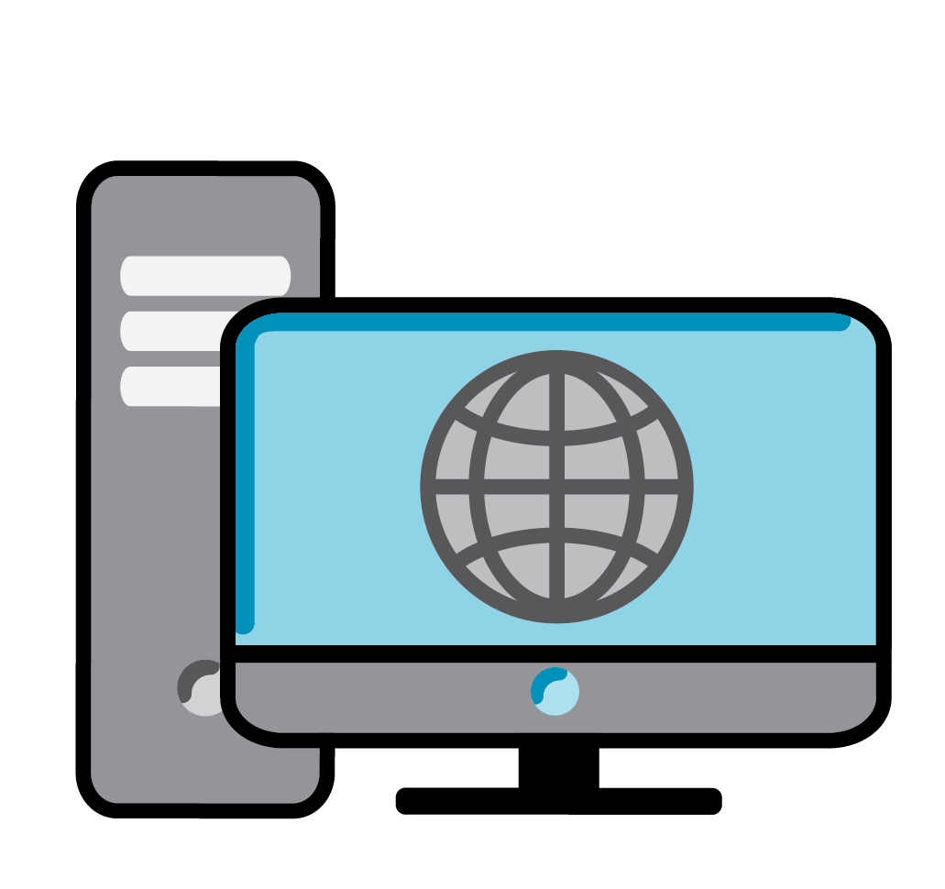
Additional Resources
You may find answers at
FDIC’s website: fdic.gov/consumernews
Type “disaster” in the
Search box to find
FDIC Consumer News
articles by topic
Notes:
To learn more about being financially prepared for disasters, visit fdic.gov/consumernews/ and type “disaster” in the Search FDIC Consumer News article by topic box.

Slide 11

Activity 4: How Financially Prepared Are You?
Complete Activity 4 in the Resource Guide.
Reflect on what you have learned today
List the documents you will gather and where you will keep them
Notes:
Think about what you have learned today. Open your Resource Guide to Activity 4, page 68. In the space provided, jot down what documents you will gather and where you will put them.
Instructor: Refer participants to Activity 4: How Financially Prepared Are You? in their Resource Guide, page 46. Give participants a few minutes to think about what actions they might take after the class. If they are comfortable doing so, allow participants to share what they have learned and how they can apply it. Answer any questions.

