Slide 1



Module 12 Living on Your Own
MODULE 12 Living on Your Own
MONEY SMART FOR YOUNG ADULTS

Slide 2
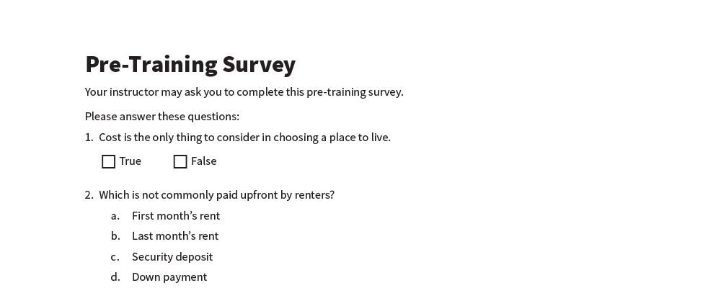
Pre-Training Survey
See page 19 in your participant guide.

Slide 3



Section 1 Options for Where to Live
SECTION 1 Options for Where to Live
See page 2 in your participant guide.

Slide 4

Key Takeaway
SECTION 1
Key Takeaway
There are different types of housing. To prioritize your options, start by defining what you need and want in a place to live.

Slide 5





Things to Consider in Choosing a Place to Live
The home itself
Cost
The location

Slide 6
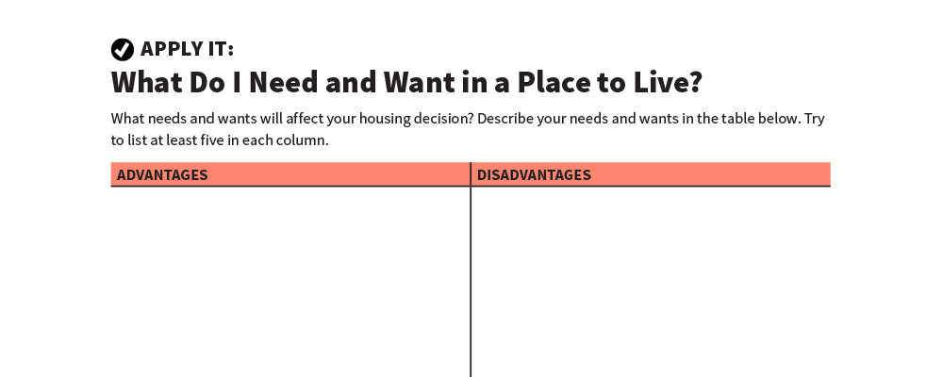
What Do I Need and Want in a Place to Live?
Apply It
See page 2 in your participant guide.

Slide 7
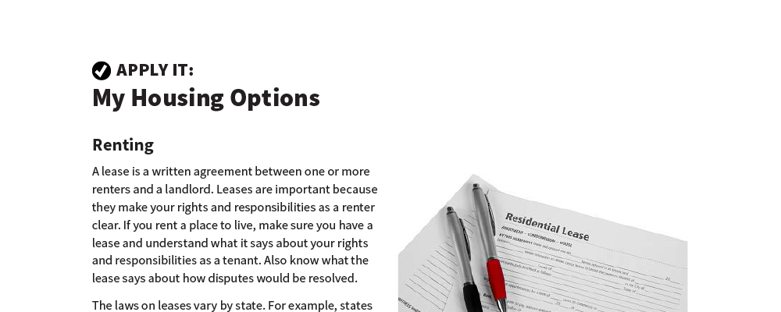
My Housing Options
Apply It
See page 3 in your participant guide.

Slide 8
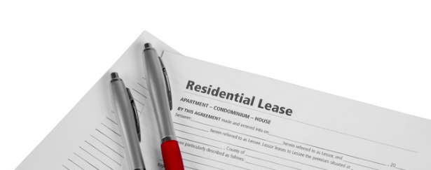
Leases
Written agreements between renters and landlords
Renter rights and responsibilities
Individual lease versus joint lease
Roommate agreement

Slide 9






Renting Options
A room in an apartment or home
Privately owned, subsidized housing
Public housing
An apartment
A house

Slide 10




Buying Options
A single-family house, modular home, or townhouse
A unit in a cooperative (co-op)
A condominium
A manufactured home

Slide 11

Remember the key takeaway
SECTION 1
Remember the key takeaway
“
There are different types of housing. To prioritize your options, start by defining what you need and want in a place to live.”

Slide 12

Section 2 Rent versus Buy
SECTION 2 Rent versus Buy
See page 6 in your participant guide.

Slide 13
Key Takeaway
SECTION 2
Key Takeaway
The advantages and disadvantages of renting and buying may change over time. Although something may be right for you now, a different option may be right for you in the future.

Slide 14

Advantages and Disadvantages of Renting and Buying

Slide 15
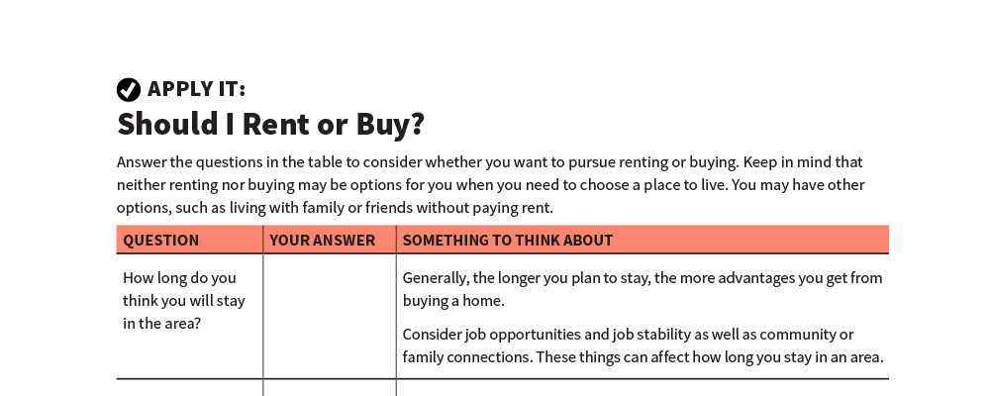
Should I Rent or Buy?
Apply It
See page 7 in your participant guide.

Slide 16
Remember the key takeaway
SECTION 2
Remember the key takeaway
“
The advantages and disadvantages of renting and buying may change over time. Although something may be right for you now, a different option may be right for you in the future.”

Slide 17

Section 2 Credit and Housing Options
SECTION 3 Credit and Housing Options
See page 9 in your participant guide.

Slide 18
Key Takeaway
SECTION 3
Key Takeaway
Your record of paying back what you owe affects your housing options.

Slide 19

How Credit Reports and Scores Affect Housing Options
Credit history
Credit reports
Credit scores
Positive and negative information

Slide 20

Get and Review Your Credit Reports
One free credit report from each of the three nationwide credit reporting agencies every 12 months
annualcreditreport.com
1-877-322-8228
Order one every four months
Dispute errors

Slide 21

Being “Credit Invisible”
Having no credit reports or scores can limit options for both renting and buying.

Slide 22
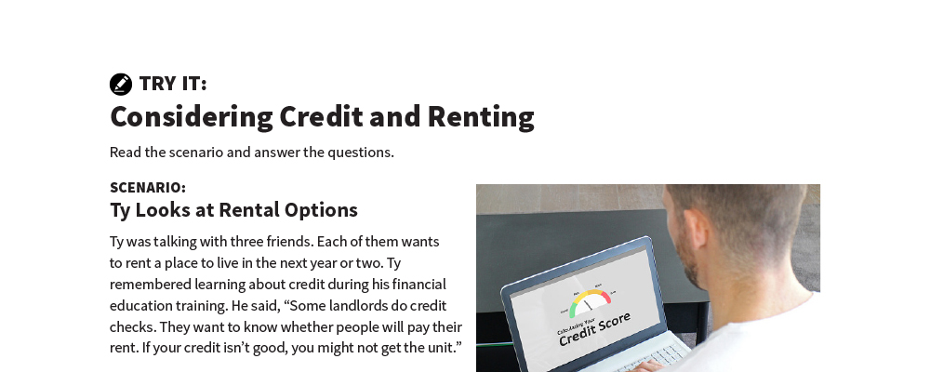
Considering Credit and Renting
Try It
See page 10 in your participant guide.

Slide 23
Remember the key takeaway
SECTION 3
Remember the key takeaway
“
Your record of paying back what you owe affects your housing options.”

Slide 24

Section 4 Costs of Renting
SECTION 4 Costs of Renting
See page 11 in your participant guide.

Slide 25
Key Takeaway
SECTION 4
Key Takeaway
Costs of renting include more than just rent. Estimate other ongoing costs, as well as one-time costs of moving.

Slide 26
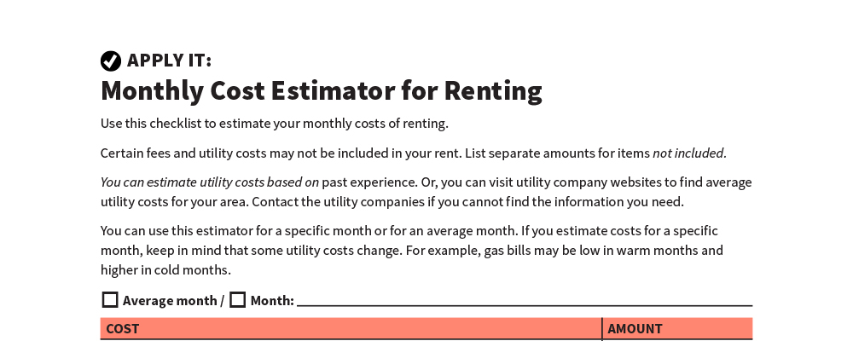
Monthly Cost Estimator for Renting
Apply It
See page 12 in your participant guide.

Slide 27


Monthly Housing Costs
Rent
Utilities
Other
Renter’s Insurance
Cleaning and maintenance

Slide 28
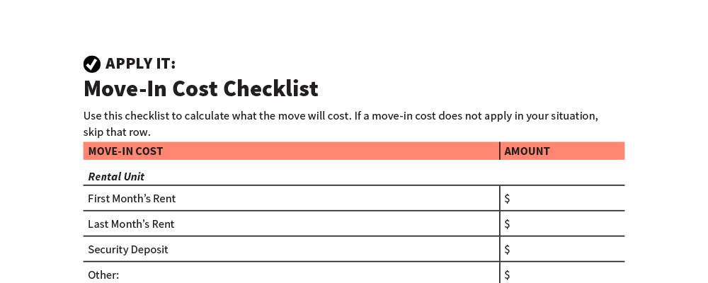
Move-In Cost Checklist
Apply It
See page 13 in your participant guide.

Slide 29


Move-In Costs: Rental Unit
First month’s rent
Last month’s rent
Security deposit

Slide 30


Move-In Costs: Utilities
Initial fees
Deposits

Slide 31

Move-In Costs: Moving Costs
Supplies
Rental costs for moving equipment and vehicles
Appreciation to friends and family who help
Shipping
Professional movers

Slide 32


Move-In Costs: Furnishing and Decorating
Furniture
Decorating

Slide 33
Remember the key takeaway
SECTION 4
Remember the key takeaway
“
Costs of renting include more than just rent. Estimate other ongoing costs, as well as one-time costs of moving.”

Slide 34

Section 5 Renter’s Insurance
SECTION 5 Renter’s Insurance
See page 15 in your participant guide.

Slide 35
Key Takeaway
SECTION 5
Key Takeaway
Renter’s insurance helps you financially recover from losses to your property. It also protects you if someone who does not live in your home is injured there.

Slide 36

About Renter’s Insurance

Slide 37
Renter’s Insurance
Covers the costs of items lost or damaged
Protects you from responsibility if someone claims to be injured while visiting you
May cover additional living expenses if you are unable to live in your rented home because of a named peril covered by your policy

Slide 38
More on Renter’s Insurance
Additional coverage for perils not named in a standard policy
No or limited coverage for some items
Sometimes required by landlords
Shop around!

Slide 39

Property Inventory
Lists the things you own
Helpful before and after you get renter’s insurance

Slide 40
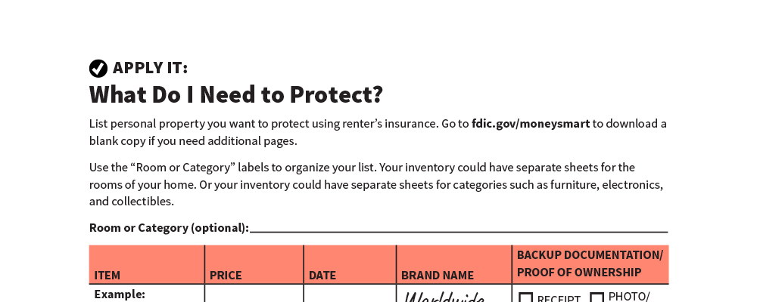
What Do I Need to Protect?
Apply It
See page 16 in your participant guide.

Slide 41
Remember the key takeaway
SECTION 5
Remember the key takeaway
“
Renter’s insurance helps you financially recover from losses to your property. It also protects you if someone who does not live in your home is injured there.”

Slide 42


Take Action
See page 17 in your participant guide.
After this training, what is one thing you will do?
Who will you tell about your planned action?
What additional information do you need?
i

Slide 43

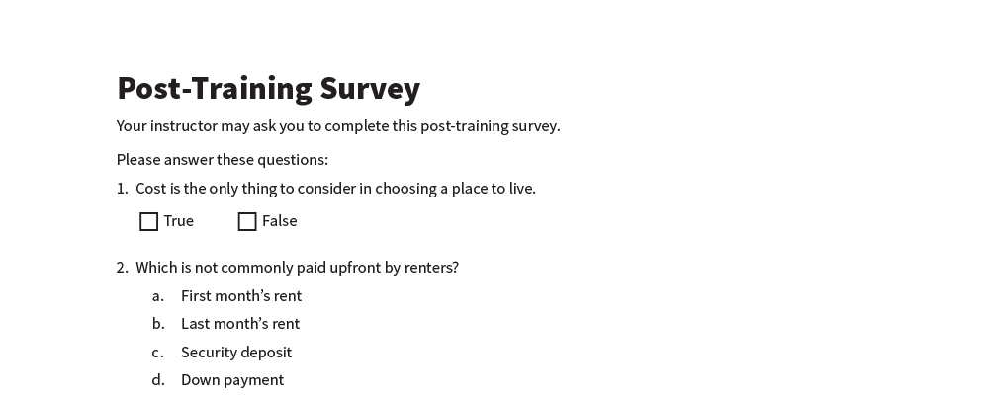
Post-Training Survey
See page 20 in your participant guide.

