Slide 1



Module 10 Buying a Car
MODULE 10 Buying a Car
MONEY SMART FOR YOUNG ADULTS

Slide 2
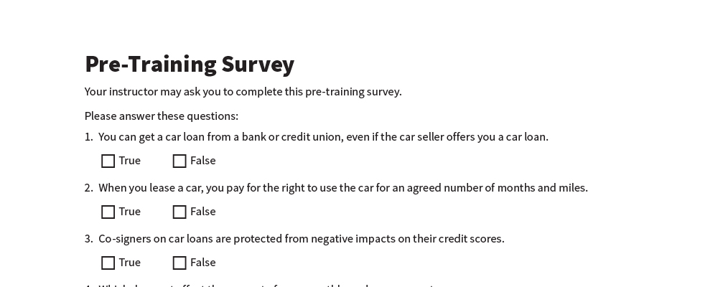
Pre-Training Survey
See page 14 in your participant guide.

Slide 3



Section 1 Car Costs and Options
SECTION 1 Car Costs and Options
See page 2 in your participant guide.

Slide 4

Key Takeaway
SECTION 1
Key Takeaway
What you pay to buy a car matters. But also consider ongoing costs of owning and using the car.

Slide 5

Car Costs

Slide 6

What are other costs of buying and owning a car?

Slide 7
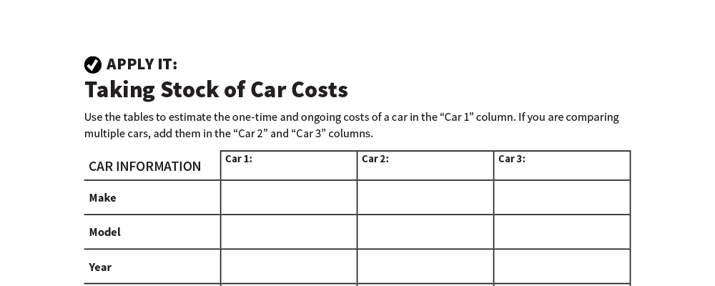
Taking Stock of Car Costs
Apply It
See page 3 in your participant guide.

Slide 8






Car Information
Model
Make
Year
Seller
Price

Slide 9

One-Time Costs
Down Payment
Registration and Title Fees
Sales Taxes
Documentation Fees
Other Seller Fees / Dealer Fees
Car Loan Origination Fees
Extended Vehicle Warranties and Service Contracts

Slide 10

Ongoing Costs
Car Loan Payment
Car Insurance
Fuel
Maintenance
Registration Renewals and Inspections
Property Taxes
Parking and Tolls

Slide 11
Leasing
Paying for the right to use the car for an agreed number of months and miles.
Monthly payments are usually lower than if you bought the car.
Lease agreement specifies who must pay for maintenance and repairs.
Mileage limit usually 15,000 or fewer miles.

Slide 12

Consider Leasing
How much will you drive?
What are the terms of the lease?
Will you move?

Slide 13

Considering Car Options
Try It
See page 6 in your participant guide.

Slide 14

Remember the key takeaway
SECTION 1
Remember the key takeaway
“
What you pay to buy a car matters. But also consider ongoing costs of owning and using the car.”

Slide 15

Section 2 Car Loans
SECTION 2 Car Loans
See page 8 in your participant guide.

Slide 16
Key Takeaway
SECTION 2
Key Takeaway
You do not have to get your car loan from the seller. Compare multiple car loan offers.

Slide 17

Car Loan Basics
Down payment
Negotiate and compare multiple offers

Slide 18

Monthly Payment
Loan amount
Annual percentage rate (APR)
Loan term

Slide 19

What can happen if you don’t make your car loan payments?

Slide 20

Consequences of not making your car payments
Being charged late fees
Paying more interest
Being contacted by a debt collector
Losing your car
Having negative information on your credit reports and lower credit scores
Triggering consequences for co-signers

Slide 21

Comparing Car Loan Offers
Try It
See page 9 in your participant guide.

Slide 22

Credit Scores and Car Loans
Why will lenders review your credit reports and scores when considering offering you a car loan?
Credit reports
Credit scores

Slide 23

Co-Signing
A co-signer pledges to pay back the loan if you do not.
Negative information will appear on the co-signer’s credit reports and may lower the co-signer’s credit scores.

Slide 24
Remember the key takeaway
SECTION 2
Remember the key takeaway
“
You do not have to get your car loan from the seller. Compare multiple car loan offers.”

Slide 25


Take Action
See page 12 in your participant guide.
After this training, what is one thing you will do?
Who will you tell about your planned action?
What additional information do you need?
i

Slide 26

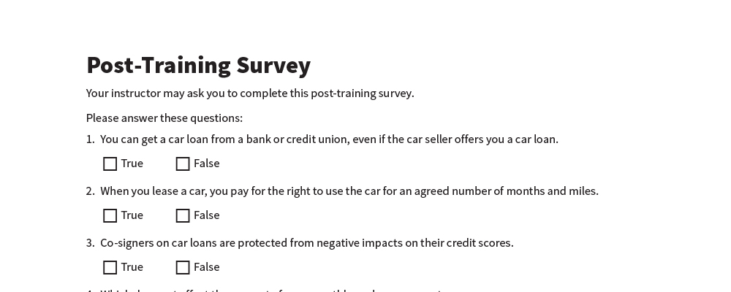
Post-Training Survey
See page 15 in your participant guide.

