Slide 1



Module 6
MODULE 6 Building Your Credit History
MONEY SMART FOR YOUNG ADULTS

Slide 2
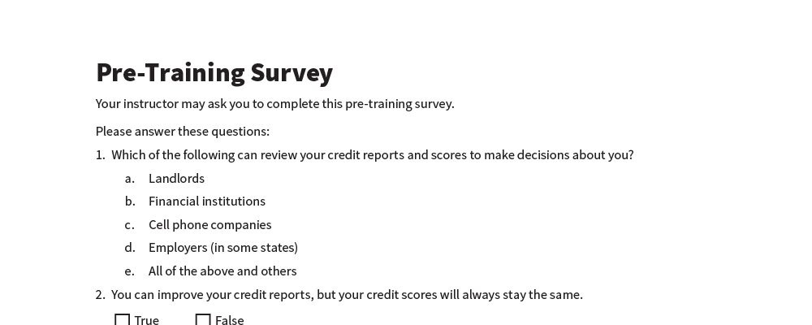
Pre-Training Survey
See page 43 in your participant guide.

Slide 3
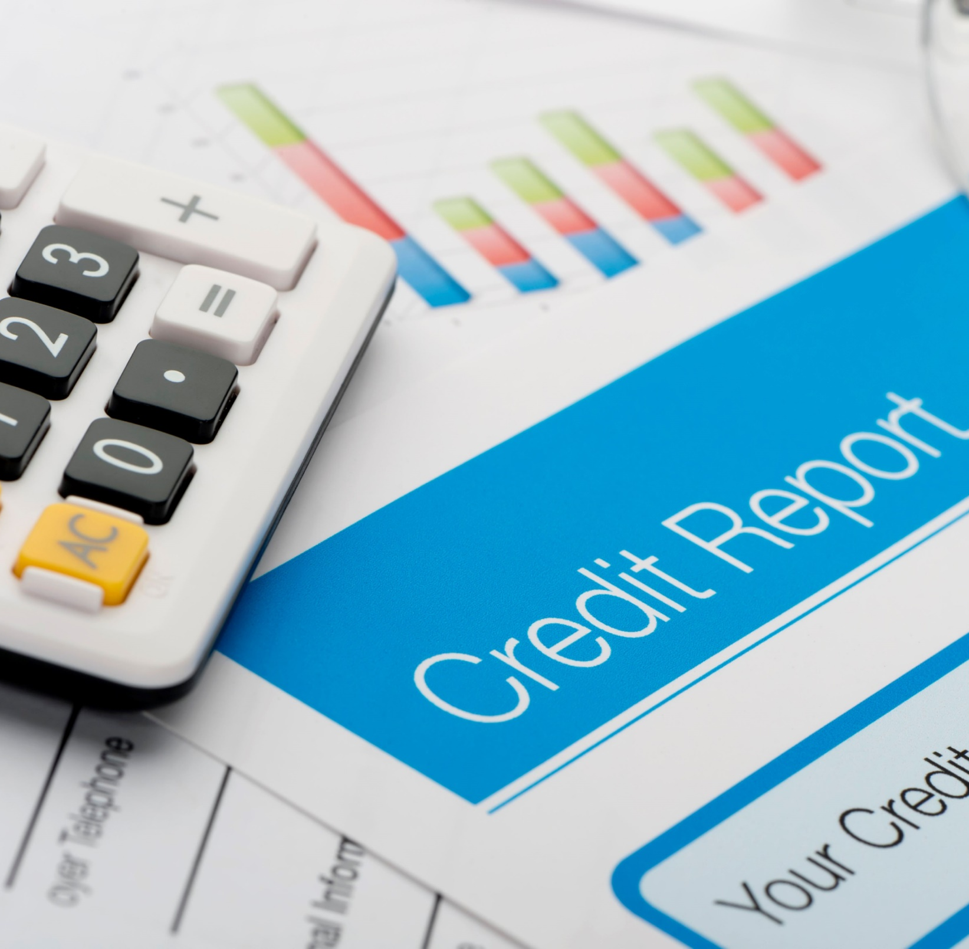


Section 1 Credit Reports
SECTION 1 Credit Reports
See page 2 in your participant guide.

Slide 4

Key Takeaway
SECTION 1
Key Takeaway
Your credit history can affect your access to credit, loans, jobs, housing, insurance, and other important services.

Slide 5
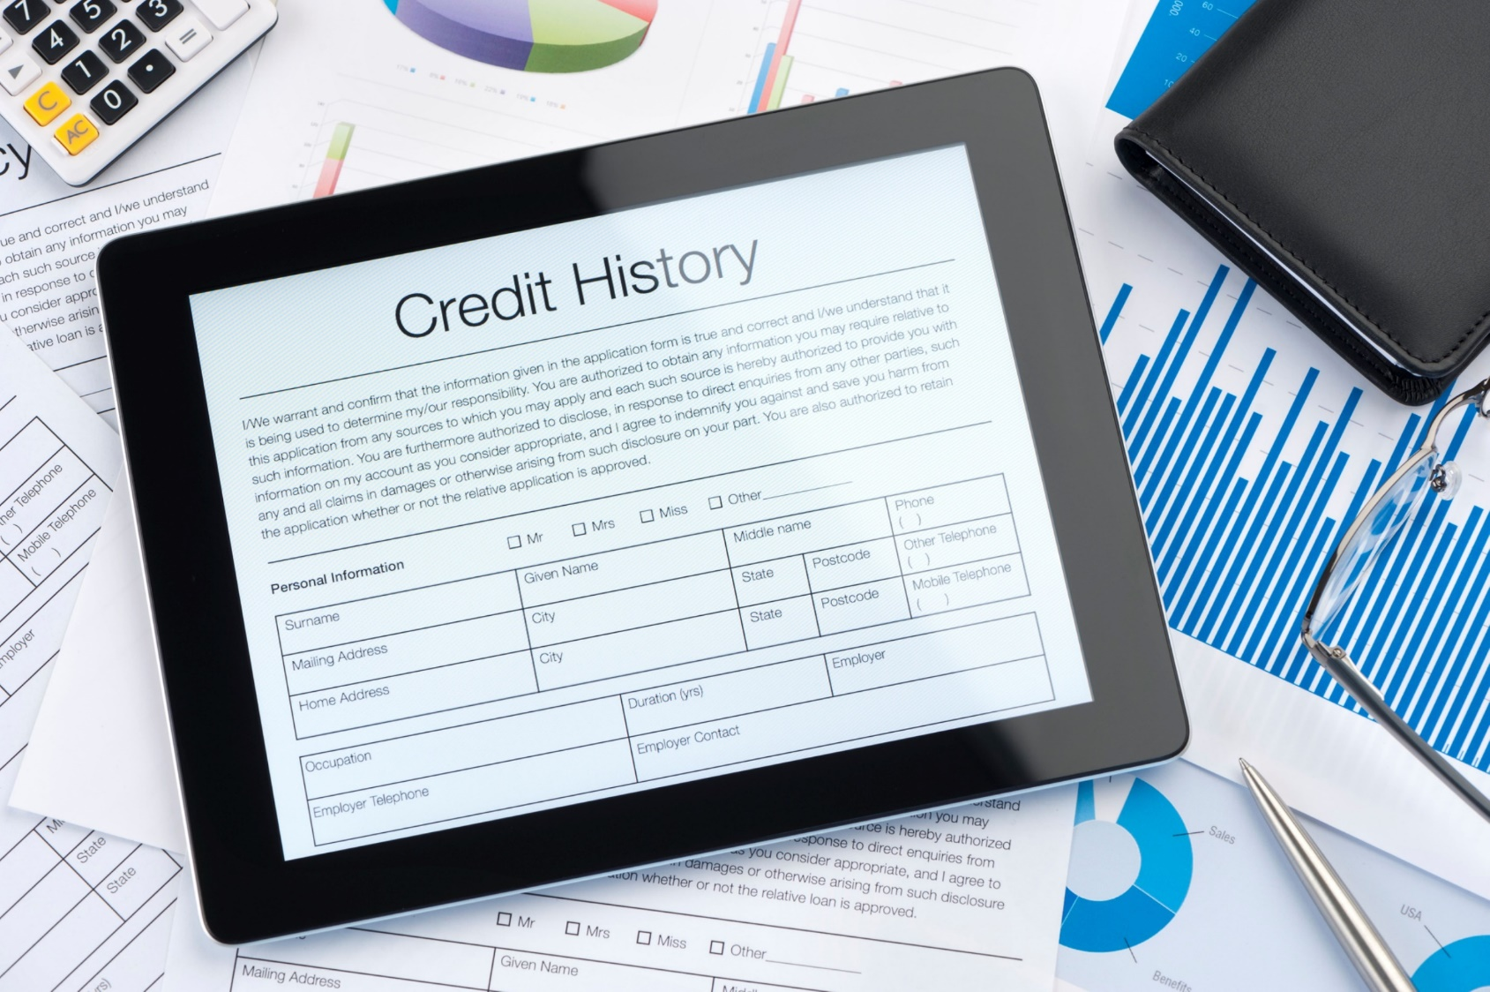
What Is a Credit Report?
Document that contains your credit history, your track record of paying your debts

Slide 6
Who Has Credit Reports?
People who have taken financial actions included on credit reports
Generally, people under age 18 do not have credit reports, except:
Authorized users on others’ credit card accounts
Student loan borrowers
Victims of identity theft or fraud
Foster care agencies help foster youth check credit reports and address issues

Slide 7
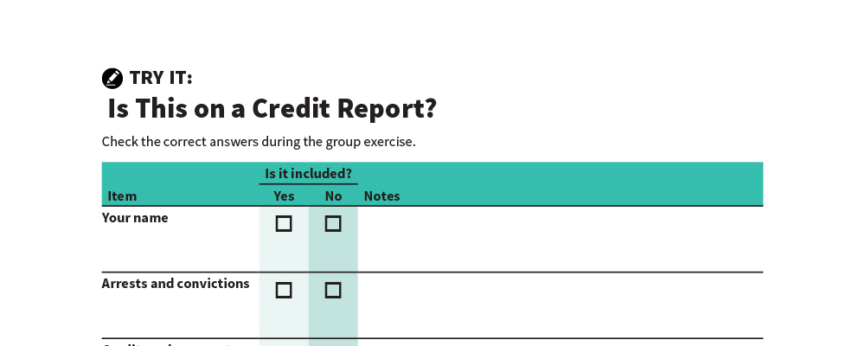
Is This on a Credit Report?
Try It
See page 3 in your participant guide.

Slide 8
What Is Listed on a Credit Report?
Identifying information
Debts and some bills
Public record information
Applications for new credit and other “inquiries”

Slide 9

Nationwide Credit Reporting Agencies
Equifax
Experian
TransUnion

Slide 10

What Is A Credit Score?
A number based on information on credit reports
Predicts payment of bills and debts as agreed
People with higher credit scores tend to present less risk to creditors
POOR
GOOD

Slide 11

Who Uses Credit Reports and Scores?
Financial institutions
Some landlords
Some utility companies
Some cell phone companies
Insurance companies (in some states)
Employers (in some states)
Some state agencies or affiliated organizations

Slide 12
Risk-Based Pricing
Credit reports and scores may be used as one factor in risk-based pricing
Lenders set interest rates and other terms based on estimated risks
Must tell you if they used your credit reports or credit scores to deny your application or offer you less favorable terms
Adverse action notices
Risk-based pricing notices

Slide 13
Having No Credit Reports or Scores
“Credit invisible”
May result in having a harder time:
Getting credit or a loan
Renting an apartment
Getting a favorable cell phone plan
Obtaining some jobs
Turning on utilities without paying a large deposit

Slide 14

Do Credit Reports Matter?
Try It
See page 5 in your participant guide.

Slide 15

Remember the key takeaway
SECTION 1
Remember the key takeaway
“
“
Your credit history can affect your access to credit, loans, jobs, housing, insurance, and other important services.”

Slide 16
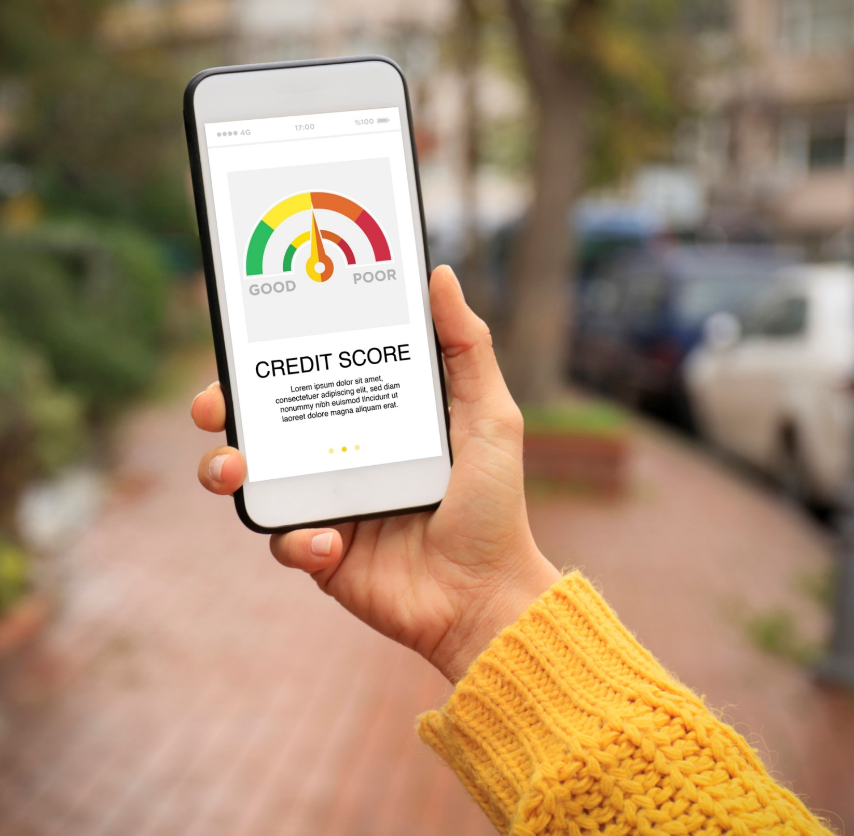
Section 2 Credit Scores
SECTION 2 Credit Scores
See page 6 in your participant guide.

Slide 17
Key Takeaway
SECTION 2
Key Takeaway
You can take steps to maintain and improve your credit scores. This includes paying your bills on time.

Slide 18
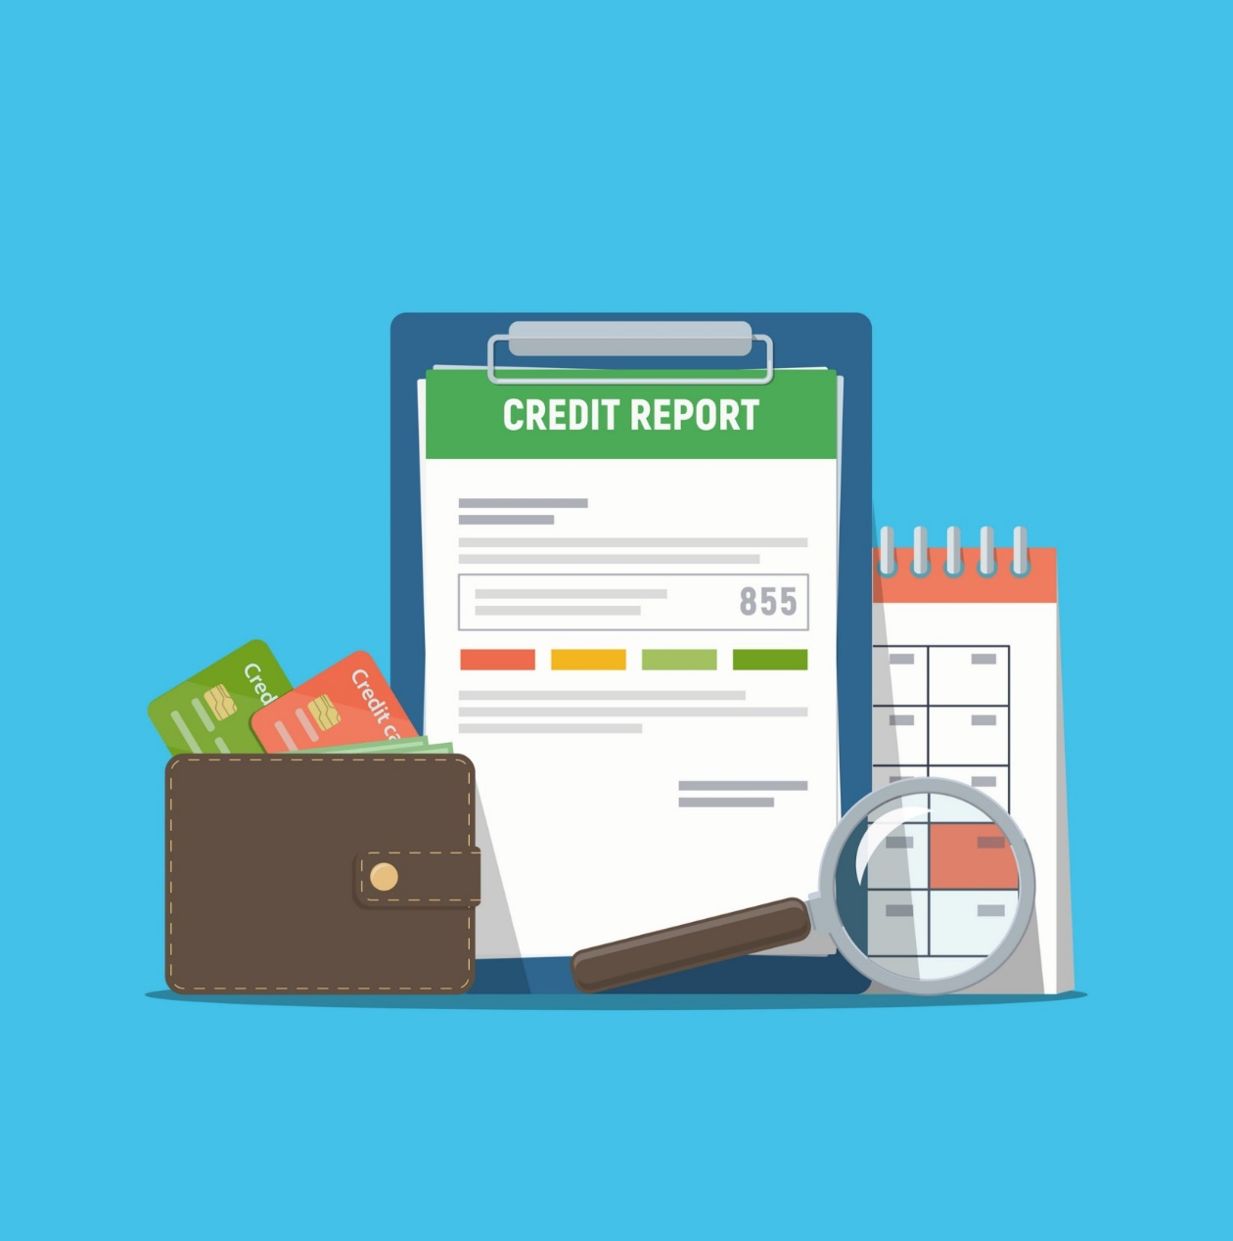
The Basics of Credit Scoring
Number calculated from information on credit reports
Generally, the better your credit history, the higher your credit score.
Predicts likelihood of paying credit obligations on time and as agreed
Two significant factors affect credit scores:
Whether debts repaid on time and as agreed
Credit utilization rate

Slide 19
More Basics of Credit Scoring
Multiple producers of credit scores
FICO® (Fair Isaac Corporation)
VantageScore®
And Others

Slide 20
Five Factors in General FICO® Model
Payment History – 35%
New Credit – 10%
Credit Mix – 10%
Amounts Owed – 30%
Length of Credit History – 15%

Slide 21
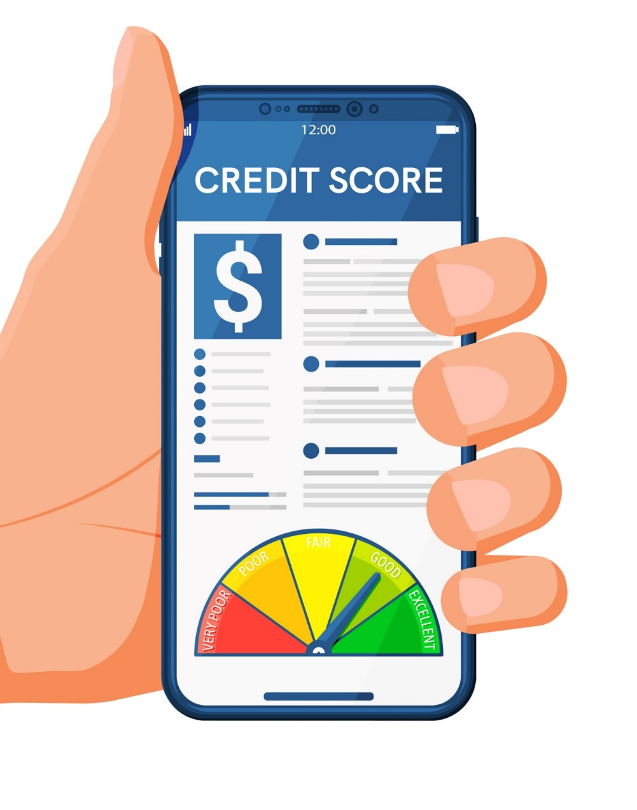
Order Your Credit Scores
May not be the ones used
If turned down for credit, you have the right to see the exact score used
Make sure your credit scores reflect your credit history
Get and review your credit reports and dispute errors

Slide 22
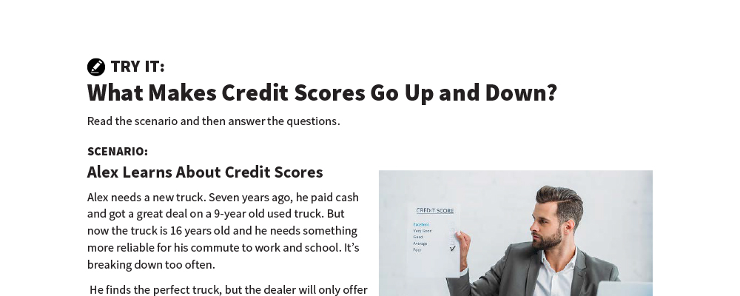
What Makes Credit Scores Go Up and Down?
Try It
See page 7 in your participant guide.

Slide 23





What Is A Good Credit Score?
Exceptional 800 – 850
Very Good 740 – 799
Good 670 – 739
Fair 580 – 669
Poor 300 – 579
Note: This is an example based on FICO®

Slide 24
Remember the key takeaway
SECTION 2
Remember the key takeaway
“
“
You can take steps to maintain and improve your credit scores. This includes paying your bills on time.”

Slide 25
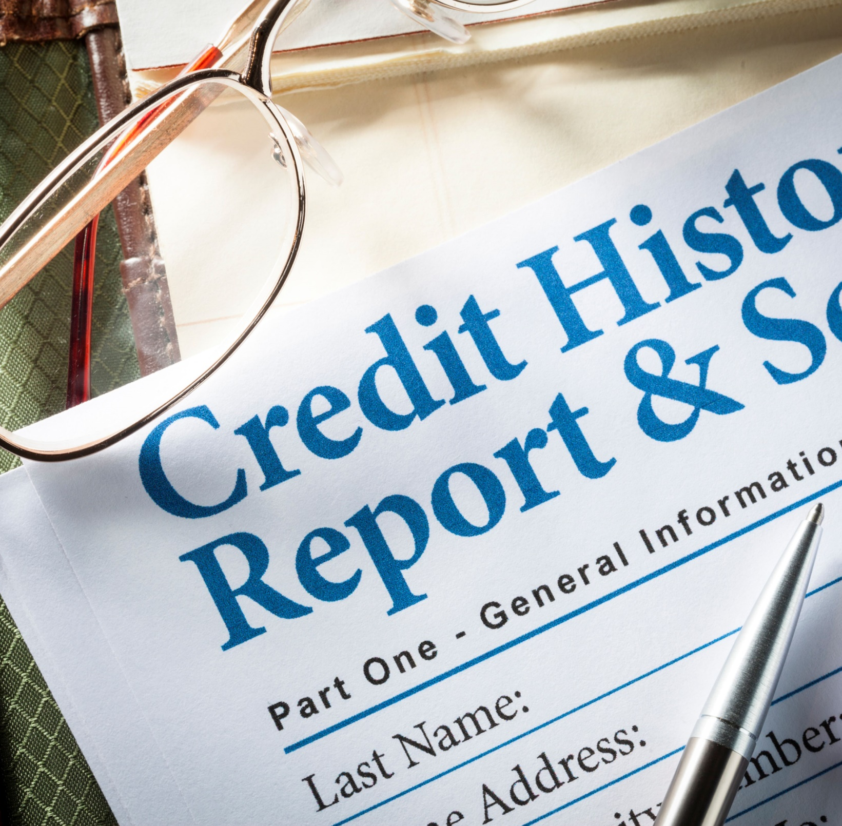
Section 3 Getting and Understanding Your Credit Reports and Scores
SECTION 3 Getting and Understanding Your Credit Reports and Scores
See page 11 in your participant guide.

Slide 26
Key Takeaway
SECTION 3
Key Takeaway
Get and review your credit reports at least once every 12 months to make sure the information is accurate.

Slide 27

What Is a Productive Credit History?

Slide 28
Right to Free Credit Reports
One free credit report every 12 months from each nationwide credit reporting agency
Equifax, Experian, and TransUnion
Annualcreditreport.com fills orders for free credit reports

Slide 29
Watch Out for Imposters
Others advertising free credit reports, credit scores, or credit monitoring are not part of the legally mandated free annual credit report program
Often, “free” services convert to ones you have to pay for after the trial period
Go directly to annualcreditreport.com

Slide 30
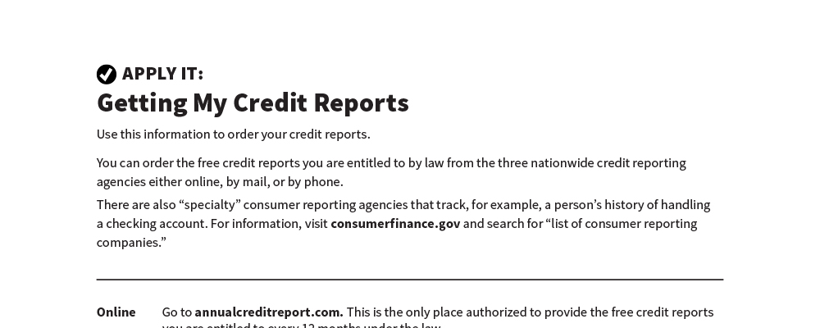
Getting My Credit Reports
Apply It
See page 12 in your participant guide.

Slide 31
Right to Additional Free Credit Reports
Receive public assistance
Are unemployed and looking for a job
Were victim of identity theft or financial fraud
Are provided free credit reports under state law
Are denied credit, service, an apartment, or employment

Slide 32
What Sections Are in Credit Reports?
Personal or identifying information
Public records
Accounts assigned or sold
Credit accounts
Inquiries

Slide 33
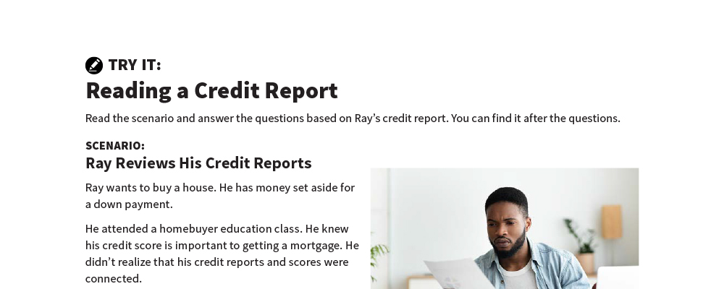
Reading a Credit Report
Try It
See page 16 in your participant guide.

Slide 34
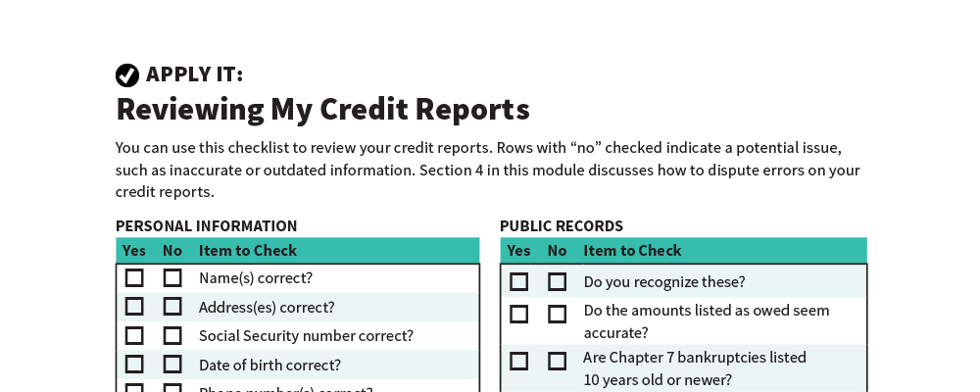
Reviewing My Credit Reports
Apply It
See page 19 in your participant guide.

Slide 35
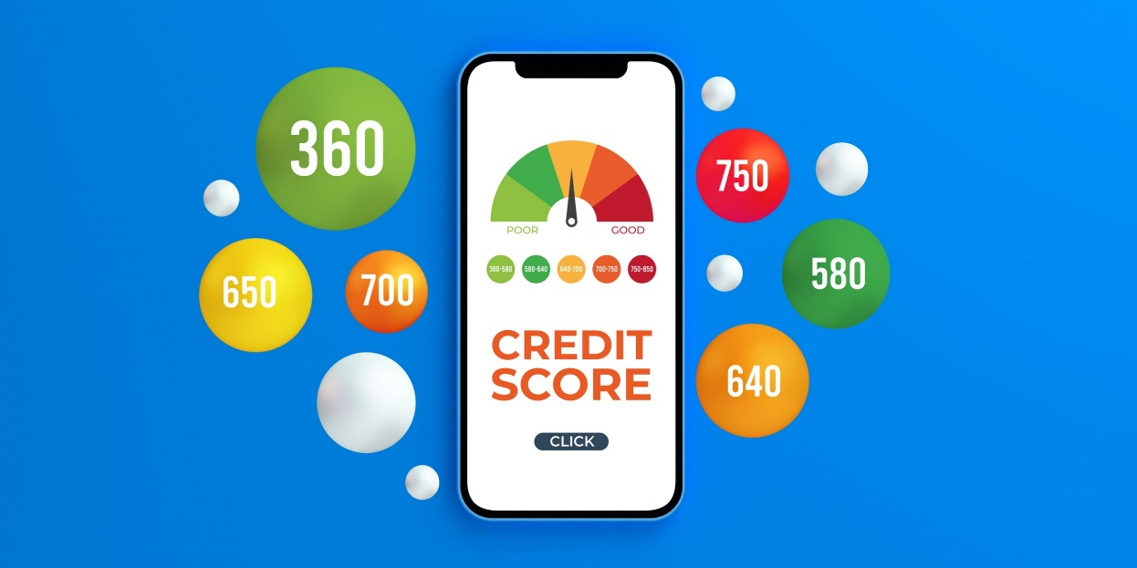
Getting Your Credit Scores
Some nonprofit organizations
Credit card statements or your financial institution’s website or customer service
When you have a right to a score
FICO® at myfico.com
VantageScore® at vantagescore.com
Three nationwide credit reporting agencies

Slide 36
Remember the key takeaway
SECTION 3
Remember the key takeaway
“
“
Get and review your credit reports at least once every 12 months to make sure the information is accurate.”

Slide 37

Section 4 Disputing Errors on Your Credit Reports
SECTION 4 Disputing Errors on Your Credit Reports
See page 21 in your participant guide.

Slide 38
Key Takeaway
SECTION 4
Key Takeaway
If you find errors on your credit reports, file a dispute right away. Keep records and follow up.

Slide 39
Errors on Your Credit Reports
Identity errors
Account status errors
Data management errors
Balance errors
Outdated information errors

Slide 40

Time Limits on Negative Information
Generally can be reported on credit reports for only seven years
Some bankruptcies are an exception

Slide 41
No Time Limits
No time limits for negative information when someone applies for:
A job with yearly salary of $75,000 or more
More than $150,000 of credit
Life insurance with a face value of $150,000 or more

Slide 42

The Seven-Year Reporting Period
Can be confusing
Generally starts 180 days after you stopped paying on the debt

Slide 43
Seven-Year Reporting Example
August 2025: 30 days late
November 2025: 120 days late and creditor closes account
Delinquency started in August
July 2025 is the month before that
July 2025 + 180 days = January 2026
January 2026 + 7 years = January 2033
January 2033: the last month the debt can be reported

Slide 44

Medical Debt and Credit Reports
Medical debt not on credit reports until 1 year overdue
Provides time to:
Resolve billing disputes
Make payments
Make payment arrangements
Medical debts of less than $500 do not appear on credit reports
Paid medical collections debt do not appear on credit reports

Slide 45


How to Dispute Errors on Your Credit Reports
Option 1: Online
Option 2: By mail

Slide 46

What to Include in Dispute Letters
Your complete name and address
Clear description of each item you are disputing and reason for each dispute
A request for correction or removal

Slide 47
Also Include Supporting Information
Send copies—not originals
Receipts
Credit card or account statement
Image of a check
Screenshot of online transaction or automatic bill payment

Slide 48
After You File a Dispute
Credit reporting agency sends you a letter
Incorrect information cannot be put back
Check for it
You can request notices of corrections to be sent to individuals or businesses that received your report

Slide 49
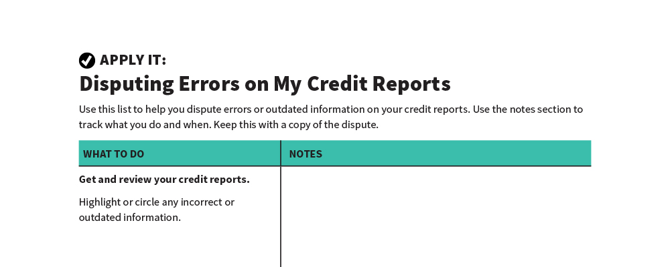
Disputing Errors on My Credit Reports
Apply It
See page 23 in your participant guide.

Slide 50
Remember the key takeaway
SECTION 4
Remember the key takeaway
“
“
If you find errors on your credit reports, file a dispute right away. Keep records and follow up.”

Slide 51
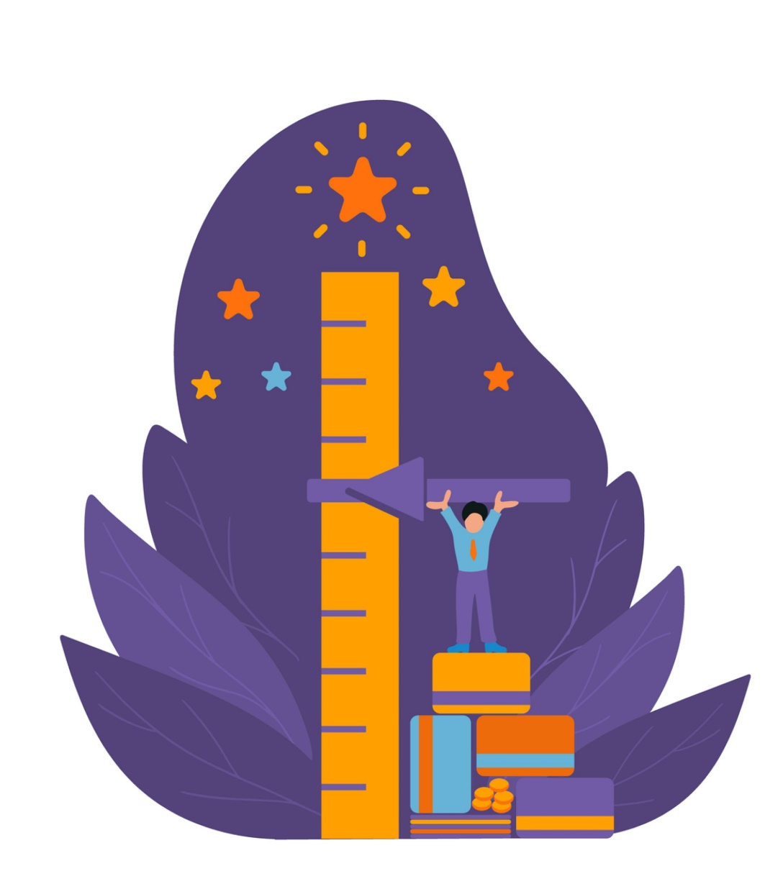
Section 5 Build Repair and Maintain a Productive Credit History
SECTION 5 Build, Repair, and Maintain a Productive Credit History
See page 27 in your participant guide.

Slide 52
Key Takeaway
SECTION 5
Key Takeaway
Your credit history does not have to be your credit future.

Slide 53

Create a Productive Credit History
Build your credit
Build an alternative credit history
Repair or improve your credit
Maintain your credit

Slide 54
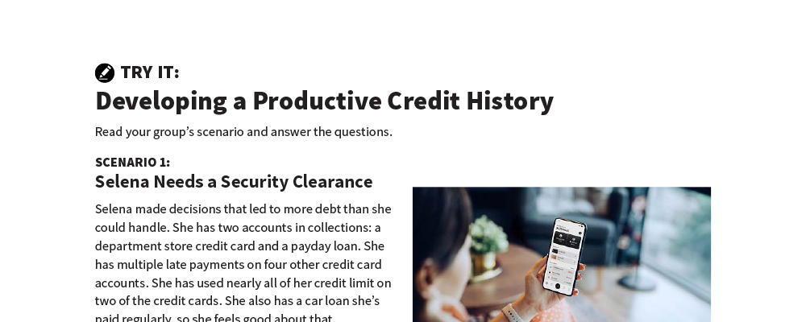
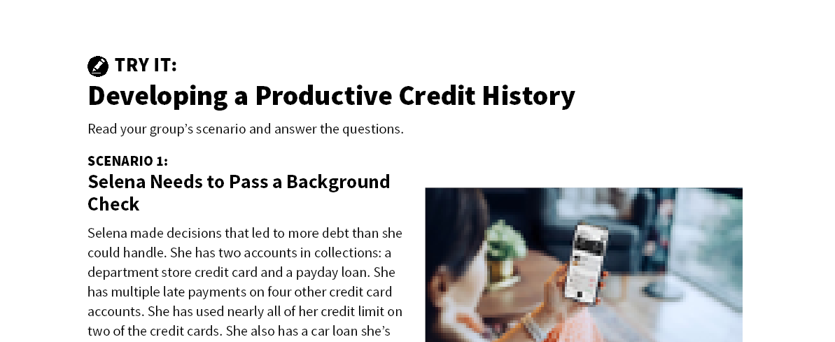
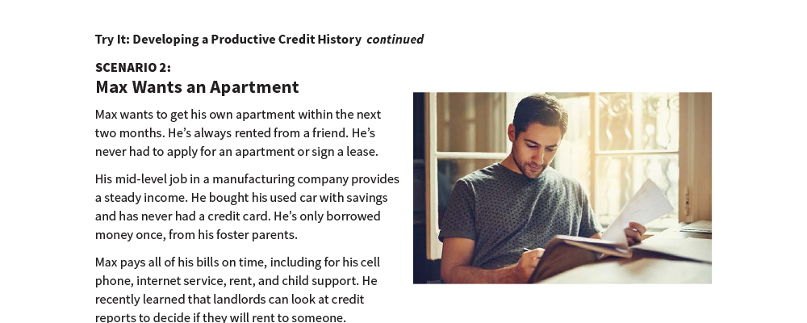

Developing a Productive Credit History
Try It
See page 28 in your participant guide.

Slide 55

Repair and Improve Credit
Get and review your credit reports
Dispute and correct any errors
Make sure anything in the collections section belongs to you
Pay all your bills on time and as agreed
Use as little of your credit limit as possible
Use a credit-builder strategy
Keep old accounts open if you can
Apply for credit only if you need it
Negotiate different terms
Ask for a “good will” deletion

Slide 56
Build Alternative Credit History
Document other payments you regularly make, such as:
Rent
Child care/elder care
Spousal/child support
Cell phone
Electric
Gas
Water, sewage, and garbage
Cable/satellite/TV viewing services
Internet service
Insurance
Loan from friend or family member
Savings

Slide 57

Build Credit
Get a secured credit card
Get a credit-builder loan
Become an authorized user on an account
Get a co-signer
Apply for a credit card at a store or gas station
Make a large down payment and negotiate a loan for the balance

Slide 58
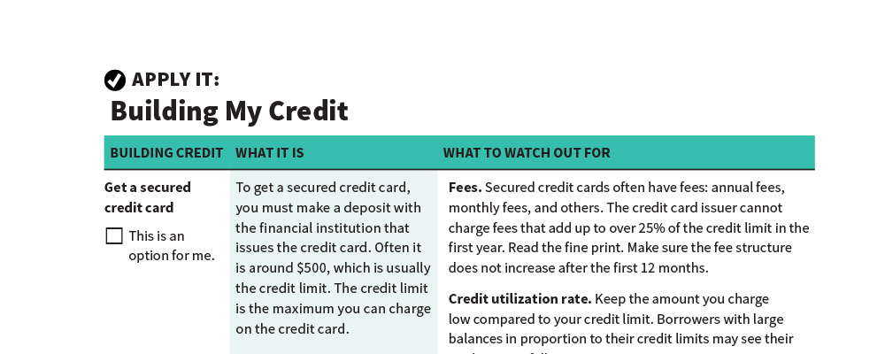
Building My Credit
Apply It
See page 31 in your participant guide.

Slide 59
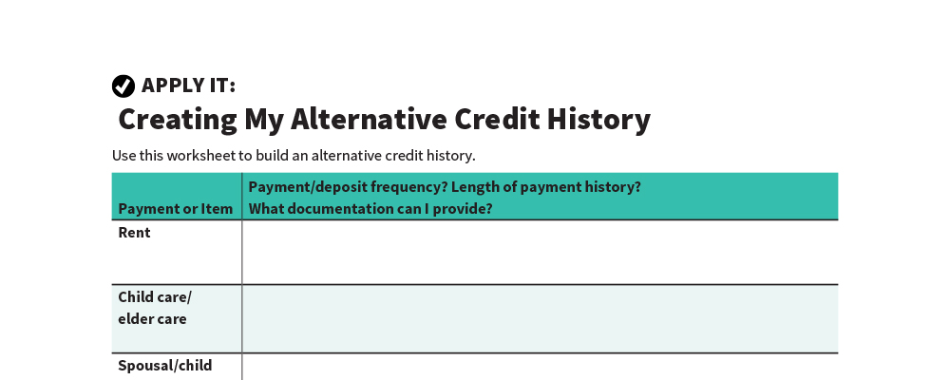
Creating My Alternative Credit History
Apply It
See page 33 in your participant guide.

Slide 60
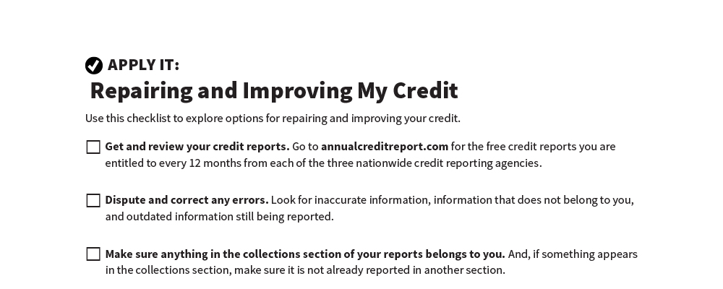
Repairing and Improving My Credit
Apply It
See page 34 in your participant guide.

Slide 61
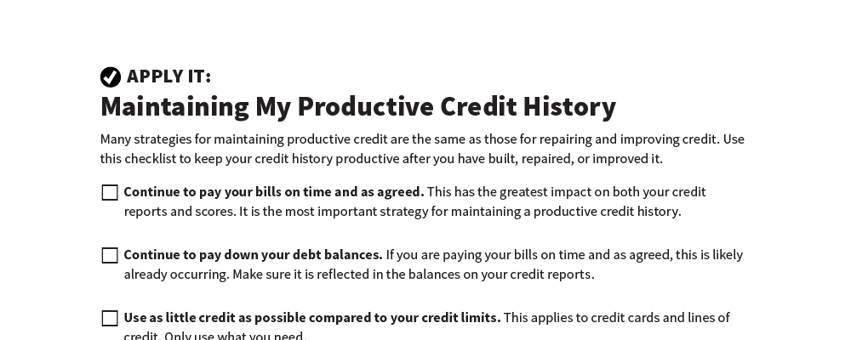
Maintaining My Productive Credit History
Apply It
See page 35 in your participant guide.

Slide 62

Maintain Credit
Pay your bills on time and as agreed
Continue to pay down your debt balances
Use as little credit as possible compared to your credit limits
Don’t apply for too much credit
Check your credit reports and regularly dispute errors
Keep good financial records

Slide 63
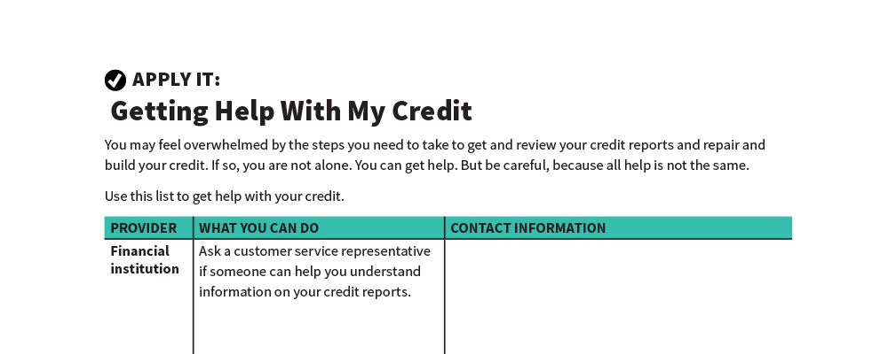
Getting Help With My Credit
Apply It
See page 36 in your participant guide.

Slide 64

Get Help
Financial institution
Nonprofit consumer credit counseling service
Housing counseling agency approved by Department of Housing and Urban Development (HUD)
Financial education nonprofit organization
Certified financial planners (CFPs)
Other

Slide 65

Credit Repair and Debt Consolidation
Credit Repair Companies
Promise to fix your credit for a fee
Debt Consolidation Businesses
Offer different services
Often specialize in debt consolidation loans and debt settlement services

Slide 66

Use Caution
Debt consolidation
Taking out new loan to pay off other debts
Does not address underlying causes of debt
Debt settlement
Working with creditors to accept lower payment and settle debt
Might have to pay income tax on portion that was settled

Slide 67

Credit Repair Scams
Beware of credit repair companies that:
Promise to erase bad credit or remove other negative, but accurate, information
Promise fast and easy credit repair
Offer to create a new identity for you
Want you to pay upfront
Will not tell you your rights

Slide 68

Protecting Your Credit History
Initial fraud alert
Active duty military alert
Extended fraud alert
Credit freeze
Credit lock

Slide 69
Remember the Key takeaway
SECTION 5
Remember the key takeaway
“
“
Your credit history does not have to be your credit future.”

Slide 70


Take Action
See page 41 in your participant guide.
After this training, what is one thing you will do?
Who will you tell about your planned action?
What additional information do you need?
i

Slide 71

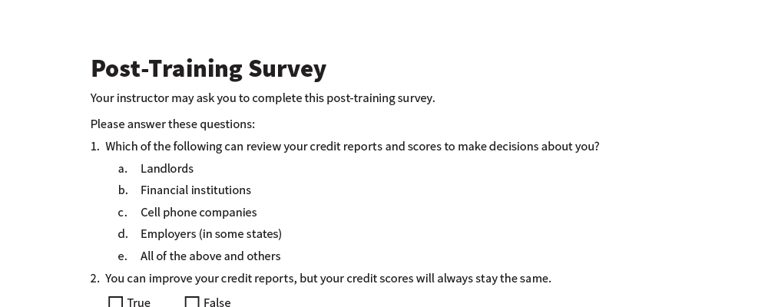
Post-Training Survey
See page 44 in your participant guide.

