Slide 1



Module 9 Protecting Your Money and Your Identity
MODULE 9 Protecting Your Money and Your Identity
MONEY SMART FOR YOUNG ADULTS

Slide 2
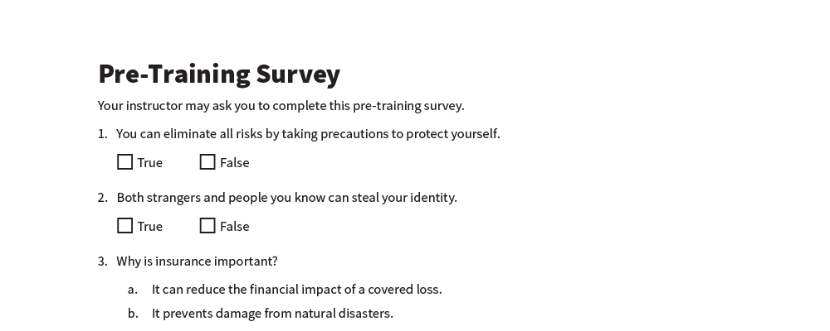
Pre-Training Survey
See page 20 in your participant guide.

Slide 3



Section 1 Risks to Your Assets
SECTION 1 Risks to Your Assets
See page 2 in your Participant Guide.

Slide 4

Key Takeaway
SECTION 1
Key Takeaway
Being aware of risks to your assets prepares you to take steps to reduce those risks.

Slide 5



Assets and Risks
Asset
Something you own that has value
Risk to an asset
Possibility that you will lose it or that it will lose value
You can protect the value of your assets by taking steps to reduce risks.

Slide 6
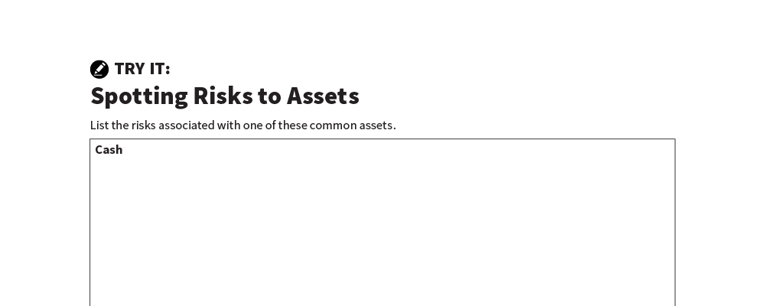
Spotting Risks to Assets
Try It
See page 3 in your participant guide.

Slide 7

Reducing Risks to Your Assets
You cannot eliminate all risks
You can reduce many of them
Make informed choices that anticipate risks
Be careful with personal information
Know your rights and responsibilities
Get insurance

Slide 8
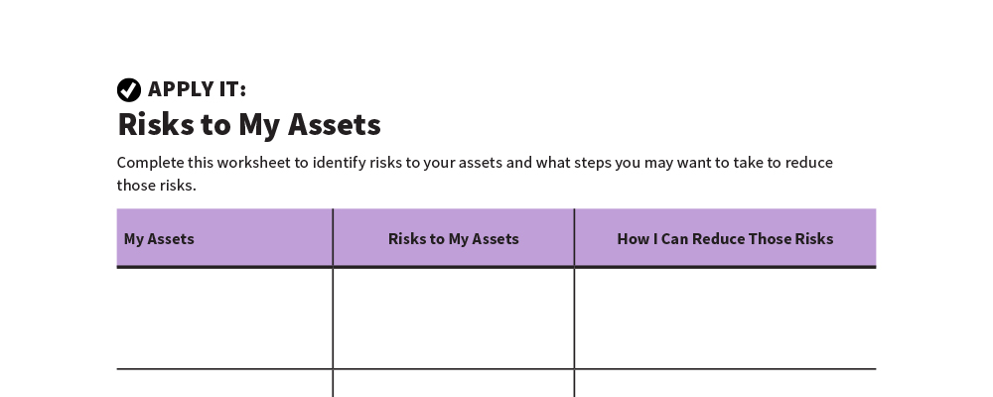
Risks to My Assets
Apply It
See page 4 in your participant guide.

Slide 9

Remember the key takeaway
SECTION 1
Remember the key takeaway
“
Being aware of risks to your assets prepares you to take steps to reduce those risks.”

Slide 10
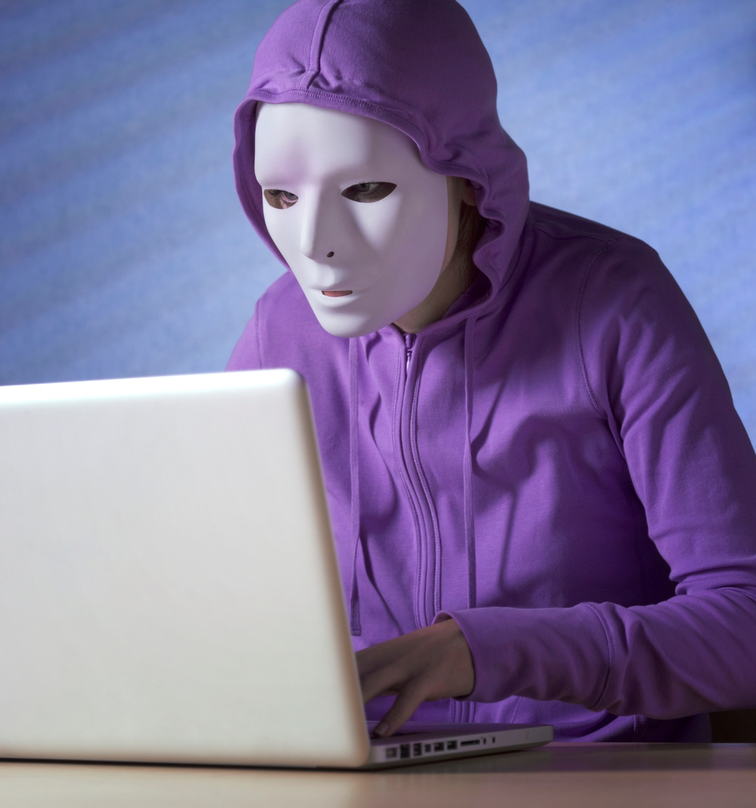
Section 2 Identity Theft and Fraud
SECTION 2 Identity Theft and Fraud
See page 5 in your Participant Guide.

Slide 11
Key Takeaway
SECTION 2
Key Takeaway
You can reduce your risk of identity theft. Help is available if it happens to you.

Slide 12
Identity Theft Basics
Your identity is an asset
Identity theft is:
A crime that happens when someone uses a person’s identifying information without authority

Slide 13
What Do We Mean by Identity?
Documents that have information about identity
What are some examples?
Other information thieves can use to impersonate someone
What are some examples?

Slide 14
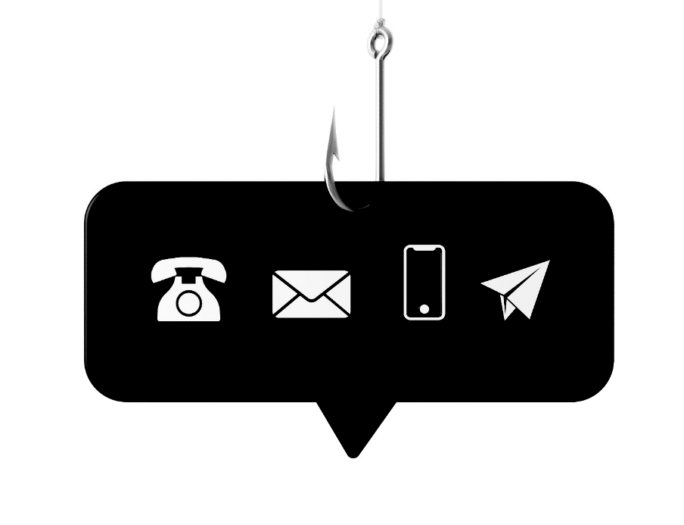
Ways Criminals Can Steal Your Identity
Phishing
trick you into giving personal information, often through email
Vishing – phishing by phone
Smishing – phishing by text messages
Spear phishing
targeted phishing
Pharming
fake websites
Skimming
stealing credit card or debit card numbers when you swipe a payment card
Social media scamming

Slide 15
Warning Signs of Identity Theft
Withdrawals you did not make
Missing bills or statements
Merchants refusing your checks
Credit card transactions not going through

Slide 16
More Warning Signs of Identity Theft
Letters about accounts you didn’t open
Emails about purchases you didn’t make
Statements for credit cards you don’t have
Debt collectors calling about debts that aren’t yours
Passwords or usernames not working
Notifications about changes to your online accounts you did not make

Slide 17
Additional Warning Signs of Identity Theft
Unfamiliar accounts on your credit reports
Medical bills for services you didn’t receive
Health records for conditions you don’t have
Multiple tax returns or inaccurate tax records
Notification about a data breach

Slide 18
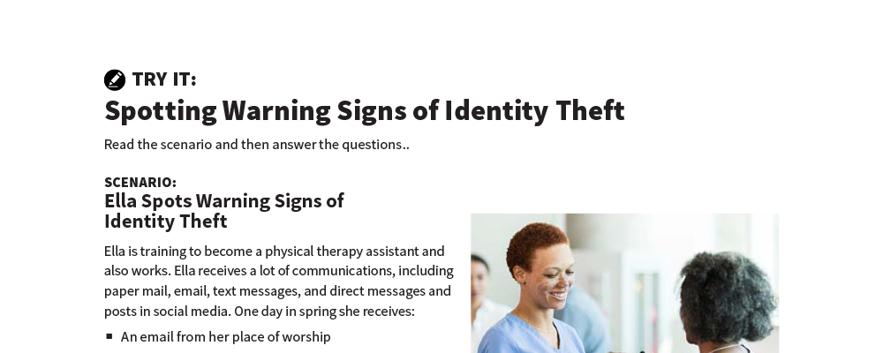
Spotting Warning Signs of Identity Theft
Try It
See page 7 in your participant guide.

Slide 19

Steps to Minimize Identity Theft
Guard your personal information closely
Avoid letting others use your smart phone
Activate security features on your devices
Don’t respond to unsolicited requests
Protect your mail
Sign up for direct deposit
Shred all personal and financial information
Review your financial accounts regularly and carefully

Slide 20

More Steps to Minimize Identity Theft
Beware of identity theft on the internet
Protect your devices
Keep your important documents secure
Review your credit reports at least once every 12 months at annualcreditreport.com
Read scam alerts
Beware of disaster-related scams

Slide 21
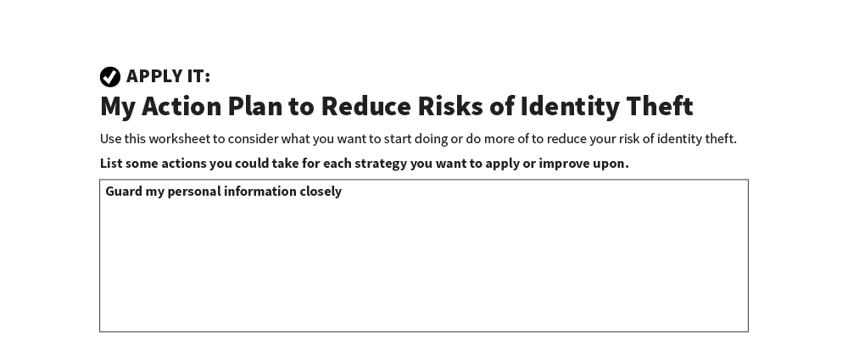
My Action Plan to Reduce Risks of Identity Theft
Apply It
See page 9 in your participant guide.

Slide 22

Reporting Identity Theft and Getting Help
Create an identity theft report
Visit identitytheft.gov for more information

Slide 23
If Your Identity Has Been Stolen
Work with credit reporting agencies to respond to the theft
Place a fraud alert on your credit reports
Dispute inaccurate information
Get a credit freeze

Slide 24



Communicate With Your Creditors and Debt Collectors
Alert them about fraudulent accounts
Get copies of documents related to the theft of your identity
Ask them to stop contacting you about fraudulent accounts
Get written information about fraudulent accounts

Slide 25
You Have Other Federal Rights
See identitytheft.gov
You generally have limited liability for fraudulent debts and accounts caused by identity theft
Go to usa.gov to learn about your rights in a data breach

Slide 26
Remember the key takeaway
SECTION 2
Remember the key takeaway
“
You can reduce your risk of identity theft. Help is available if it happens to you.”

Slide 27

Section 3 Insurance and Recordkeeping
SECTION 3 Insurance and Recordkeeping
See page 14 in your Participant Guide.

Slide 28
Key Takeaway
SECTION 3
Key Takeaway
Insurance provides protection from financial loss. Keep accurate records of your assets and any damages to your property.

Slide 29

How Insurance Works
Reduces the financial impact of a loss or event covered by the insurance policy
Helps protect you from financial catastrophe

Slide 30

Key Terms
Insurance premium
Covered loss
Coverage limit
Deductible

Slide 31

More Key Terms
Copayment
Coinsurance
Exceptions or exclusions
Claim
Adjudication

Slide 32
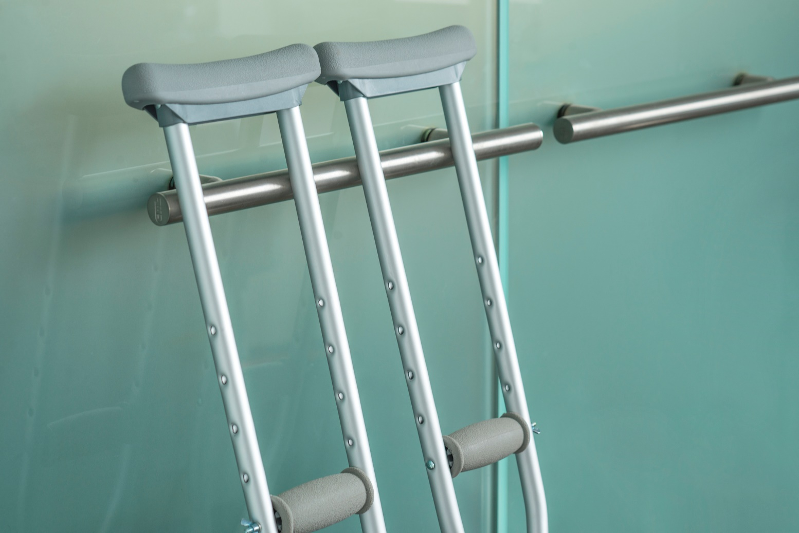
Types of Insurance
Health insurance
Long-term care insurance
Dental insurance
Vision insurance
Disability insurance
Life insurance
Pet insurance

Slide 33

More Types of Insurance
Identity theft insurance
Vehicle insurance
Renter’s insurance
Homeowners insurance
Flood insurance

Slide 34
Getting Insurance
Depends on your individual circumstances
Purchase it to manage risks to your assets
Consider it for things that could happen and cause serious financial harm
Some insurance is required by law
Periodically review your coverage and shop around

Slide 35

Shop Around
Review state-specific information
Check out insurance companies
Ask about discounts
Compare several quotes
Consider tradeoff between deductibles, coinsurance, coverage limits, and premiums

Slide 36
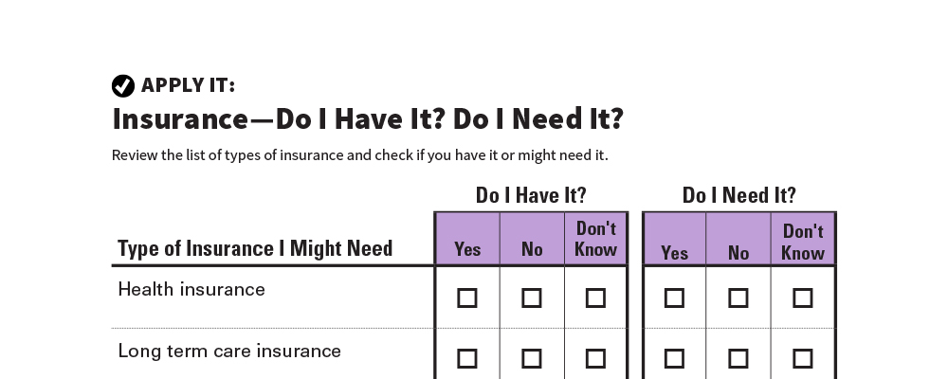
Apply It
Apply It
Insurance—Do I Have It? Do I Need It?
See page 16 in your participant guide.

Slide 37

Keeping Accurate Records
Important part of making sure insurance adequately covers your risks
Create and maintain a list of your assets
Document any damages and save receipts for related expenses
File claims as soon as possible

Slide 38
Remember the key takeaway
SECTION 3
Remember the key takeaway
“
Insurance provides protection from financial loss. Keep accurate records of your assets and any damages to your property.”

Slide 39


Take Action
Take Action
See page 18 in your participant guide.
After this training, what is one thing you will do?
Who will you tell about your planned action?
What additional information do you need?
i

Slide 40

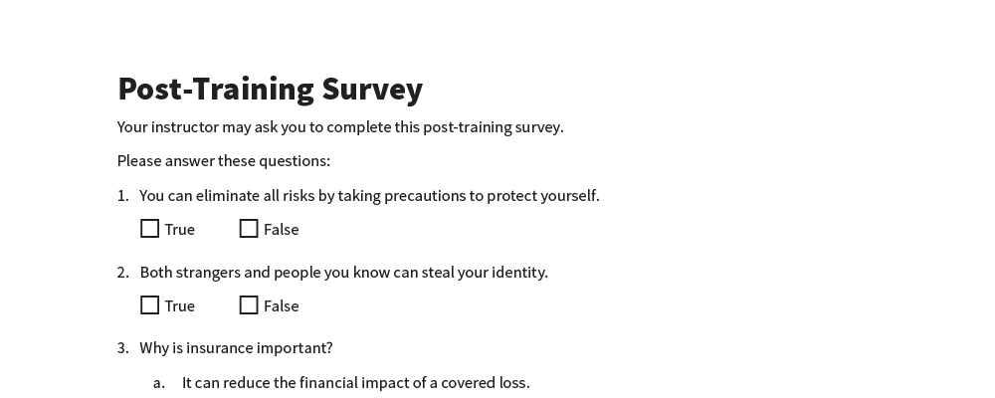
Post-Training Survey
Post-Training Survey
See page 21 in your participant guide.

