Slide 1



Module 4
MODULE 4
Your Spending and
Saving Plan
MONEY SMART
FOR YOUNG ADULTS

Slide 2
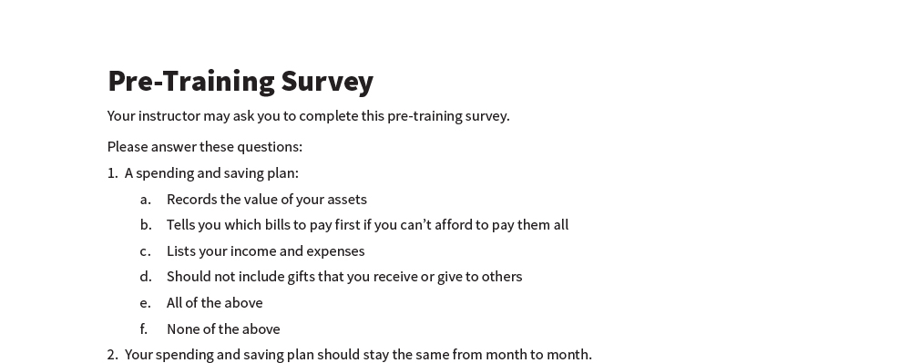
Pre-Training Survey
See page 22 in your participant guide.

Slide 3



Section 1
SECTION 1
Making a Monthly Spending and Saving Plan
See page 2 in your participant guide.

Slide 4

Key Takeaway
SECTION 1
Key Takeaway
Use a monthly spending and saving plan to guide how you use your money.

Slide 5

Building Blocks of a Spending and Saving Plan
Compare income and expenses
Understand where your money is going
Make adjustments
INCOME:
Money you receive
EXPENSES:
How you use your income

Slide 6
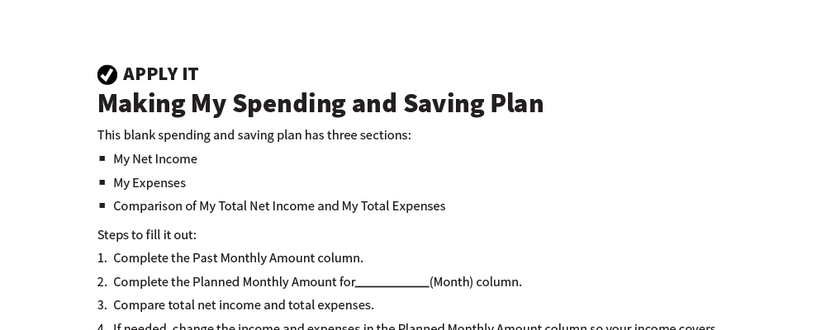
Making My Spending and Saving Plan
Apply It
See page 3 in your participant guide.

Slide 7
Filling Out My Spending and Saving Plan
Filling Out My Spending and Saving Plan
STEPS TO FILL IT OUT:
  Complete Past Monthly Amount
  Complete Planned Monthly Amount
  Compare total net income and
  total expenses
  If needed, make changes
THREE SECTIONS:
  My Net Income
  My Expenses
  Compare My Total Net Income and
  My Total Expenses

Slide 8
When You Compare
My Total Net Income MINUS My Total Expenses
IF YOUR DIFFERENCE IS:
Zero – your income equals your expenses
Positive – you have more income than expenses
Negative – you have more expenses than income
0
+
-

Slide 9
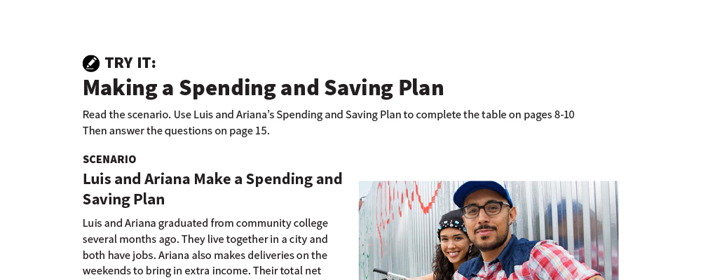
Making a Spending and Saving Plan
Try It
See page 7 in your participant guide.

Slide 10
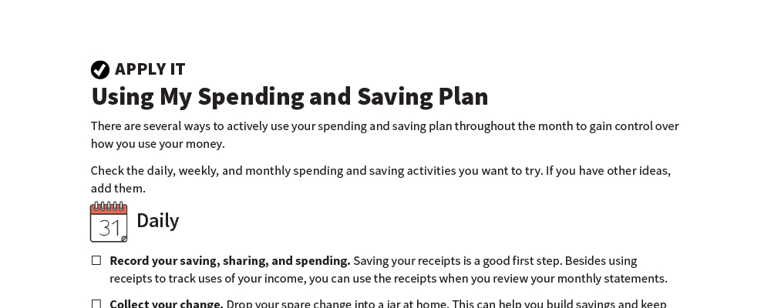
Using My Spending and Saving Plan
Apply It
See page 11 in your participant guide.

Slide 11

Daily and Weekly Ideas
Daily and Weekly Ideas
DAILY IDEAS
  Record your saving, sharing, and spending
  Collect your change
  Other ideas?
WEEKLY IDEAS
  Envelope system
  Weekly money
  check-in
  Other ideas?

Slide 12

Monthly Ideas
Conduct a monthly review
Have a monthly goal-setting session
Celebrate successes
Prepare for taxes
Other ideas?

Slide 13
Increasing
Income
Can help you cover expenses, save, or share
ONCE:
Sell something
OCCASIONALLY:
A few garage sales
ONGOING:
Part-time second job
LONG-TERM:
Workforce development
What are other ways to increase your income?

Slide 14
Decreasing Expenses
Think About Needs, Wants, and Obligations
CONSERVE:
What can you get cheaper or use less of?
ADJUST:
What can you renegotiate?
DO WITHOUT:
What can you eliminate?

Slide 15
Making Adjustments
Your spending and saving plan should change to reflect your reality
It helps you decide where to change things
Making adjustments doesn’t mean you have a bad plan

Slide 16
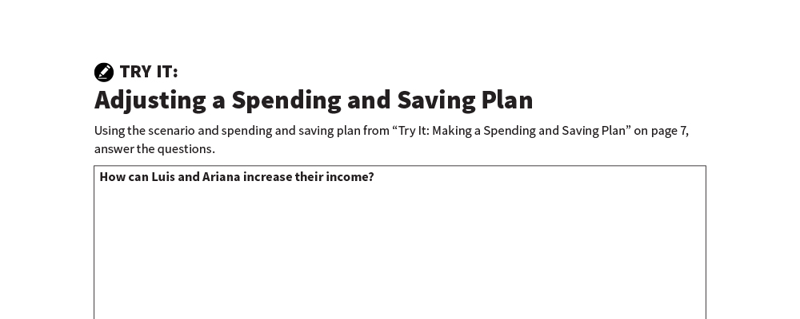
Adjusting a Spending and Saving Plan
Try It
See page 15 in your participant guide.

Slide 17

Remember the key takeaway
SECTION 1
Remember the key takeaway
“
“
Use a monthly spending and saving plan to guide how you use your money.”

Slide 18

Section 2 When Money Is Short
SECTION 2
When Money Is Short
See page 16 in your participant guide.

Slide 19
Key Takeaway
SECTION 2
Key Takeaway
Prioritize which bills to pay first when money is short.

Slide 20

How Does It Happen?
Even with careful planning, money can run short

Slide 21

What Can I Do
What Can I Do?
  Increase income
  Decrease expenses
  Contact your creditors
  Reach out for help
  Prioritize which bills to pay first

Slide 22
Prioritizing Based on What Might Happen
Make choices about which bills to pay in full, pay partially, or pay late
Pay attention to consequences that:
  Prevent you from earning income
  Jeopardize your shelter
  Impact health or ability to live independently
  Could cause loss of your assets
  Your spending and saving plan should change to reflect your reality
  It helps you decide where to change things
  Making adjustments doesn’t mean you have a bad plan

Slide 23
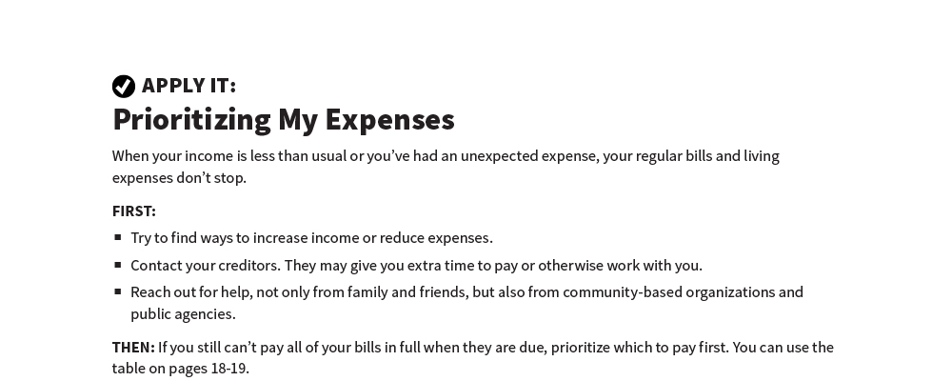
Prioritizing My Expenses
Apply It
See page 18 in your participant guide.

Slide 24
Remember the key takeaway
SECTION 2
Remember the key takeaway
“
“
Prioritize which bills to pay first when money is short.”

Slide 25


Take Action
See page 20 in your participant guide.
After this training, what is one thing you will do?
Who will you tell about your planned action?
What additional information do you need?
i

Slide 26

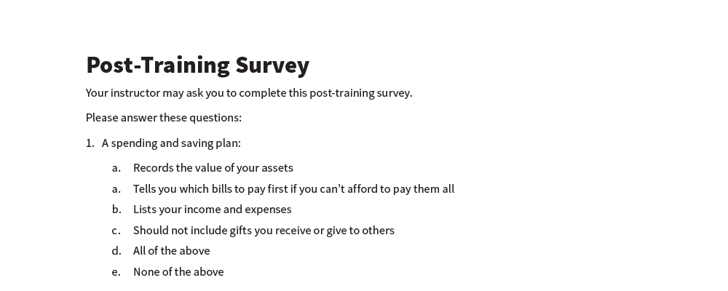
Post-Training Survey
See page 23 in your participant guide.

