Slide 1



Module 11 Paying for Education and Training
MODULE 11 Paying for Education and Training
MONEY SMART FOR YOUNG ADULTS

Slide 2
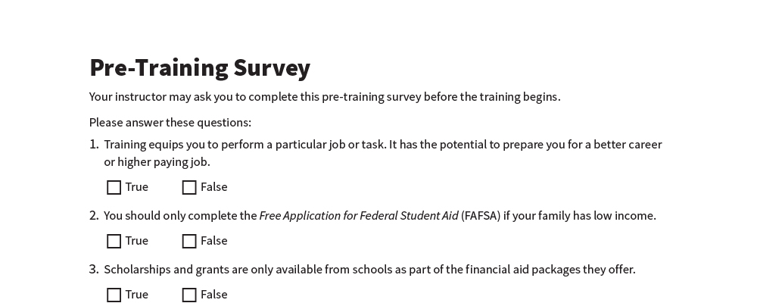
Pre-Training Survey
See page 17 in your participant guide.

Slide 3



Section 1 Benefits and Costs of Education and Training
SECTION 1 Benefits and Costs of Education and Training
See page 2 in your participant guide.

Slide 4

Key Takeaway
SECTION 1
Key Takeaway
Consider all costs and benefits of education and training opportunities before you commit.

Slide 5


Benefits of Education and Training

Slide 6

Types of Education and Training
On-the-job training
Apprenticeships
Vocational schools
Career and technical schools
Community colleges
Four-year colleges
Military service
Job Corps, AmeriCorps, and Peace Corps

Slide 7


Costs of Education and Training
What are some costs of education and training?

Slide 8
Some Costs of Education and Training
Application fees
Tuition
Books and supplies
Opportunity cost
Student loan interest and fees
Child care or dependent care
Room and board
Transportation
Tools
Assistive technologies for people with disabilities

Slide 9
Estimated Cost of Attendance
Tuition and fees
Room and board
Books
Supplies
Transportation
Loan fees
Personal computer
Child care or other dependent care

Slide 10
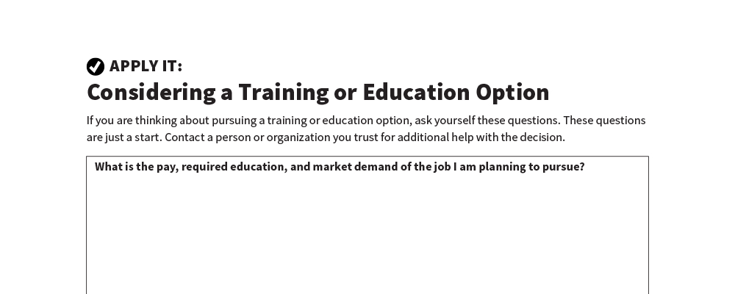
Considering a Training or Education Option
Apply It
See page 3 in your participant guide.

Slide 11

Remember the key takeaway
SECTION 1
Remember the key takeaway
“
Consider all costs and benefits of education and training opportunities before you commit.”

Slide 12

Section 2 Paying for Education and Training
SECTION 2 Paying for Education and Training
See page 5 in your participant guide.

Slide 13
Key Takeaway
SECTION 2
Key Takeaway
To be considered for most forms of financial aid, you must complete the online Free Application for Federal Student Aid (FAFSA).

Slide 14
Ways to Pay
Getting help from your friends and family
Using savings
Working while attending school
Getting scholarships and grants
Getting help from your employer
Borrowing student loans

Slide 15


Financial Aid
Scholarships
Grants
Work-study
Federal student loans

Slide 16
Free Application for Federal Student Aid (FAFSA)
Visit fafsa.gov or use the FAFSA mobile app
Check deadlines carefully
Submit your FAFSA early
Apply regardless of income

Slide 17

Scholarships and Grants
How are scholarships and grants different?

Slide 18
Scholarships and Grants (continued)
Scholarships
Not repaid
May be based on academic merit, talent, or a particular area of study
May also be based on membership in particular communities or affinity groups
Grants
Not repaid
Mostly awarded to students with financial need

Slide 19

Other Sources of Scholarships and Grants
Who else may offer scholarships or grants?

Slide 20
Other Sources of Scholarships and Grants (continued)
Local businesses
Your employers
Your parent’s employer
Trade associations and worker organizations
Places of worship
Chambers of commerce
Ethnic organizations

Slide 21

Work-Study
Earn money to pay for school by working part-time
On-campus or off-campus jobs

Slide 22


Type of Student Loans
Private student loans
Not a form of student financial aid
Vary considerably from lender to lender
Federal student loans
Form of student financial aid
School determines the amount you can borrow
Low interest rates
Repayment options

Slide 23
Types of Federal Student Loans
Direct subsidized loans
Available to undergraduate students with financial need
U.S. Department of Education pays the interest:
While you’re in school
For the first six months after you leave school
During deferments
Direct unsubsidized loans
Available to undergraduate and graduate students
No requirement to demonstrate financial need
Borrower responsible for paying interest throughout the life of the loan

Slide 24
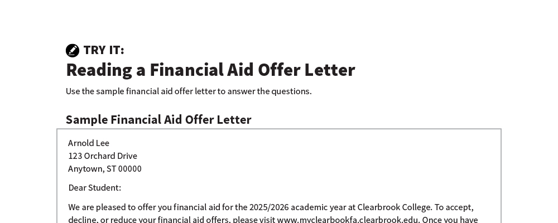
Reading a Financial Aid Offer Letter
Try It
See page 8 in your participant guide.

Slide 25

Considering Options for Paying for School
Try It
See page 10 in your participant guide.

Slide 26
Tax Advantaged Savings for Training or Education
529 plans
Savings grow free of federal income tax
Rules and other benefits vary by state
ABLE accounts (529A accounts)
For people with disabilities
Rules and other benefits vary by state

Slide 27
Remember the key takeaway
SECTION 2
Remember the key takeaway
“
To be considered for most forms of financial aid, you must complete the online Free Application for Federal Student Aid (FAFSA).”

Slide 28

Section 3 Repaying Federal Student Loans
[Picture]
SECTION 3 Repaying Federal Student Loans
See page 12 in your participant guide.

Slide 29
Key Takeaway
SECTION 3
Key Takeaway
It is important to pay back your student loans on time and as agreed. If you can’t, contact your loan servicer right away.

Slide 30
Consequences of Not Repaying Student Loans
Consequences of Not Repaying Student Loans
Paying more fees and interest
Wage garnishment
Account garnishment
Treasury offset

Slide 31
Consequences of Not Repaying Student Loans cont.
Consequences of Not Repaying Student Loans (continued)
Unable to get more federal student aid
Negative information on credit reports
Decrease in credit scores
Decreased ability to borrow money
Stress
Delay in reaching other goals

Slide 32

If you won’t be able to make your student loan payments on time, contact your loan servicer right away.

Slide 33
Federal Student Loan Repayment Options
Standard Repayment Plan
Graduated Repayment Plan
Extended Repayment Plan
Revised Pay as You Earn (REPAYE) Plan
Pay as You Earn (PAYE) Plan
Income-Based Repayment (IBR) Plan
Income-Contingent Repayment (ICR) Plan

Slide 34

Other Possible Options
Forbearance
Deferment

Slide 35
Take Action to Prevent Default
Ask whether you can change your payment due date
Consider available repayment plan options
Explore eligibility for forbearance and deferment
Continue making payments
Declaring bankruptcy does not automatically discharge federal student loans

Slide 36

Beware of Student Loan Scams
Never pay an upfront fee
Don’t promises of quick fixes
Scammers sometimes pretend they are with the government
Consider unsolicited calls or texts asking for your personal information to be scams

Slide 37

Exploring Options for Repaying Student Loans
Try It
See page 14 in your participant guide.

Slide 38
Remember the key takeaway
SECTION 3
Remember the key takeaway
“
It is important to pay back your student loans on time and as agreed. If you can’t, contact your loan servicer right away.”

Slide 39


Take Action
See page 15 in your participant guide.
After this training, what is one thing you will do?
Who will you tell about your planned action?
What additional information do you need?
i

Slide 40

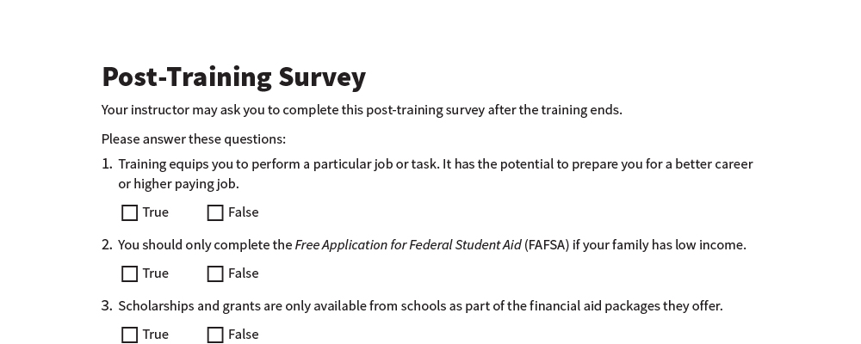
Post-Training Survey
See page 18 in your participant guide.

