Slide 1



MODULE 2
Setting Goals and Making Financial Decisions
MONEY SMART
FOR YOUNG ADULTS

Slide 2
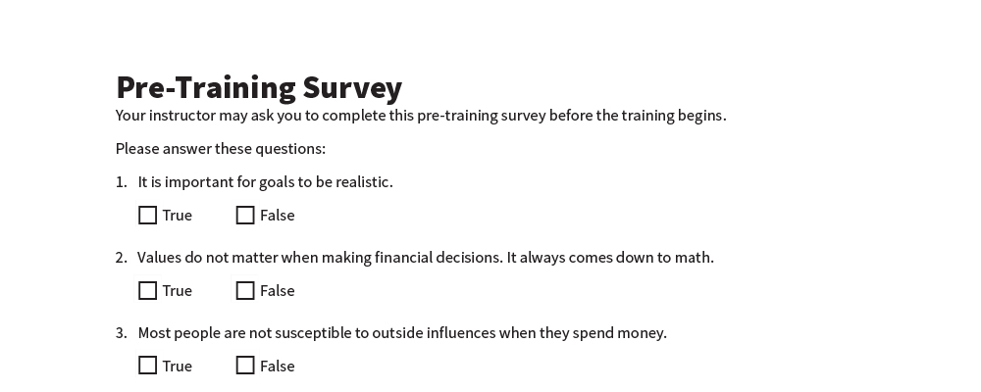
Pre-Training Survey
See page 14 in your Participant Guide.

Slide 3



SECTION 1
Setting Goals
See page 2
in your Participant Guide.

Slide 4

Key Takeaway
SECTION 1
Setting SMART goals helps you achieve your hopes and dreams for the future by providing a realistic plan to follow.

Slide 5





Setting
SMART Goals
Specific
Measurable
Action-oriented
Reachable
Time-bound
GOALS SHOULD BE:

Slide 6





SMART Goals
To ensure your goals are… | Ask yourself…
Specific | What exactly do I want to accomplish? Why is this important to me? Is this something I really want?
Measurable | How much? How many? How will I know when I have met my goal?
Action-oriented | What specific actions do I need to complete to meet this goal?
Reachable | Is this goal something I can actually reach?
Time-bound | When will I reach this goal?

Slide 7

Writing a SMART Goal
Try It
See page 3 in your participant guide.

Slide 8

My SMART Goals
Apply It
See page 3 in your participant guide.

Slide 9

Remember the key takeaway
SECTION 1
“
Setting SMART goals helps you achieve your hopes and dreams for the future by providing a realistic plan to follow.”

Slide 10

SECTION 2
Using Your Values When Managing Your Money
See page 5
in your Participant Guide.

Slide 11
Key Takeaway
SECTION 2
Understanding your values can help you set achievable financial goals.

Slide 12

My Values
Apply It
See page 6 in your participant guide.

Slide 13



Using Your Values When Managing Your Money
Understanding your core values can help you set realistic goals.
Understanding your core values can also help you make spending decisions that will help you meet your goals.

Slide 14

Considering the Values Behind Financial Choices
Try It
See page 7 in your participant guide.

Slide 15
Remember the key takeaway
SECTION 2
“
Understanding your values can help you set achievable financial goals.”

Slide 16

SECTION 3
External Influences on Choices About Money
See page 8
in your Participant Guide.

Slide 17
Key Takeaway
SECTION 3
External influences impact financial choices. Use strategies to stay focused on your goals.

Slide 18









Influences on
Choices About Money
Friends and peers
Celebrities and athletes
Social media and influencers
Advertisements
Television and movies

Slide 19


Influences Can Be…
PRODUCTIVE
Helping you achieve your goals
UNPRODUCTIVE
Getting in your way

Slide 20

External Influences: Small Groups
Friends and peers
Celebrities and athletes
Social media and influencers
Advertisements
Television and movies

Slide 21
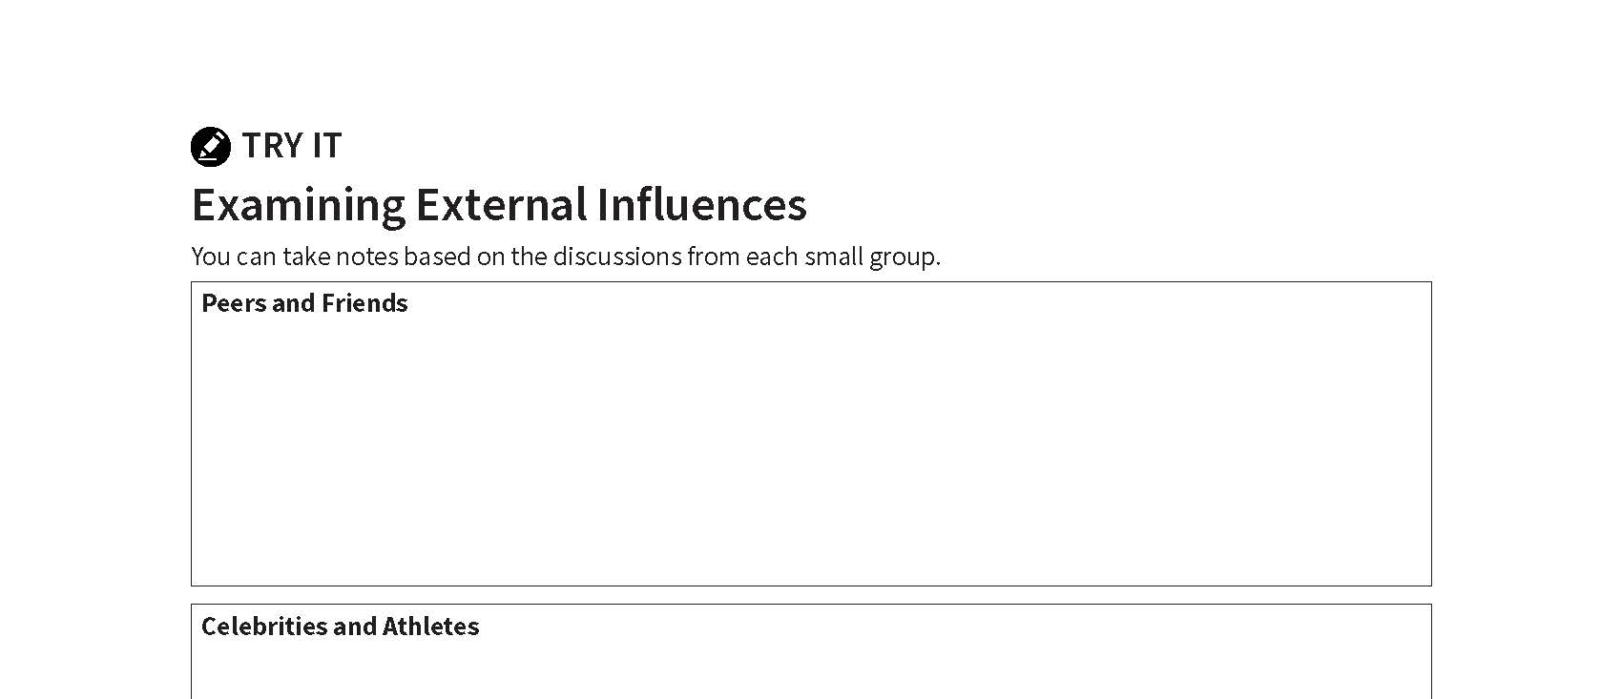
Examining External Influences
Try It
See page 9 in your participant guide.

Slide 22

Social Pressure and Advertising
It is human nature to want what others have.
Advertisers spend money to influence how we spend our money.
Social media influencers work for brands to influence how you spend money.
Impulse purchases can make it harder to achieve goals.

Slide 23

Blocking and Resisting Unproductive Messages and External Influences

Slide 24






Strategies for Staying Focused on Your Goals
Recognize tactics used by advertisers.
Build in a pause.
Control your environment.
Notice when and where you are tempted.
Talk yourself out of it.
Calculate how many hours or days of work an item is worth.

Slide 25
Remember the key takeaway
SECTION 3
“
External influences impact financial choices. Use strategies to stay focused on your goals.”

Slide 26


Take Action
See page 12 in your participant guide.
After this training, what is one thing you will do?
Who will you tell about your planned action?
What additional information do you need?
i

Slide 27

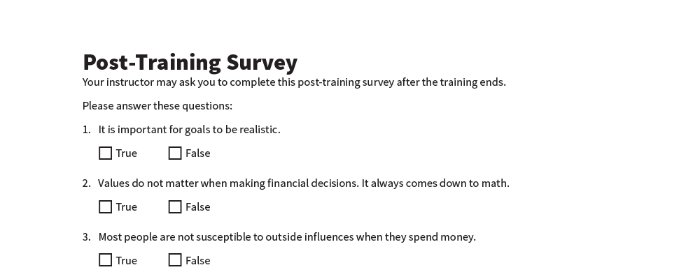
Post-Training Survey
See page 15 in your Participant Guide.

