Slide 1



MODULE 8
Charge It Right
MONEY SMART
FOR YOUNG ADULTS

Slide 2
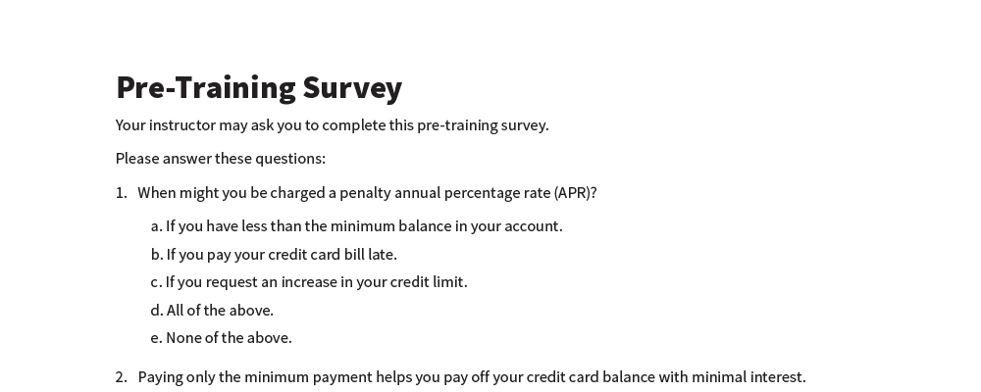
Pre-Training Survey
See page 21 in your participant guide.

Slide 3



SECTION 1
How Credit Cards Work
See page 2 in your participant guide.

Slide 4
Key Takeaway
SECTION 1
Know how credit cards work so you can shop around for one that meets your needs.

Slide 5
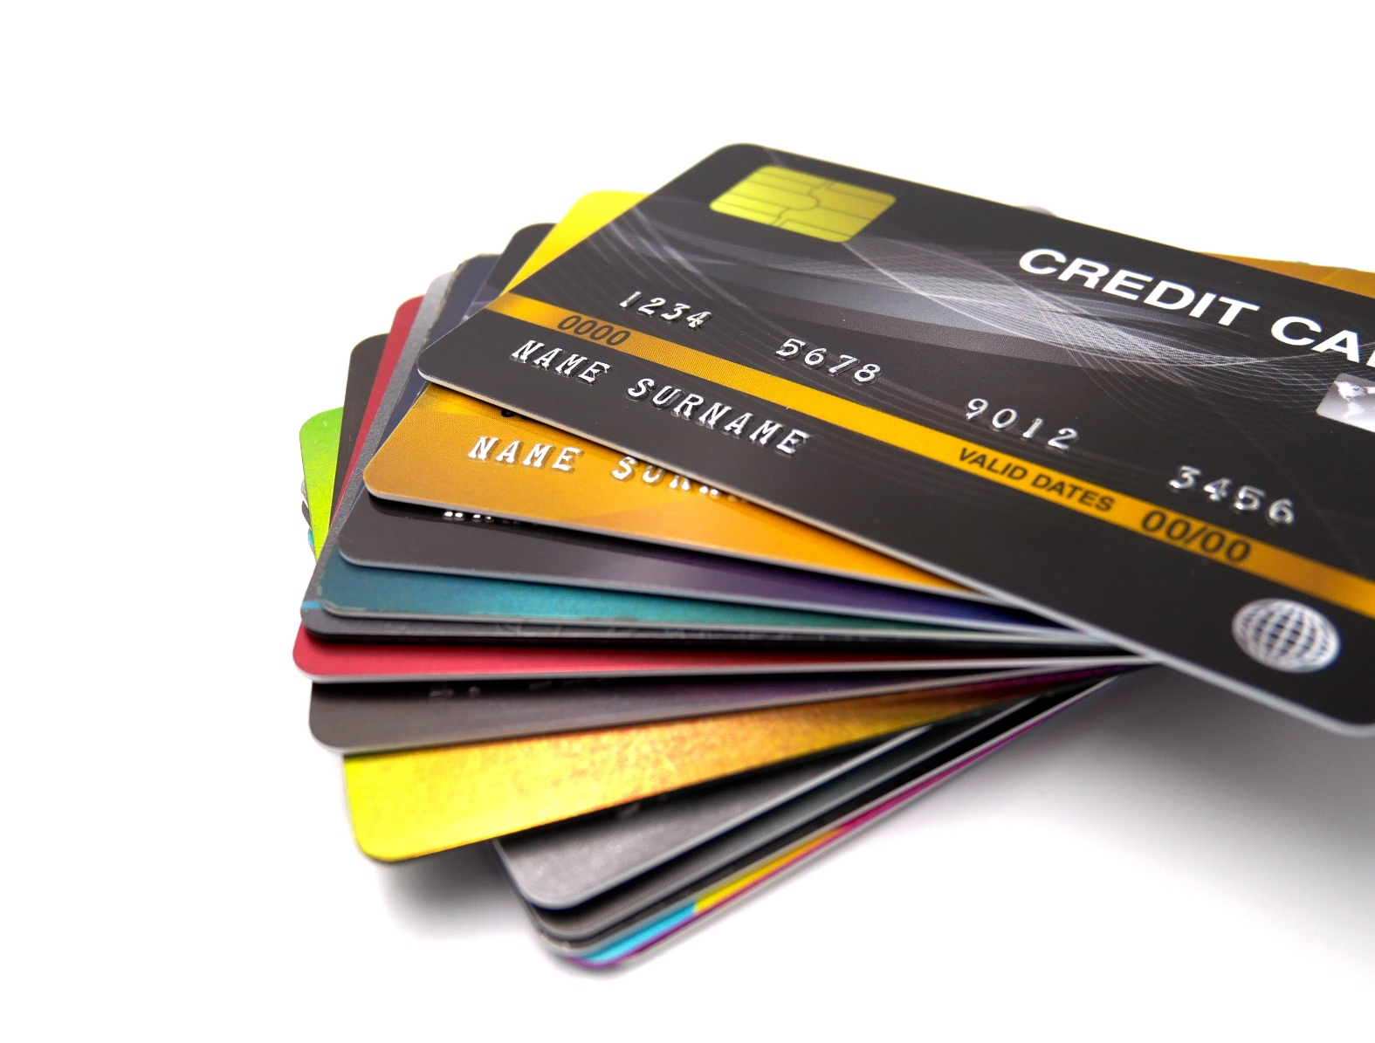
What Do You
Know About
Credit Cards?

Slide 6
What is a Credit Card?
Has a revolving line of credit
Is a convenient way to buy goods
and services
Allows you to buy now, pay later
Has a limit on how much you can borrow (credit limit or credit line)
Requires you to pay at least a part
of the bill every billing cycle (minimum payment)

Slide 7





Important Financial Tools
Can show you are creditworthy
Can help you pay for emergency expenses
Is a convenient option for purchases online or by phone
Gives you the right to dispute wrong credit card charges
Gives you the right to dispute certain charges for goods and services that were not delivered as agreed

Slide 8



Cards That Are Not Credit Cards?
Prepaid cards
(also known as stored value cards)
Gift cards
Debit cards

Slide 9


Annual Rates and Fees
Annual Percentage Rate (APR)
  The cost of credit expressed as a yearly rate
Penalty APR
  The increased rate if you do not pay the bill on time
Interest Rates
  Fixed or variable

Slide 10
Low Introductory APRS
Teaser rates
Last for a limited time, at least six months
For example
  0% interest on purchases for 15 months
  Then, variable APR of 15.49% to 25.49%

Slide 11
TILA Disclosure
Credit card rates and fees vary greatly
The Federal Truth in Lending Act—or TILA—disclosure is a written disclosure containing important rate and fee information
Creditors must give the TILA disclosure to prospective credit card customers

Slide 12
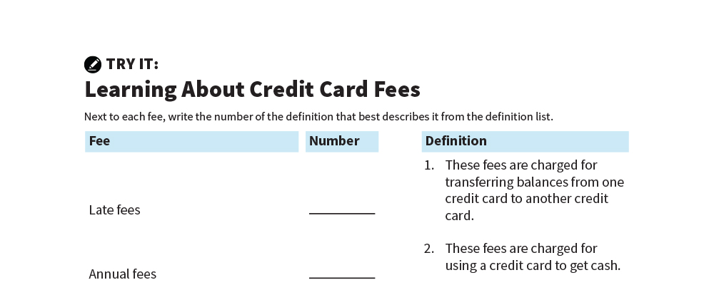
Learning About Credit Card Fees
TRY IT
See page 5 in your participant guide.

Slide 13



Rewards
Examples
Know how to qualify
Understand how to maintain rewards
Consider fees
Cash rebates
Points you can use to make other purchases
Airline miles

Slide 14
Other Important Terms: Credit Limit
The credit limit is the maximum credit you can use
Each creditor has its own standards
Creditors may consider your:
Credit history
Current income
Outstanding debt

Slide 15
Grace Period
The time between when your statement is issued and when your payment is due
Creditors do not have to give a grace period
Applies to new purchases

Slide 16
Balance Computation Method
The balance computation method is how interest on your account is calculated
There are different methods
The cardholder agreement will include which method is used
The average daily balance method is one method

Slide 17
Other Features, Products, and Services
Customer service features
Additional features for free
Example: Extended warranty, free credit scores, rental car insurance
Additional products and services for a fee
Examples: Payment protection, credit monitoring

Slide 18

Choosing a Credit Card
TRY IT
See page 7 in your Participant Guide.

Slide 19
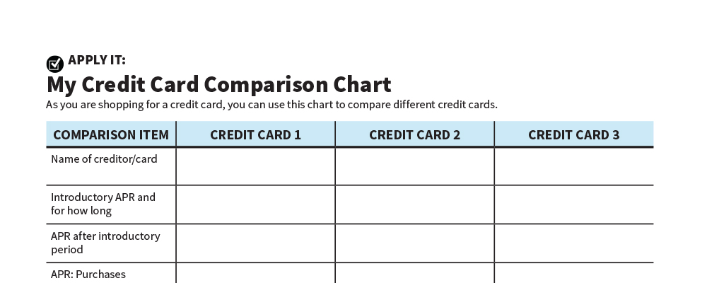
My Credit Card Comparison Chart
APPLY IT
See page 8 in your Participant Guide.

Slide 20
Unsecured and Secured Credit Cards
Unsecured credit cards—do not require collateral
Secured credit cards—require collateral
You keep money (collateral) in a dedicated deposit account;
the amount may be equal to the card’s credit limit
If you pay the balance regularly by the due date, you generally
can improve your credit history and scores
These are usually easier to qualify for than unsecured cards

Slide 21
Secured Credit Cards
Secured cards typically have lower credit limits
Some people apply for secured credit cards if they are unable to get unsecured cards
The card can help them build their credit history

Slide 22
Applying for a Credit Card
Several options to find credit
card offers
Financial institutions and
retail stores
Card comparison websites
Offers received in the mail
Opting out of pre-screened offers:
1-888-5-OPTOUT (567-8688)
optoutprescreen.com

Slide 23
Key Terms in Application Process
Credit card applicant
Cosigner
Creditor
Individual credit
Joint credit
Authorized user

Slide 24
Remember the key takeaway
SECTION 1
“
Know how credit cards work so you can more effectively shop around for one that meets your needs.”

Slide 25

SECTION 2
Managing Your Credit Card
See page 11
in your participant guide.

Slide 26
Key Takeaway
SECTION 2
Credit cards can be convenient, but manage them carefully to keep costs down and avoid damage to your credit.

Slide 27
Reading a Credit Card Statement
Account Billing Cycle | Time Period Covered by Statement
Account Summary | Previous Balance
 | New Balance
 | Credit Limit
 | Credit Available
Payment Information | New Balance
 | Minimum Payment Due
 | Payment Due Date
 | Late Payment Warning
 | Total Minimum Payment Warning

Slide 28
More Items on a Credit Card Statement
Credit counseling statement
Notice of interest rate changes
Transactions or account activity
Transactions, finance charges, annual fee, and interest totals
Interest charge calculation

Slide 29
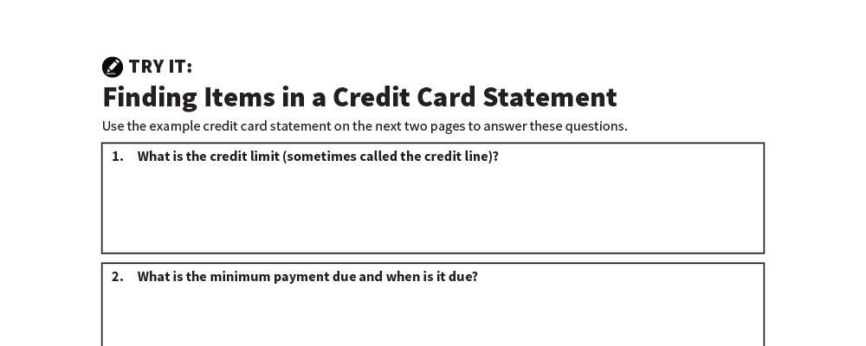
Finding Items in a Credit Card Statement
TRY IT
See page 12 in your Participant Guide.

Slide 30





Steps to Managing Your Credit Card
Keep good records
Check statements for mistakes
Pay on time and at least the minimum due
Understand the impact of different payment strategies
Try to limit what you owe compared to your credit limit

Slide 31
Paying Only the Minimum Payment
Item | Price | Credit Card APR | Interest Paid | How Much You Really Pay for the Item | Total Years to Pay Off
TV | $500 | 18% | $132 | $632 | 3
Repair | $1,000 | 18% | $863 | $1,863 | 8
Furniture | $2,500 | 18% | $5,363 | $7,863 | 23

Slide 32
Paying More Than the Minimum Payment
Original Balance | Credit Card APR | Monthly Payments | Total Years to Pay Off | Interest Paid | Total Amount Paid
$2,500 | 18% | Minimum Payment | 23 | $5,363 | $7,863
$2,500 | 18% | Minimum Payment + $24 | 4 | $1,025 | $3,525
$2,500 | 18% | Minimum Payment + $41 | 3 | $754 | $3,254

Slide 33
How Payments Are Applied to Your Balance
Minimum payment
Creditor chooses how to apply to balance
Often applied to portion of balance with lowest interest rate
Amounts over minimum payment
Generally applied to portion of balance with the highest interest rate

Slide 34
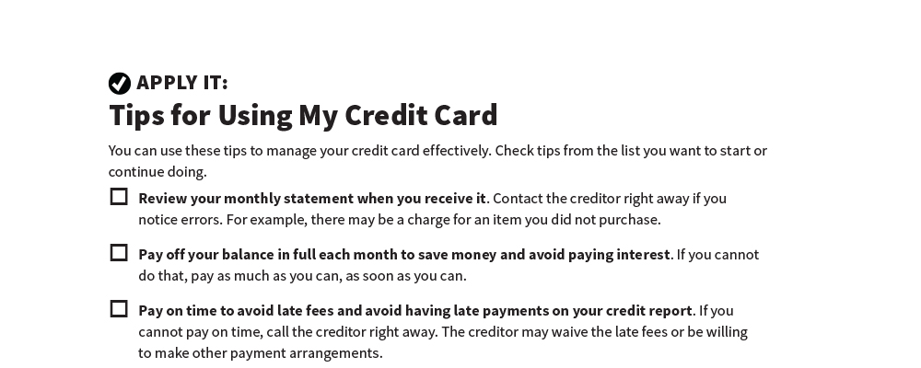
Tips for Using My Credit Card
APPLY IT
See page 17 in your Participant Guide.

Slide 35
Remember the key takeaway
SECTION 2
“
Credit cards can be convenient, but manage them carefully to keep costs down and avoid damage to your credit.”

Slide 36


Take Action
See page 19 in your participant guide.
After this training, what is one thing you will do?
Who will you tell about your planned action?
What additional information do you need?
i

Slide 37

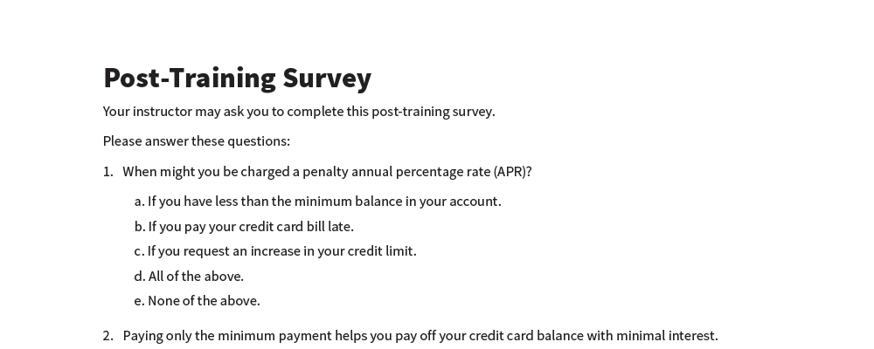
Post-Training Survey
See page 22 in your Participant Guide.

