Slide 1



Module 5
MODULE 5 Saving for Your Goals and Your Future
MONEY SMART FOR YOUNG ADULTS

Slide 2
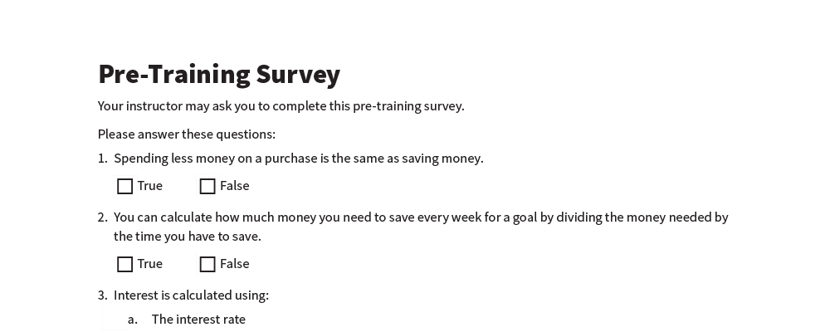
Pre-Training Survey
See page 21 in your participant guide.

Slide 3



SECTION 1 What Is Saving?
See page 2 in your participant guide.

Slide 4

Key Takeaway
SECTION 1
Key Takeaway
Set aside some money every time you get income. Regularly saving money can make a big difference over time.

Slide 5
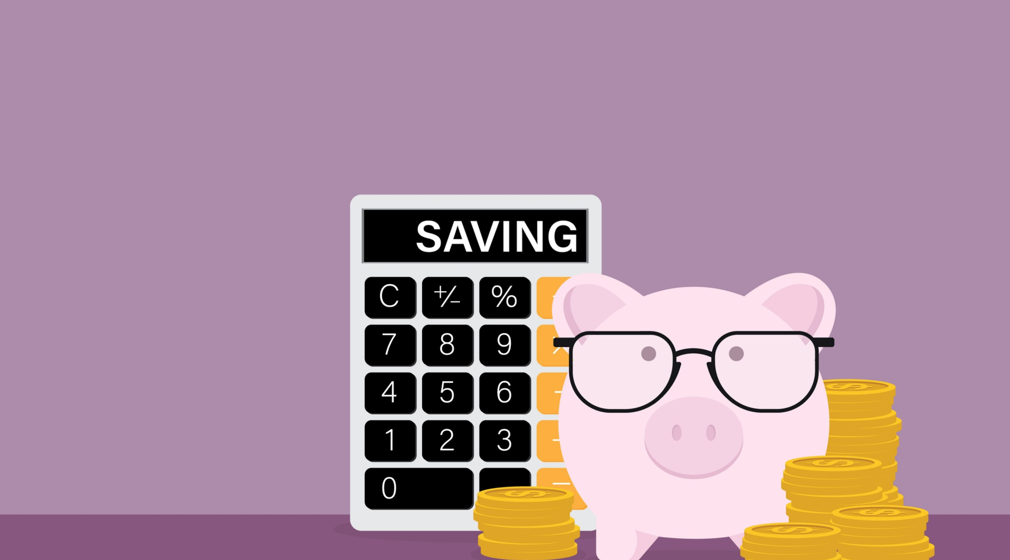
Defining Saving
What does “saving” mean?

Slide 6
Is Buying Thins for Less the Same as Saving Money
Is Buying Things for Less Money the Same as Saving Money?
Only if you save what you did not spend
Saving is setting aside money today for the future
To build savings, put some or all of what you did not spend into savings

Slide 7
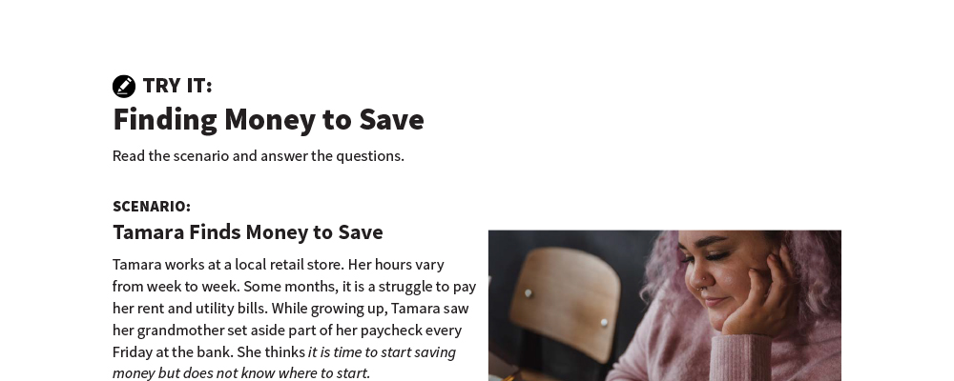
Finding Money to Save
Try It
See page 3 in your participant guide.

Slide 8
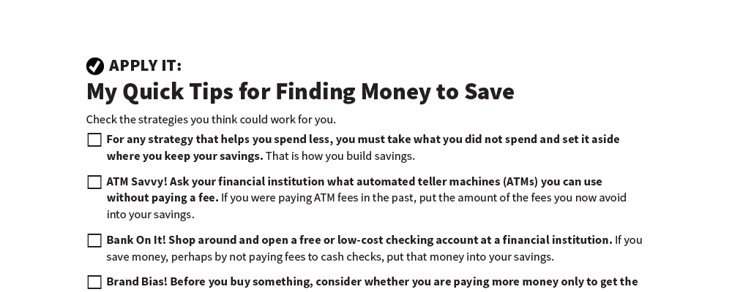
My Quick Tips for Finding Money to Save
Apply It
See page 4 in your participant guide.

Slide 9


Why Save Money
Why Save Money?
Goals
Wealth-building
Emergencies
Covering times with less income or more expenses
Peace of mind
Job-related expenses
Other

Slide 10

Remember the key takeaway
SECTION 1
Remember the key takeaway
“
“
Set aside some money every time you get income. Regularly saving can make a big difference over time.”

Slide 11

Section 2: Making a Saving Plan
SECTION 2 Making a Saving Plan
See page 7 in your participant guide.

Slide 12
Key Takeaway
SECTION 2
Key Takeaway
Create a plan to save money for your goals.

Slide 13

Unexpected Expenses

Slide 14

Emergency Savings Fund
Avoids debt if you use it to pay for unexpected expenses
Takes time and commitment
Is a cycle
Still worth doing
Improves financial health and stability

Slide 15
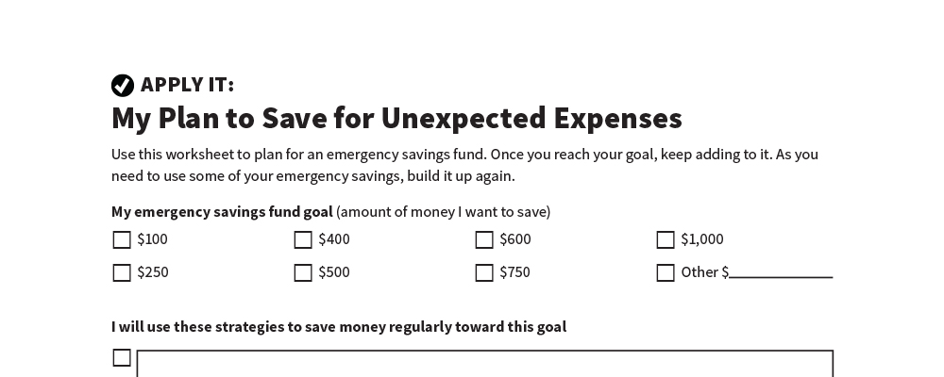
My Plan to Save for Unexpected Expenses
Apply It
See page 8 in your participant guide.

Slide 16
How Much Money Should You Save for Your Goals?
What are you saving for?
How much will it cost?
How much of that cost do you need to save?
What is your deadline?
Money Needed ÷ Time to Save
For example: $1,000 ÷ 100 (50 weeks x 2 years) = Save $10 per week
After two years you will have $1,000!

Slide 17
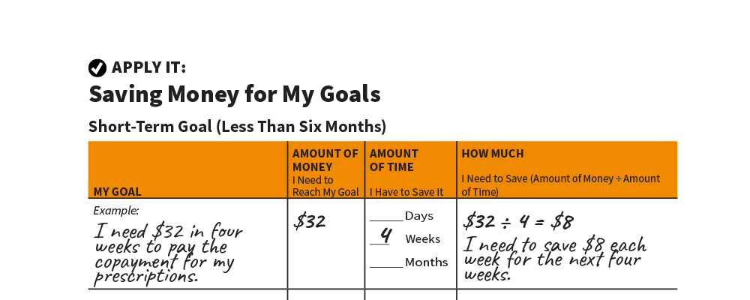
Saving Money for My Goals
Apply It
See page 10 in your participant guide.

Slide 18
Saving and Public Benefits
PUBLIC BENEFIT | ASSET LIMIT AS OF 2021 | WHERE TO GET MORE INFORMATION
Temporary Assistance for Needy Families (TANF) | $1,000 to $3,000 in most states | Visit usa.gov and search for “TANF program” and the name of your state
Supplemental Nutrition Assistance Program (SNAP, sometimes referred to as “food stamps”) | Varies by state | Visit usda.gov and search for “SNAP” and the name of your state
Medicaid | $2,000 if single; $3,000 if married (for some disability- linked Medicaid benefits) Otherwise, generally no asset limit, although there are income limits | Visit medicaid.gov and search for “eligibility”
Supplemental Security Income (SSI) | $2,000 if single; $3,000 if married | Visit ssa.gov and search for “understanding SSI”
Social Security Disability Insurance (SSDI) | No asset limit | Visit ssa.gov and search for “disability”
Special Supplemental Nutrition Program for Women, Infants, and Children (WIC) | No asset limit | Visit usa.gov and search for “WIC eligibility requirements”
Child Care Subsidies | Varies by state | Visit childcare.gov and select “See Your State’s Resources”

Slide 19
Remember the key takeaway
SECTION 2
Remember the key takeaway
“
“
Create a plan to save money for your goals.”

Slide 20

Section 3: Where to Save
SECTION 3 Where to Save
See page 12 in your participant guide.

Slide 21
Key Takeaway
SECTION 3
Key Takeaway
Consider the advantages and disadvantages of savings options before choosing where to save.

Slide 22

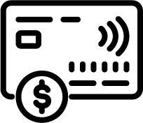


Advantages and Disadvantages of Savings Options
Home
Friend or family member
Prepaid card
Savings account

Slide 23
Home
Advantages | Disadvantages
No fees No rules No additional costs to maintain Convenient Easy to access | Can be lost or stolen Can be destroyed in fire, flood, or other disaster Easy to access, may lead to overspending

Slide 24
Friend or Family Member
Advantages | Disadvantages
No fees No additional costs to maintain May be convenient May keep you from spending the money so you can build savings | Can be lost or stolen May strain relationship if something happens to the money Does not earn interest

Slide 25
Prepaid Card
Advantages | Disadvantages
Easy to get a card Electronic or online functionality Convenient May be able to directly deposit wages and automatically move funds to savings | Fees Theft or loss—review card agreement to find out if you are protected from theft or loss Might not have federal deposit insurance Might not be possible to easily move money to savings Might have an expiration date Does not earn interest

Slide 26
Savings Account
Advantages | Disadvantages
Deposits in federally insured financial institutions are insured up to at least $250,000 by FDIC (banks) or NCUA (credit unions) May be able to directly deposit wages into the account May be able to automatically move money from checking account to savings account May earn interest Can help establish a banking relationship | Monthly or recurring fees can vary Not always best option for saving money for long-term goals because interest you earn may be lower than with other options A financial institution may not be near you, or you may not have access to online banking or want to use it May have limited number of withdrawals

Slide 27
Rotating Savings and Credit Association (ROSCA)
Advantages | Disadvantages
Group members encourage each other to save Prevents unplanned spending because members cannot access their money until it is their turn Encourages planning based on the date members will have access to funds | Risk of loss due to theft or other mismanagement of funds Depending where funds are kept, may not have federal deposit insurance Group members might not make their deposits when required Changes to the size of the group may affect the timing of access to funds

Slide 28

Deposit Insurance
Deposits in a federally insured financial institution are insured up to at least $250,000

Slide 29

Interest and Compounding
Interest and Compounding
INTEREST: money financial institutions pay you for keeping money deposited with them
Expressed as a percentage
May need to pay income tax on interest
COMPOUNDING: earning interest on the interest

Slide 30

Automating Your Savings
Automating Your Savings
Consider ways to make saving automatic:
Split your direct deposit
Set up an automatic recurring transfer
Understand what happens if you do not have enough money in your account to cover the automatic transfer

Slide 31
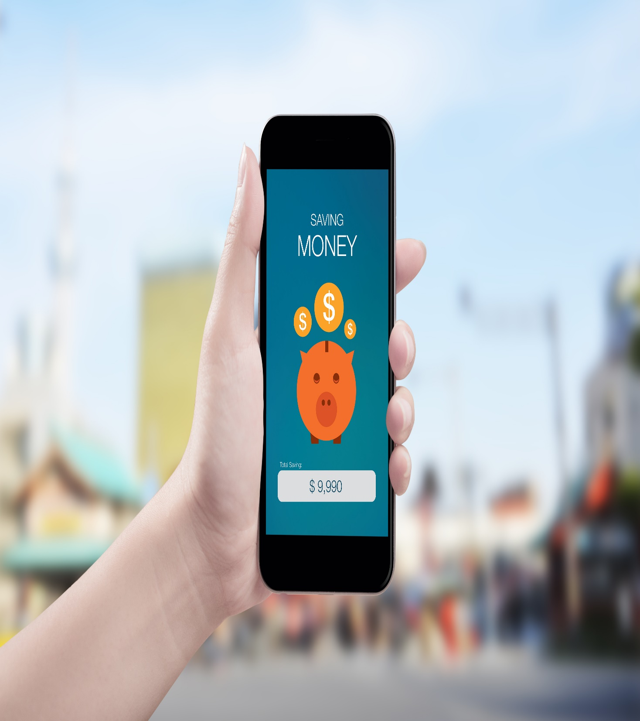
Using Savings Apps
Understand your savings goals and what you want from a savings app
There are many savings apps you may consider
They typically transfer funds from your checking account into a savings account

Slide 32
Savings App
Advantages | Disadvantages
Electronic or online functionality Convenient If savings are kept separately from checking may be less likely to touch it May be able to automatically move money from checking account to savings account May earn interest | Depending where funds are kept, may not have federal deposit insurance May have fees Risk that automatic movement of money might overdraw your account May have limited number of withdrawals Risk of identity theft if the savings app does not keep your information secure

Slide 33
Other Places for Savings
Money market deposit accounts (MMDAs)
Certificates of deposit (CDs)
U.S. savings bonds
Retirement accounts:
From your employer
Individual retirement accounts (IRAs)
Investments such as stocks, corporate bonds, and mutual funds

Slide 34
Remember the key takeaway
SECTION 3
Remember the key takeaway
“
“
Consider the advantages and disadvantages of savings options before choosing where to save.”

Slide 35

Section 4: Saving Smart
SECTION 4 Saving Smart
See page 17 in your participant guide.

Slide 36
Key Takeaway
SECTION 4
Key Takeaway
Look out for possible fraud or scams. Protect what you save.

Slide 37
Warning Signs of Fraud and Scams
SOMEONE…
Calling or emailing you, claiming to be from the government and asking you to pay money
Asking you to pay money or taxes upfront to receive a prize or a gift
Asking you to wire them money, send money by courier, or put money on a prepaid card or gift card and send it to them
Asking for access to your money
Pressuring you to “act now” or else the deal will go away

Slide 38

Phishing
Scammer impersonates a business or a person to get passwords, credit card numbers, or account information
Scammer uses fraudulent emails, texts, or websites

Slide 39
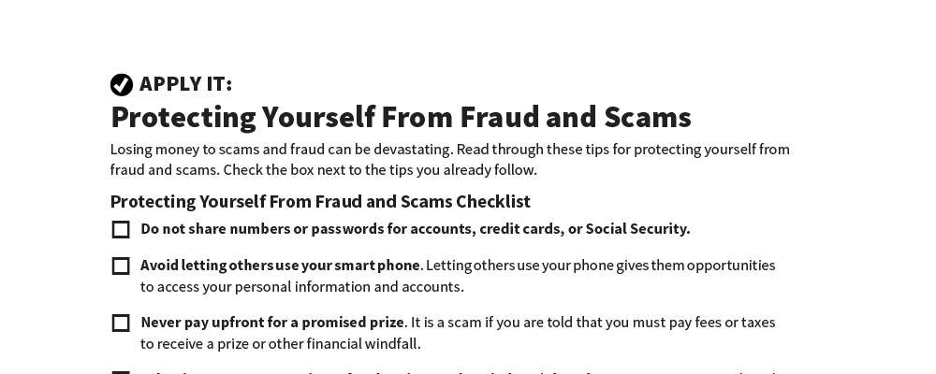
Protecting Yourself From Fraud and Scams
Apply It
See page 18 in your participant guide.

Slide 40
Remember the key takeaway
SECTION 4
Remember the key takeaway
“
“
Look out for possible fraud or scams. Take steps to protect what you save.”

Slide 41


Take Action
See page 19 in your participant guide.
After this training, what is one thing you will do?
Who will you tell about your planned action?
What additional information do you need?
i

Slide 42

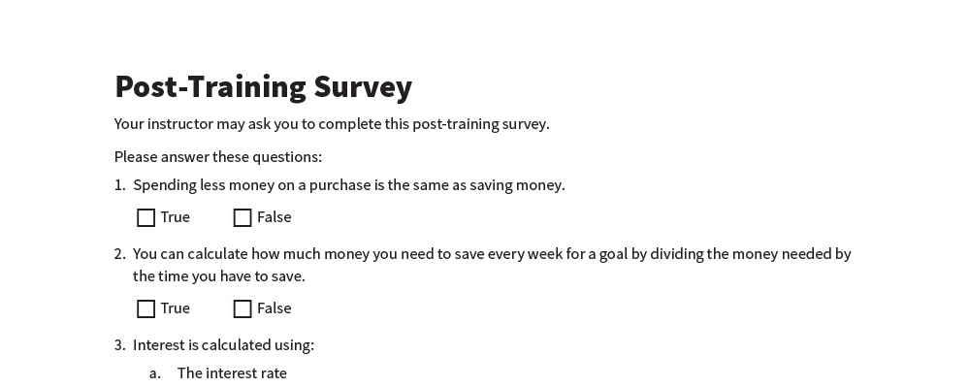
Post-Training Survey
See page 22 in your participant guide.

