Slide 1



Module 3
MODULE 3 Making the Most of Your Income
MONEY SMART FOR YOUNG ADULTS

Slide 2
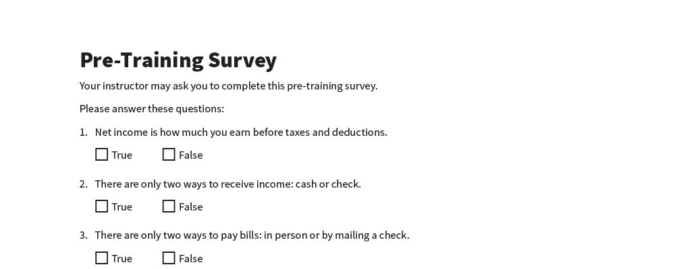
Pre-Training Survey
See page 23 in your participant guide.

Slide 3



Section 1 Income
SECTION 1 Income
See page 2 in your participant guide.

Slide 4

Key Takeaway
SECTION 1
Key Takeaway
Understand your income. That is the first step to using it to meet your needs.

Slide 5
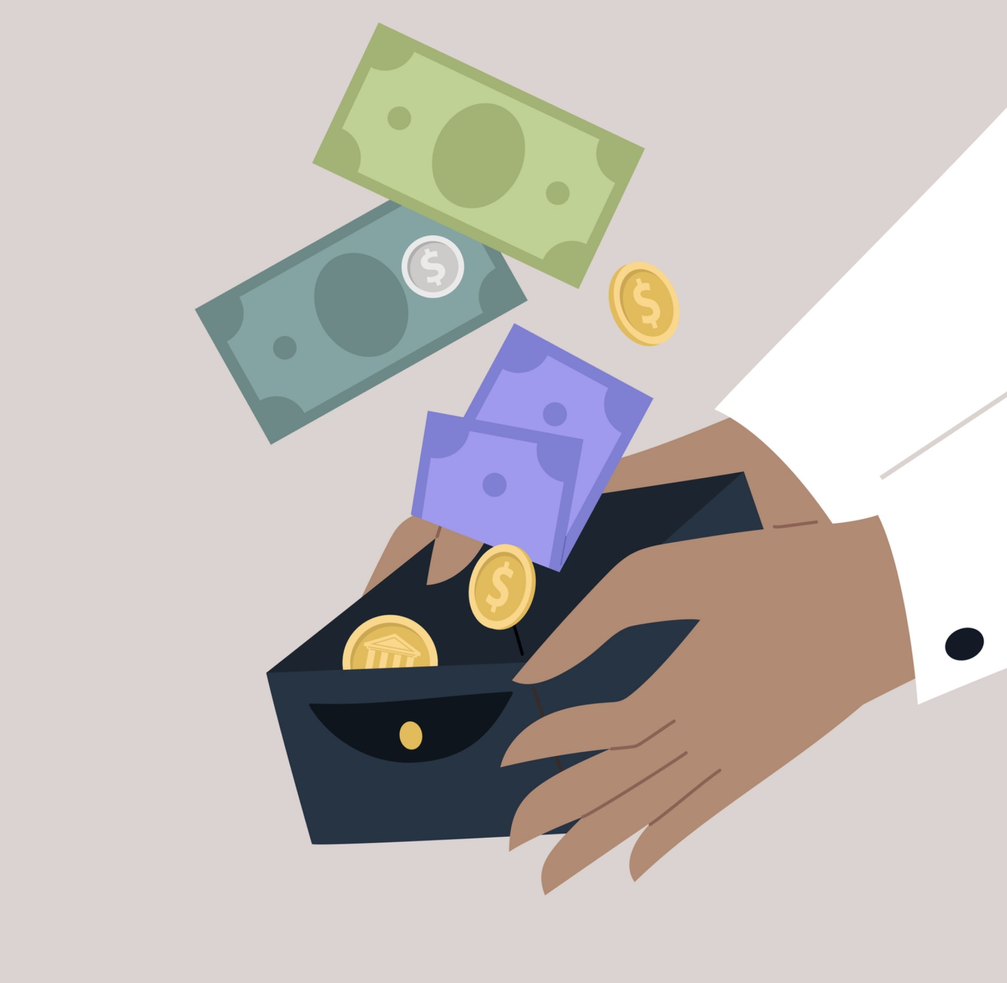
What is Income?
Income is money you receive.
What are the types of income?

Slide 6






Types of Income
Earned income
Income from assets or investments
Public benefits or entitlements that pay money
Other benefits or entitlements
Other income

Slide 7

Gross and Net Income
GROSS INCOME
Total income without deductions
NET INCOME
Gross income minus deductions
What you have to save, share, and spend
Your take-home pay
Gross Income – Deductions = Net Income

Slide 8
Understand How You Are Paid
Understand How You Are Paid
If You Receive… | Employer Considers You… | Taxes Are Generally…
IRS Form W-2 | An employee | Withheld from your pay
IRS Form 1099-MISC | Self-employed | Not withheld from your pay

Slide 9

What Are Ways You Can Be Paid
What Are Ways You Can Be Paid?

Slide 10
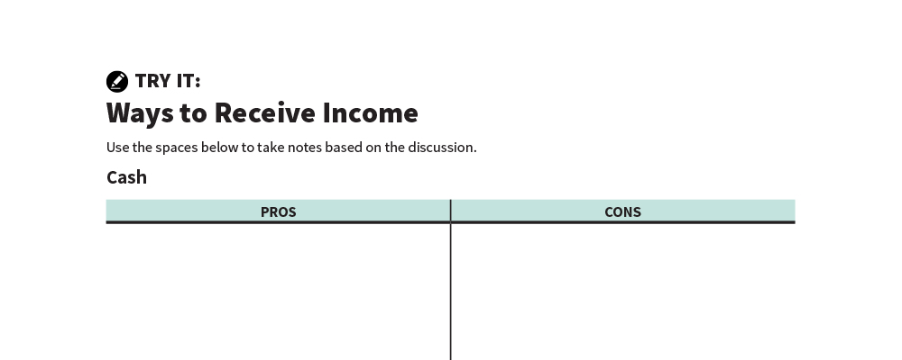
Ways to Receive Income
Try It
See page 3 in your participant guide.

Slide 11

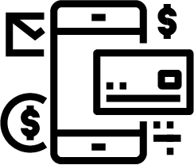


Ways to Receive Income
Ways to Receive Income – Small Groups
Cash
Direct Deposit
Paper Check
Payroll Card

Slide 12

Understanding Pay Statements
Typical pay statement information:
Personal information
Pay period
Pay date
Gross pay
Deductions
Net pay
Employer contributions
Balances for personal time off, vacation, and sick leave
Gross income minus deductions
What you have to save, share, and spend
Your take-home pay

Slide 13
Deductions
Deductions
Required deductions
FICA: Social Security and Medicare Income tax: federal, state, local
Elective (voluntary) deductions
Such as insurance premiums, union dues, charitable contributions, direct deposits, retirement account contributions

Slide 14
Income Tax Withholding
Income Tax Withholding
Internal Revenue Service Form W-4
Possibly state and local income tax forms too
Additional
Withholding
Lower Take-Home Pay
Reduced
Withholding
Higher Take-Home Pay
Be careful not to have too little withheld!

Slide 15
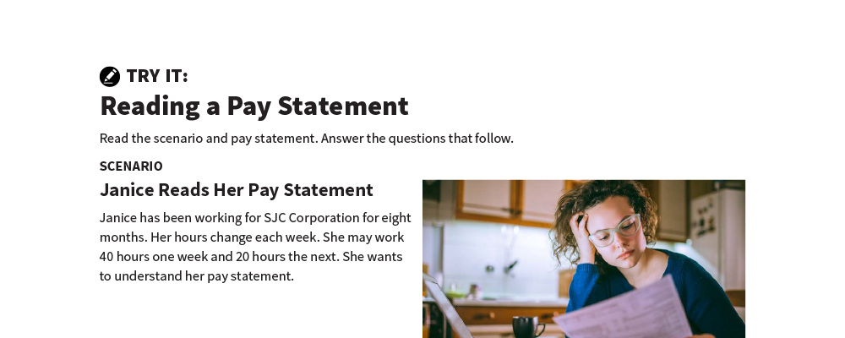
Reading a Pay Statement
Try It
See page 6 in your participant guide.

Slide 16
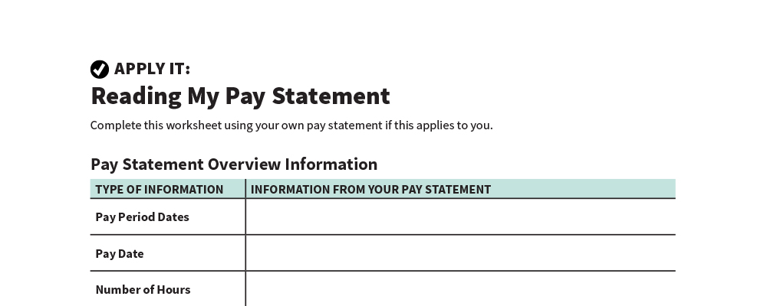
Reading My Pay Statement
Apply It
See page 8 in your participant guide.

Slide 17

Tracking Your Income
Regular income
Unpredictable income
Seasonal income
One-time income

Slide 18
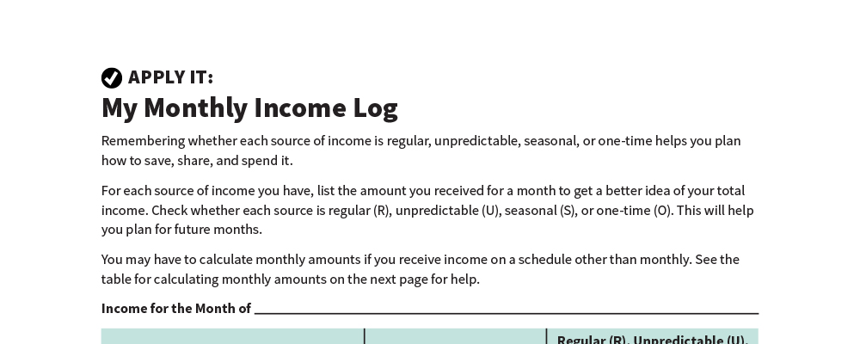
My Monthly Income Log
Apply It
See page 10 in your participant guide.

Slide 19

Remember the key takeaway
SECTION 1
Remember the key takeaway
“
Understand your income. That is the first step to using it to meet your needs.”

Slide 20
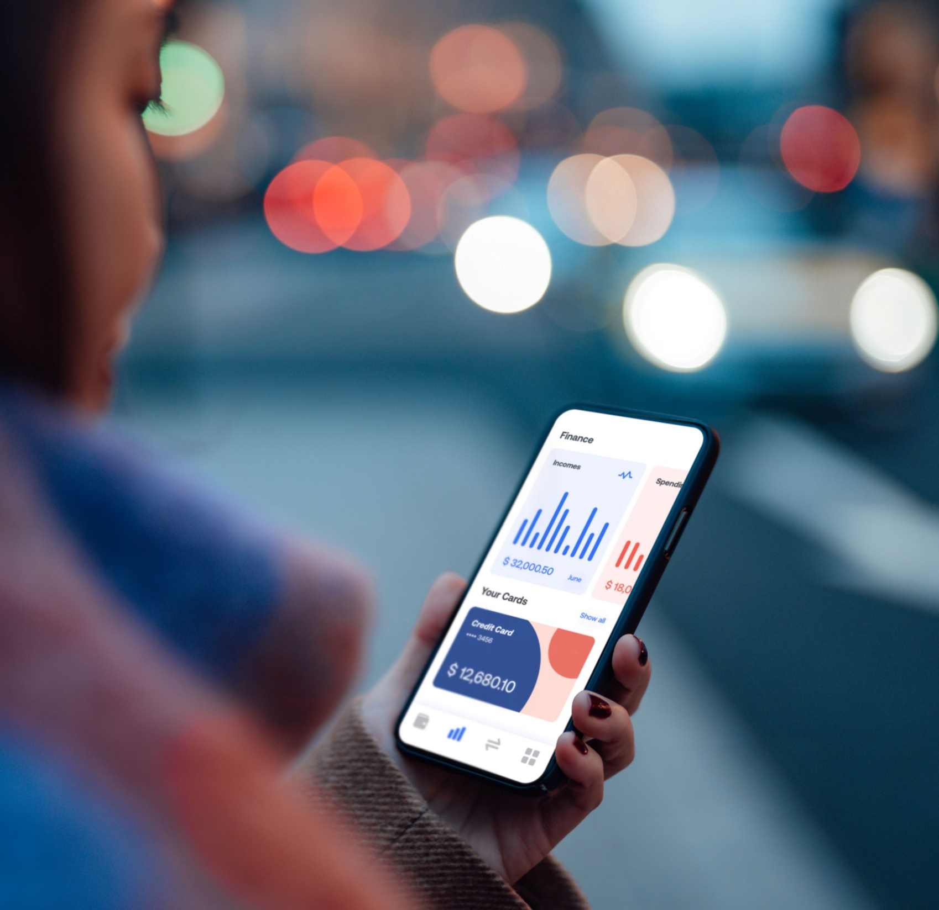
Section 2
SECTION 2 Expenses
See page 12 in your participant guide.

Slide 21
Key Takeaway
SECTION 2
Key Takeaway
Understand your expenses. That will help you decide how to save, share, and spend your income.

Slide 22

Ways to Use Your Money
What do people do with their money?

Slide 23



Think About How You Use Your Money
Saving it
Sharing it
Spending it
Think About How You Use Your Money

Slide 24
Ways to Think About Expenses
Ways to Think About Expenses
$
NEEDS: Things you must have to live
WANTS: Things you desire and can live without
OBLIGATIONS: Debts you owe
CAN YOU:
Find less expensive ways to meet needs?
Use less money for wants?
Negotiate lower payments for obligations?

Slide 25

If You Receive Public Benefits
Learn about resource and asset limits
Monitor how your spending and saving affect countable assets
Use income in ways that avoid exceeding asset limits

Slide 26
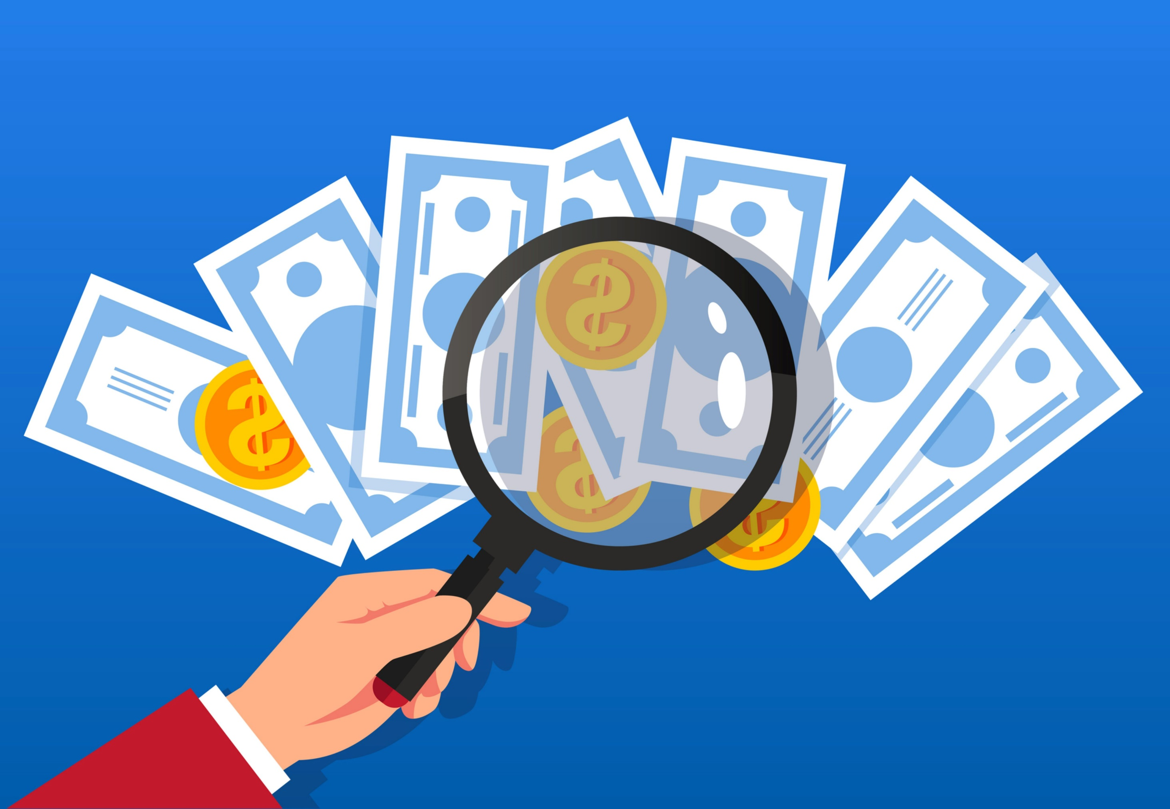
Tracking Your Expenses
Helps you understand if you are using money in line with your values and goals
Uncovers where you can make changes

Slide 27
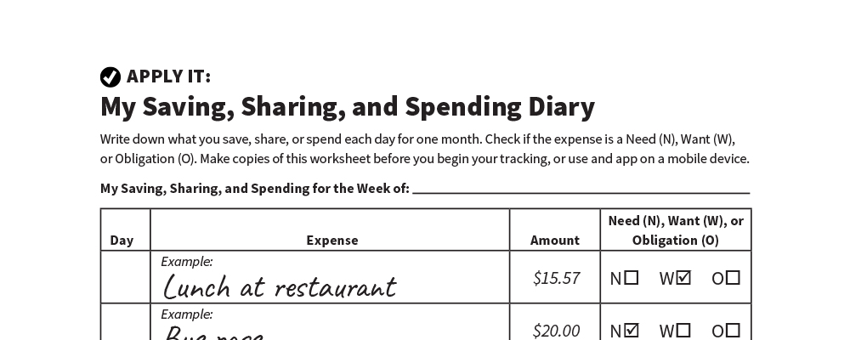
My Saving, Sharing, and Spending Diary
Apply It
See page 13 in your participant guide.

Slide 28
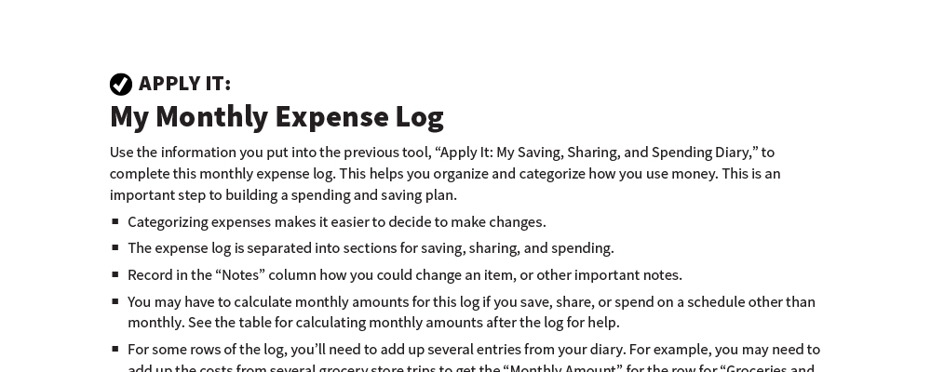
My Monthly Expense Log
Apply It
See page 16 in your participant guide.

Slide 29

Managing Your Expenses
HELPS YOU AVOID:
Late fees
Interest on unpaid balances
Negative credit report entries
Loss of services
Additional charges associated with loss of services

Slide 30



Ways to Pay Bills
In person
Ways to Pay Bills
By mail
Electronically
Through financial institution
Through credit card website
Through bill paying service
Through company you owe

Slide 31
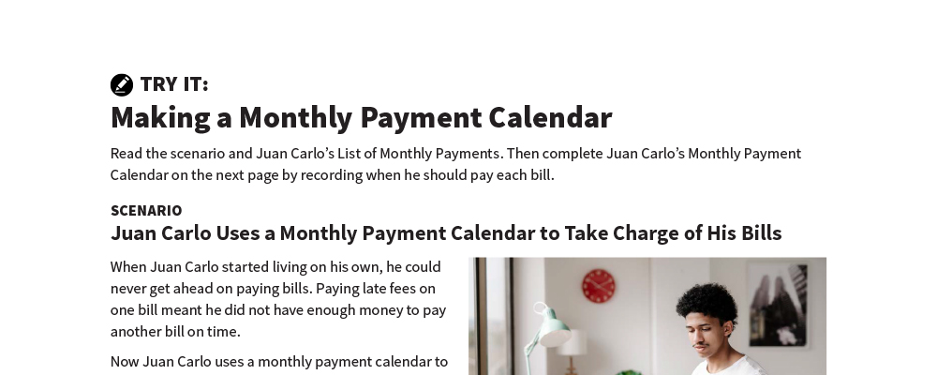
Making a Monthly Payment Calendar
Try It
See page 19 in your participant guide.

Slide 32
Remember the key takeaway
SECTION 2
Remember the key takeaway
“
Understand your expenses. That will help you decide how to save, share, and spend your income.”

Slide 33


Take Action
See page 21 in your participant guide.
After this training, what is one thing you will do?
Who will you tell about your planned action?
What additional information do you need?
i

Slide 34

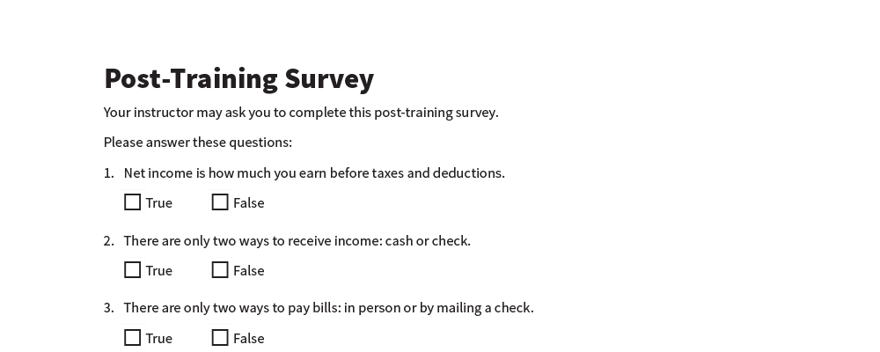
Post-Training Survey
See page 24 in your participant guide.

