Slide 1
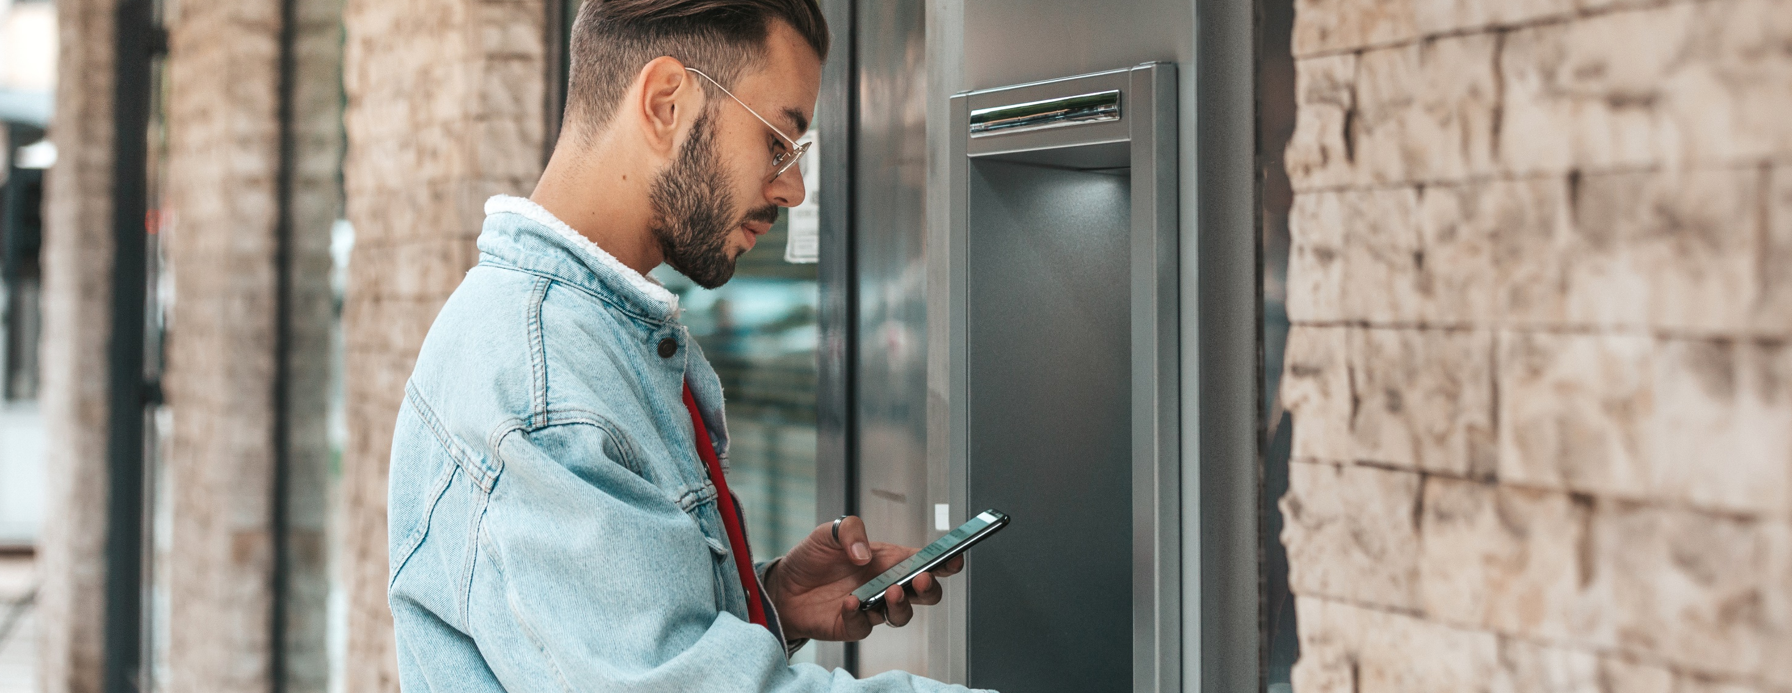


Bank On It
MODULE 1
Bank On It
MONEY SMART
FOR YOUNG ADULTS

Slide 2
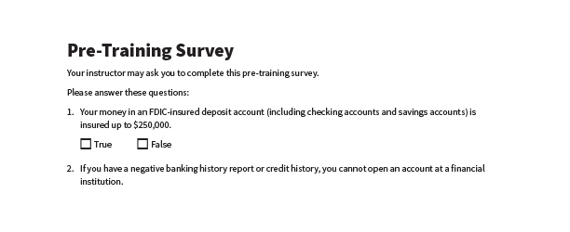
Pre-Training Survey
See page 33 in your participant guide.

Slide 3
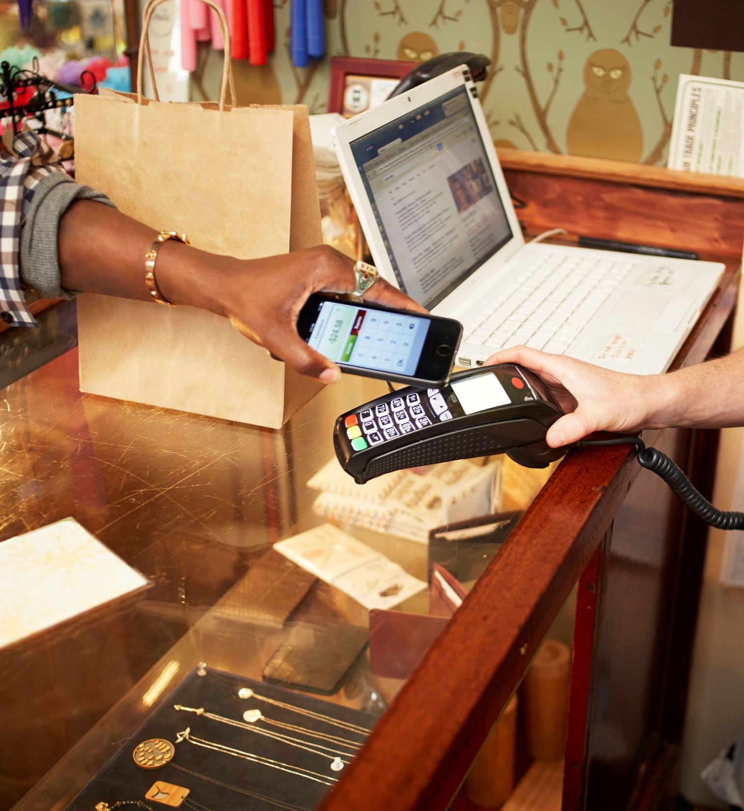
SECTION 1
Financial Products, Services, and Providers
SECTION 1
Financial Products, Services, and Providers
See page 2 in your participant guide.

Slide 4

Consider your needs before you select financial products and services.
SECTION 1
Key Takeaway
Consider your needs before you select financial products and services.

Slide 5
Financial Institutions:
Banks and Credit Unions
Banks (including savings associations)
Credit unions
Accept deposits of money
Lend money
May offer other products and services, such as credit cards, auto loans, student loans, mortgages, among others

Slide 6
Differences Between Banks and
Credit Unions
Banks | Credit Unions
Customers | Members
Generally, no limitations on who can open accounts | Membership criteria
Most are for-profit businesses owned by shareholders | Not-for-profit organizations owned by members

Slide 7
Deposit Insurance—for Banks
Federal Deposit Insurance Corporation
Protects funds depositors place in federally insured banks in case of bank failure
Insurance up to at least $250,000 per depositor, per FDIC-insured bank, per ownership category

Slide 8
Share Insurance—for Credit Unions
National Credit Union Administration
Protects funds depositors place in federally insured credit unions
Insurance rules are the same as those of the FDIC

Slide 9




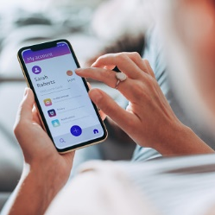
Accessing Services
Access services through:
Retail locations
Automated teller machines (ATMs)
Customer service phone numbers and email
Websites
Mobile banking and smart phone apps
Request reasonable accommodations if needed

Slide 10



Products and Services Available at Financial Institutions
Deposit products
Credit products
Other products and services

Slide 11
Deposit Products Include…
Savings accounts
Checking accounts
Certificates of deposit
Money market accounts

Slide 12
Credit Products Include…
Credit cards
Lines of credit
Installment loans
Mortgages

Slide 13
Other Products and Services Include…
^{Check cashing}
^{Money orders}
^{Prepaid cards}
^{Debit cards}
^{Cashier’s checks}
Automated teller machines (ATMs)
^{ATM cards}
Online or mobile banking, including bill-paying service
Person-to-person (P2P) payments
^{Remittance transfers}
^{ACH payments}

Slide 14
Other Financial Service Providers
Convenience stores and
U.S. post offices
Stores that sell prepaid cards
Check-cashing stores and outlets
Payday lenders
Pawn shops
Vehicle title lenders

Slide 15
What Financial Products and Services Do You Need?
Financial products and services can help you:
Save money
Spend money
Manage money
Borrow money
Start with your needs

Slide 16
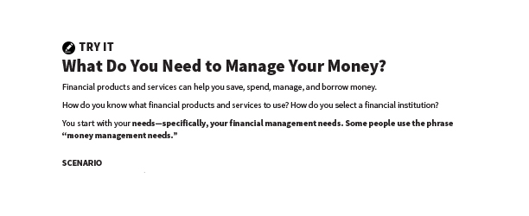
What Do You Need to Manage Your Money?
Try It
See page 5 in your participant guide.

Slide 17
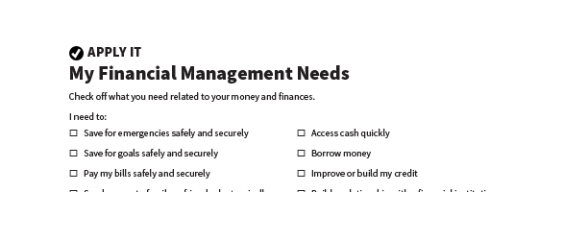
My Financial Management Needs
Apply It
See page 6 in your participant guide.

Slide 18
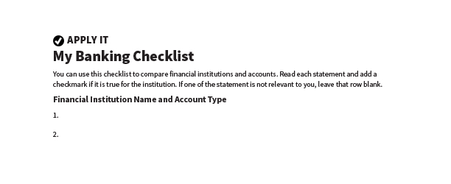
My Banking Checklist
Apply It
See page 7 in your participant guide.

Slide 19
Sections in Apply It: My Banking Checklist
My Needs and Access
Checking Accounts, Reloadable Prepaid Cards, and Other Transactional Accounts
Savings Accounts

Slide 20

Remember the key takeaway
SECTION 1
Remember the key takeaway
“
Consider your needs before you select financial products and services.

Slide 21
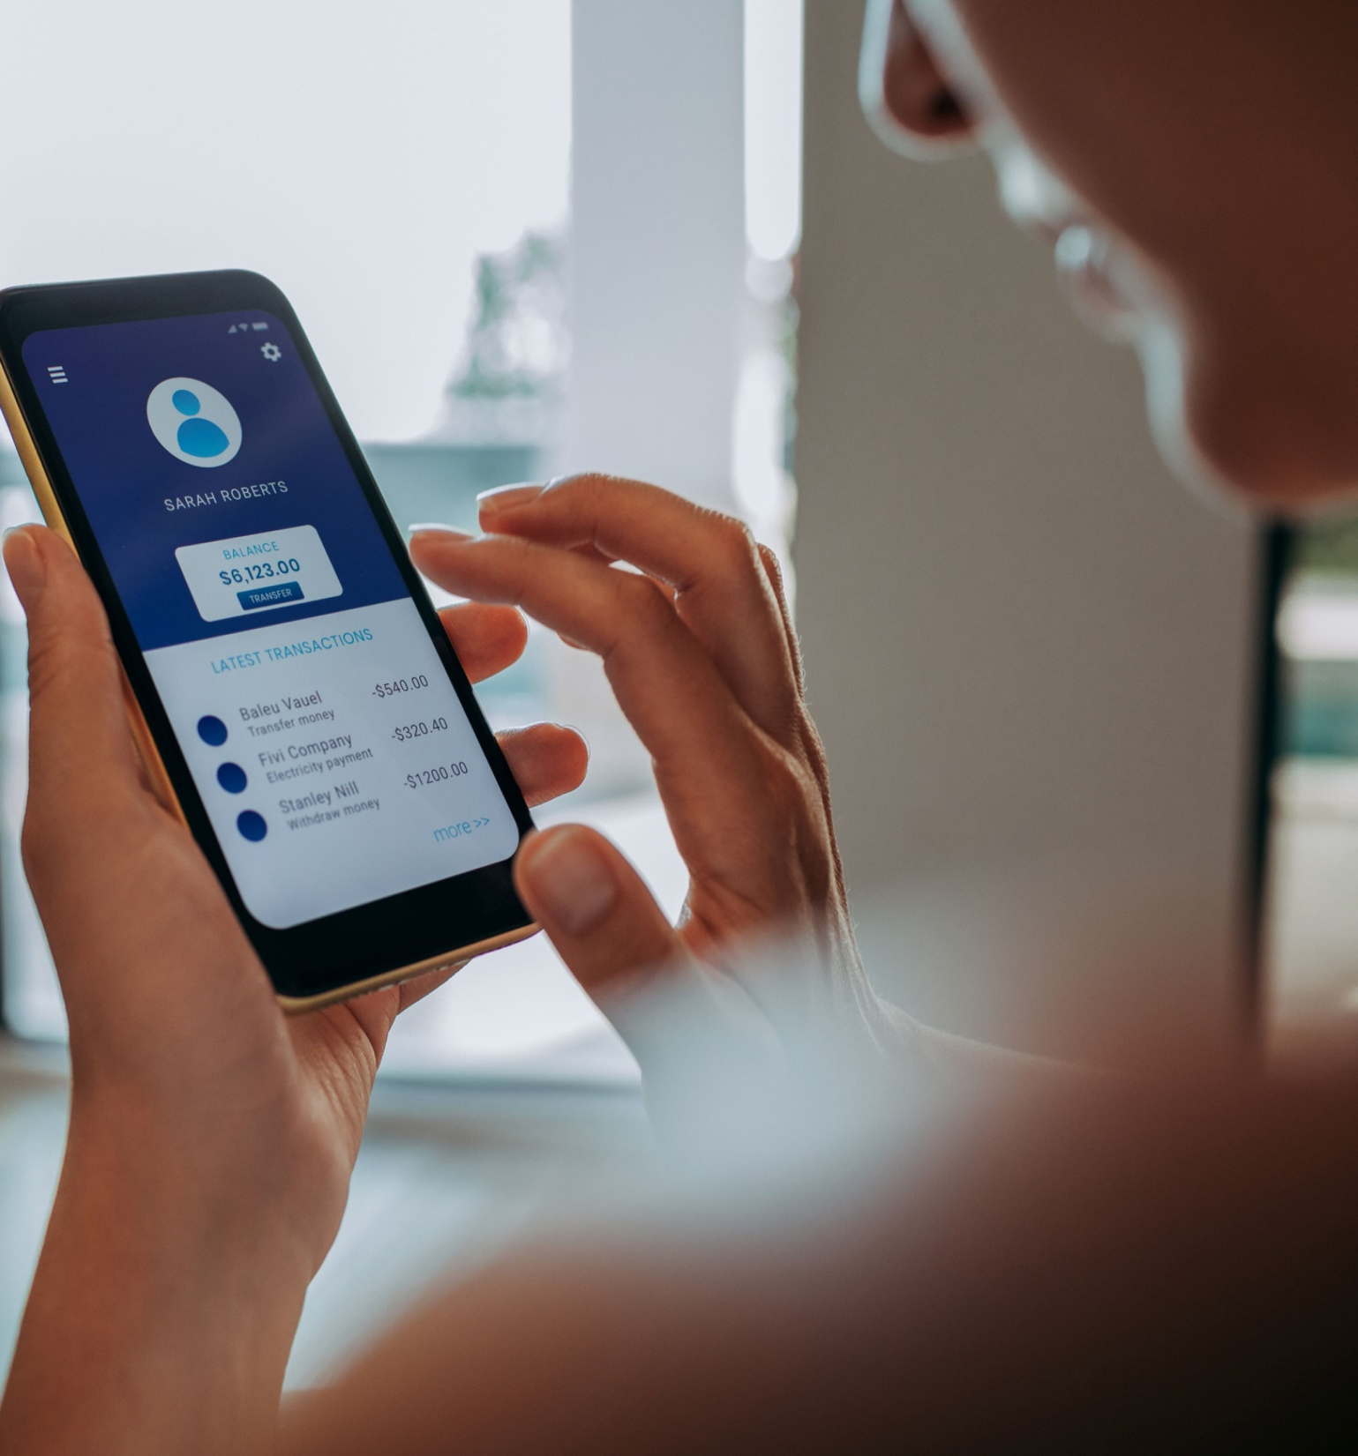
SECTION 2
Opening an Account
See page 9 in your participant guide.

Slide 22
Know the general process for opening a savings or checking account. You have options if you cannot open an account.
SECTION 2
Key Takeaway
Know the general process for opening a savings or checking account. You have options if you cannot open an account.

Slide 23
Savings and Checking Accounts
Safety and security through federal deposit insurance
Ability to earn interest, depending on the account
Convenience
Ability to build a relationship with a financial institution
Important consumer protections

Slide 24
Types of Accounts
Custodial accounts
Owned by a minor, but managed by an adult
Only open a custodial account with a trusted adult
Noncustodial accounts
Allowed in some states
Financial institutions choose whether to offer
Joint accounts
Jointly owned by a minor and an adult or by two adults
Financial institutions may limit options

Slide 25
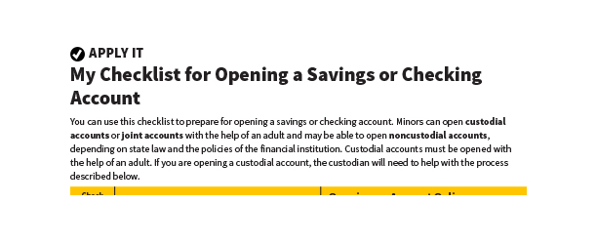
My Checklist for Opening a Savings or Checking Account
Apply It
See page 10 in your participant guide.

Slide 26
Apply In Person or Online
Complete an application
Verify your identity
Make first deposit
Activate account tools
Decide whether to opt in to overdraft program
Sign disclosure documents
Ask questions

Slide 27
Banking History Reports
Everyone is not approved for an account
Banking history reports include information on:
  Unpaid balances on accounts
  Suspected fraud related to accounts
  Certain accounts closed by financial institution
Right to one free banking history report from each nationwide consumer reporting company every 12 months
  May file a dispute to correct errors

Slide 28
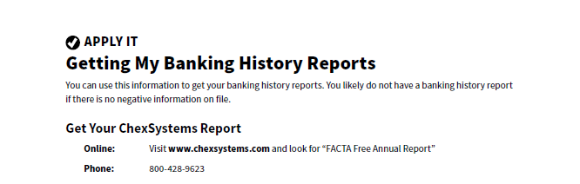
Getting My Banking History Reports
Apply It
See page 12 in your participant guide.

Slide 29
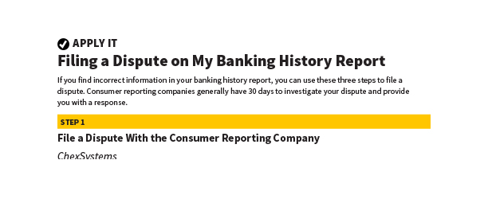
Filing a Dispute on My Banking History Report
Apply It
See page 13 in your participant guide.

Slide 30
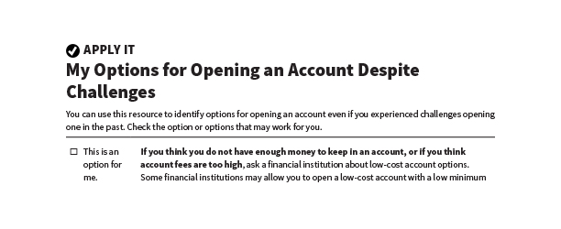
My Options for Opening an Account Despite Challenges
Apply It
See page 14 in your participant guide.

Slide 31
Possible Options
For This Challenge | Consider…
Not enough money or account fees too high | Low-cost account options
Negative information in banking history report | “Second chance” checking account
Negative information on credit reports and low credit scores | Credit-building loan, secured credit card, credit counseling
No Social Security number | Other identification documents
Cannot open a particular account | Another type of account; Perhaps a prepaid card

Slide 32
Remember the key takeaway
SECTION 2
Remember the key takeaway
“
Know the general process for opening a savings or checking account. You have options if you cannot open an account.

Slide 33

Section 3
Managing an Account
SECTION 3
Managing an Account
See page 16 in your participant guide.

Slide 34
Learn the terms of your account and keep track of how you use it.
SECTION 3
Key Takeaway
Learn the terms of your account and keep track of how you use it. This can help you develop a positive banking relationship.

Slide 35
Using a Savings Account
Build savings by depositing money and keeping it there to earn interest
Designed to save money for the future
Often offer higher interest rates than checking accounts that earn interest
Not designed for frequent transactions

Slide 36
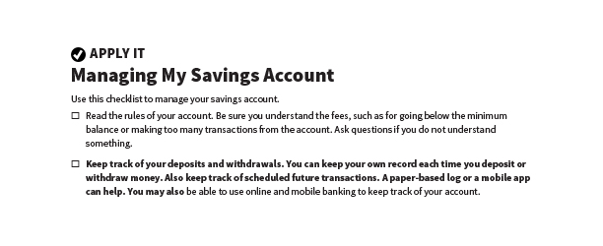
Managing My Savings Account
Apply It
See page 17 in your participant guide.

Slide 37




Managing My Savings Account
Read the rules of your account
Keep track of your deposits and withdrawals
Review your account statements
Set up email or text alerts, if possible
Stay safe online

Slide 38
Using a Checking Account
For frequent use and multiple transactions—deposit money, pay bills, make purchases, access cash
ATM cards and debit cards
  Not the same thing
  Money is taken out of your account
Checks
  Tell your financial institution to pay money to someone else, the payee
  Some checking accounts don’t use checks

Slide 39
Overdrafts
Transaction goes through but there’s not enough money in the account to cover it
Programs to cover overdrafts for ATM card and debit card transactions
  Opt in: Certain transactions processed for a fee
  Do not opt in: Certain transactions declined
Financial institutions decide if they will process checks and other payments that would cause an overdraft
  Processed: Expect to be charged an overdraft fee
  Not processed: Expect to be charged a non-sufficient funds fee and possibly a returned check fee

Slide 40
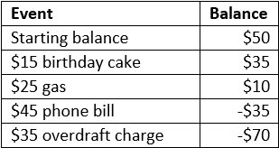
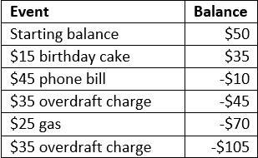
Rodney: Overdraft Example
Transaction Order Resulting in One Overdraft Charge
Transaction Order Resulting in Two Overdraft Charges

Slide 41
Rodney: Overdraft Example
$50 in checking account with “opt in”
March 1 transactions:
  $15 birthday cake
  $25 gas
  $45 phone bill on auto-pay
Result: One or two overdraft charges of $35
  Depends on order transactions are processed

Slide 42
Direct Deposit
Deposit money safely and securely into your account electronically
No need to make deposits in person
Many employers offer direct deposit for paychecks
  Might be able to have part of your paycheck directly deposited into your savings account

Slide 43
Automatic Bill Payment/Automatic Debit
Automatic Bill Payment
  Schedule and send payments through your financial institution
  One-time or recurring payments
Automatic Debit
  Give permission to merchant or lender to take payments from your account
Make sure you have enough money in your account to cover these payments

Slide 44
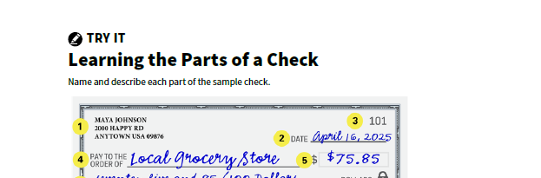
Learning the Parts of a Check
Try It
See page 19 in your participant guide.

Slide 45
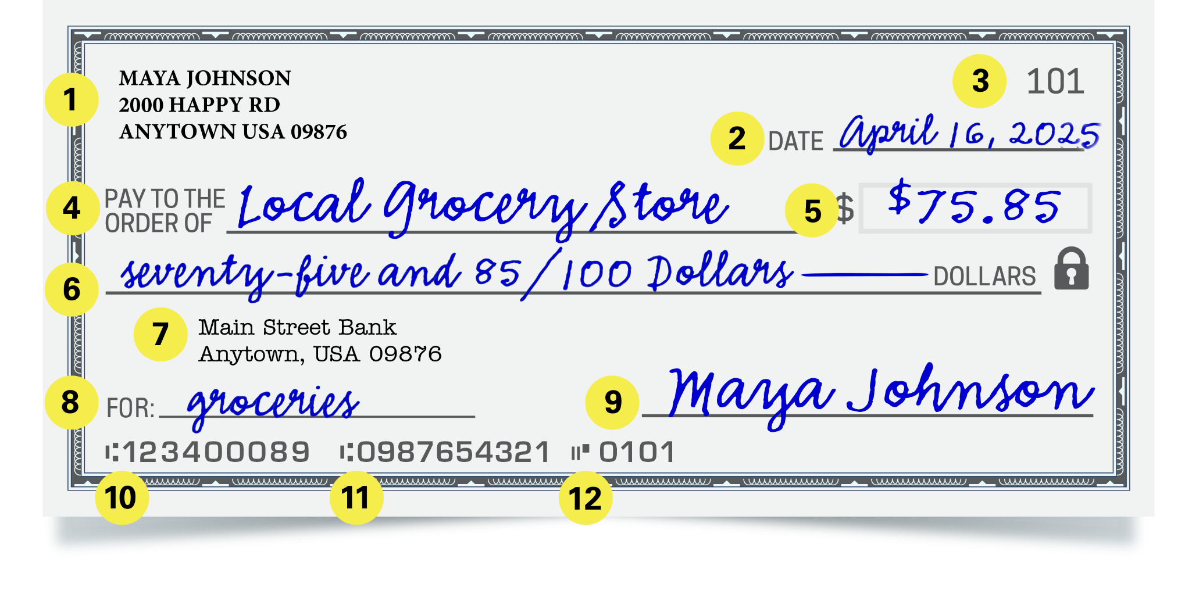
Example Check

Slide 46
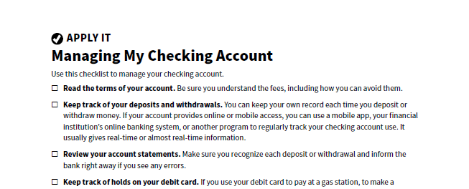
Managing My Checking Account
Apply It
See page 20 in your participant guide.

Slide 47
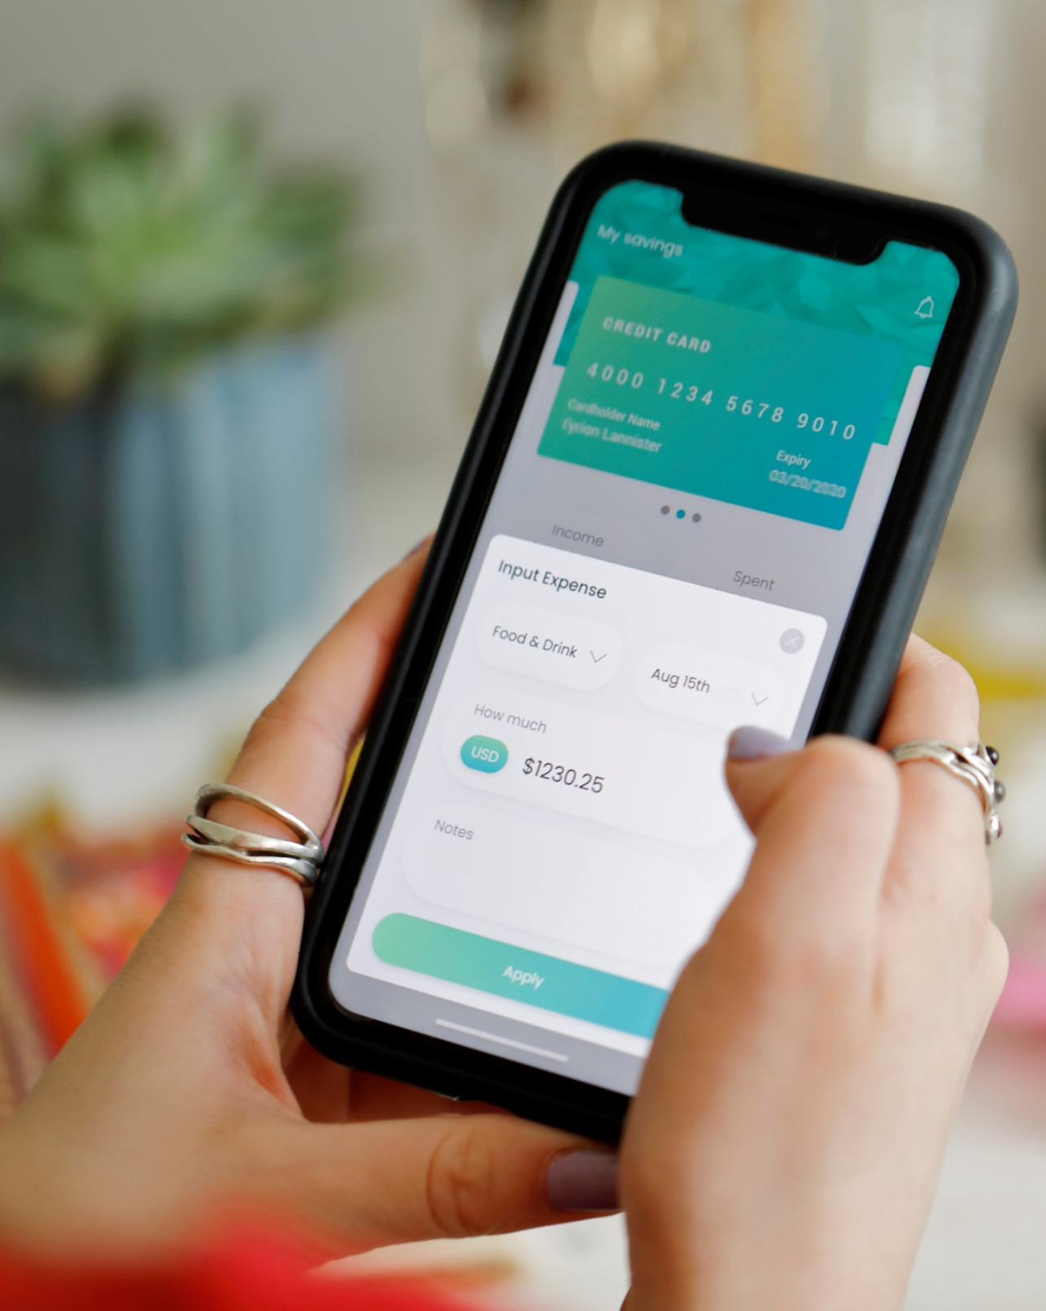
Managing a Checking Account
Read the terms of your account
Keep track of your deposits and withdrawals
You can use:
  A mobile app
  Your financial institution’s online banking system
  Another program
  A transaction register

Slide 48

More Ways to Manage a Checking Account
Review your account statements
Keep track of holds on your debit card
Set up email or text alerts
Consider linking your checking account to your savings account or line of credit
Protect your debit card or ATM card
Stay safe online

Slide 49
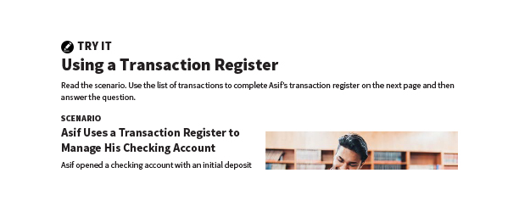
Using a Transaction Register
Try It
See page 21 in your participant guide.

Slide 50
Try It: Using a Transaction Register ‒ Answer Key
Check Number | Date | Transaction | Withdrawal |  | ✓ | Deposit |  | Balance
 |  | Opening Deposit |  |  |  | $300 | 00 | $300 | 00
 | 4/3/25 | Local Market | 50 | 00 |  |  |  | 250 | 00
 | 4/3/25 | USA Gas | 30 | 00 |  |  |  | 220 | 00
 | 4/10/25 | Deposit |  |  |  | 280 | 00 | 500 | 00
 | 4/13/25 | Auto Lender USA | 150 | 00 |  |  |  | 350 | 00
 | 4/25/25 | Deposit |  |  |  | 300 | 00 | 650 | 00
 | 4/28/25 | ATM | 50 | 00 |  |  |  | 600 | 00
 | 4/28/25 | ATM Fee | 4 | 00 |  |  |  | 596 | 00
715 | 5/1/25 | Happy Properties | 500 | 00 |  |  |  | 96 | 00

Slide 51
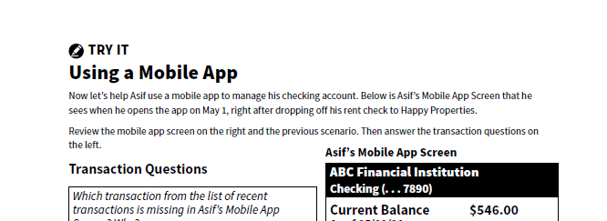
Using a Mobile App
Try It
See page 23 in your participant guide.

Slide 52
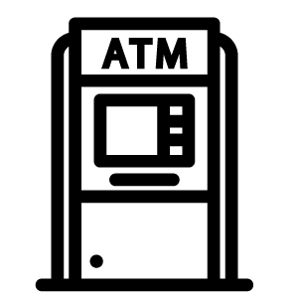
Automated Teller Machine (ATM) Cards
Use an ATM for a variety of account transactions
Ask your financial institution about purchases with an ATM card
Money comes out of your financial institution account
There are various accessibility features
Keep safety in mind

Slide 53
Debit Cards
Do what ATM cards do, plus more
Look like credit cards because they have a card network logo on them
  But they are not credit cards
  Can be processed on credit network, but still not using credit
Money is taken out of your checking account

Slide 54
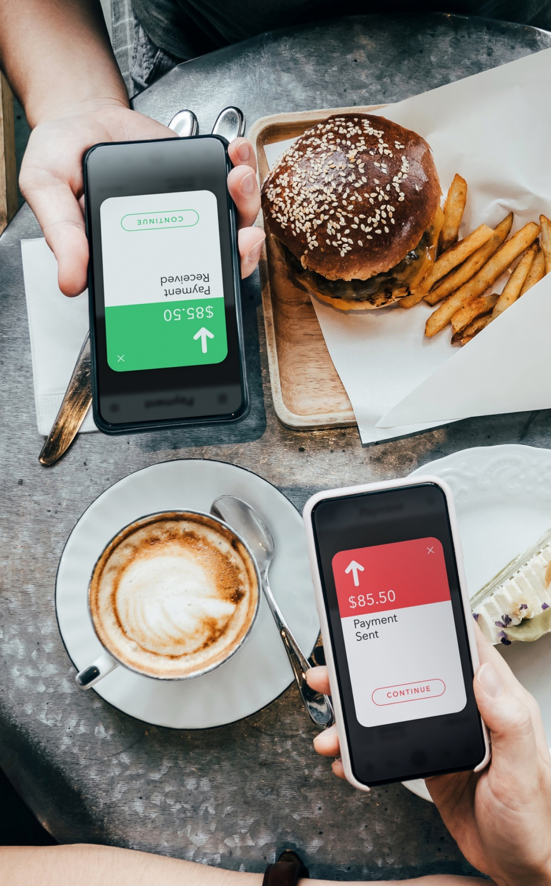
Person to Person (P2P) Payments
Money transfers to another person
Help with everyday money transactions, such as paying babysitter or reimbursing lunch
Different P2P systems—each works differently
Rapidly changing area
Keep in mind deposit insurance, fees, privacy, funds availability, and more

Slide 55
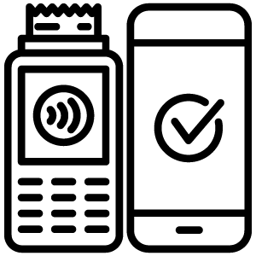

Mobile Wallet Apps
Make point-of-sale purchases with your mobile device instead of a debit, credit, or prepaid card
Keep your device and information secure
Visit https://OnGuardOnline.gov

Slide 56
Remember the key takeaway
SECTION 3
Remember the key takeaway
“
Learn the terms of your account and keep track of how you use it. This can help you develop a positive banking relationship.

Slide 57

Section 4
Prepaid Cards
SECTION 4
Prepaid Cards
See page 26 in your participant guide.

Slide 58
Before you use a prepaid card, know its features and fees.
SECTION 4
Key Takeaway
Before you use a prepaid card, know its features and fees.

Slide 59
How Prepaid Cards Work
Not linked to a checking or savings account
Access money loaded onto the card
  Load money in person, by phone, online, or through a mobile app
  Use direct deposit (some cards)
Register card to use all its features
  Not the same as activating the card
May allow minors to be authorized users

Slide 60
Kinds of Prepaid Cards
Reloadable prepaid cards
Payroll cards
Electronic benefit transfer (EBT) cards
College or university identification cards
Prepaid cards for specific stores or public transportation systems

Slide 61
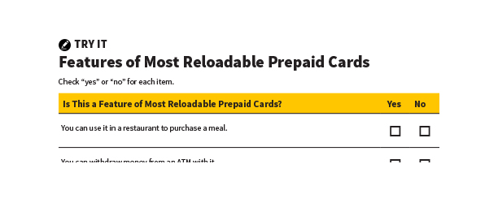
Features of Most Reloadable Prepaid Cards
Try It
See page 27 in your participant guide.

Slide 62
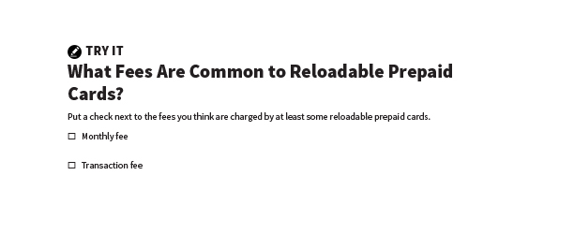
What Fees Are Common to Reloadable Prepaid Cards?
Try It
See page 28 in your participant guide.

Slide 63
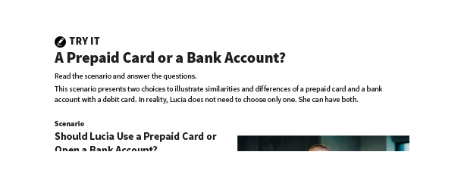
A Prepaid Card or a Bank Account?
Try It
See page 29 in your participant guide.

Slide 64
Lost or Stolen Prepaid Cards
Report loss, theft, or charge you did not make right away to the card issuer
Protections depend on type of card
Generally, must register card to get protections offered by the issuer

Slide 65





Tips for Using Prepaid Cards
Review your account and dispute charges you did not authorize
Understand your card’s limits
Know the fees and how you may avoid them
Report loss or theft immediately
Stay safe online

Slide 66
Remember the key takeaway
SECTION 4
Remember the key takeaway
“
Before you use a prepaid card, know its features and fees.

Slide 67


Take Action
See page 31 in your participant guide.
After this training, what is one thing you will do?
Who will you tell about your planned action?
What additional information do you need?
i

Slide 68

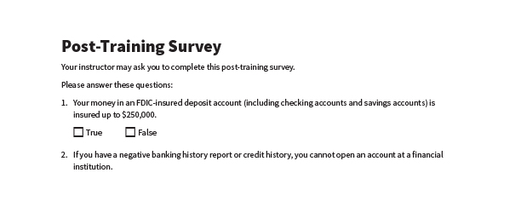
Post-Training Survey
See page 34 in your participant guide.

