Slide 1



Module 7
MODULE 7 Borrowing Basics
MONEY SMART FOR YOUNG ADULTS

Slide 2
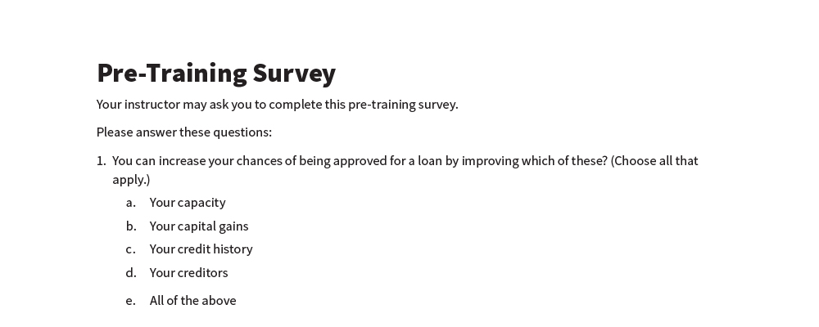
Pre-Training Survey
See page 19 in your participant guide.

Slide 3


Section 1 Ways to Borrow Money and What It Costs
[Picture]
SECTION 1 Ways to Borrow Money and What It Costs
See page 2 in your participant guide.

Slide 4

Key Takeaway
SECTION 1
Key Takeaway
Be sure you can afford the payments before getting a loan. Also, know how much it costs and what happens if you can’t pay it back.

Slide 5


What Borrowing Means
What Borrowing Means
CREDIT = The Ability to Borrow Money
DEBIT = Money You Owe a Person or Business
Lender provides you money and you have to pay it back, usually with interest

Slide 6
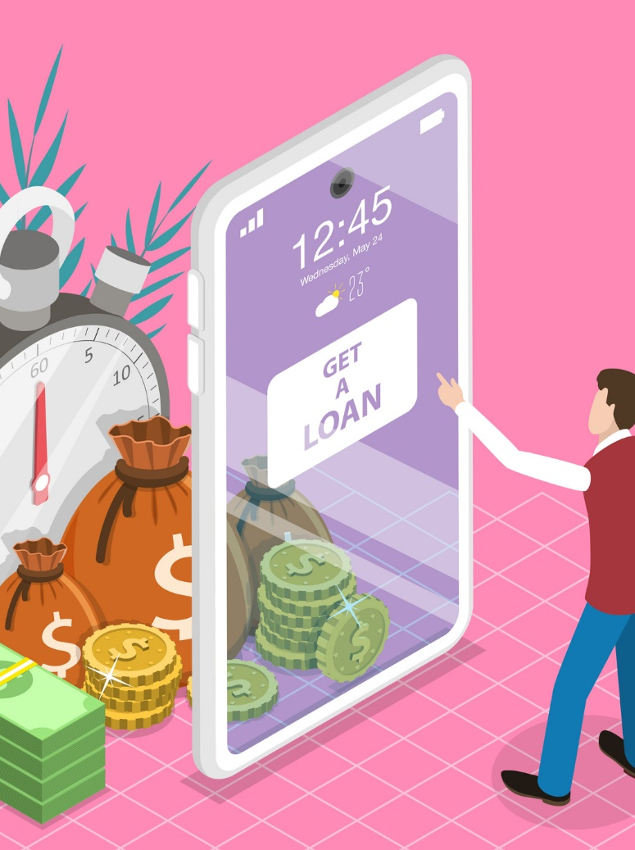

Type of Loans
Installment Loans
Typically repaid in equal payments over set period
Examples include most fixed rate mortgages, auto loans, and student loans
Revolving Loans
Repaid based on how much you borrowed
Examples include most credit cards and home equity lines of credit

Slide 7


Rent-to-Own Services
Not a loan
Use an item for a period of time and make monthly or weekly rental payments
Rental payments partly credited toward purchase price
Store can take back the item if you miss a payment
Longer Time Making Payments = More You Pay

Slide 8
Buying on Layaway
Not a loan
Initial deposit, then payments over time
Store holds merchandise until you pay in full
Understand the layaway plan
Fees
Consequences of late or missed payments
Refund policy

Slide 9

Buy Now, Pay Later
A loan that is taken out at time of purchase repaid in installments
May charge interest
Often include fees for late or missed payments
Late or missed payments can affect your credit
Understand the terms

Slide 10

Secured and Unsecured Loans
Secured and Unsecured Loans
Secured Loans
Require collateral, such as your house, vehicle, or cash
You lose the collateral if you don’t pay as agreed
Unsecured Loans
No collateral
Often higher interest rates than secured loans

Slide 11
The Cost of Borrowing
You generally repay more money than you borrowed
Amount you repay on loan > Amount you borrowed
Principal:
The money you borrowed
Interest:
Amount of money financial institution charges for allowing you to use its money
Fees:
May be charged for certain activities like reviewing loan application

Slide 12
Prepayment
Early repayment of ALL of a loan
Reduces interest costs
Pays off the loan
Or, early repayment of PART of a loan
Generally reduces interest costs
Potentially earlier payoff date
Some loans have prepayment penalties, others do not

Slide 13

Exploring Borrowing Options
Try It
See page 4 in your participant guide.

Slide 14
Truth in Lending/Comparing Offers
Truth in Lending Act (TILA) written disclosure
Shows loan terms in clear and uniform manner
Receive the TILA disclosure before you sign for loan
Can help you compare loan offers

Slide 15
Part of a Sample TILA Disclosure*
Annual Percentage Rate | Finance Charge | Amount Financed | Total of Payments
The cost of your credit as a yearly rate | The dollar amount the credit will cost you | The amount of credit provided to you or on your behalf | The amount you will have paid after you make all payments as scheduled
12% | $600 | $5,000 | $5,600
*Disclosures for mortgages (home loans) and some student loans will look different than this.

Slide 16
Finance Charge*
Annual Percentage Rate | Finance Charge | Amount Financed | Total of Payments
The cost of your credit as a yearly rate | The dollar amount the credit will cost you | The amount of credit provided to you or on your behalf | The amount you will have paid after you make all payments as scheduled
12% | $600 | $5,000 | $5,600
0.12 x $5,000 = $600
*Disclosures for mortgages (home loans) and some student loans will look different than this.

Slide 17
Total of Payments*
Annual Percentage Rate | Finance Charge | Amount Financed | Total of Payments
The cost of your credit as a yearly rate | The dollar amount the credit will cost you | The amount of credit provided to you or on your behalf | The amount you will have paid after you make all payments as scheduled
12% | $600 | $5,000 | $5,600
$600 + $5,000
*Disclosures for mortgages (home loans) and some student loans will look different than this.

Slide 18

Shop Around
Shop Around
Use TILA disclosures, particularly the annual percentage rates (APRs), to compare offers
Seek help if needed
Housing counseling agencies approved by the U.S. Department of Housing and Urban Development
Credit counseling organization

Slide 19

Remember the key takeaway
SECTION 1
Remember the key takeaway
“
“
Be sure you can afford the payments before getting a loan. Also, know how much it costs and what happens if you can’t pay it back.”

Slide 20

Section 2 Preparing to Apply for a Loan
SECTION 2 Preparing to Apply for a Loan
See page 7 in your participant guide.

Slide 21
Key Takeaway
SECTION 2
Key Takeaway continued
Learning what lenders look for helps prepare you to apply for a loan.

Slide 22
Factors Lenders May Use in Their Decisions
Methods vary by lender
Key factors lenders may use:
Your credit history
Your capacity
Your capital
Your collateral (for secured loans only)
Conditions

Slide 23
Credit History
Credit History
Your credit reports and scores are used to evaluate:
How you have used credit in the past
How many credit accounts you have
Whether you have filed for bankruptcy, had property repossessed or foreclosed upon, made late payments
How you have paid your bills or debts

Slide 24
Capacity
Capacity
How much of your income goes to paying debt
Debt-to-income ratio
How long you have been employed
How much money you make each month
What your monthly expenses are
Your present and future ability to meet your payments

Slide 25
Capital
Capital
How much money is in your checking and savings accounts
Your investments and other assets
Your net worth
Net Worth = Assets - Liabilities
The value of your assets and net worth

Slide 26
Collateral
Collateral
Assets that will secure the loan
For example, your house or money in a bank account
CONDITIONS:
Depend on type of loan
For secured loans only

Slide 27
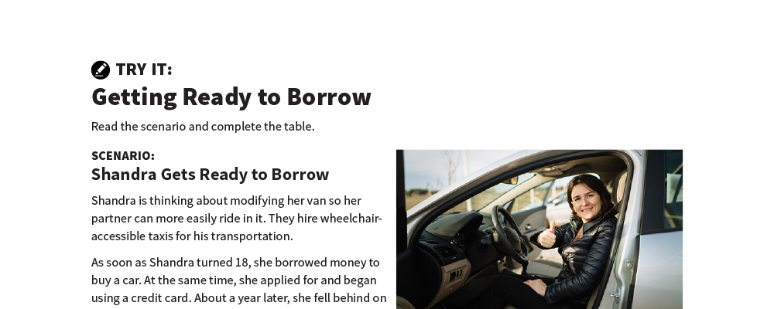
Getting Ready to Borrow
Try It
See page 9 in your participant guide.

Slide 28
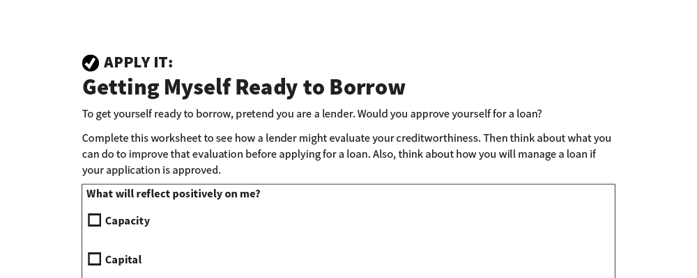
Getting Myself Ready to Borrow
Apply It
See page 11 in your participant guide.

Slide 29

Co-Borrowing and Co-Signing
Co-borrowing
Taking out a loan with others
You must repay debt even if co-borrower(s) do not
Co-signing
Loan proceeds go to the borrower, not co-signer
Co-signer promises to pay debt if borrower does not

Slide 30
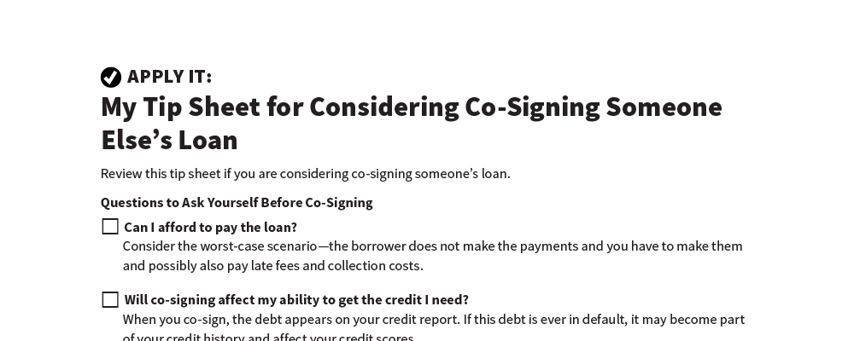
My Tip Sheet for Considering Co-Signing Someone Else’s Loan
Apply It
See page 14 in your participant guide.

Slide 31
Remember the key takeaway
SECTION 2
Remember the key takeaway
“
“
Learning what lenders look for helps prepare you to apply for a loan.”

Slide 32

Section 3 Borrowing When Someone Helps You Manage Your Money
[Picture]
SECTION 3 Borrowing When Someone Helps You Manage Your Money
See page 15 in your participant guide.

Slide 33
Key Takeaway
SECTION 3
Key Takeaway continued
Even if someone helps you manage your money, understand the terms of a loan before you commit to it.

Slide 34
Responsibilities of the Person Helping You
Act in your best interest
Manage your money and property carefully
Keep your money and property separate from theirs
Keep good records
Include you in decision-making to the extent possible

Slide 35
What to Discuss
Why do you want or need to borrow money?
Do you have enough money to repay the loan?
How will you make payments on the loan?
How will you monitor the loan?
Will it affect any of your sources of income?
What is the best borrowing option for your needs?

Slide 36
If You Decide to Borrow Money
You can get help considering the terms and completing the application
Lender decides if you are a good credit risk
Lender does not consider creditworthiness of the person helping you
After you borrow money, you need to:
Repay the loan.
Always make payments on time, every time.
Keep good records.

Slide 37
Remember the key takeaway
SECTION 3
Remember the key takeaway continued
“
“
Even if someone helps you manage your money, understand the terms of a loan before you commit to it.”

Slide 38


Take Action
See page 17 in your participant guide.
After this training, what is one thing you will do?
Who will you tell about your planned action?
What additional information do you need?
i

Slide 39

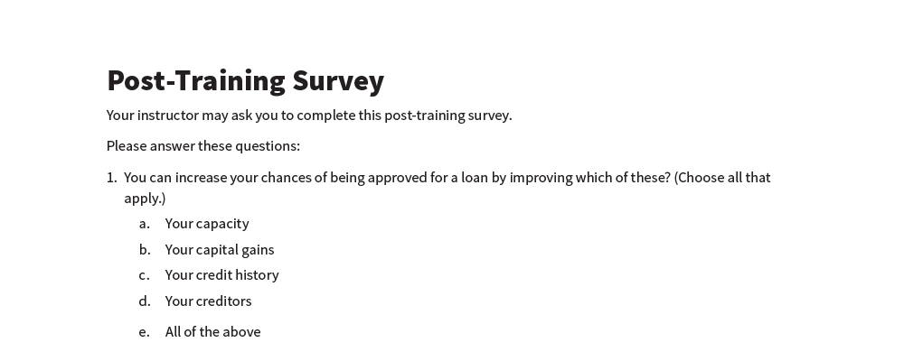
Post-Training Survey
Post-Training Survey
See page 20 in your participant guide.

