Slide 1
Money Smart for Young People
Grades 6–8
Lesson 8: Money Doesn’t Grow on Trees

Slide 2

Investment Vehicles
13
Stock
Investment in a company
Shares of ownership in a company
Value of investment based on
company performance
Mutual Funds
Investments in several areas
(companies, bonds, etc.)
Diversified
Returns are passed to the investors
LAST | CHG | % |  | LAST CHG | % |  | LAST | CHG %
19.01 | 1.2 | 4.4 |  | 14.67 7.8 | 3.7 |  | 34.62 | 1.9 0.3
14.67 | 7.8 | 3.7 |  | 15.01 1.1 | 6.2 |  | 22.65 | 1.9 4.9
12.01 | 1.3 | 2.5 |  | 22.65 1.9 | 4.9 |  | 14.67 | 7.8 3.7
11.04 | 1.6 | 5.3 |  | 18.37 3.2 | 9.5 |  | 12.01 | 1.3 2.5
6.97 | 3.0 | 3.1 |  | 12.01 1.3 | 2.5 |  | 6.97 | 3.0 3.1
22.65 | 1.9 | 4.9 |  | 34.62 1.9 | 0.3 |  | 2.06 | 3.5 2.2
17.07 | 0.6 | 1.2 |  | 12.01 1.3 | 2.5 |  | 34.78 | 5.4 6.7
34.78 | 5.4 | 6.7 |  | 6.97 3.0 | 3.1 |  | 15.01 | 1.1 6.2
15.01 | 1.1 | 6.2 |  | 14.71 2.7 | 2.3 |  | 18.37 | 3.2 9.5
2.06 | 3.5 | 2.2 |  | 18.37 3.2 | 9.5 |  | 19.01 | 1.2 4.4
18.37 | 3.2 | 9.5 |  | 2.06 3.5 | 2.2 |  | 17.07 | 0.6 1.2
14.71 | 2.7 | 2.3 |  | 34.62 1.9 | 0.3 |  | 11.04 | 1.6 5.3
12.01 | 1.3 | 2.5 |  | 18.37 3.2 | 9.5 |  | 14.71 | 2.7 2.3
34.62 | 1.9 | 0.3 |  | 15.01 1.1 | 6.2 |  | 12.01 | 1.3 2.5
Investors pool their money with a Registered Mutual Fund
Returns on the pooled investments
MUTUAL FUND
Mutual Fund — Fund Manager invests this amount with securities

Slide 3
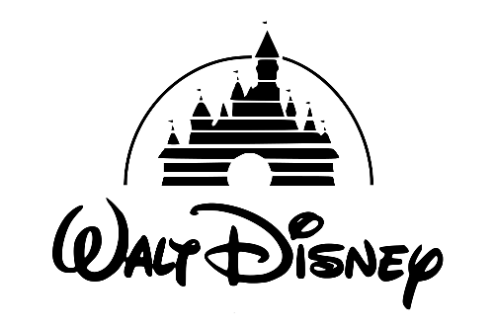


Case Study: Three Stocks
14
Yum! Brands (YUM)
Yum! Brands owns such popular chains as Taco Bell, KFC, and Pizza Hut.
At $73 per share, it sells for 20 times projected earnings, while yielding 2%. The company is expected to increase profits over the next 3–5 years.
Stock symbol: YUM Today’s share price: $73
Target (TGT)
Target has 1,822 stores in the United States that sell everything from baby cribs to bananas. This retailer is expected to increase profits at a 15% pace in coming years.
Shares are $84 each as of October 2018.
Stock symbol: TGT Today’s share price: $84
Walt Disney (DIS)
Walt Disney owns several business interests: animated films, theme parks, and the sports network ESPN, among others. At $116 a share, it is expected to increase profits at a 15% pace for the next several years.
Stock symbol: DIS Today’s share price: $116
Share prices from 10/04/2018
Source: www.nyse.com/index and www.stockmarketgame.org

