Slide 1
Money Smart for Young People
Grades 6–8
Lesson 4: Being a Savvy Shopper

Slide 2
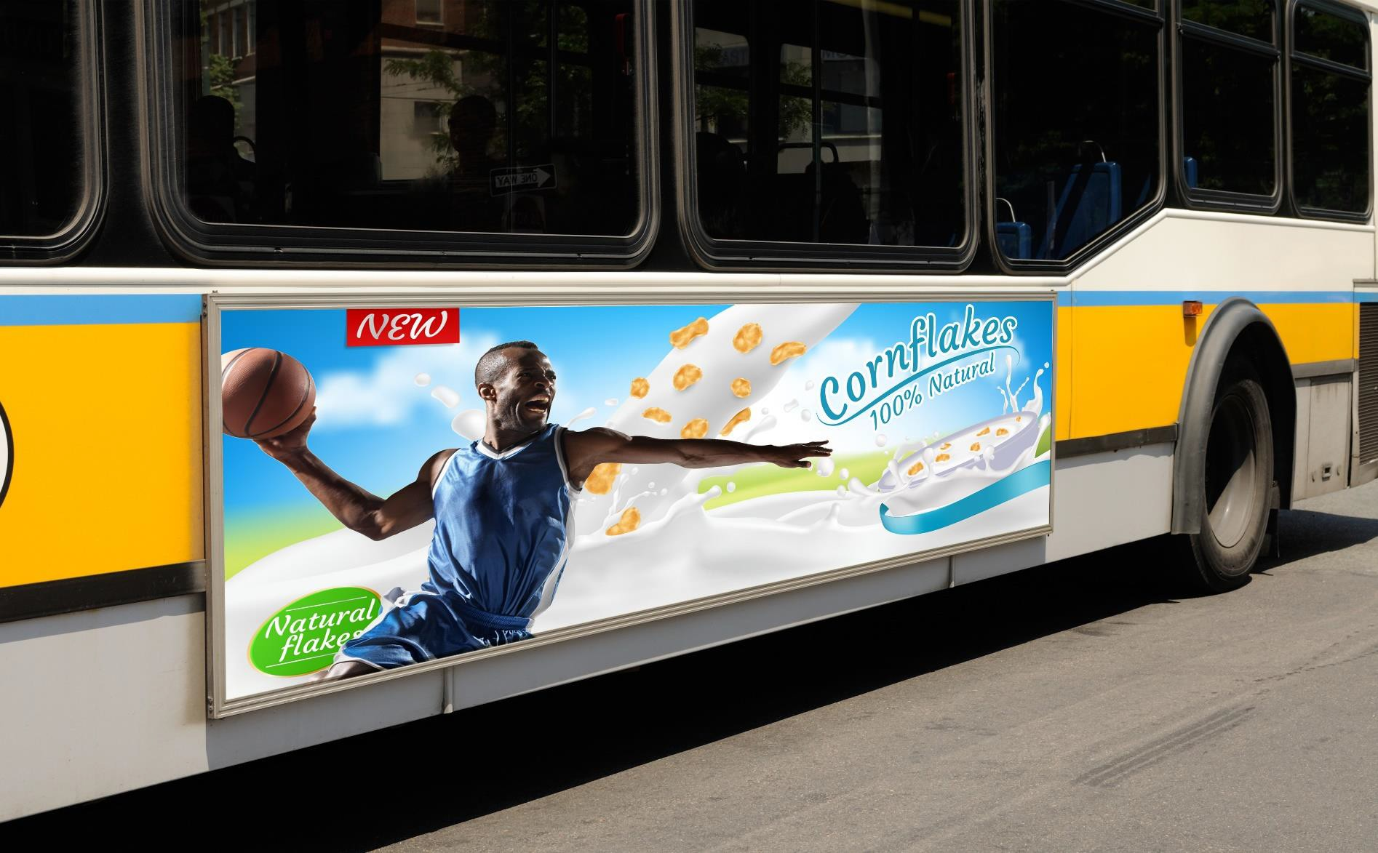
Cereal Advertisement
8

