Slide 1
Money Smart for Young People
Grades 6–8
Lesson 3: Designing a Dream

Slide 2



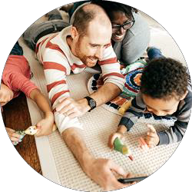




Financial Values Sample
6
Education Charitable Giving
Retirement Family
Investment Entertainment
Travel Lifestyle

Slide 3








Financial Goals Sample
7
Buying my mom a vehicle.
Donating money and volunteering time every holiday season.
Buying a home.
Saving enough money to live a comfortable life.
Buying a gaming system.
Making money by investing in a company’s stock.
Paying for part of my college tuition.
Visiting my relatives out of state.

