Slide 1
Money Smart for Young People
Grades 6–8
Lesson 2: Bread and Butter

Slide 2


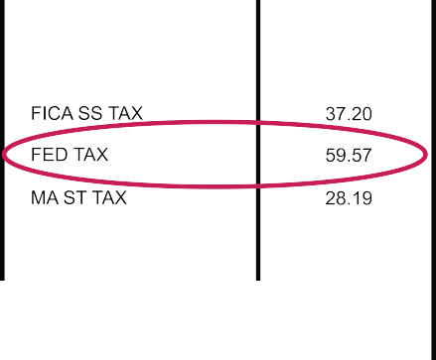





Explaining Taxes
3

Slide 3
Income and Taxes
4
My First Job | My Second Job | My Third Job
Level of Education: Bachelor’s degree | Level of Education: Master’s degree | Level of Education: Master’s degree plus an Advanced Certificate
Job Experience: First month on the job | Job Experience: Five years on the job | Job Experience: 20 years on the job
Salary: $55,000 annually | Salary: $76,000 annually | Salary: $122,000 annually

Slide 4
Tax Brackets
5
If Taxable Income Is: | The Tax Is:
Not over $9,075 | 10% of the taxable income
Over $9,526 but not over $38,700 | $952.50 plus 12% of the excess over $9,525
Over $38,701 but not over $82,500 | $4,453.50 plus 22% of the excess over $38,700
Over $82,501 but not over $157,500 | $14,089.50 plus 24% of the excess over $82,500
Over $157,501 but not over $200,000 | $32,3089.50 plus 32% of the excess over $157,500
Over $200,001 but not over $500,000 | $45,689.50 plus 35% of the excess over $200,000
Over $500,001 | $150,689.50 plus 37% of the excess over $500,000
https://www.irs.com/articles/2018-federal-tax-rates-personal-exemptions-and-standard-deductions

