Slide 1
Money Smart for Young People
Grades 6–8
Lesson 1: The Path to Success

Slide 2
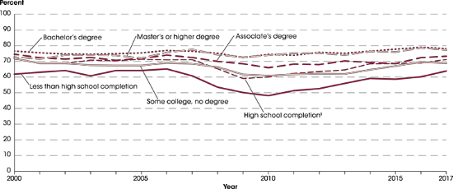
Degrees Matter
2
Source: https://nces.ed.gov/programs/coe/indicator_cba.asp

