Slide 1

1
Money Smart for Young People
Grades 9-12
Lesson 20: Protect Yourself

Slide 2

Identity Theft
39
There is only one of you... or is there?

Slide 3
What Do Thieves Do With Your Information?
40
Get into your bank accounts and steal your money
Use your name to open up credit cards and run up the bills
Set up utilities and rental agreements using your name
Take out a loan in your name
They may even try to use your health insurance!

Slide 4
TYPES OF IDENTITY THEFT: Phishing
41
Phishing is when criminals:
Send out unsolicited, or spam, e-mails that appear to be from a legitimate source: perhaps from your bank, school, well-known merchants, your Internet service provider, or even a trusted government agency (e.g., the FDIC)
Attempt to trick you into divulging personal information

Slide 5
TYPES OF IDENTITY THEFT: Pharming
42
Criminals seek to obtain personal or private information by making fake websites appear legitimate
Your browser will even show that you are at the correct website
This makes pharming more difficult to detect than phishing

Slide 6
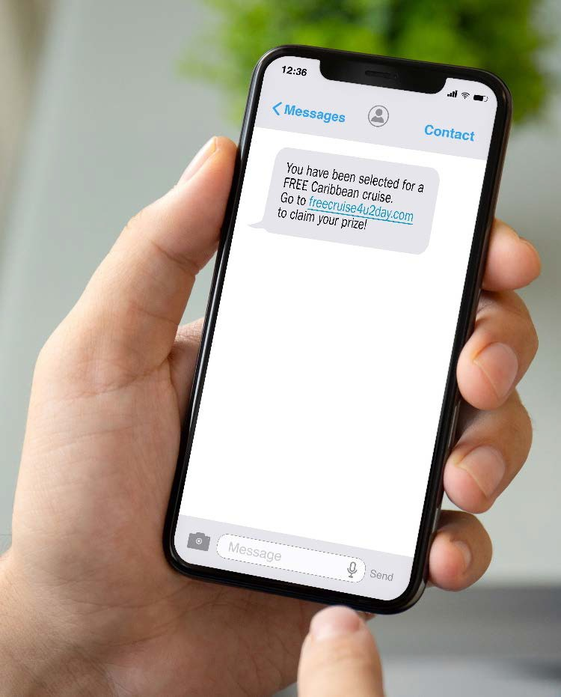
TYPES OF IDENTITY THEFT: Text Message Spam
43
Similar to e-mail spam, but on your cell phone
Criminals often text offers of free gifts or low-cost credit offers with a link
Clicking the link can install malware on your phone, which is how your personal information is captured

Slide 7
Job Scams
44
Promise work, but usually ask you to pay for training or services
They never deliver the promised employment
They often advertise on real job websites, so it can be hard to tell them apart from true employment opportunities
Earn $500 per week GUARANTEED!
Sign up today and get started!

