Slide 1

1
Money Smart for Young People
Grades 9-12
Lesson 19: Financial Sleuth

Slide 2
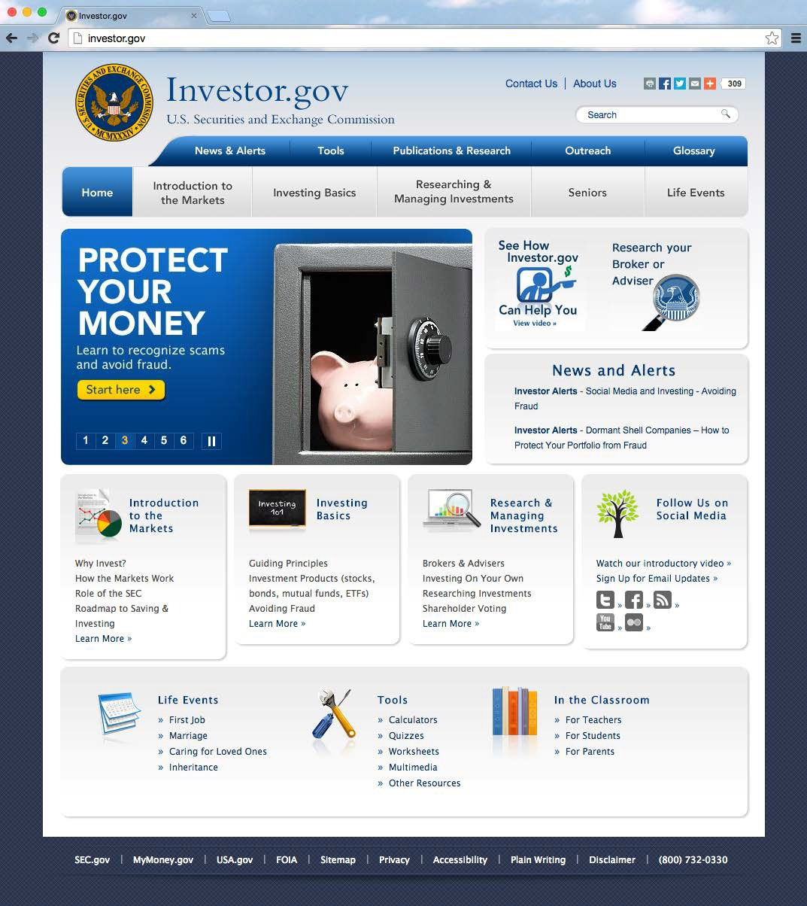
Credibility 1
37

Slide 3

Credibility 2
38

