Slide 1

1
Money Smart for Young People
Grades 9-12
Lesson 18: Paving the Future

Slide 2
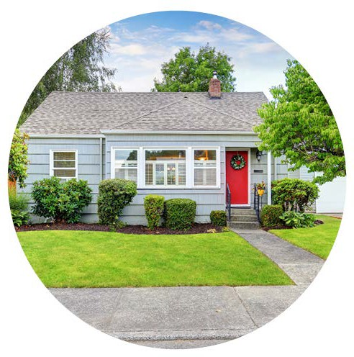

Money Marooned
32
Your family is here
You are here
What would you do?

Slide 3


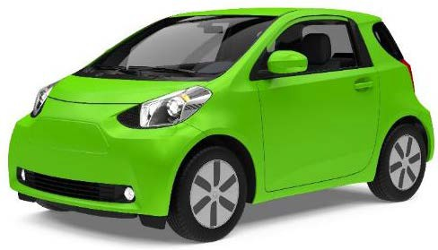
ESTATE PLANNING: Trusts & Wills
33
Will: legal document that you create outlining your last wishes
Trust: legal document used to transfer your property with the ability to set stipulations and conditions before an heir receives your assets (such as a minor child turning 18 before he or she inherits property)

Slide 4
ESTATE PLANNING: Power of Attorney
34
Power of Attorney: when you grant permission to someone to handle your affairs if you are unable to do so yourself

Slide 5

ESTATE PLANNING: Example of Titles
35
Tenancy in Common
Shared ownership of a property
Ex. five people each holding title
to one property (does not have to be equal shares)
Joint Tenancy
Shared ownership of a property with equal shares
If one owner dies, the other owner(s) have Right of Survivorship, meaning the share of the property is transferred to them
Tenancy in Entirety
Shared ownership of a property between a husband and wife
A surviving spouse has Right of Survivorship and becomes the sole owner

Slide 6

ESTATE PLANNING: Life Insurance
36
Life Insurance: provides financial security to your family in the event of death by paying money to a beneficiary

