Slide 1

1
Money Smart for Young People
Grades 9-12
Lesson 12: Halls of Knowledge

Slide 2

What is Your Skill and Will?
2
C“HAMPIONS AREN’T MADE IN GYMS.
Champions are made from something they have deep inside them, a desire, a dream, a vision. They have to have the skill and the will. But the will must be stronger than the skill.”
—MUHAMMAD ALI

Slide 3

Cost of College
3
Tuition
Food
Transportation
Room and Board
Phone
Books
Entertainment
School Fees
Personal Expenses (clothes, haircuts, laundry)
Technology Expenses (computer, hardware, software)

Slide 4

The Financial Aid Process
4
Source: https://www.studentaid.ed.gov/sites/default/files/financial-aid-process.png

Slide 5
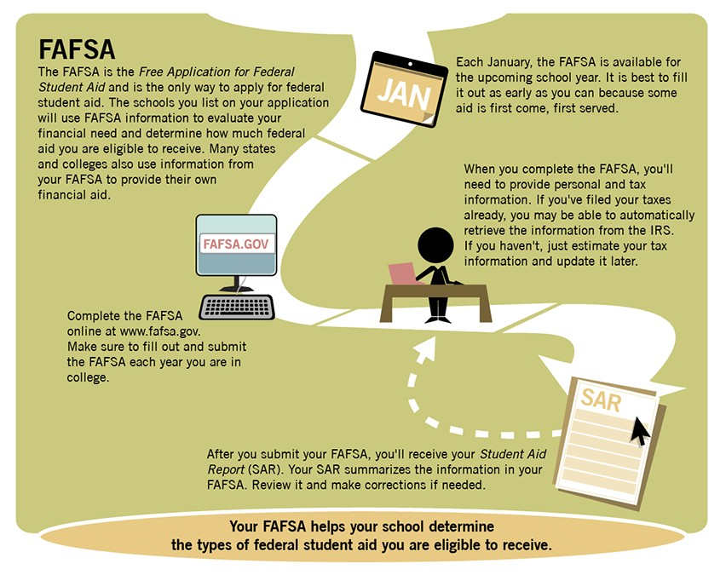
The Financial Aid Process
(CONTINUED)
5
Source: https://www.studentaid.ed.gov/sites/default/files/financial-aid-process.png
Money Smart for Young People Grades 9 -- 12

Slide 6
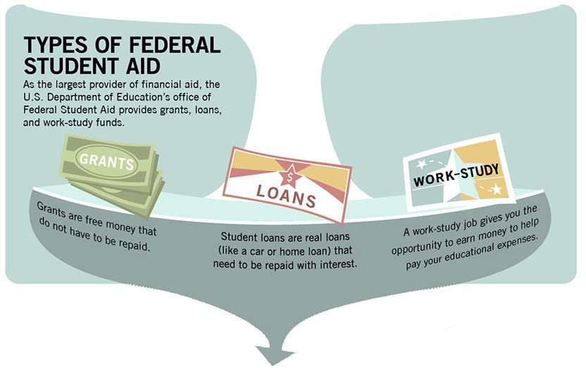
The Financial Aid Process
(CONTINUED)
6
Source: https://www.studentaid.ed.gov/sites/default/files/financial-aid-process.png
Money Smart for Young People Grades 9 -- 12

Slide 7
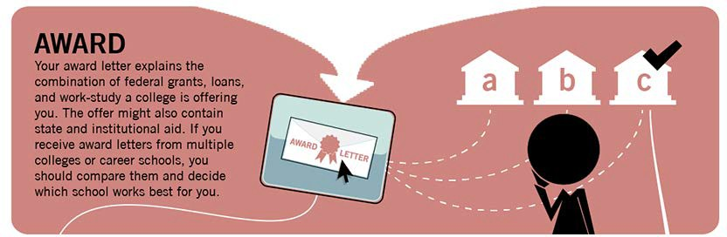
The Financial Aid Process
(CONTINUED)
7
Source: https://www.studentaid.ed.gov/sites/default/files/financial-aid-process.png
Money Smart for Young People Grades 9 -- 12

Slide 8

The Financial Aid Process
(CONTINUED)
8
Source: https://www.studentaid.ed.gov/sites/default/files/financial-aid-process.png

Slide 9

The Financial Aid Process
(CONTINUED)
9
Source: https://www.studentaid.ed.gov/sites/default/files/financial-aid-process.png

