Slide 1

1
Money Smart for Young People
Grades 9-12
Lesson 11: Risky Business

Slide 2

Types of Insurance
38
Life
Health
Auto
Insurance
Property
Disability
Long-Term Care

Slide 3
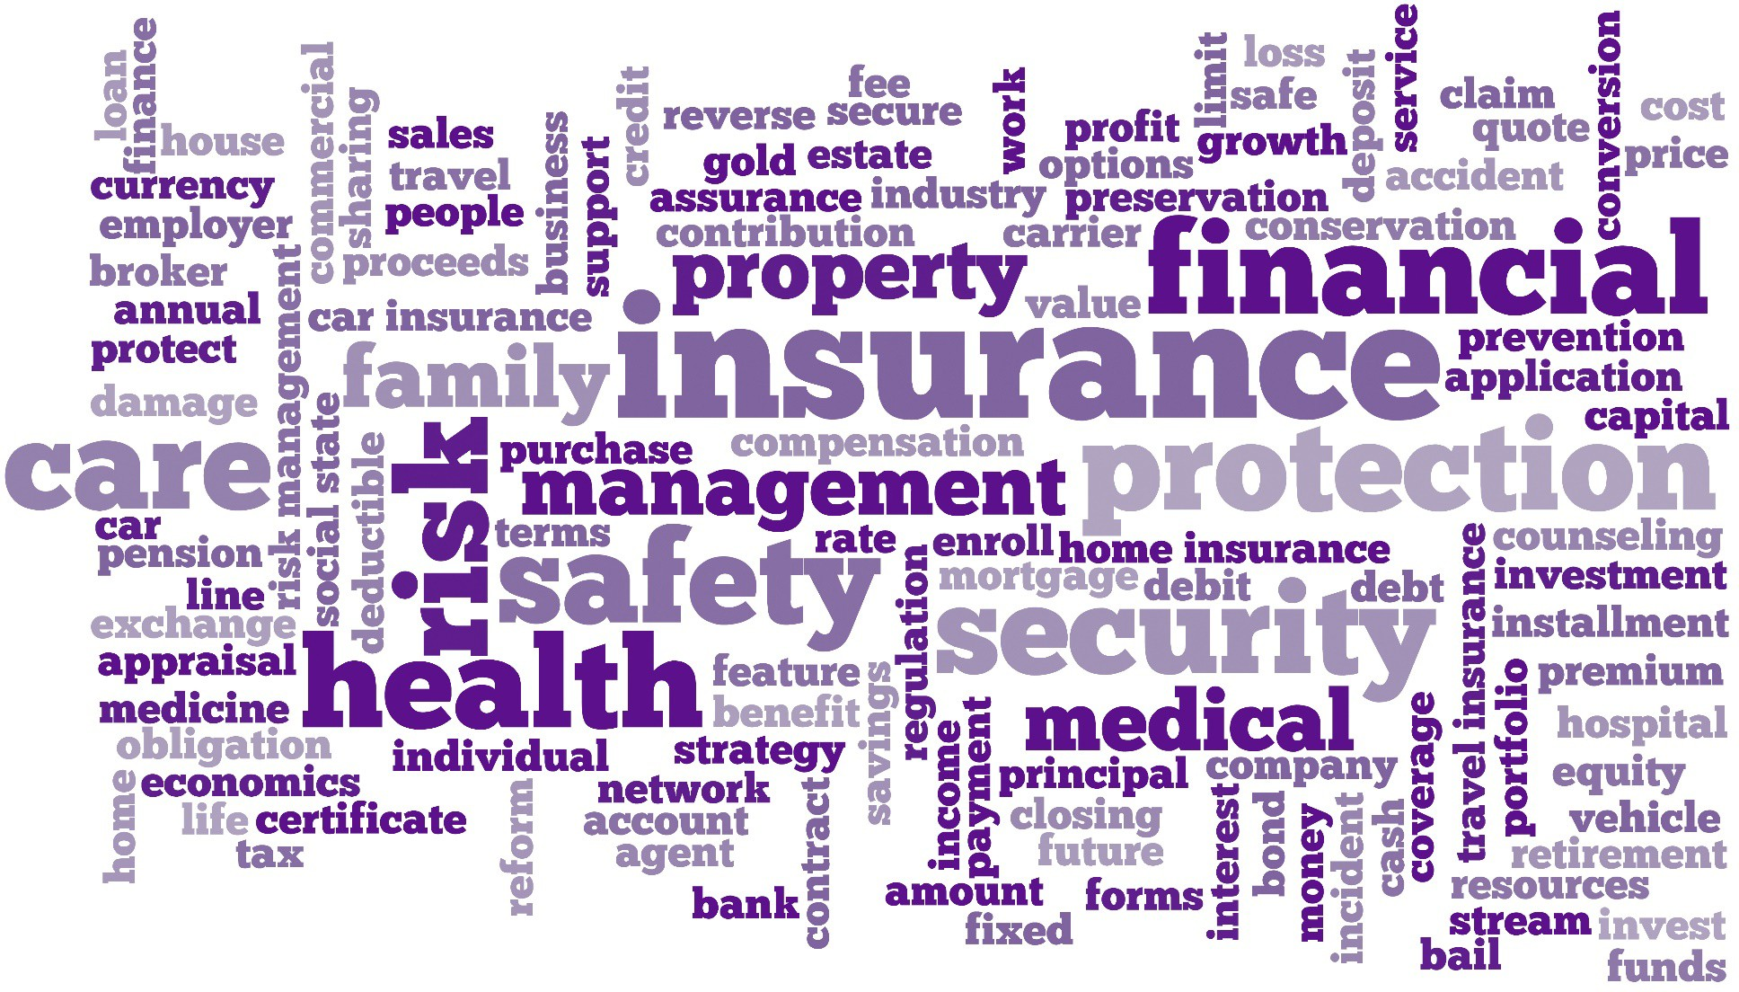
Insurance Lingo
39

