Slide 1

1
Money Smart for Young People
Grades 9-12
Lesson 13: The Policy of Personal Choice

Slide 2
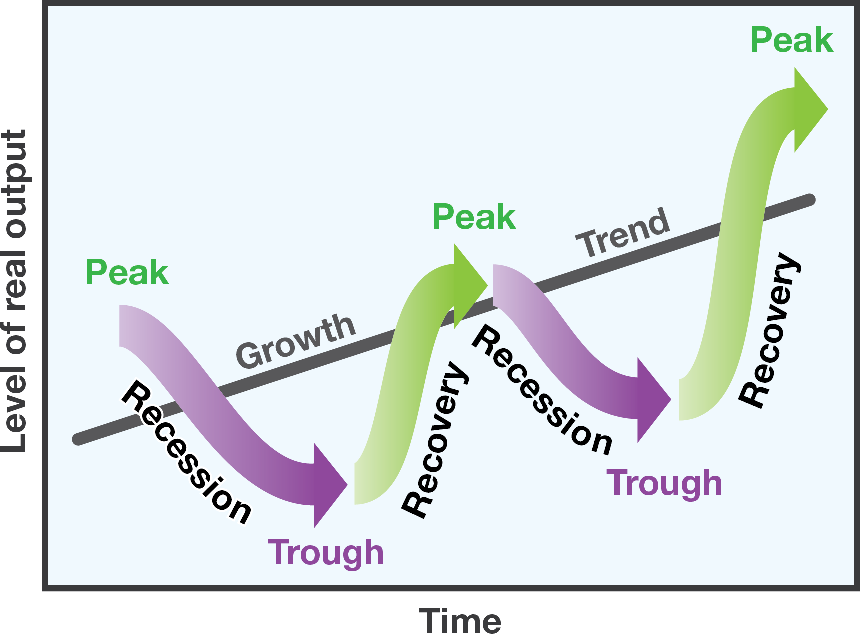
Economic Cycles
10

Slide 3

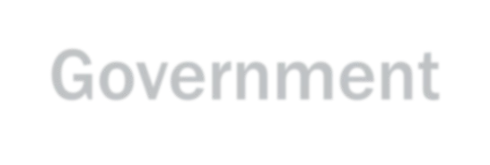
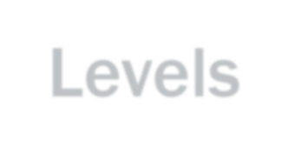


Fiscal Policy
11
Tax Levels
Government Spending

Slide 4


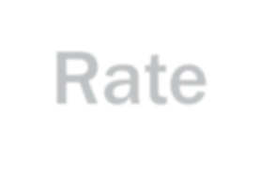

Monetary Policy
12
Interest Rate
Money Supply

