Slide 1

1
Money Smart for Young People
Grades 9-12
Lesson 10: Convertible or Clunker

Slide 2
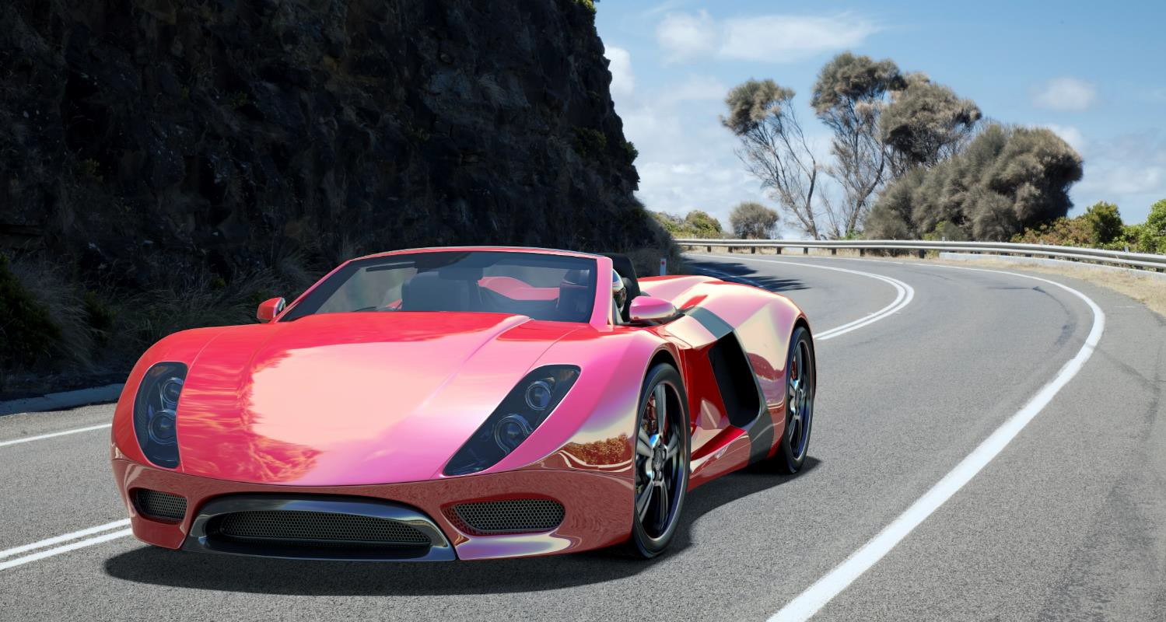
Reality Check 1
34

Slide 3

Reality Check 2
35

Slide 4


True Cost of Vehicles
36
What can I afford
What can I afford 1 year…2 years… 5 years from now?
How much money will I need for a down payment?
right now?
How much will insurance cost?
Do I NEED a vehicle, or do I WANT one?
Should I lease or own?
What amount can I pay each month?
Will I need money for repairs?
GAS! I forgot about gas…how much will that cost over time?

Slide 5
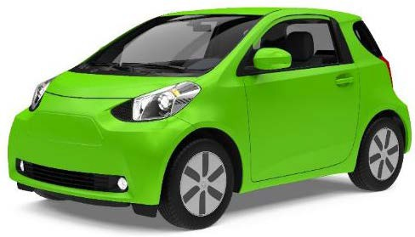



Secure or Unsecured?
37
Types of Installment Loans
Secure = collateral
Unsecured = no collateral

