Slide 1

1
Money Smart for Young People
Grades 9-12
Lesson 7: Capacity, Character, Collateral, Capital

Slide 2

Predatory Lending
20

Slide 3
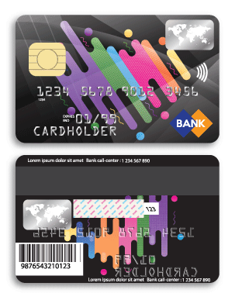
Types of Loans 1
21
With a CREDIT CARD, you can…
Buy goods or services and pay for them over time
Borrow money for household, family, and other personal expenses
Get into big trouble if you’re not careful with spending
Either build a positive credit history or damage it depending on how you manage the card.

Slide 4
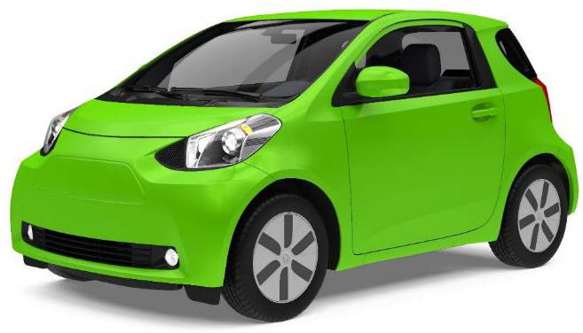
Types of Loans 2
22
With a CONSUMER INSTALLMENT LOAN, you…
Can pay your personal expenses and your family's expenses
Can pay the same amount each month in installments for a set period of time
Can either build or damage credit, by whether you repay the loan on time
as you agreed

Slide 5
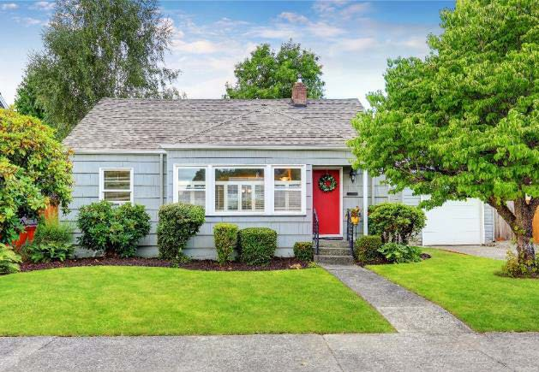
Types of Loans 3
23
With a HOME LOAN (mortgage), you can…
Borrow money for the purpose of buying a house
Build positive credit by paying on time
Damage credit by skipping payments or paying late

Slide 6

The Four Cs of Credit
24
Collateral
Capacity
CREDIT
Capital
Character

Slide 7
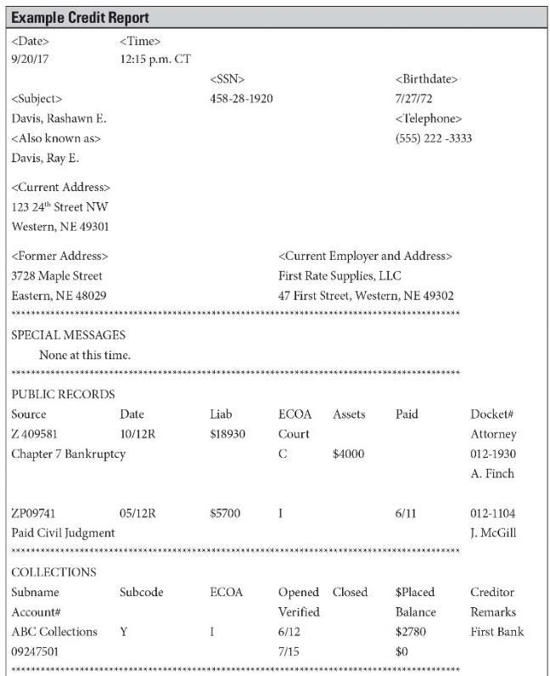
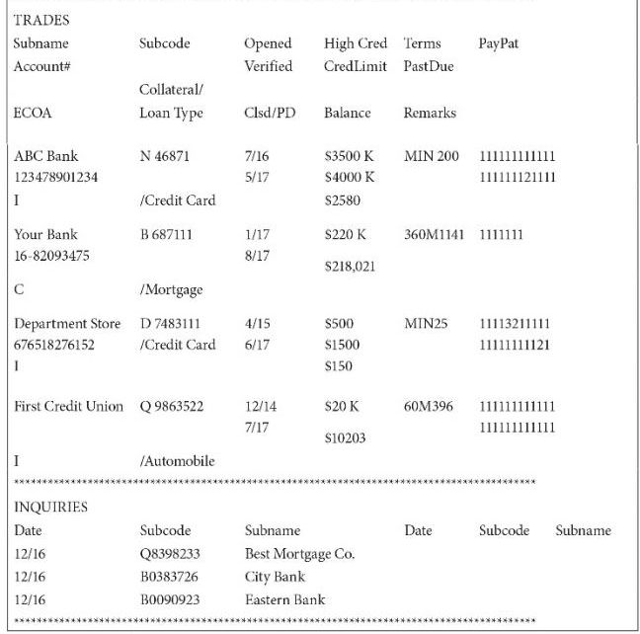
Credit Report
25

Slide 8
Managing Debt
26
Am I overextending myself?
Have I researched and compared rates (using the APR)?
Do I have a plan in place for paying off the borrowed money?

