Slide 1

1
Money Smart for Young People
Grades 9-12
Lesson 14: Increasing the Value of Your Money

Slide 2
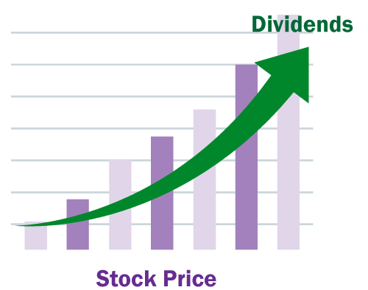
INVESTMENT VEHICLES: Stocks
13
When you buy a stock, you own part of the company, called a share. When the company does well, you may receive dividends or a portion of the company’s profits.
The value of your investment changes as the company’s stock price changes. When you sell the stock, you may receive more or less money than what you paid for it.

Slide 3
INVESTMENT VEHICLES: Bonds
14
Bonds are loans to corporations or to the government for a set period of time, or a term. You earn interest on your investment, and bonds can be purchased for as little as $25.

Slide 4
INVESTMENT VEHICLES: Mutual Funds
15
Mutual funds are offered by companies that combine money from many investors to purchase numerous separate investments (for example: some include a mix of stocks and bonds or even a mix of stocks of companies in several different countries). They may pay dividends and they may also gain or lose money over time.
By combining your money with the money of other investors, you can diversify even a small investment.

Slide 5
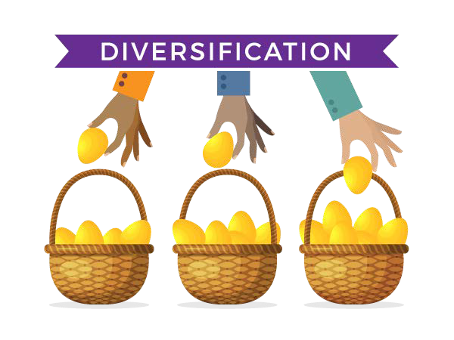
INVESTMENT VEHICLES: Diversification
16
Diversification means “do not put all of your eggs in one basket.” It spreads the risk of loss across many investment options.

Slide 6
INVESTMENT VEHICLES: Retirement Accounts
17
Individual Retirement Accounts (IRAs): IRAs are designed to help you save money for your retirement. Your contributions are generally tax-deductible. IRAs can include FDIC-insured deposit accounts offered by banks, and non-deposit investment accounts offered by investment firms that may include stocks or bonds.
Employer Retirement Accounts:
A 401(k) plan is a retirement savings plan established by an employer that lets its employees set aside a percentage of their pay for retirement before taxes are taken out. This can help lower your tax bill.
A 403(b) plan is a retirement savings plan for employees of public schools and certain tax-exempt organizations.

Slide 7
Investor Considerations
18
Risk Tolerance: willingness to lose some or all of an investment in exchange for greater potential returns
Diversification: spreading your assets across multiple investments
Asset Allocation: the distribution of assets among investments to balance risk and reward
Rate of Return: the percentage of money earned or lost on investments

