Slide 1

1
Money Smart for Young People
Grades 9-12
Lesson 3: Can You Pay Your Bills?

Slide 2
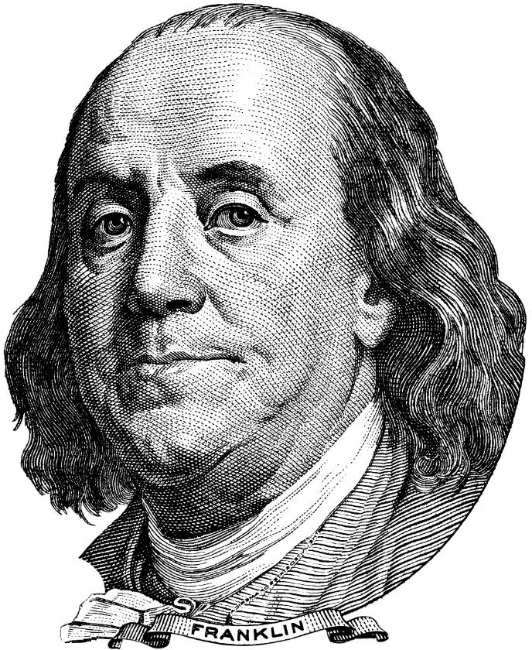
Sinking Ship
9
Beware of little expenses. A small leak will sink a great ship.

Slide 3
1-2-3 Budget
10
Three steps to building a budget…
Keep track of your spending
Identify your income and expenses
Analyze cash flow and look for ways to increase your income and decrease expenses

Slide 4
Budget Breakdown
11
Income:
Various jobs or work, like cutting grass or babysitting wages
Full- or part-time employment
Allowances
Odd jobs
Interest and dividends
Other sources, including tips
Expenses:
Bills (for example: cell phone or cable bill, rent)
Transportation expenses (for example: vehicle payment, gas, insurance, bus or transit fares)
Movies, music purchases, game downloads or other entertainment
Clothes or accessories
Eating out
Personal items (makeup, cologne, and so on)
Savings for college or other future purchases
Cash flow is the relationship between income and expenses
Fixed expenses do not change from month to month (for example: rent and auto loan payments)
Flexible expenses might change from month to month (for example: food and gas)

