Slide 1

1
Money Smart for Young People
Grades 9-12
Lesson 6: Bread-And-Butter

Slide 2
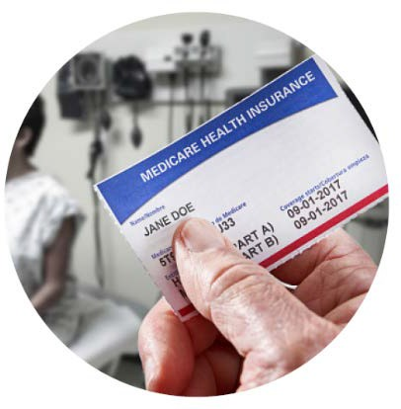
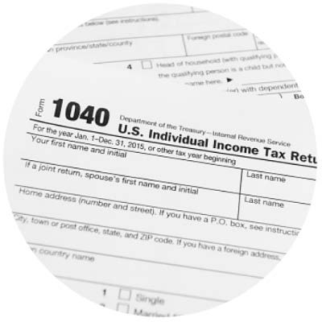

Deduction Introduction
18
Medicare
Income Tax
Social Security

Slide 3
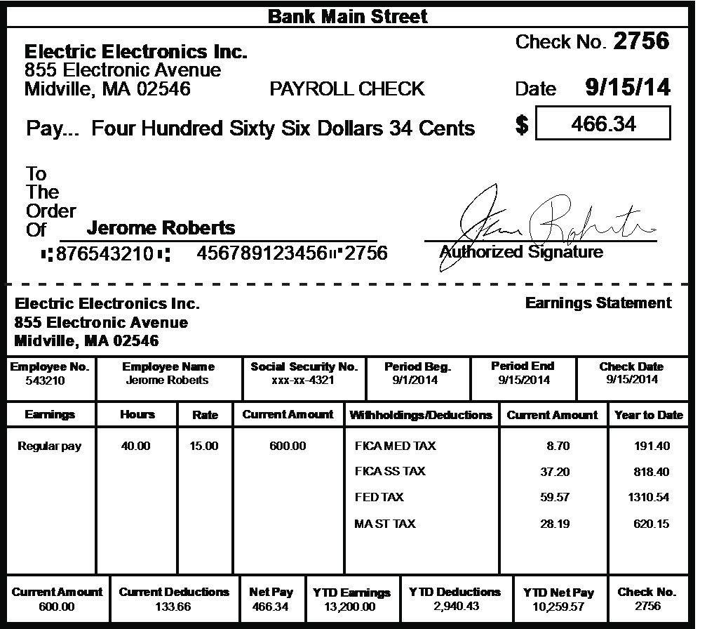
Paycheck
19

