Slide 1

1
Money Smart for Young People
Grades 9-12
Lesson 1: Working Hard for the Money

Slide 2
Dream job
2
What are your interests? What excites you?
What are you good at? What skills do you have?
What do you want to do after high school or college?
What is your dream job, and why?
What skills do you think are required for your dream job?
How do you think you could get the skills needed for your dream job?

Slide 3
Possible Employer Benefits
3
Health Insurance: helps cover employee medical costs related to illness or injury
Flexible Spending Accounts: tax-free money set aside by an employee often to be used for out-of-pocket medical expenses
Retirement Accounts:
401(k): an employer-sponsored plan to accumulate retirement savings that gives employees a choice of investment options, typically mutual funds. Employees who participate in a traditional 401(k) plan have a portion of their pre-tax salary invested directly in the option or options they choose.
403(b): exclusively for employees of public schools and certain tax- exempt organizations to accumulate retirement savings
Life Insurance: provides money to a beneficiary after the death of the insured
Extras: child care, relocation expenses, tuition reimbursement, transportation, wellness programs, discounts on products/services

Slide 4
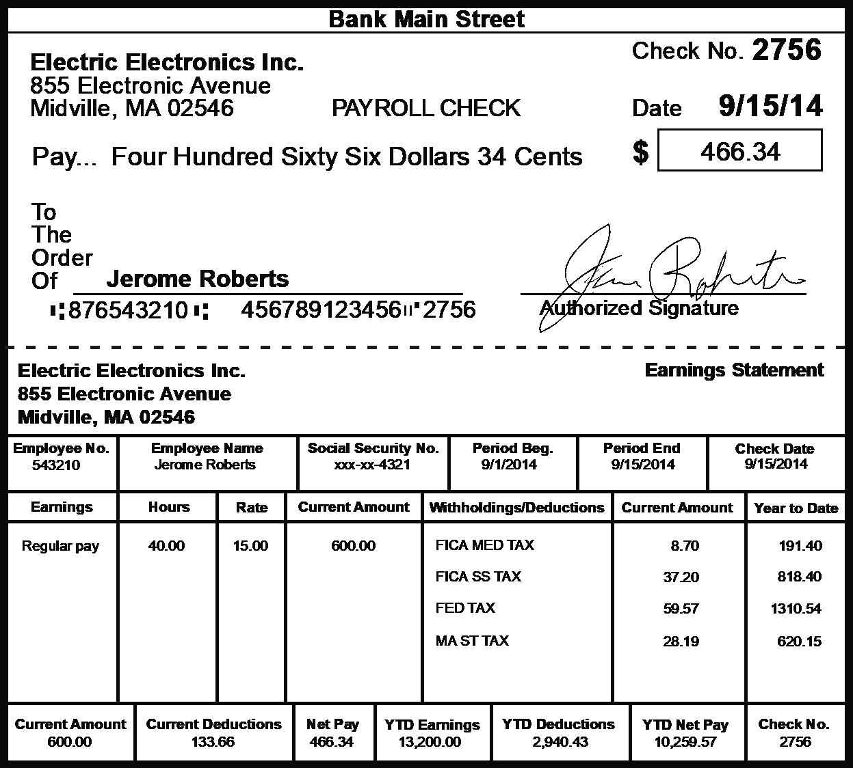
Paycheck
4

Slide 5






Choices
5
Two-Year College
Four-Year College
Apprenticeship
Associate’s Degree
Bachelor’s Degree
On-the-Job Training
Direct to Workforce
Military
Entrepreneur
Armed Forces Career
Job
Owning Your Own Business

