Slide 1
Money Smart for Young People
Grades 3–5
Lesson 6: Get Invested

Slide 2
Investing Your Money
25
The goal of investing is to make money in the future. Here are three different investment options:
CD (Certificate of Deposit)
When you buy a CD from a bank, you lend money to the bank for a set amount of time. It can be several months or years. At the end, the bank pays you back the money with interest.
Bond
A bond is a certificate sold by a company or government. When you buy a bond, you
lend money to a company or government for a set amount of time. It can be as long as 30 years. The borrower promises to pay your money back with interest. If they are not able to pay the money back, you could lose your money.
Stock
A stock is a share of a company. When you buy stock in a company, you own a tiny
piece of a company. If the company makes a profit, it may share some of those profits with you. Those profits may be called a “dividend.” You can also make money by selling your shares to another buyer for more than you paid. But you could also lose money if you have to sell your shares for less money than you paid for them.

Slide 3
INVESTING: Risk and Return
26
Some investments are more risky than others. What is the risk? You could lose your money. But you may also make money. If an investment is low risk, you have a low chance of losing your money. If an investment is high risk, you have a high chance of losing your money. The money you make from an investment is called the return.
CD (Certificate of Deposit)
CDs are low risk and low return. You won’t risk losing any money, but you won’t make a lot of money either. For example, you decide to buy a one-year CD for $1,000. At the end of the year, you might get back $1,050.
Bond
U.S. government bonds are low risk and low return. For example, if you buy a U.S. government bond for $1,000, in 10 years, you might get back $1,500.
Company bonds can be high risk and high return. You risk losing your money, but you can also make a lot of money. If you buy a company bond for $1,000, you might get back more than $1,500 in 10 years. Or you might lose your money.
Stock
Stocks can be high risk and high return. You might lose it all, but you might also make a lot of money. For example, you might buy stocks in a company for $1,000. If the company does not make a profit, you might lose all of your money. If the company makes a big profit, you might be able to sell your stocks and double your money.

Slide 4
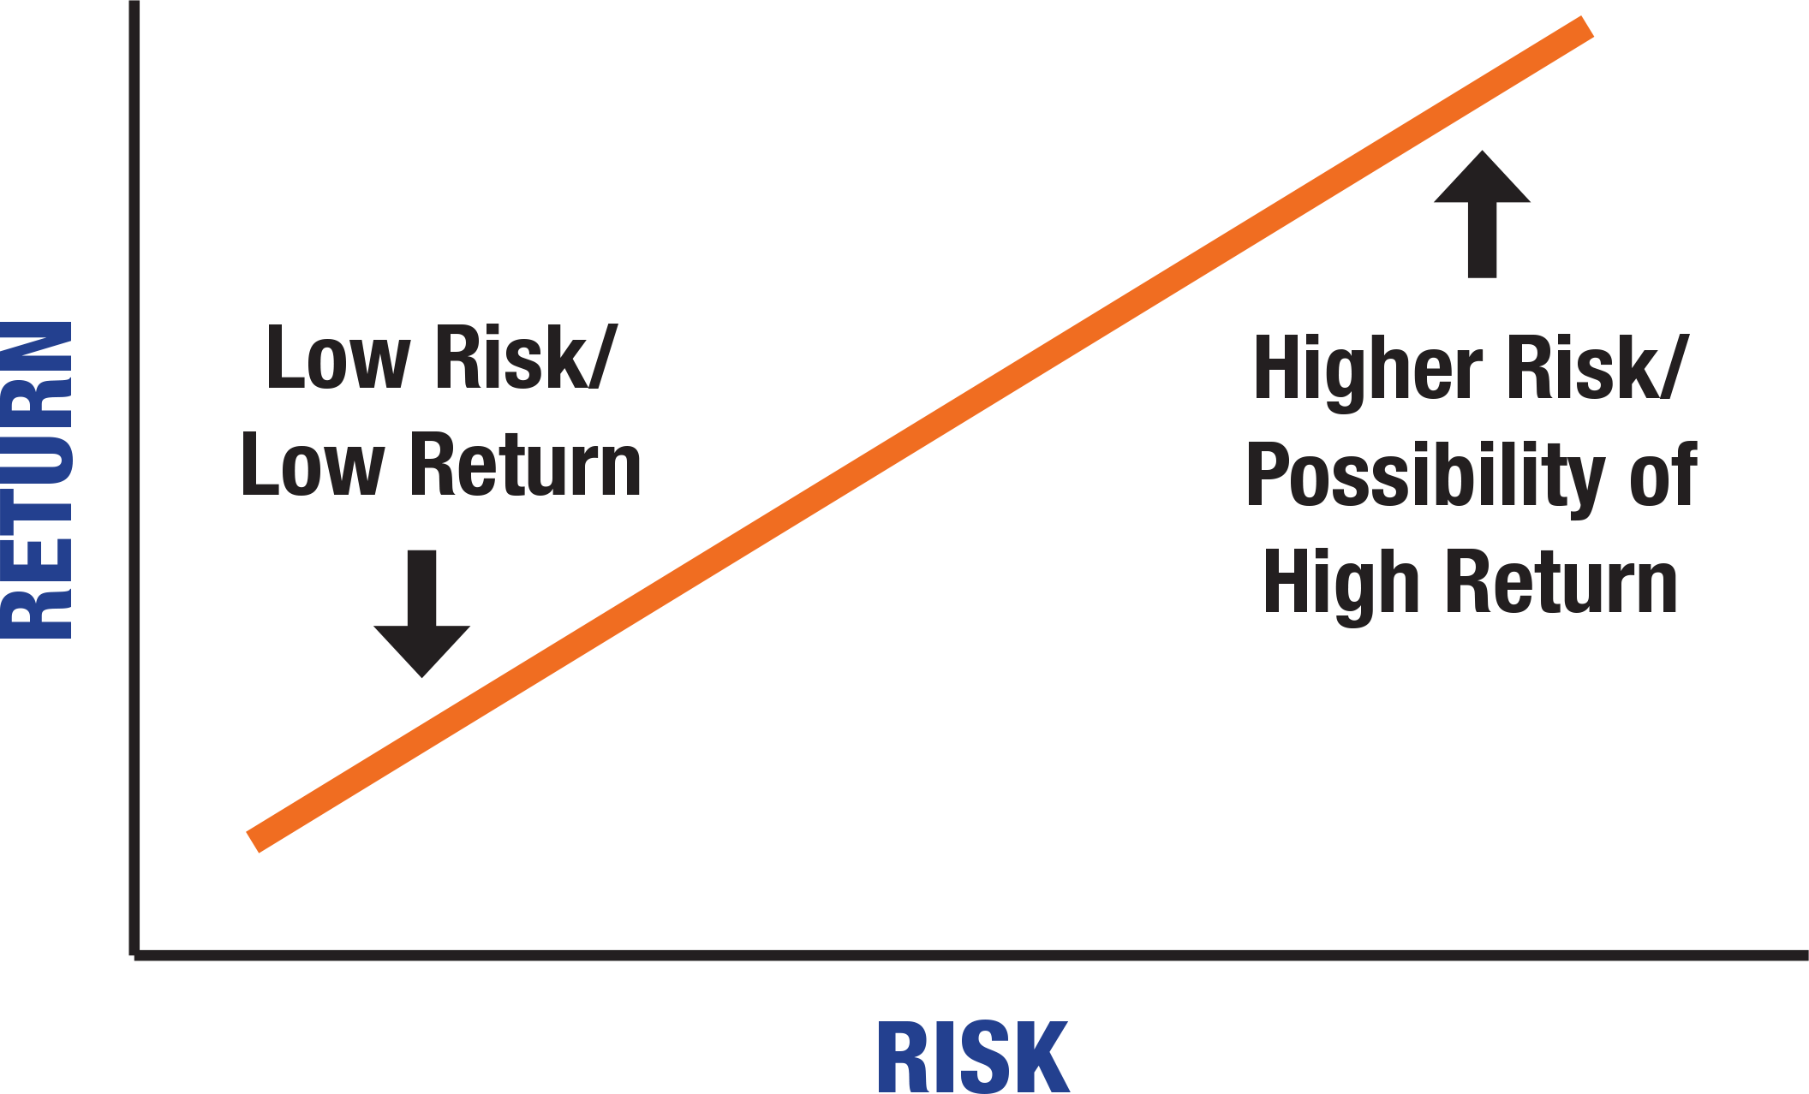
INVESTING: Risk and Return
27
(CONTINUED)
Study the line graph below. What does it show? What might “possibility of high return” mean?

Slide 5
STORY PROBLEMS: Investing
28
The goal of investing is to make money.
Directions: Choose the best answer to each question below.
Jay does not like to take risks. He just bought a one-year CD from the bank. He knows it is low risk. How much money will he probably make next year from the CD?
  no money
  a little money
  double his money

Slide 6
STORY PROBLEMS: Investing
29
(CONTINUED)
Maya has a lot of money saved and wants to invest some of it. She wants to take a risk with her money so she has a chance of making a lot of money back. She wants to use the money to start her own restaurant one day. What kind of investment should she make?
  stocks
  one-year CD
  U.S. bond
Your friend Kelvin asks what you know about company bonds.
He is thinking of buying one. He is sure he will make a lot of money if he does. What would you tell him about company bonds?
  They are as safe as U.S. government bonds.
  They can be risky, but you might make a lot of money, too.
  They are known for making almost no money in return.

Slide 7
What is Inflation?
30
Inflation is the overall rise in prices. For example, a pound of oranges today costs more money than it did 10 years ago.
A pound of oranges will cost more in the future than it does today. Read the graph to the right to learn more. Then answer the questions.
What was the average price of a pound of oranges in 2008?
Which year shows the biggest increase in the average price of oranges?
In which years did the average price of oranges get lower?
How much more was the average cost of a pound of oranges in 2018 than in 2008?
Average Price of a Pound of Oranges
2008 | $0.91
2010 | $0.90
2012 | $0.93
2014 | $1.12
2016 | $1.20
2018 | $1.33

