Slide 1
Money Smart for Young People
Grades 3–5
Lesson 5: Which Way to Pay

Slide 2
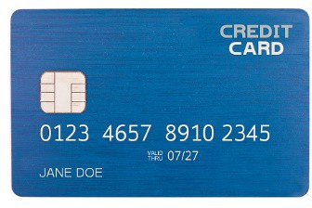
What is Credit?
19
Credit is a loan. When you pay using credit, you are borrowing money.
A credit card is a plastic card that lets you pay using credit. The card has a limit on how much you can
charge (spend).
Each month, you’ll receive a statement or bill showing details such as new charges on the card and how much you owe. If you don’t pay all the money back on time, you have to pay it back with interest. Interest can add up quickly! It’s important to only use credit cards for things you can afford to pay back soon.

Slide 3
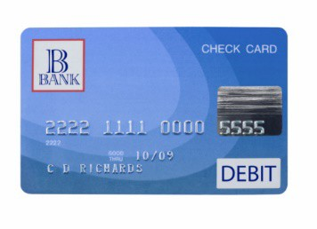
What is Debit?
20
A debit is money removed from an account.
A debit card is a plastic card that, when it’s used, money is taken out of your checking account right away.
If you don’t have enough money in your account to make a purchase, you can’t pay with your debit card.

Slide 4
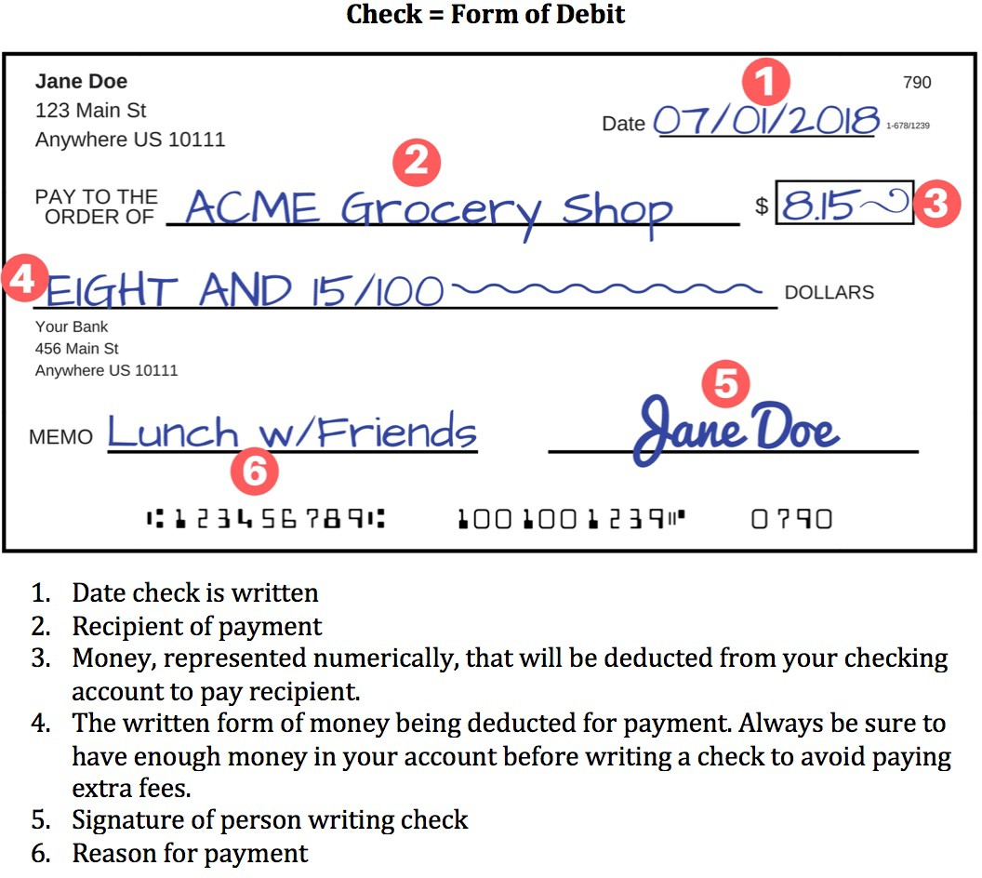
What is Debit? (CONTINUED)
21

Slide 5
Private Information
22
Some information should be kept personal. It should not be shared with anyone without a parent’s permission, especially when you are online.
Here is some personal information you should keep private:
Birth date
Phone number
Home address
Bank account number
A parent’s credit card number
Passwords
School name and address
Protecting your personal information helps prevent identity theft.

Slide 6
Private Information (CONTINUED)
23
Identity theft is a crime. It is when someone pretends to be another person by taking that person’s personal information to steal his or her money. For example:
A thief might steal someone else’s credit card number to buy things online. Then the bill is sent to the owner of the credit card, not the thief. Let’s say your parent’s credit card number was stolen. On the next statement, your parent notices a charge for 50 pounds of lizard food. Wait a minute — you don’t have a pet lizard! Now your parent has to call the credit card company and report a theft.
Let’s say you are using the computer and you get a pop-up ad. It says you can win a prize if you click on the ad. (Don’t click on the ad!) But if you did click on the ad, it might ask you to enter personal information so you can collect your prize. NEVER enter personal information without a parent’s permission. If you do, someone may use the information you entered to steal your identity.

Slide 7
STORY PROBLEMS: Payment Decisions
24
People can make purchases using different payment options.
Directions: Read each scenario and answer the questions to make payment decisions.
Violet has $20 cash and her checkbook. She is in a hurry and needs to pay for a birthday card that costs $3. How should she pay for the card? Why?
Sierra and her grandmother go out for lunch. Her grandmother needs to pay $32 and has $35 in her wallet, along with and a credit card. She wants to make sure she has at least $5 left for the rest of the day. How should Sierra’s grandmother pay for the meal? Why?
Max has to pay his credit card bill. It is due in two weeks. Max wants to mail in a check for the total amount of $135. He has $100 in his checking account. Does Max have enough money to write the check? If not, how can he still pay by check?

