Slide 1
Money Smart for Young People
Grades 3–5
Lesson 4: Save Your Money

Slide 2
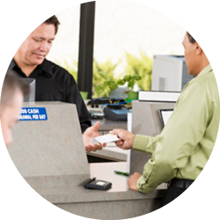
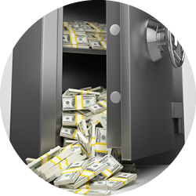
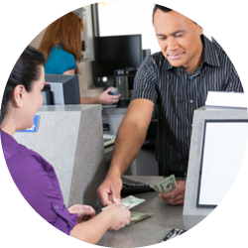
How do Banks Work?
15
After you open a savings account, you can put money in (make a deposit) and take money out (make a withdrawal).
The bank keeps your money safe and pays you interest.
Why does the bank pay you? When you have a savings account, you are lending money to the bank. The bank lends your money to other people. They pay the money back to the bank with interest. The bank gives you a small amount of the money they make.
A customer deposits | The bank keeps | The bank loans money to other
money into a savings | the money safe in | people, who pay interest. Some
account at the bank. | a vault. | of that interest goes back to the customers saving their money
Money Smart for Young People Grades 3 -- 5 |  | in the bank.

Slide 3
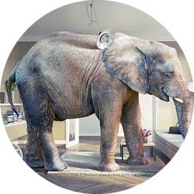
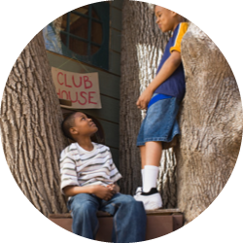
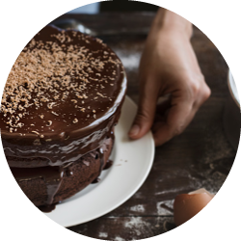
STORY PROBLEMS: Risks
16
CHALLENGE 1
A risk is the possibility that something bad might happen.
Directions: Pick one of the scenarios below. On a separate piece of paper, create a chart to show the risks and ways to avoid or reduce each risk.
Someone just gave you an elephant as a gift.
A friend comes over to help you build a tree house.
You decide to bake a five-layer chocolate cake.
1
2
3

Slide 4
Saving for Emergencies
17
Risks carry the potential to cost people time, effort, and money. That is why it’s important to save money for an emergency.
Bad news: Your pet elephant just ate the cake you baked and then sat on your new tree house. That is going to cost you a lot of money!
List some of the possible expenses below:

Slide 5


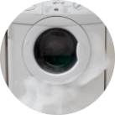
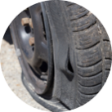

Real-Life Emergencies
18
If you were a grown-up, here are some emergencies that you might have to save money for:
An unplanned hospital stay.
A sick or injured pet needs to go to the vet.
The washing machine breaks and needs repairs. Tires wear out and need to be replaced.
Working fewer hours but still need to pay the bills.
What other emergencies might grown-ups need to save for?

