Slide 1
Money Smart for Young People
Grades 3–5
Lesson 3:Make a Plan

Slide 2
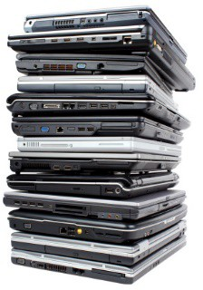
How Much is $10,000?
11
You just won $10,000? Congratulations!
Each example below is something you may be able to buy for about $10,000:
A trip for four to another country
4 used cars
10 large, flat-screen televisions
20 laptop computers
200 video games
100 concert or amusement park tickets
1,000 movie tickets
10,000 packs of granola bars

Slide 3
STORY PROBLEMS: Budget
12
A budget is a spending plan to help you manage your money.
Directions: Read the problem and answer the questions.
Imagine that you are grown up. You saved up $10,000! Your savings will be your only income for the next five months. (Then you start a new job.)
Your Monthly Expenses:
Rent $910
Car Payments | $410
Food | $200
Gasoline | $100
Your Monthly Savings | $180
Total | $1,800
How much money will you have left after the first month?
How much money will you have left after five months?
Which expenses can you pay for using the money you have left?

Slide 4
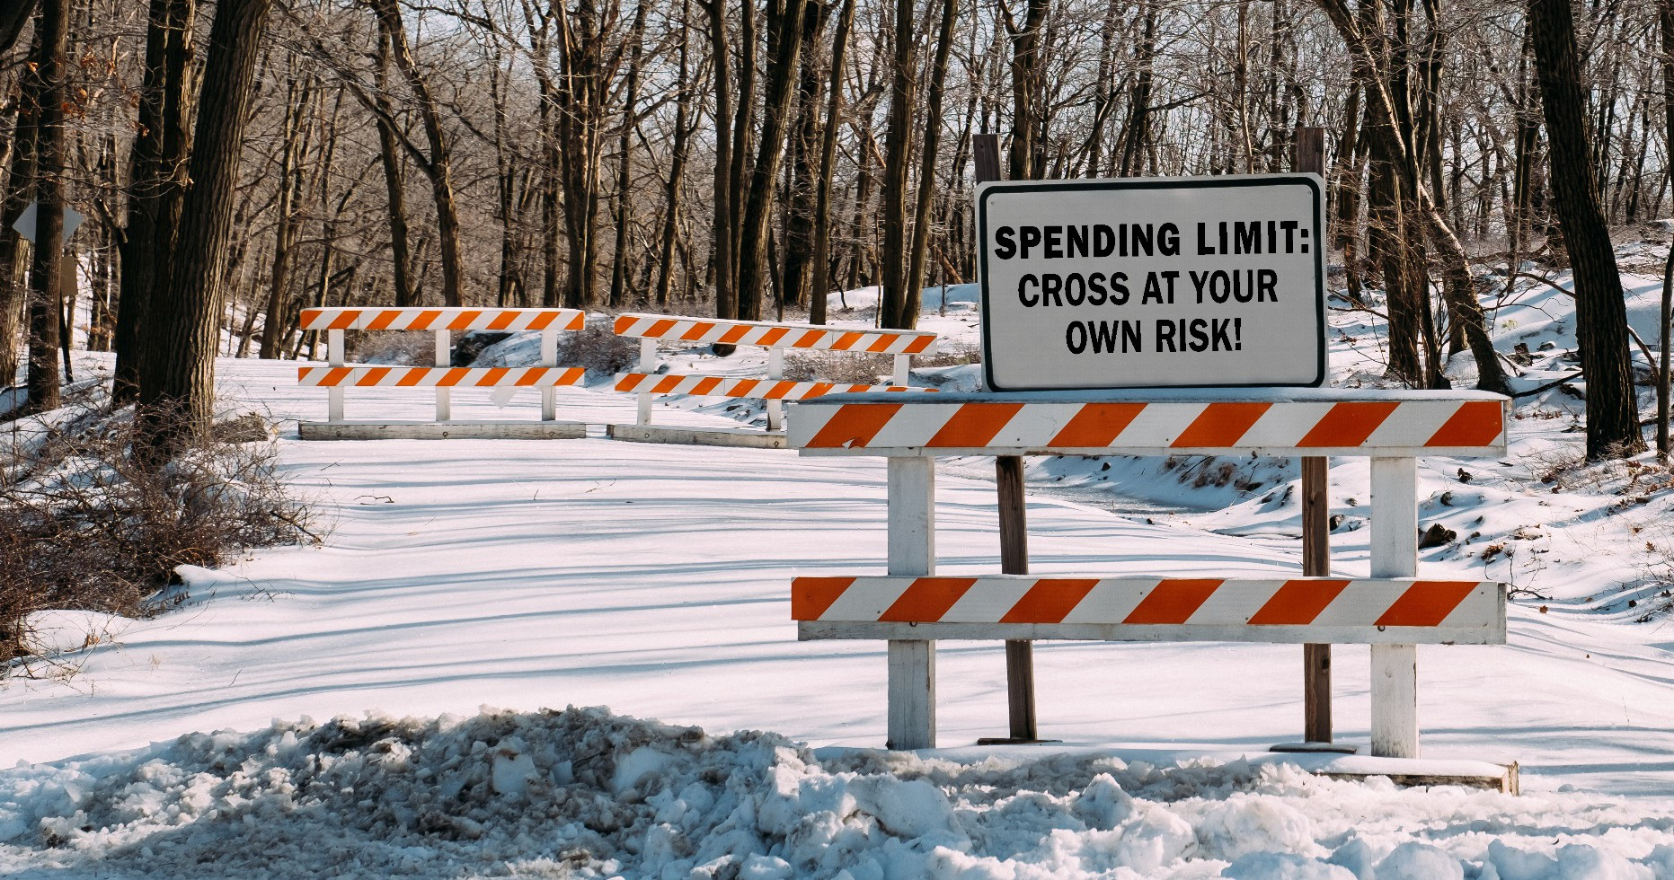
Spending Limits
13
A spending limit is a limit to the amount of money a person can spend.

Slide 5
Pay Yourself First
14
What does “pay yourself first” mean? When you receive money, make sure to save some of it before you spend it.
Pay yourself first by deciding how much to save. Let’s say you decide to save 10% of your money. That means you would save:
A dime (10 cents) for every $1
$1 for every $10
$2 for every $20
Based on the example above (saving 10%), answer these questions:
How much money would you save if you had $50?
How much money would you save if you had $100?

