Slide 1
Money Smart for Young People
Grades 3–5
Lesson 1: Money Matters

Slide 2

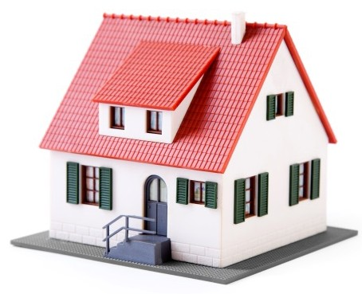
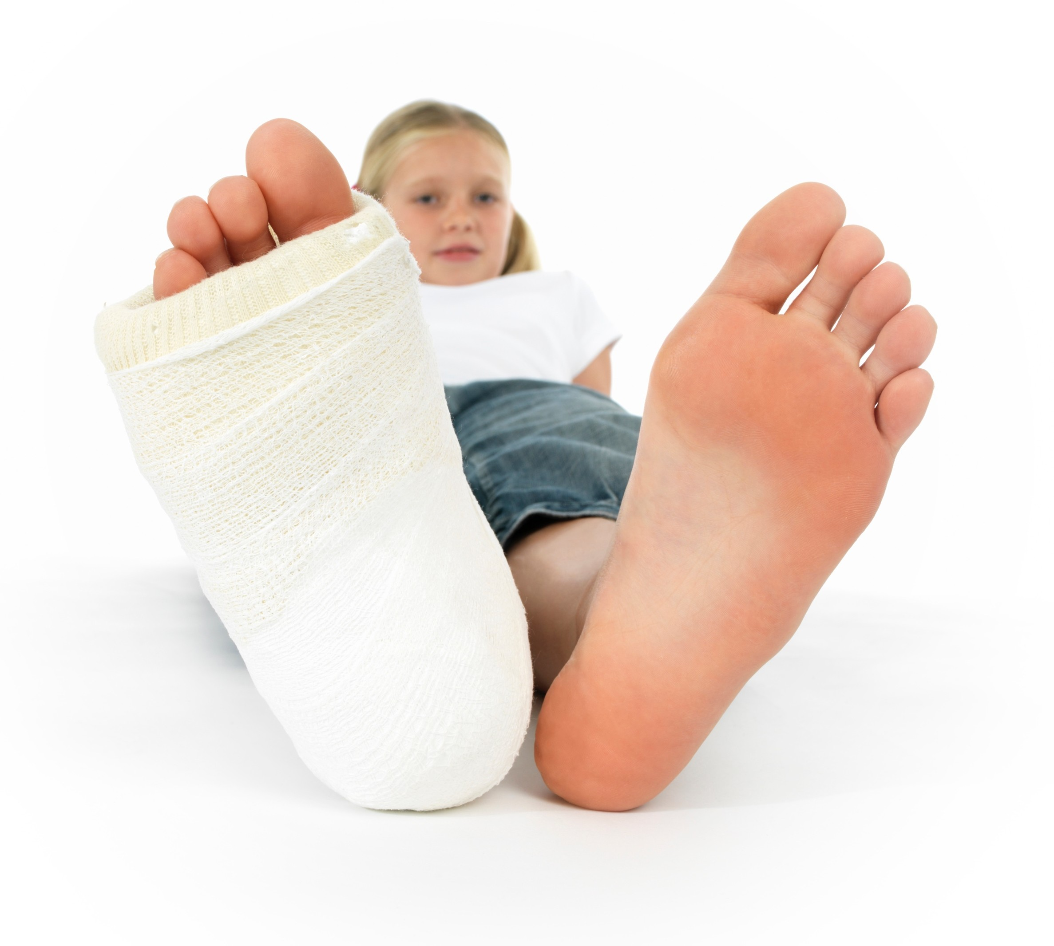
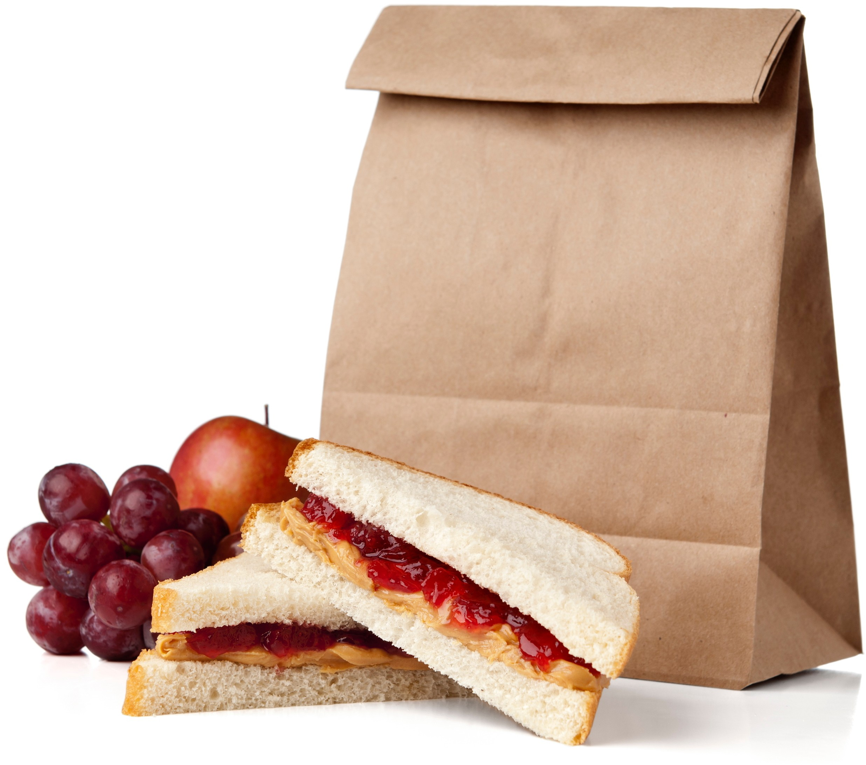
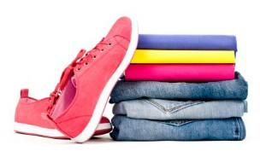
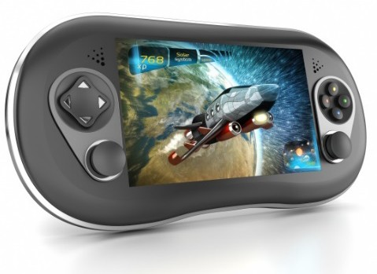

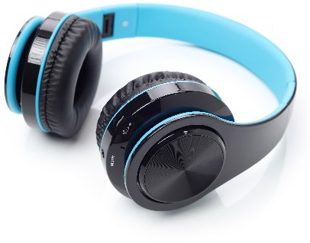

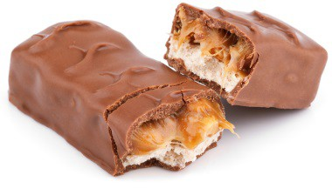
What are needs and wants?
2
A need is something that you cannot live without.
Water Food Shelter Clothes Medical Care
A want is something you would like, but can live without.
Toys
Candy
Video Game
Headphones
Movie Tickets

Slide 3


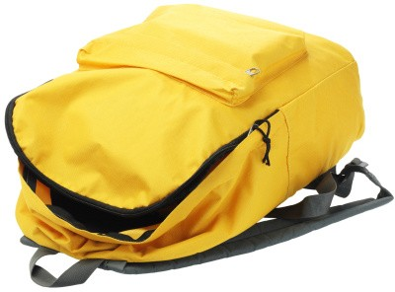
What SHOULD I BUY ?
3
Maya has $25 saved. She would like to buy three things.
Book ($8) Science Kit ($15) Backpack ($20)
The latest book by her favorite author. She can’t wait to read it!
A magnet science kit with over 30 experiments! She loves science.
A new backpack; her old backpack is badly damaged.
Which of the items are needs? Wants?
Which item is the most important to buy?
How do you think Maya should spend her money? Why?

Slide 4
STORY PROBLEMS: Opportunity Cost
4
CHALLENGE 1
An opportunity cost is the trade-off of making one choice over another. When you make a choice, you give up something else.
Directions: Read each situation below to identify the opportunity costs.
Tanisha has a soccer game next Saturday. She was invited to a friend’s birthday party on the same day. Tanisha has to decide whether she should go to the soccer game or the party. If Tanisha chooses to go to the party, what is the opportunity cost (the trade-off)?
James has $5 to spend on lunch. He is trying to decide whether he should buy a chicken sandwich or a hamburger. Both meals cost $5. What is the opportunity cost if James chooses the hamburger?
You can either walk or ride your bike to your friend’s house. What is the opportunity cost of each choice?

Slide 5
STORY PROBLEMS: Opportunity Cost
5
CHALLENGE 2
An opportunity cost is the trade-off of making one choice over another. When you make a choice, you give up something else. That “something else” may be time, money, or another resource.
Directions: Read the situation below and choose the best answer to the question.
Trey decided to go with friends to see a movie on Sunday afternoon from 2:00 pm to 3:30 pm. The cost of the movie ticket was $9.50. What was the opportunity cost of Trey going to the movies?
  the time he gave up to go see the movie
  his friends not paying for his movie ticket
  $9.50, the money he spent on a movie ticket
  the time he gave up and the $9.50 he spent

Slide 6
STORY PROBLEMS: Opportunity Cost
6
CHALLENGE 3
An opportunity cost is the trade-off of making one choice over another. When you make a choice, you give up something else. That “something else” may be time, money, or another resource.
Directions: Read the situation below and choose the best answer to the question.
Sarah went to the mall with her friends on Saturday morning for three hours. Before they left, they had lunch at the food court. Sarah paid $9.50 for her meal. She normally walks her neighbor’s dog on Saturday morning and makes $5. Her brother walked the dog instead and was paid $5. What was the opportunity cost of Sarah going to the mall?
  $5, the money she gave up by not walking the dog
  the use of the $9.50 that she spent on lunch
  $14.50, the cost of lunch, plus the $5 not earned
  the $14.50 (lunch and money lost) and time

