Slide 1
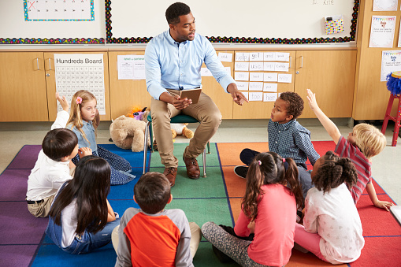
Money Smart for Young People
Grades Pre-K–2
Lesson 6: Borrowing Bills

Slide 2

Borrowing Books Responsibly
Take good care of books.
Lose books.
Give books away to someone else.
Return books on time (due date).
Use books respectfully.
Draw in or tear out pages from a book.

Slide 3

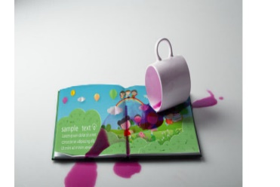
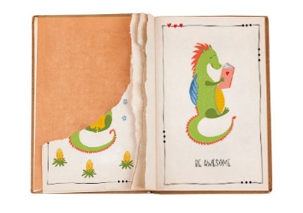
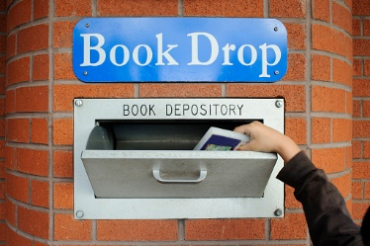
Ways to Borrow And Share
What are some examples of how we should treat things we borrow and share?

Slide 4
story problems: Borrowing Bills
Challenge 1
Brian has five colored pencils. His friend Andy wants to borrow three colored pencils to draw. How many colored pencils does Brian have after he lets Andy borrow some?
Draw a picture of Brian’s five colored pencils.
Circle the colored pencils Andy wants to borrow.
Count and then write the number of colored pencils Brian has left.
Notes:
ANSWERS:
c) 2 colored pencils

Slide 5
story problems: Borrowing Bills
Challenge 2
Callie and Isabel have 40 pennies all together. Isabel has 16 pennies.
How many pennies does Callie have?
If Callie lends 9 pennies to Isabel, how many pennies does she have left?
How many pennies is Isabel borrowing from Callie?
How many pennies does Isabel now have in total?
Notes:
ANSWERS:
a) 24 pennies
b) 15 pennies
c) 9 pennies
d) 25 pennies

