Slide 1
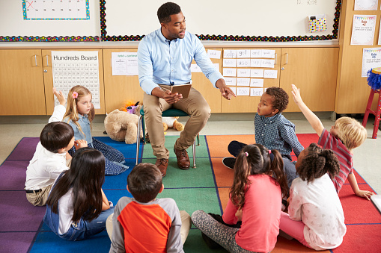
Money Smart for Young People
Grades Pre-K–2
Lesson 4: Ready Set Goal

Slide 2

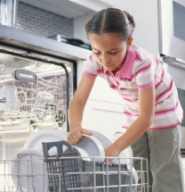
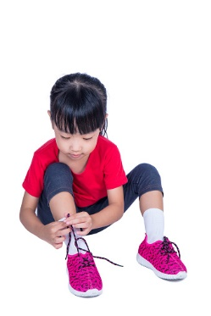
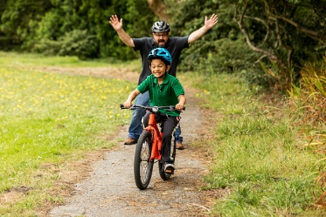
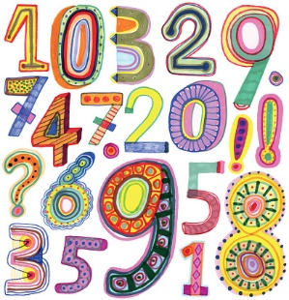
My Goals
Read every night.
Help with the chores.
Tie my own shoes.
Ride a bicycle.
Count to 100.

Slide 3
CHART: Student Goals
Reading Every Night | Saving for a Toy
Number of Votes
Goals

Slide 4

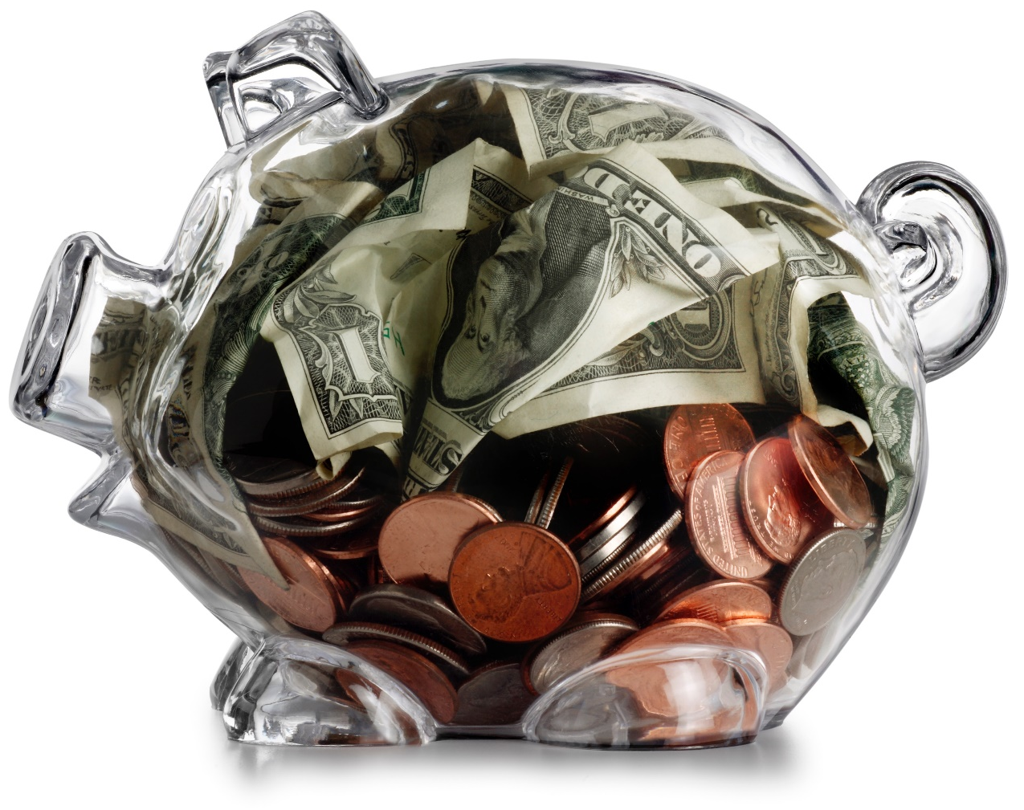
Savings Goal Example
I am saving for a
soccer ball.

Slide 5
story problems: Ready. Set. Goal.
Challenge 1
Sam wants three balloons: one for his mom, one for his sister, and one for himself. He has two balloons. How many more balloons does he need to reach his goal of three balloons?
Draw the balloons Sam already has.
Draw the number of balloons he needs.
Write a number sentence to solve the problem.
Notes:
ANSWERS:
c) 2 balloons + 1 more balloon = 3 balloons

Slide 6
story problems: Ready. Set. Goal.
Challenge 2
Sophia wants to buy a new cage for her pet rabbit. The cage costs $10, but Sophia has only $3. Sophia does chores around the house to earn extra money. She earns $1 for every chore she does.
Does Sophia have enough money to buy the cage?
How much more money does Sophia need to earn?
How many chores does Sophia need to do in order to buy the cage?
Notes:
ANSWERS:
a) no
b) $7
c) 7 chores

