Slide 1
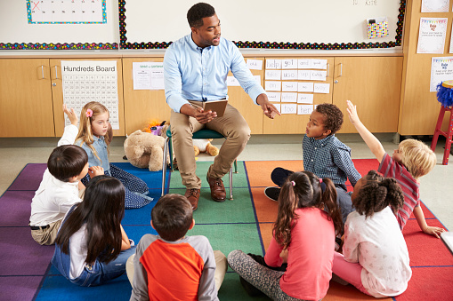
Money Smart for Young People
Grades Pre-K–2
Lesson 2: Learn to Earn

Slide 2
Graph: Our Favorite Classroom Jobs
Line Leader
Number of Votes
Jobs

Slide 3
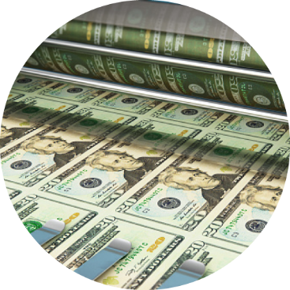
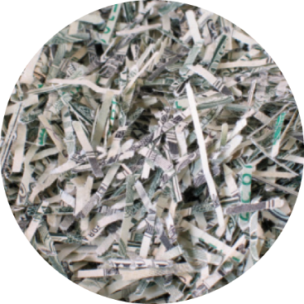
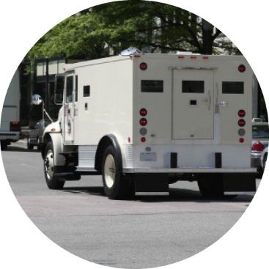
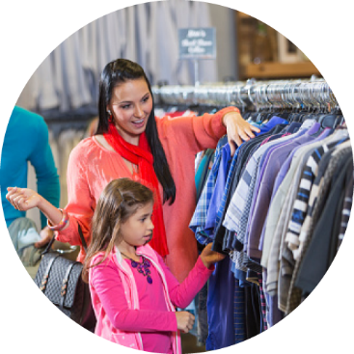
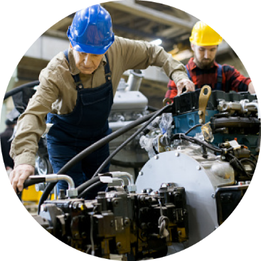
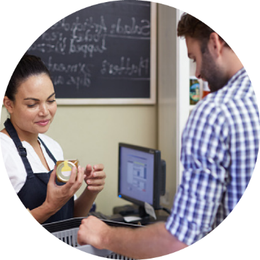
The Cycle of Money
Money is printed or made.
Old money is collected and recycled.
Money travels to bank for use.
Money is spent by shop owner.
Money is earned by worker.
Money is earned by shop owner.
Money is spent by worker.

Slide 4
STORY PROBLEMS: Learn to Earn
Challenge 1
Stephen helps his dad mow the lawn. He gets 4 quarters. He helps his mom with dishes and gets 4 more quarters. How many coins does he have?
Draw a picture of how many coins Stephen got from his dad.
Draw a picture of how many coins Stephen got from his mom.
Count all the coins.
Write the number of coins Stephen has all together.
Notes:
ANSWERS:
c) 8 coins

Slide 5
STORY PROBLEMS: Learn to Earn
Challenge 2
Sarah and Jayden have been selling cards they made for $1 each at the local store. On Monday they sold two cards, Tuesday they sold four cards, Wednesday they sold two cards.
Draw a picture of how many cards Sarah and Jayden sold for all three days.
How many cards did they sell?
How much money did they make?
If they each get half the money, how much do they each get?
Notes:
ANSWERS:
b) 8 cards
c) $8
d) $4

