Slide 1
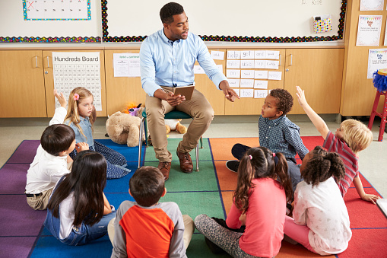
Money Smart for Young People
Grades Pre-K–2
Lesson 5: Super Savers

Slide 2
story problems: Super Savers
Challenge 1
Molly’s grandma gave her a piggy bank for her birthday. Molly also got $2 from her aunt and $3 from her grandpa. She put her money into her piggy bank.
Draw the piggy bank.
Draw the $2 Molly got from her aunt.
Draw the $3 Molly got from her grandpa.
Count how many dollars Molly has all together.
Notes:
ANSWERS:
d) $5

