Slide 1

Money Smart for Young People
Grades Pre-K–2
Lesson 3: Weighing Needs

Slide 2

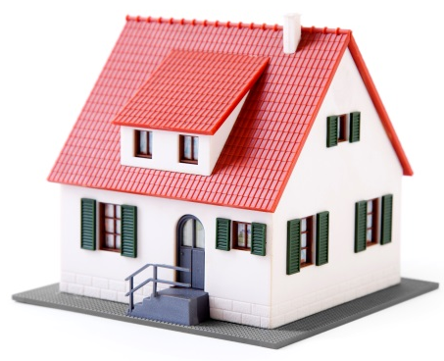
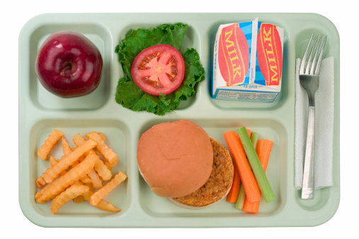
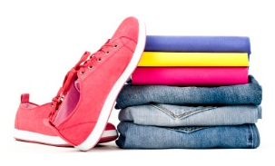
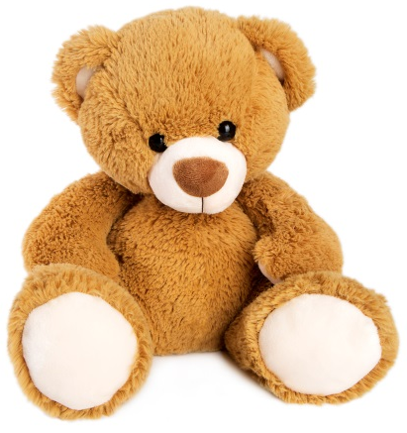
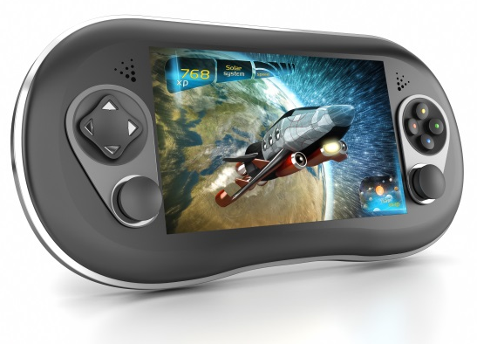
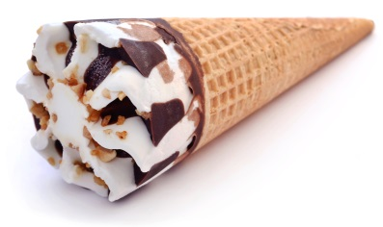
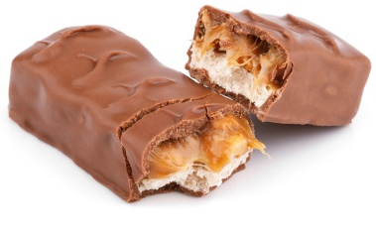
DEFINITIONS: Needs and Wants
Needs are something you must have in order to live a healthy life.
Shelter Food Water Clothes
Wants are something you would like to have but could live without.
Ice Cream Toys Candy Video Games

Slide 3
CHART: Needs and Wants
Things We NEED for Our Classroom | Things We WANT for Our Classroom
Pencils Paper | Markers Stickers

Slide 4
story problems: Weighing Needs and Wants
Challenge 1
Liam has $5 to spend. He needs to buy lunch for school but wants a toy car.
Draw a picture of the thing Liam needs, and write the word “needs” under the picture.
Draw a picture of the thing Liam wants, and write the word “wants” under the picture.
Liam wants to buy lunch for school. Lunch costs $3 and the toy car costs $2. Is Liam going to have enough money for lunch and the toy car?
Notes:
ANSWERS:
c) yes

Slide 5
story problems: Weighing Needs and Wants
Challenge 2
Maria was given $10 to spend on art supplies for summer camp. She wants to buy crayons, markers, colored paper, and stamps. She also wants to buy an extra-special eraser for her pencil. Use the prices below to solve the problems.
Crayons: $2 Markers: $3 Colored Paper: $2 Stamps: $4 Eraser: $1
Does Maria have enough money to buy all of the things she wants?
What three things can Maria buy with her $10?
If Maria only buys three things on her list, will she have enough left over for the eraser? Use drawings, words, and number sentences to show your thinking.
Notes:
ANSWERS:
a) no
b) Possible answer: Crayons, Markers, and Stamps for $9
c) Yes. If she buys crayons, markers, and stamps for $9 she will have $1 left.

