Slide 1

Money Smart for Young People
Grades Pre-K–2
Lesson 1: Counting Coins

Slide 2
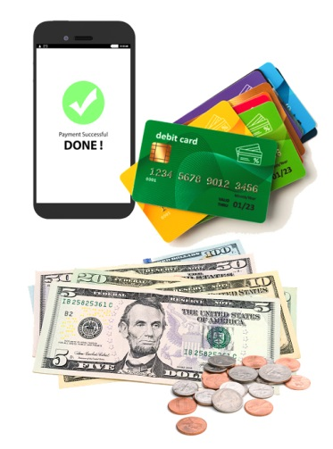
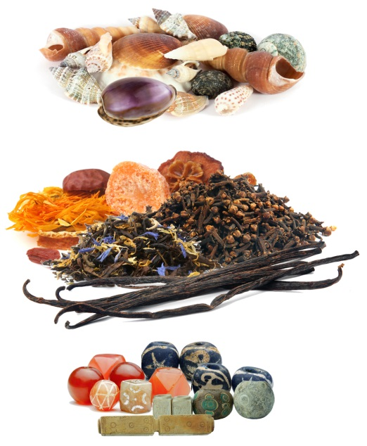
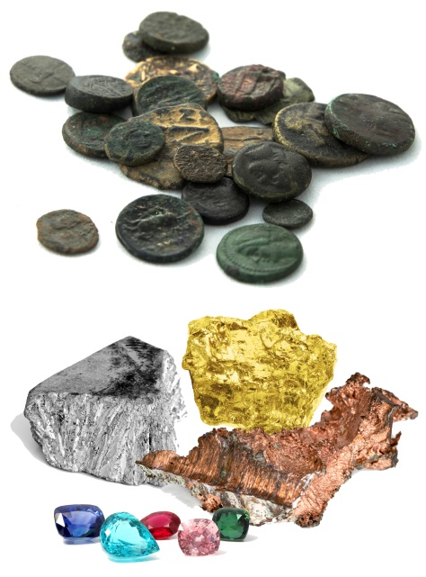
TIMELINE: The History of Money
Tea, spices, shells, beads
Gems, precious metals, coins
Money today
Past
Present

Slide 3
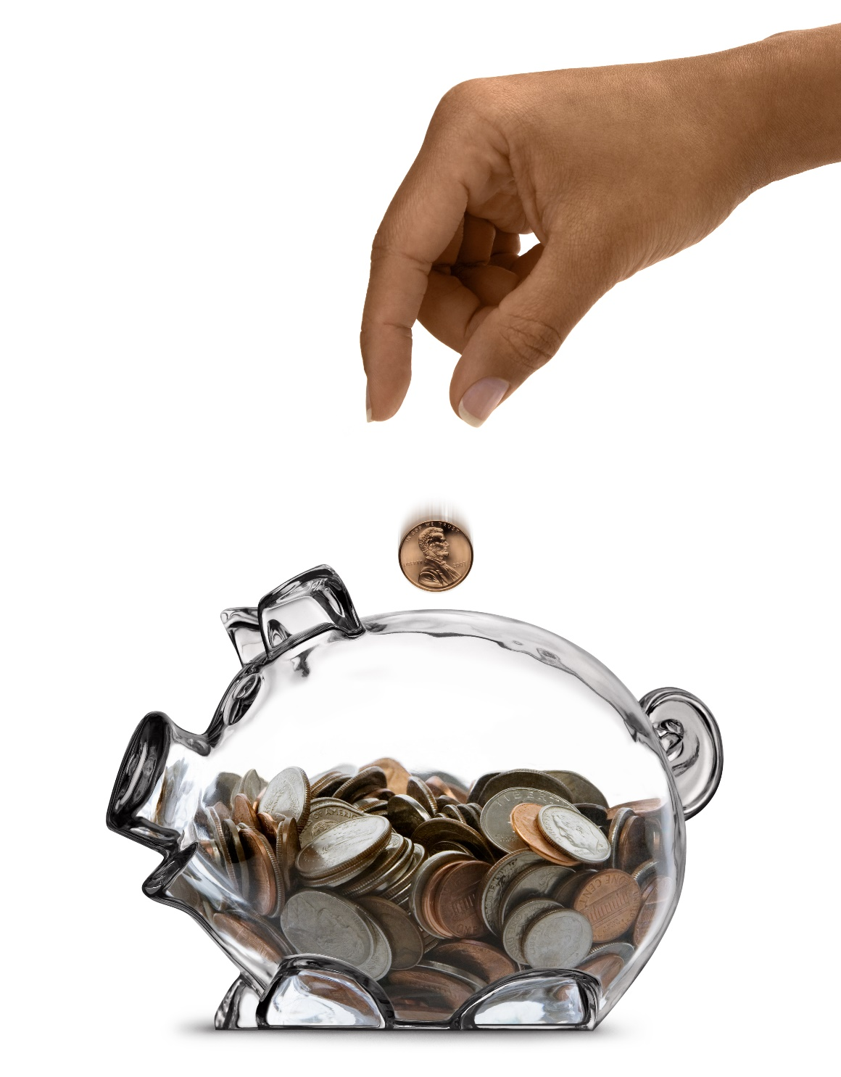
Mixed Coins

Slide 4
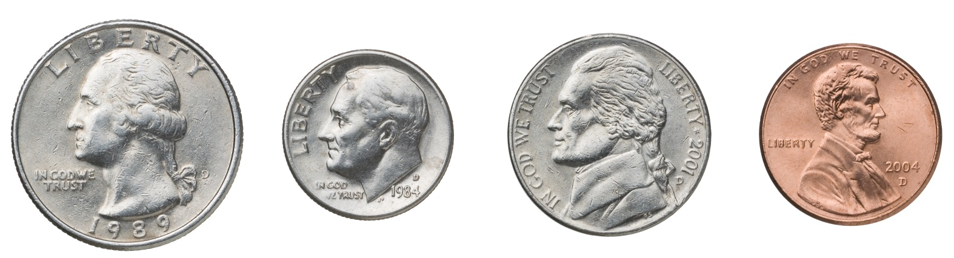
STORY PROBLEMS: Counting Coins
Challenge 1
Jamie has a handful of coins. She wants to know how many coins she has and what kind of coins they are.
Can you find the penny? The nickel? The dime? The quarter?
How many coins does Jamie have all together?
Which coin is the largest? The smallest?
Notes:
ANSWERS:
b) 4 coins
c) The quarter is the largest. The dime is the smallest.

Slide 5
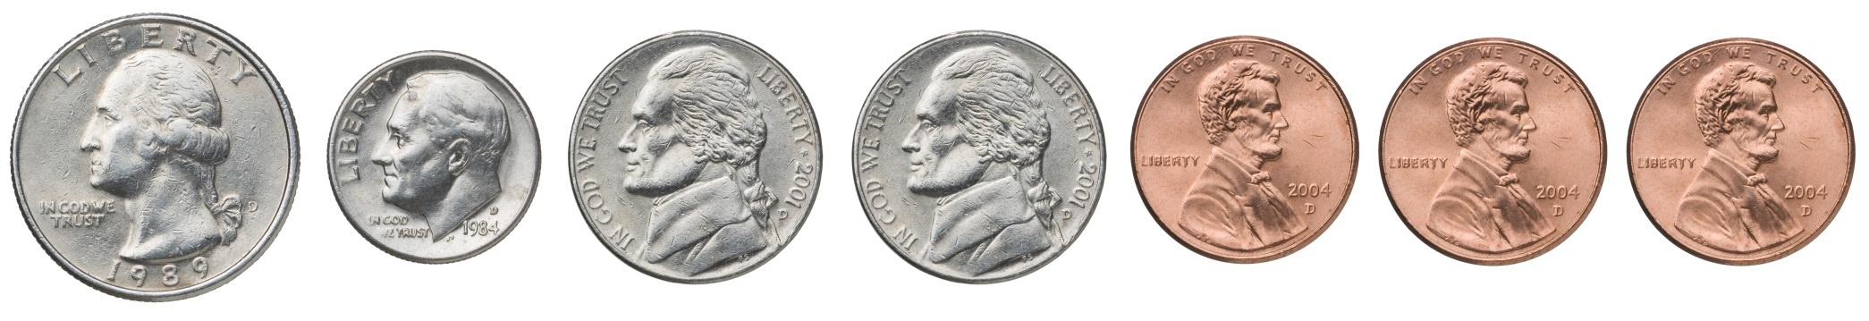
STORY PROBLEMS: Counting Coins
Challenge 2
Diego has a pocket full of change. He wants to know how many coins he has and how much they are worth.
a) How many coins does Diego have?
b) How much is each coin worth?
c) How much are they worth all together?
Notes:
ANSWERS:
a) 7 coins
b) Each penny is worth 1 cent. Each nickel is worth 5 cents. 1 dime is worth 10 cents. 1 quarter is worth 25 cents.
c) 48 cents

