Slide 1



Tax Planning
And Reporting
FOR A SMALL BUSINESS

Slide 2

Welcome
Agenda
Ground Rules
Introductions

Slide 3
Objectives
After completing this training, you will be able to:
Identify the federal, state, and local tax reporting requirements of a small business and its owner, and establish a plan to account and pay them.
Identify methods for researching the local, municipal, and county reporting/licensing requirements for a small business.

Slide 4
What Do You Know?
What do you know or want to learn about tax planning and reporting?

Slide 5



Managing Your Tax Obligations
Get informed
Plan
Save

Slide 6

Primary Business Taxes
Income Tax
Self-Employment Tax
State Income Taxes
Employment Taxes
Sales Tax
Local taxes

Slide 7
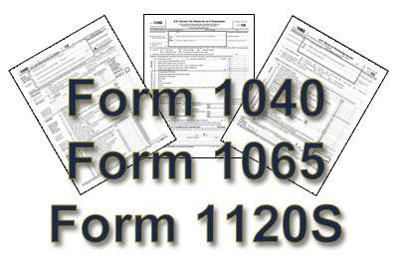
Federal Income Tax
Sole Proprietorship
Partnerships
S-corporation
C-corporation
Limited Liability Company

Slide 8

Complete Discussion Point #1 in the Participant Guide.
What federal tax forms will you need for your business?
Discussion Point #1: Federal Tax Forms

Slide 9
Employment Tax and Forms
Federal Employment Taxes
  Employer’s Annual Federal Unemployment Tax Return, Form 940
  Employer’s QUARTERLY Federal Tax Return, Form 941
Forms
  Employee’s Withholding, W-4 Form
  Wage and Tax Statement, W-2 Form
  Miscellaneous Income, Form 1099-MISC

Slide 10
State and Local Taxes
State/County/City Income Tax
Permits
Licenses
Fictitious name permit (“doing business as”)
State Sales Tax

Slide 11

Know Your Tax Obligations
Your form of business determines how you pay income taxes
Pay-as-you-go

Slide 12

Cost of Not Paying Your Taxes
Never use payroll taxes for working capital during cash flow shortages.

Slide 13

Money Management for Taxes
Know when, what, and how much
Save for taxes
Separate accounts

Slide 14
Accounting Systems
Deductions
Bookkeeping
Business accounting software
Cash versus accrual accounting methods

Slide 15
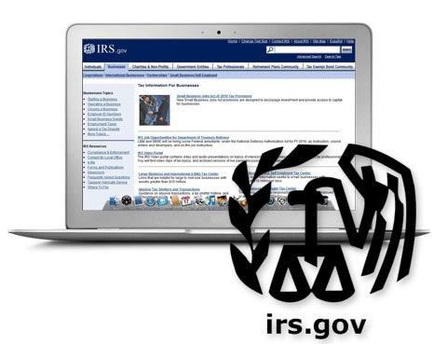
Using an accountant
Doing it yourself
Accountant services
Where to find a qualified business accountant

Slide 16
Services Business Accountants Offer
Business consulting
Personal finance advice
Information on organizational structures
Financing information
Audits
Reviewed or audited financial statements

Slide 17
Five Key Points to Remember
Get qualified advice.
Learn your business tax liability: income, employment, self-employment, sales and social.
Set money aside to cover your taxes and avoid comingling funds.
Have an accounting system in place to track income and expenses.
An accountant can help you manage your business.

Slide 18

Summary
What final questions do you have?
What have you learned?
How would you evaluate the training?

Slide 19
Conclusion
You have learned about:
  Managing your tax obligations
  Typical taxes a business pays: Income, Self Employment, Sales, Employment, Local.
  The forms and processes used to pay business taxes

