Slide 1
Insurance
For a Small Business
Updated: 09-2016

Slide 2

Welcome
Agenda
Ground Rules
Introductions

Slide 3
Objectives
Identify the types of insurance required for a small business
Identify other types of insurance a small business should consider
Explain why insurance is important for a small business

Slide 4

What Do You Know?
What do you know or want to learn about insurance?

Slide 5
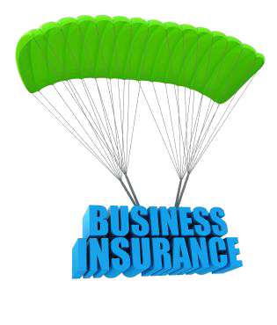
Insurance for a Small Business
Six key areas
Insurance your business may require
Other types to consider
Reasons for insurance
Location-related considerations
Selecting a policy, agency and agent
What to do after the purchase

Slide 6

Insurance Your Business May Require
State and Local Requirements
Always check with federal, state, county and local governments
Medical insurance with specific coverage may
be required for employees
Automotive insurance coverage for vehicles used in connection with the business

Slide 7

Other Liability Insurance
Professional Liability Insurance
May be required for
Certain professional licenses
Certificates of business or professional business registrations
General Liability Insurance
Directors & officers
Liability laws change –
Stay Informed

Slide 8

Discussion Point #1: Work-Specific Insurance
Review examples of work-specific insurance which are required by certain licenses. Here are a few to begin:
Restaurant – food business insurance
Construction company – general
contractor’s liability
Auto repair shop – business general liability
Can you list other professions that require insurance?

Slide 9
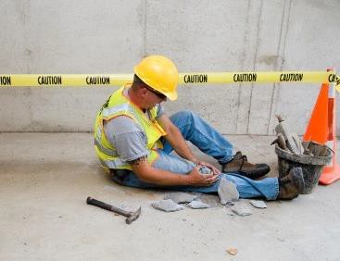
Worker’s Compensation Insurance
Protects against illnesses, injuries at work.
Pays for rehabilitation, retraining
Addresses payments to beneficiaries and medical payout limits
Required by most states, check state laws
Private or state administered

Slide 10

Unemployment Insurance
Benefits those who are unemployed through no fault of their own.
Willing and able to work, actively searching
Federally regulated, state administered
Check with state and Federal Dept. of Labor
Always make payments, avoid penalties
and actions (lien, misdemeanor, felony)

Slide 11
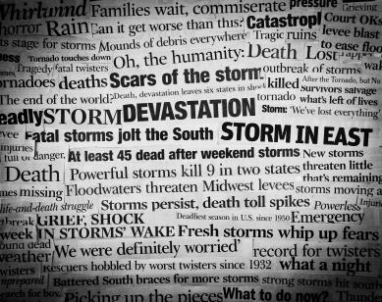
Other Types of Insurance to Consider
Property Insurance
Commercial – natural disaster and theft
Equipment – coverage in commercial policy and repair and replacement of parts
Inventory – suppliers shipments and in stock

Slide 12
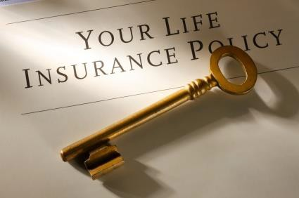
Other Types of Insurance to Consider (continued)
Loss of income
Life
Disability
Medical

Slide 13
Discussion Point #2: Required Insurance
Review examples of required business insurance.
Is your business required by law to carry any of these types of insurance?
Liability
Worker’s Compensation
Unemployment
Disability
If not required, should it carry the insurance anyway? Why?

Slide 14

Lender or Investor-Required Insurance
When financing, a lender or investor may require you show insurance protecting:
Business assets (building, property)
Cash flow – provision for interruption of business (e.g., reconstruction, repairs)
In the event of owner’s disability or death

Slide 15
Activity 3: “Key Person” Policy
Think about and respond to these discussion points.
Do you have a list the names who could run your business or that you would trust to do so, if you were ill for an extended period of time?
List who would take over your business in the event of your death.
Do you have a plan for your business in the event of your death?
Is there a family member or trustee named to liquidate the assets?

Slide 16
Activity 3: “Key Person” Policy (continued)
Think about and respond to these discussion points.
What about employee ownership?
Would selling to the employees provide income to a spouse not involved in the business?
Do you have life insurance to cover all liabilities of the business?

Slide 17
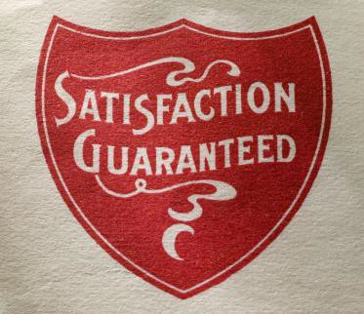
Surety Bonds
A surety bond is issued by a third party, known as a surety, as a guarantee the second party will fulfill its obligations or meet certain laws. If the second party fails to do this, the bond covers the damages.
Required for some licenses or permits (e.g., car dealer, construction contractor)
Protection for consumers and for government
“Bid bond” may be required to submit a bid to the government

Slide 18

Reasons for Insurance
Why is it important to have insurance?
Manage the risks involved in business
Protection of assets – cash or property
Protection from loss of income
Maintain continued financing
Protection from injuries and damages received or inflicted

Slide 19
Reasons for Insurance (continued)
Why is it important to have insurance?
Legal and regulatory requirements
Retention of employees
Business continuity – recovery from disasters, systems continuations, maintains cash flow
Protection from errors

Slide 20
Location-Related Considerations
Business location affects type of policy
Home-based – Add-on to homeowner’s or separate
Warning: Your traditional homeowner’s insurance may NOT cover damage caused by your home-based small business!
Retail – one or more locations, inventory theft, credit card theft, personal vehicle for deliveries

Slide 21
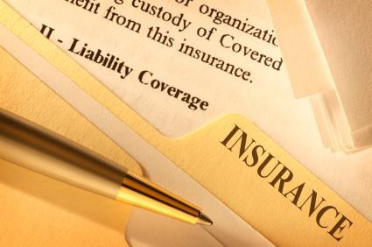
Location-Related Considerations (continued)
Business location affects type of policy
Commercial – greater coverage than Retail, larger businesses
Vendor – kiosks at festivals, conferences, full- time or shorter periods

Slide 22
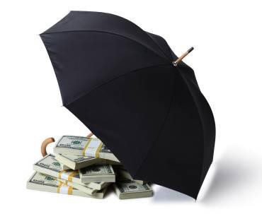
Selecting a Policy
Weigh the costs to insure the risk
Does it make sense? Could you cover it without insurance?
Consider policy costs with deductibles and coverage limits
Is the coverage sufficient?
Does the policy provide for growth?
Are there time constraints on modifying coverage?

Slide 23

Selecting a Company and an Agent
Compare quotes, coverage, deductibles, and other details
Stable and accessible?
Check consumer and business reviews, network with others
Know what’s NOT covered!

Slide 24
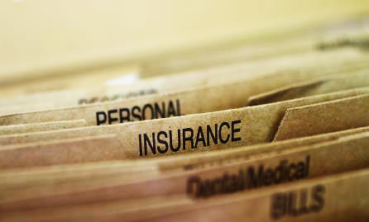
What to Do After the Purchase
Keep policies easily accessible
Keep phone numbers readily available
Maintain insurance-related procedures in business continuity plan
Review policies periodically
Meet with agent from time-to-time

Slide 25
What to Do After the Purchase (continued)
Financing no longer needed? Make beneficiary changes
Handle credit responsibly – premiums are affected by credit worthiness
Get credit or refund for cancellations
File complaints with state insurance department or commissioner if needed

Slide 26

Assuming Risk is Part of Doing Business
Going outside is a risk, but so is staying in.
Going out may require boots, coat, or an umbrella for protection, but staying in can result in missed opportunities.
Business insurance eases the burden of risks, so owners can “go out” to…
Focus on business growth.

Slide 27
Key Points to Remember (1 of 3)
Check federal, state, county and local laws for insurance requirements
Paying Unemployment Insurance and Worker’s Compensation premiums on time will keep your business reputation intact
Professional licensing may require additional insurance or surety bonds
Lenders and investors require insurance protection from risks involved with doing business

Slide 28
Key Points to Remember (2 of 3)
Insurance
Minimizes the impact risks can have on your ability to continue operations
Impacts continued financing
Helps retain employees
Provides protection from liabilities
Your location, facilities, autos and type of business operations determines insurance needs

Slide 29
Key Points to Remember (3 of 3)
Evaluate your risks, ask questions, compare policies and agencies
Keep accurate records for claims
Keep emergency contact information in an accessible place
Update beneficiaries, obtain releases and maintain adequate coverage

Slide 30

Summary
What final questions do you have?
What have you learned?
How would you evaluate the training?

Slide 31
Conclusion
You learned about:
Small business insurance requirements for professional licensing, unemployment and worker’s compensation
Insurance required for the protection of lenders and investors
Other types of insurance to lessen risks of disaster, liability, loss of income, injuries and death

Slide 32
Conclusion (continued)
You learned about:
The importance of insurance for your business
Differences in insurance policies for various types of facilities and locations
Comparing policies, agents and providers
What to do before you buy, while you have the policy and after the purchase

