Slide 1
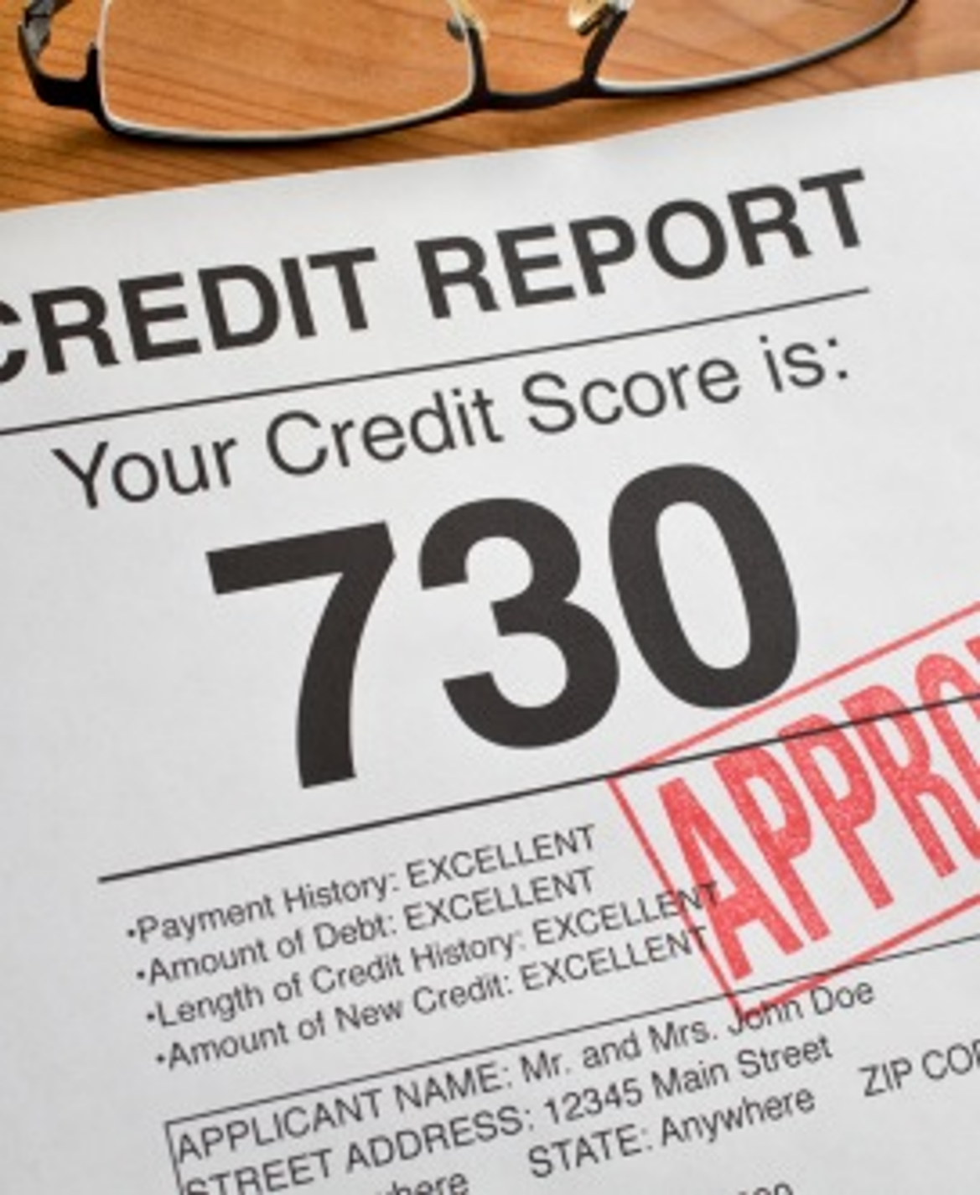
FDIC Money Smart for Small Business
2019
Building credit

Slide 2
Agenda
Welcome, Pre-Survey and Learning Objectives
SECTION I: The Big Picture: Credit Reporting and My Business
SECTION II: The Impact of Personal Credit on My Business
SECTION III: Business Credit Reporting
SECTION IV: How Lenders Evaluate Your Creditworthiness
SECTION V: Credit Reporting and Business Operations
Summary, Post-Survey, Evaluation

Slide 3
Learning Objectives
Understand how the personal and business credit reporting landscape relates to your business
Identify what goes into personal and business credit reports and scores
Learn how to establish and build strong personal and business credit histories
Understand how lenders and others may use your personal and business credit information

Slide 4
Learning Objectives (continued)
Learn how credit reporting services may benefit your business
Leverage strong personal and business credit histories for better financing terms
Recognize when business credit history may become a bigger factor in accessing financing

Slide 5

Introductions: What Do You Know?
What do you currently know, and what do you want to learn?
Complete the What Do You Know? form or Pre-Survey and discuss the results.

Slide 6

SECTION I The Big Picture: Credit Reporting and My Business

Slide 7
Why Are Credit Reporting Agencies Important to My Business?
To seek financing
To manage debts and obligations
To assess and reduce risk before entering into a relationship

Slide 8


The Definition of Credit
Credit is:
The ability to borrow money or goods based on the promise that it will be paid back; and
Important for the financial stability and success of individuals and businesses.

Slide 9
Personal Versus Business Credit History
Personal Credit History | Business Credit History
A record of your use of credit reported to consumer credit reporting agencies. | Your business’s record of handling debts and financial obligations reported to business credit reporting agencies.

Slide 10

The Importance of Credit for a Business
Access financing
Manage working capital
Acquire or manufacture inventory
Purchase necessary equipment and materials

Slide 11
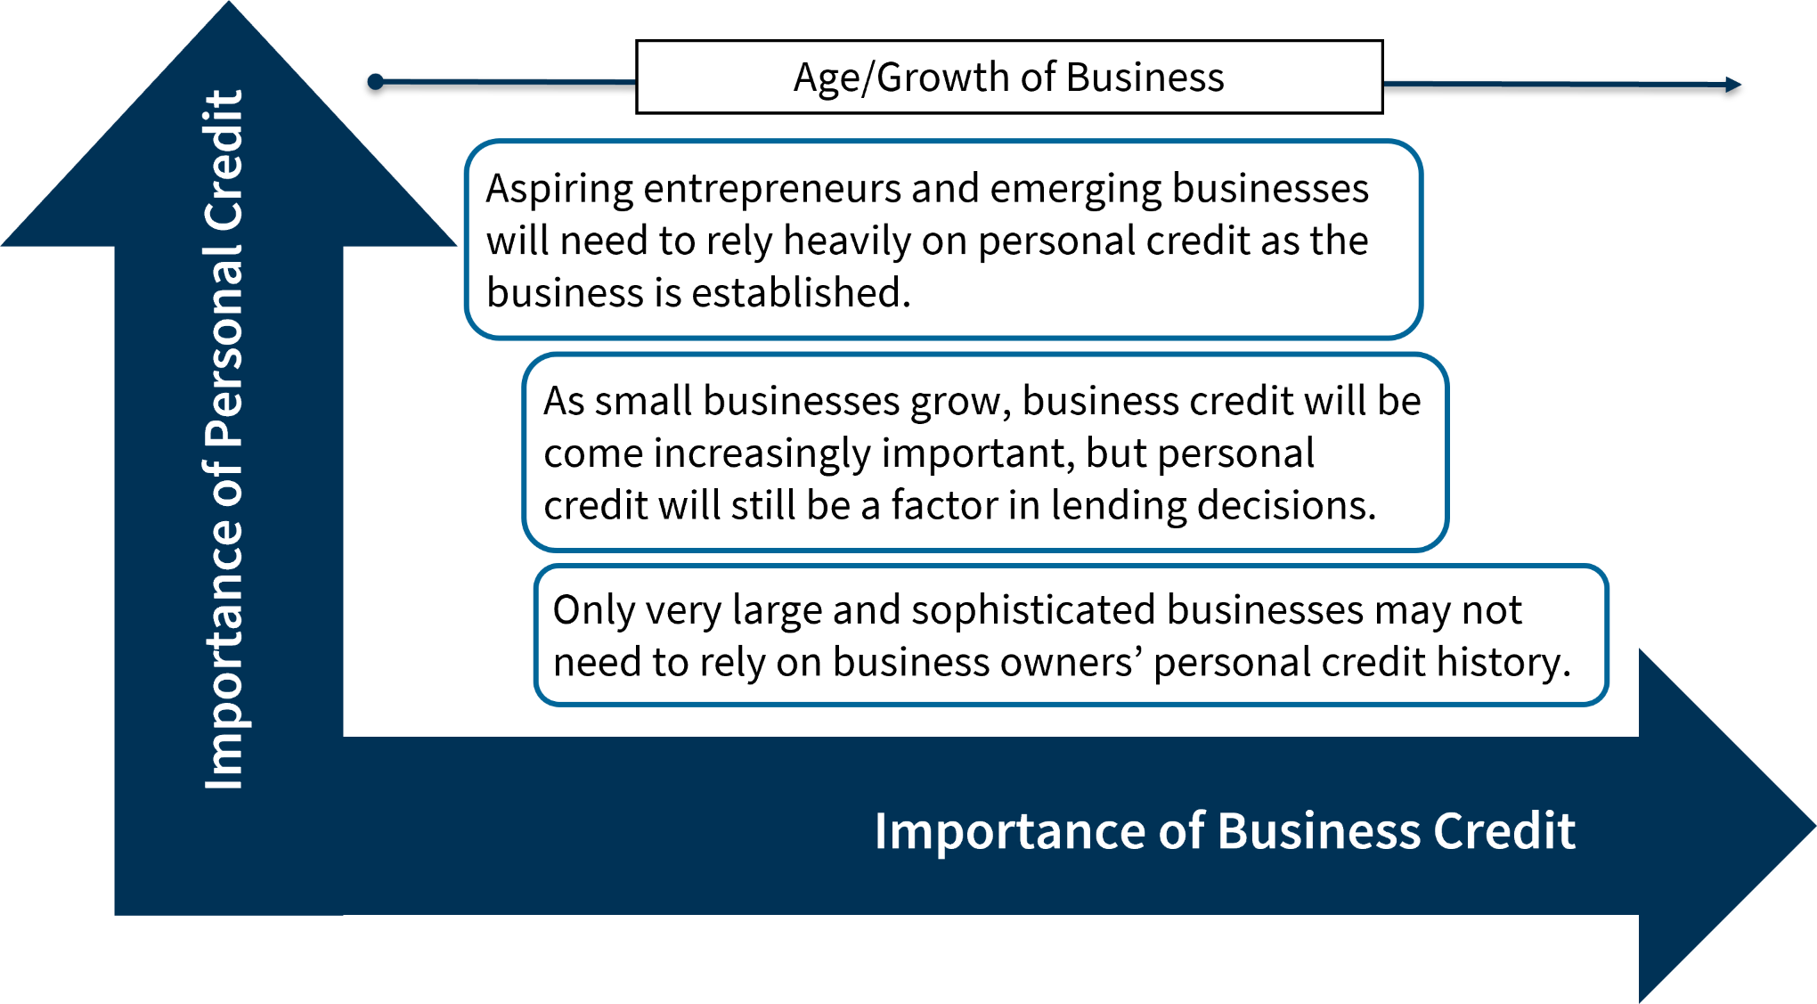
The Personal and Business Credit Spectrum

Slide 12


Case Study: Eco-Grow Solutions

Slide 13
Credit and Your Business
Have you applied for business loans or lines of credit in the past?
What information and documentation did the lender obtain or request from you during the loan application process?
Did the lender tell you if he or she would need to check your credit history?

Slide 14
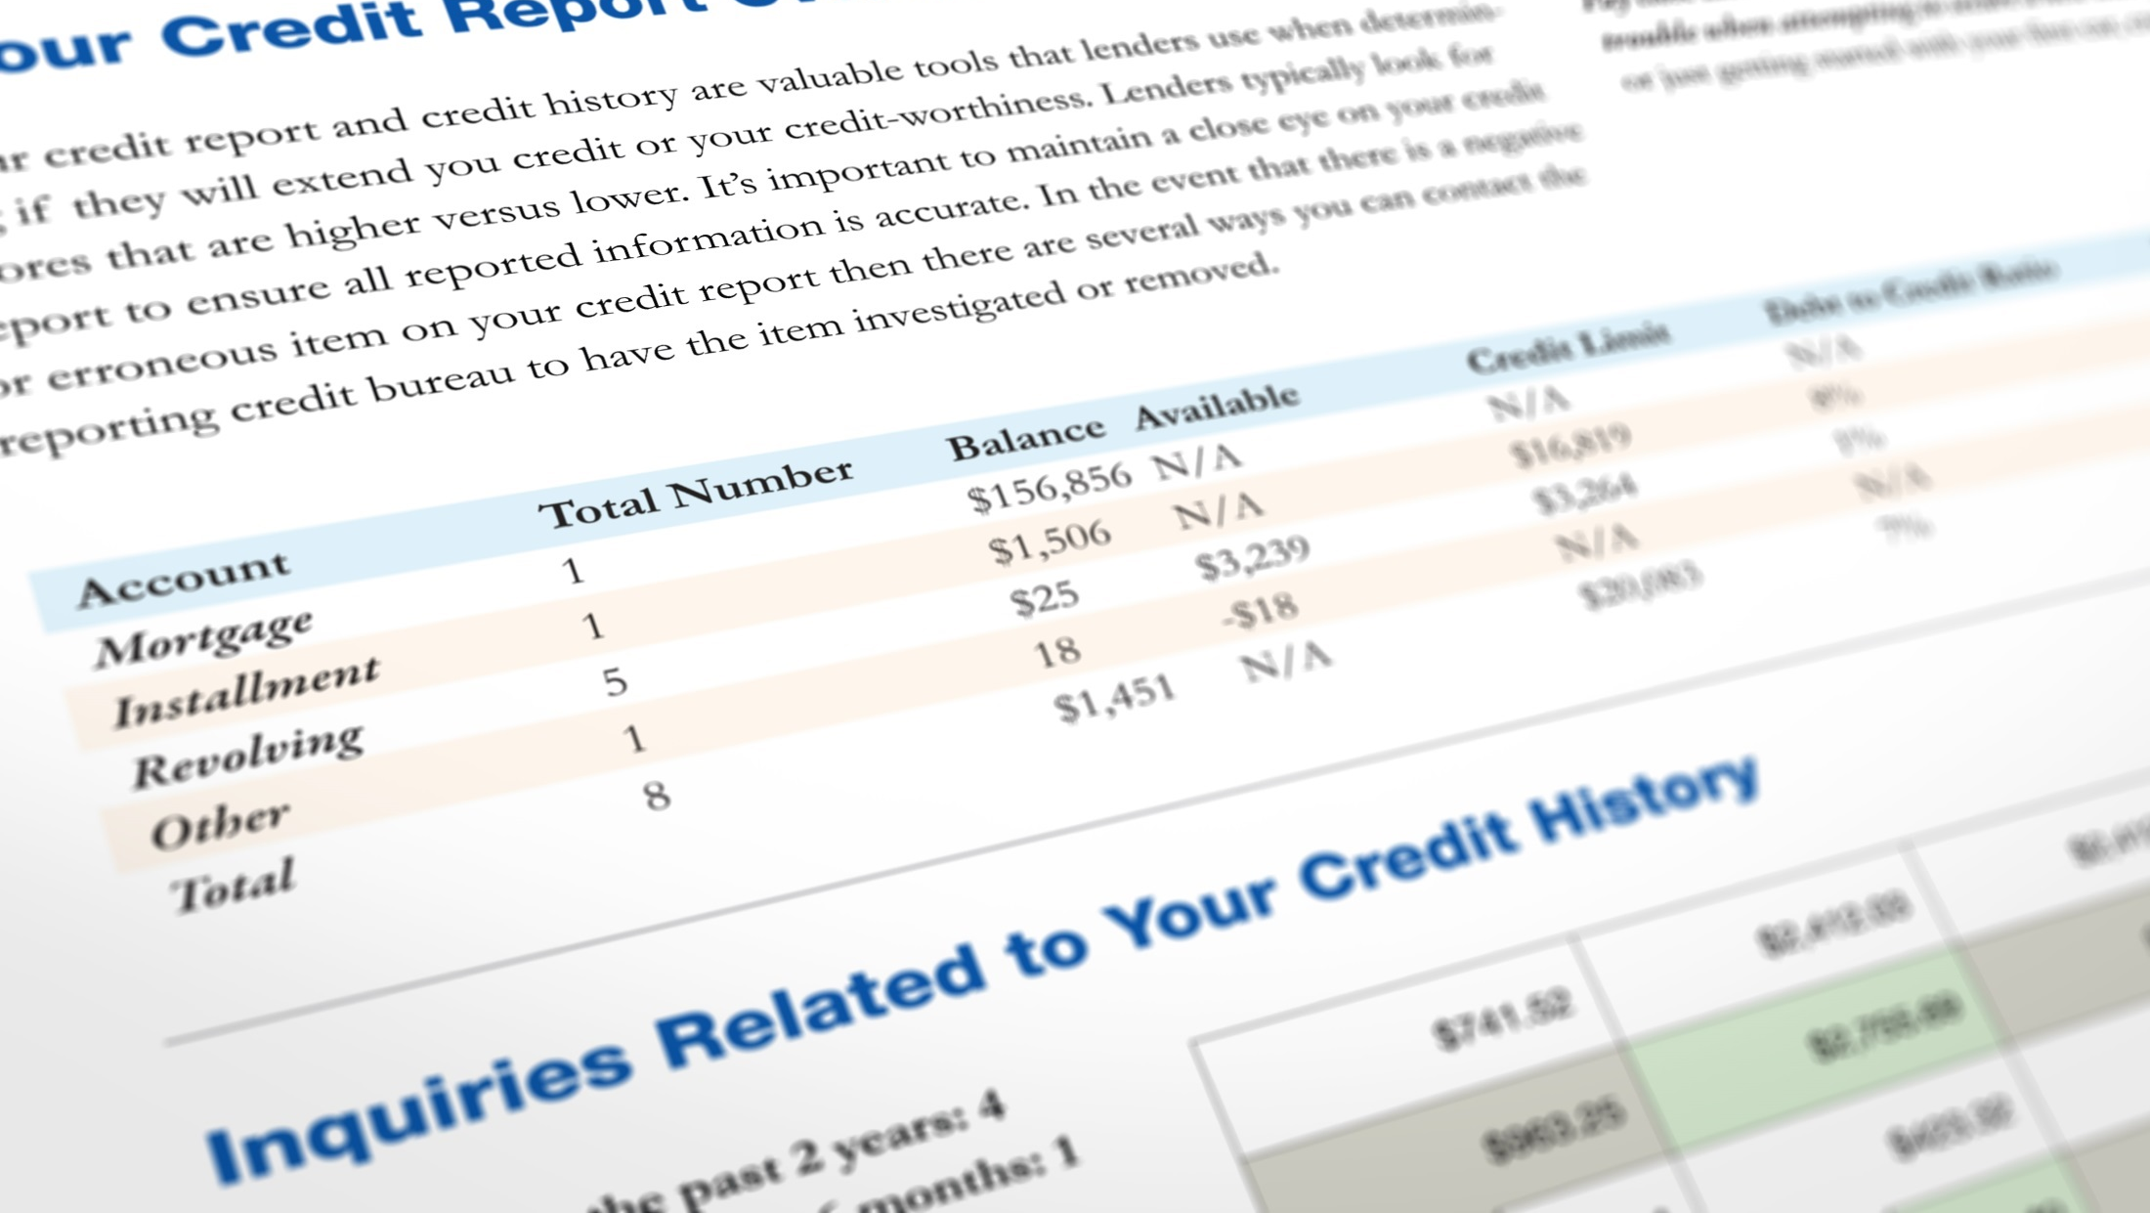
SECTION II: The Impact of Personal Credit on My Business

Slide 15
What Is a Personal Credit Report?
It tells lenders the following:
Who you are
How much debt you have — and low long you’ve had it
How frequently you have applied for credit
How much credit you are using
Whether you make on-time or late payments on credit accounts
What negative information about you exists in public records, such as bankruptcies and foreclosures

Slide 16
Major Consumer Credit Reporting Agencies
Equifax
Experian
TransUnion

Slide 17
Personal Credit Report Information
Personal Identifying Information Examples | Credit History Examples | Inquiries Example | Public Record Information* Example
Name Social Security number Current and previous addresses Date of birth Telephone number Names of current and previous employers Spouse (if married) | Open credit accounts Closed credit accounts Charged-off accounts Collection accounts Consumer statements | A list of businesses that viewed your credit report in the last 24 months, when you applied for credit | Bankruptcies Foreclosures

Slide 18

What Does NOT Appear on a Personal Credit Report?
 Checking and savings account balances
 Income
 Medical history
$ Purchases made with cash, check, or debit card
 Business account information
 Race, gender, religion, or national origin
Driving record
Marital status

Slide 19
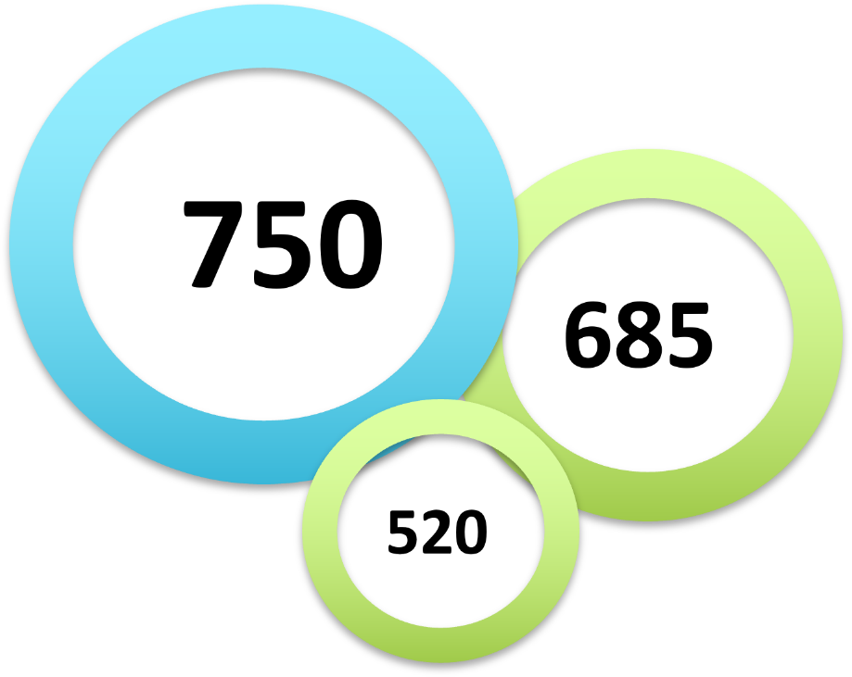
What Is a Personal Credit Score?
A number that helps lenders determine your credit risk
Frequently used score models:
FICO® Score
VantageScore®
Many lenders also use their own credit scores.
Circles labeled 520, 685, and 750, representing credit scores

Slide 20
FICO® Score and VantageScore®
Typical score range: 300 to 850
Score factors:
VantageScore®
Past payment history | Extremely influential
Age and type of credit | Highly influential
% of credit used | Highly influential
Total balances/debt | Moderately influential
Recent credit behavior and inquiries | Less influential
Available credit | Less influential
FICO®
Past payment history | 35%
Outstanding debt | 30%
How long you have had credit | 15%
New applications for credit | 10%
Types of credit | 10%

Slide 21
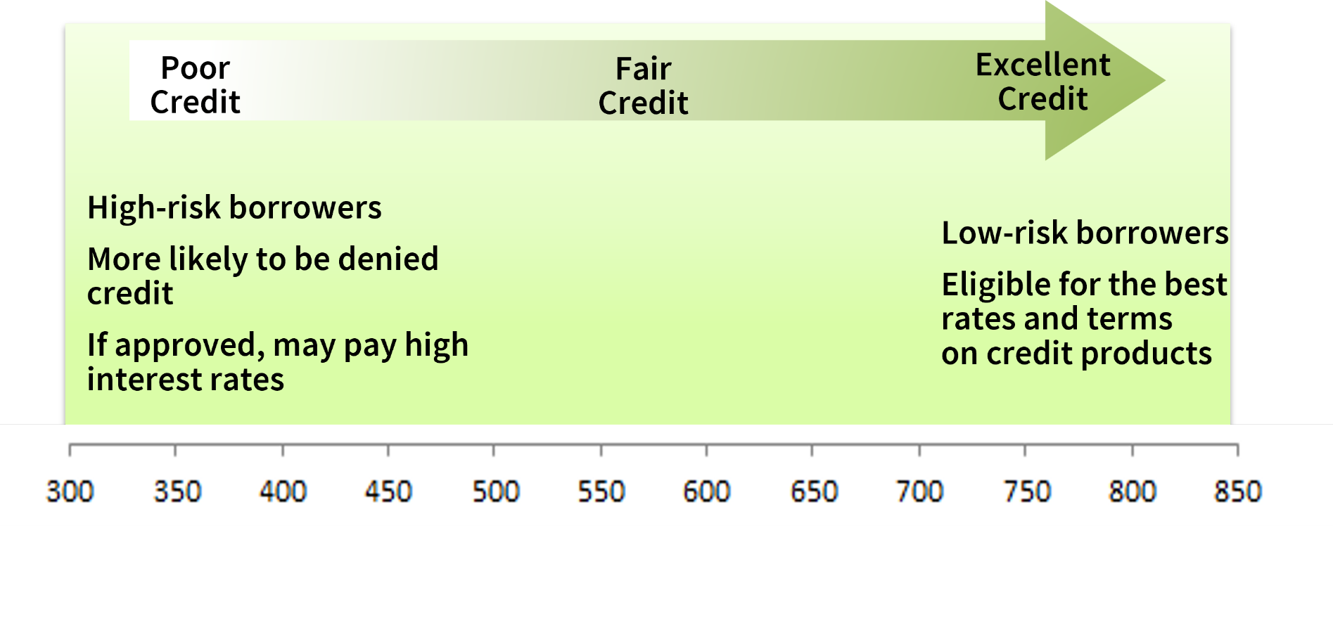
What Is a Good Personal Credit Score?

Slide 22

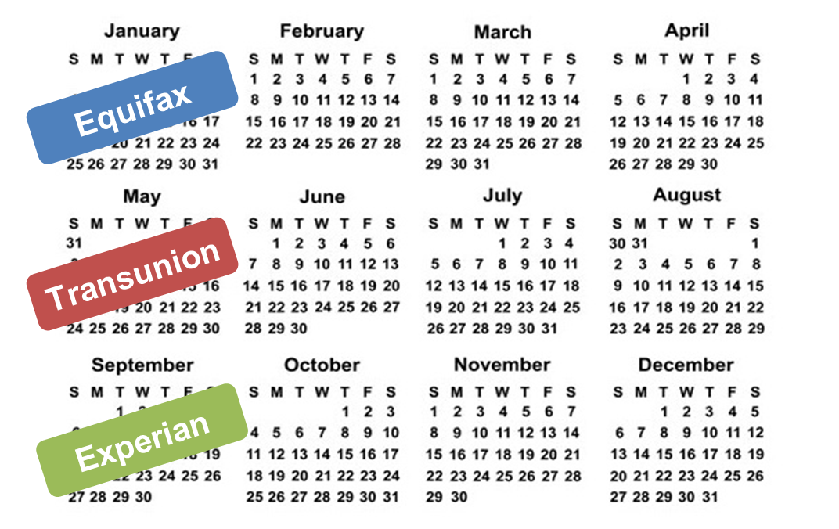

Keeping Up With Your Personal Credit Report (1 of 3)
Receive one free personal credit report every 12 months from each of the three major credit reporting agencies through www.annualcreditreport.com.
Get your reports regularly
TIP: Order one report every four months to review your credit throughout the year.

Slide 23
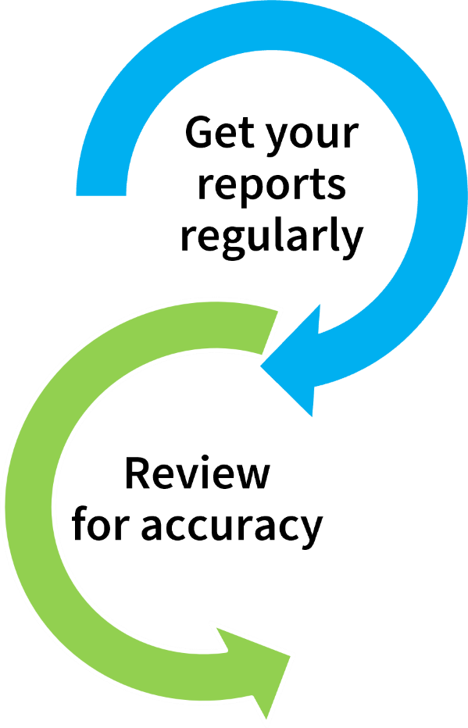
Keeping Up With Your Personal Credit Report (2 of 3)
TIP: Use a checklist to make sure you are reviewing your report in detail.

Slide 24
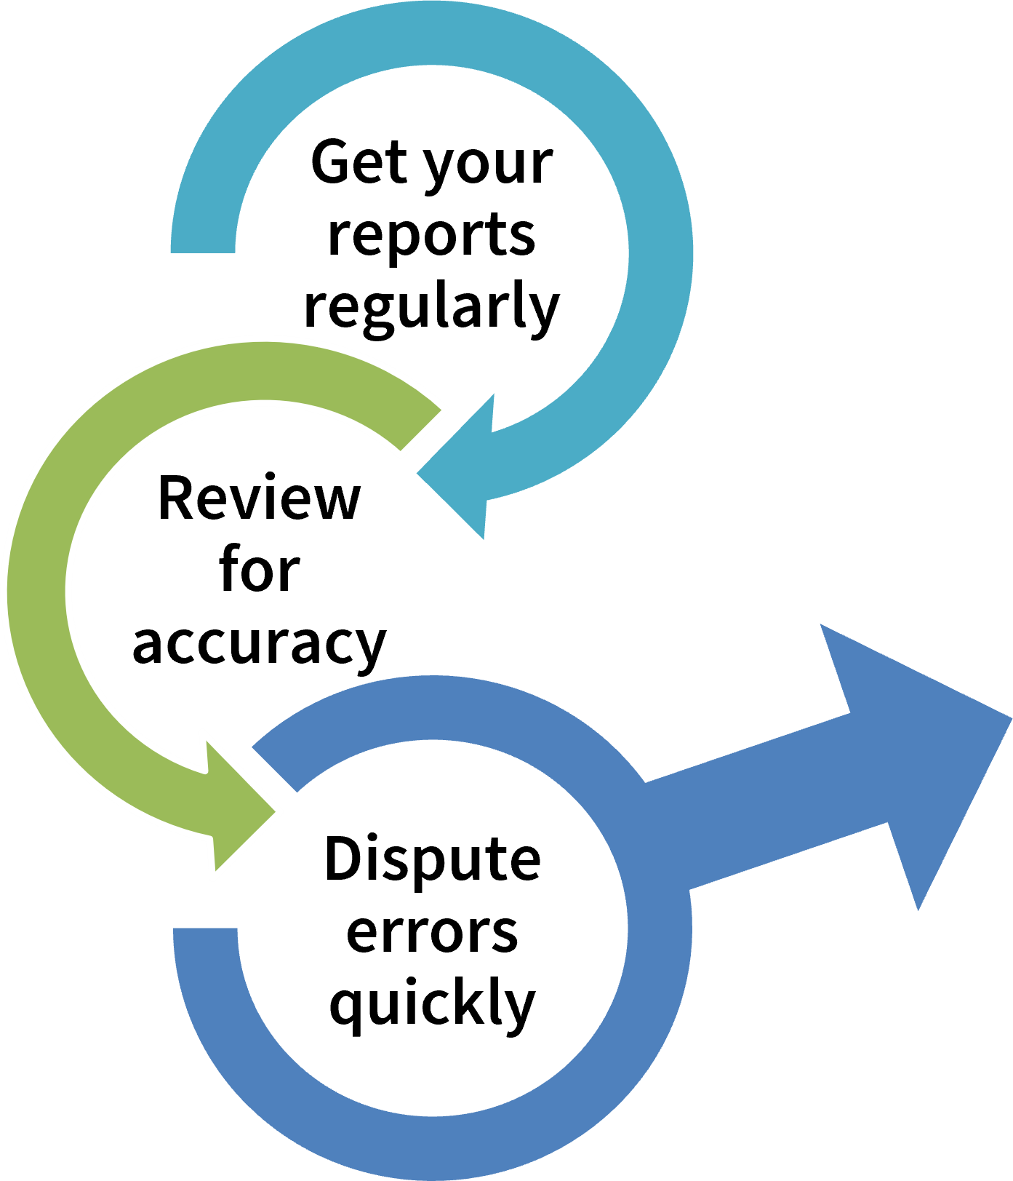
Keeping Up With Your Personal Credit Report (3 of 3)
Provide copies (never originals) of documentation to support claim
Send disputes to credit reporting agencies and creditors
Request a new credit report to verify that the correction was made

Slide 25

Fair Credit Reporting Act (FCRA) and Fair and Accurate Credit Transaction Act (FACTA)
Define regulations for personal credit bureau reporting, including:
The purposes for which lenders and other businesses can obtain your personal credit report;
When you need to give permission for others to see your personal credit report;
Your rights to see your personal credit report; and
Your rights to dispute information on your personal credit report that you judge to be incorrect.

Slide 26

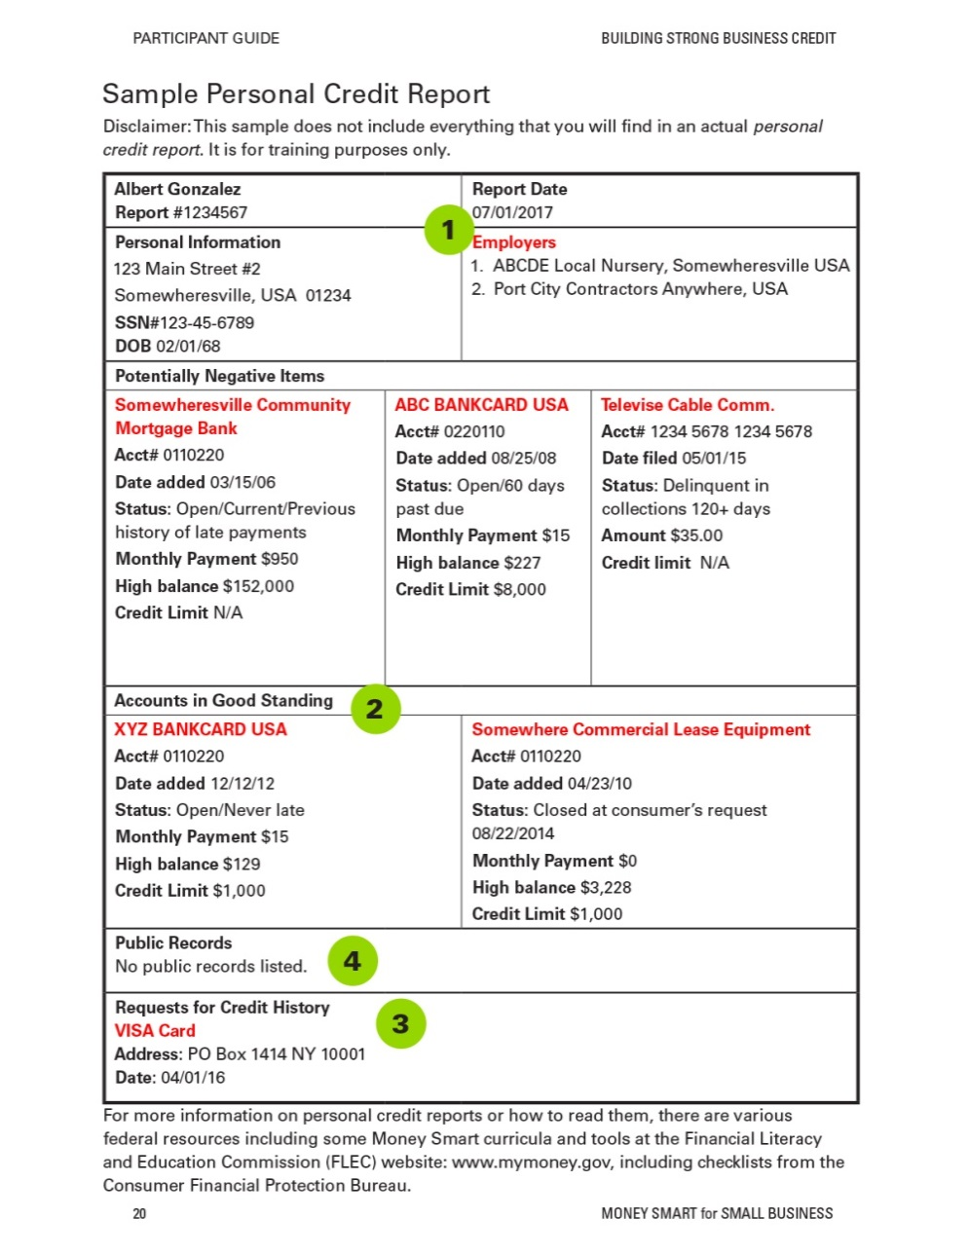
Exercise 1
SECTION II: The Impact of Personal Credit on My Business
Review a Sample Personal Credit Report

Slide 27

Best Practices for Building a Strong Personal Credit History
☑
Maintain healthy credit: Pay your loans and other bills on time.
Keep outstanding revolving debt balances low.
Pay off outstanding collection accounts and other debts.
Avoid negative events that could result in public records, such as bankruptcy or foreclosure.
Comparison shop for major loans within a 45-day window.
Maintain a mix of credit accounts.
Avoid closing older accounts in good standing.
⇒



❑

Slide 28



When Personal Credit History Is Important for Your Business
Accessing financing and/or trade credit to grow a business
Personally guaranteeing or cosigning on a business loan
Establishing a new business

Slide 29

Check-In With Rosa and Albert

Slide 30
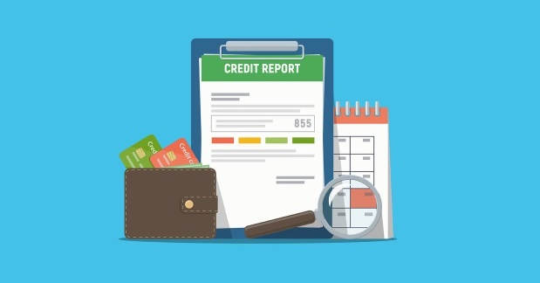
SECTION III Business Credit Reporting

Slide 31

What Are Business Credit Reports?
Risk-assessment tools used to evaluate the risk of lending, extending trade credit, or contracting with a business

Slide 32


Personal Versus Business Credit Reports
PERSONAL CREDIT REPORT | Personal Identifying Information | Credit History | Inquiries | Public Record Information
BUSINESS CREDIT REPORT | Business Identifying Information | Business Credit History | Business Background, Registration, and Financial Information | Public Record Information

Slide 33
The Major Players in Business Reporting
Dun & Bradstreet (D&B) | Focus is on how your business interacts with vendors and suppliers (trade credit performance)
Equifax | Focus is on how your business has managed business lines of credit and loans
Experian Business | Focus is on credit information from both lenders and business vendors

Slide 34
What Information Do Business Credit Reports Contain?
Business Identifying Information Examples | Business Credit History Examples | Business Background, Registration, and Financial Information Examples | Public Record Information Examples
Business names and aliases Business addresses, phone numbers, and web presence DUNS number Industry classification codes | Companies that have granted credit Payment data from suppliers and creditors Risk scores and ratings | Registration and incorporation data Legal structure and ownership History of business Affiliations Corporate financial reports Contracts, grants, loans, and debarments from the federal government Self-reported data | Uniform Commercial Code filings Lawsuits, liens, and judgments Business registrations (state, city, county courts) Incorporation and current and past bankruptcy filings from state and county courts

Slide 35
Regulation of Business Credit
Many consumer lending regulations, such as the FCRA/FACTA, do not apply to business credit reporting.
Business credit reporting agencies still have procedures in place for the following:
Providing access to reports
Managing disputes
Determining how long information stays on the report

Slide 36



Business Credit Scores
Personal Credit Scores | Business Credit Scores
Created by consumer credit reporting agencies and credit scoring companies | Created by business credit reporting agencies and credit scoring companies
Many types available | Many types available
Generally have similar ranges and measure similar factors | Have wide variety of scoring ranges and rating systems; emphasize different factors

Slide 37
Checking Your Business Credit Report
Check your business credit report to make sure the information is accurate.
You can create an account with Dun & Bradstreet to access your D&B business credit report and update basic information.*
Some businesses use credit monitoring services to receive alerts and check business credit scores. *
*Some services are free; others are subject to fees.

Slide 38
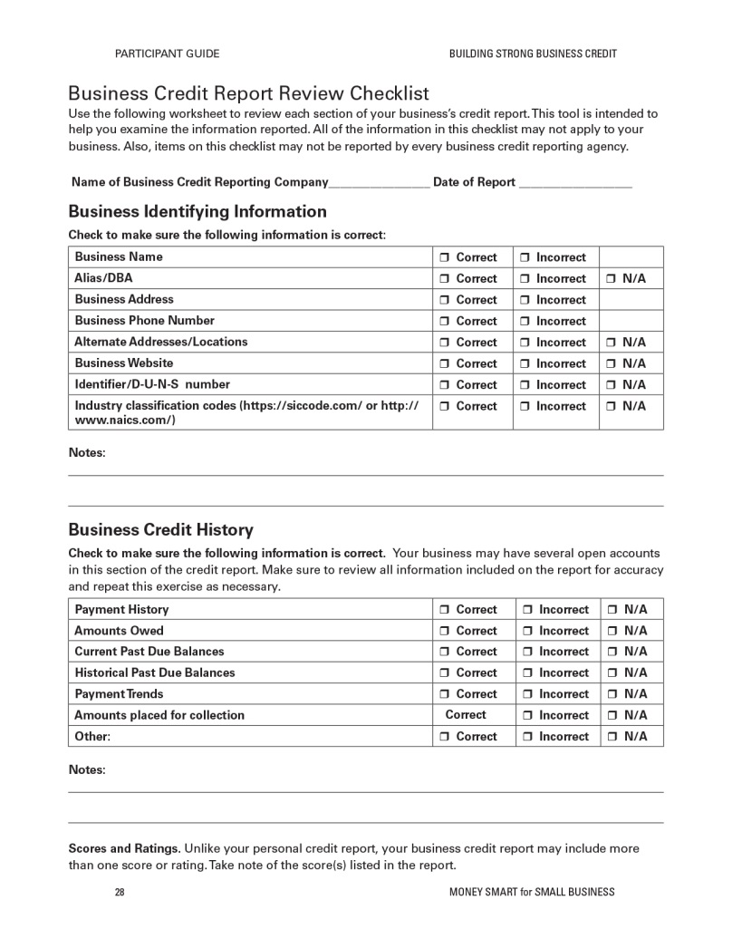
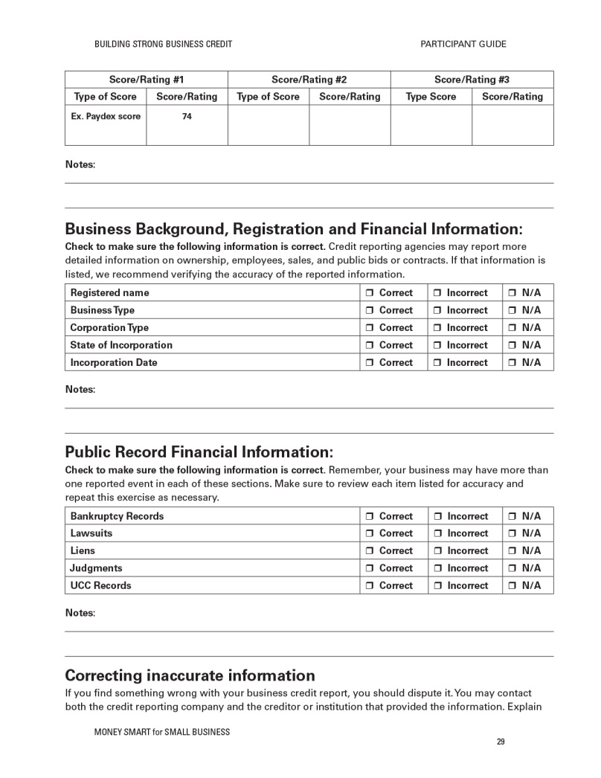
Exercise 2:
SECTION III: Business Credit Reporting
Business Credit Report Checklist

Slide 39
Why Should I Establish Business Credit?
Entity | Use credit reports to…
Lenders | Help determine approval and terms of financing
Suppliers and shipping companies | Decide whether to grant a deferral of payment for goods and services
Customers | Determine if your company is a legal entity and reputable
Insurance companies | Help determine the price of your insurance policies
Procurement officers | Help evaluate your ability to execute government contracts

Slide 40
Establishing Business Credit
What you should have | What you should do
Employer Identification Number (EIN) | Get a copy of your EIN if you don’t have one already and keep it in a safe place.
Business credit report | Verify whether you already have one.
Businesses/lenders reporting your credit information | Ask lenders/suppliers to report information about you, and self-report financial and credit data as feasible.

Slide 41
Best Practices for Strong Business Credit
☑ | Maintain healthy credit: Pay your loans, bills, and taxes on time.
 | Make sure your business is visible.
☺ | Maintain good relationships with suppliers and vendors.
 | Separate personal and business finances.
 | Monitor your personal and business credit histories.

Slide 42

Check-In With Eco-Grow Solutions

Slide 43
Building Your Business Credit History
In the next year, how do you think having a healthy business credit report could help your business?
In the next five years, how do you think having a healthy business credit report could help your business?

Slide 44

SECTION IV: How Lenders Evaluate Your Creditworthiness

Slide 45
The Current Landscape of Business Credit Reporting
Small Businesses
Lenders and businesses that use credit reports and report to credit reporting agencies
Consumer and business credit reporting agencies
Federal
and state laws
Companies that provide credit reporting, analytics, and scores

Slide 46
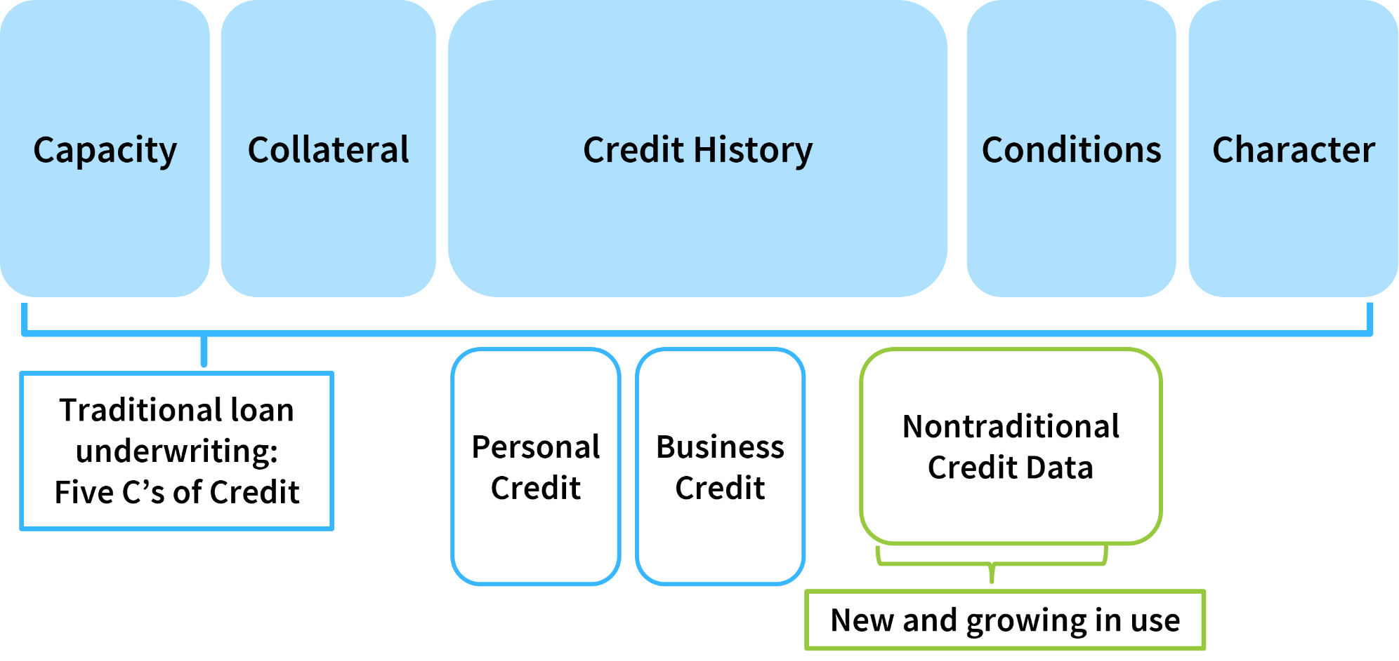
Putting It All Together
Putting It All Together

Slide 47
Nontraditional Data
What Is Nontraditional Data? Typically, non-loan data that may still help lenders predict risk
Personal credit reporting examples: Utilities, telephone services, rental data
Business credit reporting examples: Online business reviews, shipment volume, e-commerce trade, and merchant account transactions
* Nontraditional data is not as prevalent as traditional data.
Nontraditional Credit Data*

Slide 48
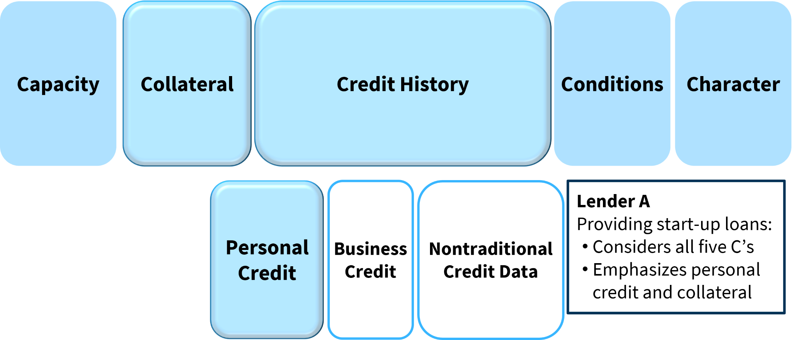
Different Lenders, Different Priorities (1 of 2)
Potential Factors in Underwriting

Slide 49
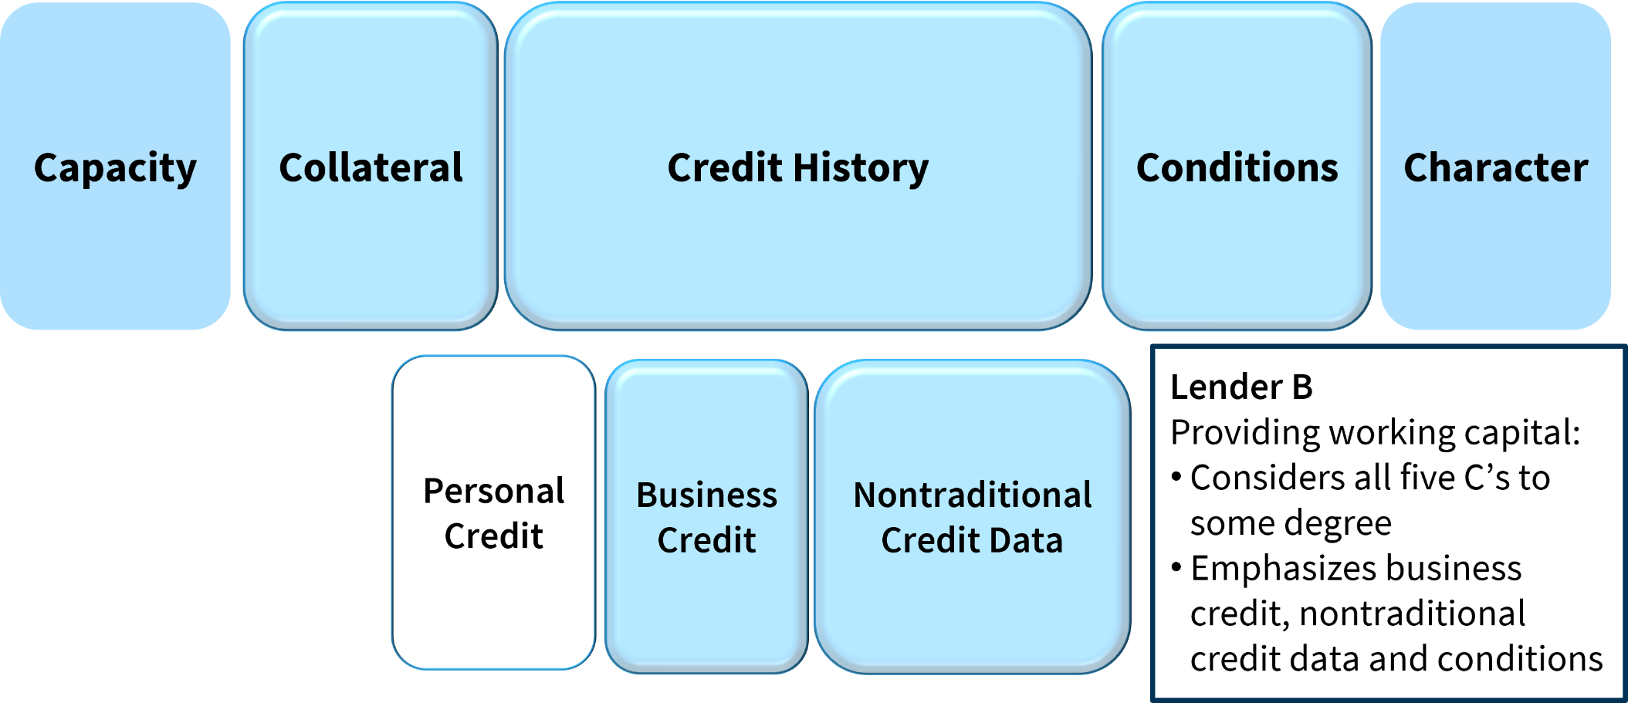
Different Lenders, Different Priorities (2 of 2)
Potential Factors in Underwriting

Slide 50

Exercise 3:
SECTION IV: How Lenders Evaluate Your Creditworthiness
Compare Lender Criteria and Financing Options

Slide 51

Best Practices for Entrepreneurs
Know your CREDIT
Know your LENDER
Know your RIGHTS

Slide 52
Exercise 4:
SECTION IV: How Lenders Evaluate Your Creditworthiness
Self-Assessment

Slide 53

SECTION V: Credit Reporting and Business Operations

Slide 54
Credit Reporting and Business Operations
Accessing Credit Reports | Reporting to Credit Reporting Agencies
What it means: Your small business pays a fee to access the credit reports of consumers or other businesses. | What it means: Your small business reports information (such as outstanding debts) about consumers or other businesses to one or more of the major consumer or business credit reporting agencies.
Why do this? Access to credit reports may be useful in helping you evaluate risks when hiring employees or working with customers, clients, or other businesses. | Why do this? Reporting to credit reporting agencies may support your ability to manage risk when you have a lot of transactional activity with customers.

Slide 55
Key Points to Remember

Slide 56
Key Points to Remember (1 of 3)
Personal Credit Histories | Business Credit Histories
Credit reports created by consumer credit reporting agencies and other companies | Credit reports created by business credit reporting agencies and other companies
Credit reports include personal identifying information, personal credit history, inquiries, and personal public records | Credit reports include business identifying information; business credit history; business background, registration, and financial information; and business public records
Many types of scores available with similar ranges and measuring similar factors | Many types of scores available with wide variety of ranges and rating systems, and emphasis on different factors

Slide 57
Key Points to Remember (2 of 3)
Personal and business credit reporting are important for your business.
Managing your personal and business credit reports and scores can help you establish and build strong credit histories.

Slide 58
Key Points to Remember (3 of 3)
Lenders and others use credit information in different ways to make decisions about your business.
Understanding your credit and achieving a healthy credit history will increase your financing options.

Slide 59

Summary
What final questions do you have?
What have you learned?
How would you evaluate the training?

Slide 60
Post Survey and Evaluation
If you have not already done so, assess what your knowledge on this topic was before you participated in this class.
Assess your knowledge on this topic after taking this class.
Complete the Evaluation form. Your feedback is helpful!
Return both forms to the instructor before you leave. Thank you!

