Slide 1




Money Smart for Small Business Banking Services
2019
Banking
Services
Available for a Small Business

Slide 2
Agenda
Welcome, Pre-Survey, and Learning Objectives
Section I: Banking Services
  Exercise 1: What Banking Services Do I Need?
  (Case Study introduction)
Section II: Financing Options and Sources
  Exercise 2: Small Business Financing Checklist
  Exercise 3: Self-Assessment Loan Readiness Checklist
  Section III: Avoiding Fraud and Scams
  Summary, Post-Survey, and Evaluation

Slide 3
Learning Objectives
Benefits of building effective long-term relationships with bankers (branch managers and lenders) and business advisors
Factors to consider when selecting a financial institution
Features, advantages, and risks associated with financial services and products
Types of financing options and lenders

Slide 4
Learning Objectives (continued)
Factors to consider when evaluating financing options
Ways to improve your chances of getting a loan, including building a strong personal and business credit history, keeping accurate business records, and understanding the Five C’s of Credit
Ways to recognize and avoid small business fraud, scams, and cybersecurity risks

Slide 5

Introductions: What Do You Know?
What do you currently know, and what do you want to learn?
Complete the What Do You Know? form or Pre-Survey
and discuss the results.

Slide 6

SECTION I: Banking Services
Building Your Banking Relationship
Factors in Selecting the Right Bank
Account Services
    Checking
    Debit Cards
    Savings and Other Deposit Accounts
Other Services
    Payroll Services
    Merchant Services

Slide 7



Building Your Banking Relationship
Meet bank staff: loan officer, account and branch manager
Myths about banks:
Banks don’t want my business because I am too small.
Banks don’t make small loans.
I need a perfect credit history.
Loan applications take months.
Fees are not affordable.

Slide 8


Consider …
What banking services do you need?
What should you look for when
choosing a bank?

Slide 9


Case Study: Meet Eco-Grow Solutions

Slide 10


Exercise 1: Banking Service Needs
Use the table in your Participant Guide on page 11 to draft a list of business banking service needs for both Eco-Grow and your business now and within the next 6 to 24 months.

Slide 11

Selecting the Right Bank
Consider
Research
Compare

Slide 12

Factors in Selecting the Right Bank
Customer service
Access to your accounts and money*
Technology
Specialized small business products and services
*More protections for consumers than businesses!

Slide 13

Basic FDIC Deposit Insurance Principles
Section I:
Banking Services
  Coverage is per depositor. A depositor may be any person (does not have to be a U.S. citizen or resident) or any legal entity (businesses, nonprofit organizations, and government agencies).
  Standard insurance amount is $250,000* per depositor, per insured bank,† for each account ownership category.
*See the FDIC’s Electronic Deposit Insurance Estimator
at https://edie.fdic.gov
†Deposits in credit unions may
be insured by the NCUA, but
insurance details may differ in
some respects.

Slide 14

Account Services
Section I:
Account Services
  Business Checking Accounts
  Business Debit Cards
  Savings Accounts
  Certificates of Deposit (CD)
  Retirement/Other Employee
  Benefit Accounts
  Business Credit Cards
  Payroll Services
  Cash Management
  Merchant Services
  Other Services

Slide 15
Cost of Services and Transactions
Brochures and fee schedules
for features and service costs,
including options for overdraft
protection
Account disclosures
Ways to get fees waived/reduced
(transaction volume/bundling)

Slide 16

Payment Transactions
Most payment transactions do not occur in real time and writing a check or initiating a bank transfer when you don’t have funds available can result in costly charges!
Direct deposit, Automated Clearing House debit and credit processing, wire transfers
Debit block
Lockbox services
Remote deposit capture

Slide 17
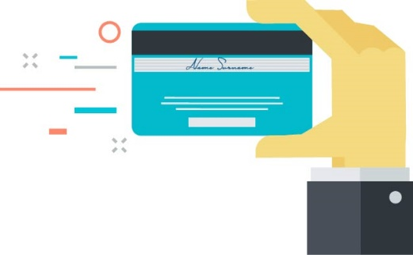
Timing, Ease, and Security of Payment Transactions
Business checking accounts: important considerations:
Transaction volume may determine best account type
Know federal, state, and contract rules governing checks*
Banks may use information systems to evaluate applicants for checking accounts (for example, ChexSystems)
Many banks also have second-chance checking accounts for individuals who performed poorly with prior checking accounts.
*For example: Uniform Commercial Code related to losses resulting from business negligence or forged checks.
  Protect yourself from check fraud liability!

Slide 18


Business Debit Cards
Section I:
Account Services
            Consider convenience and risk: ATM use, online and point-of-sale purchases, limited daily purchases/withdrawals, various cardholders
            Preloaded card option instead of additional signers

Slide 19

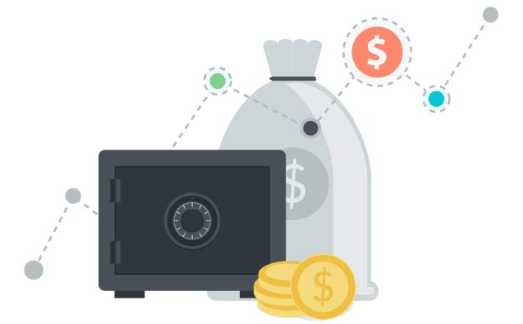
Savings Vehicles
Section I:
Account Services
  Savings Accounts: show your lender you are reserving cash for unexpected needs
  Certificates of Deposit: used as loan collateral; build your business credit history

Slide 20

Payroll Services
Section I:
Additional Banking Services
Payroll Services
Benefits
  Easier record keeping: retirement, workers’ compensation, insurance payments, federal and state taxes (reports for each employee)
  Direct deposit to employee accounts
  Payroll account separate from operating account
  Zero balance feature to manage payroll and avoid fraud

Slide 21

Cash Management and Merchant Services
Manage cash by:
Discussing options with your bank;
Keeping detailed records;
Reporting all your cash income; and
Considering remittance or wire-transfer services from a bank.
Increase sales by using merchant services
Credit and debit cards: point-of-sale card reader terminals, marketing support
Gift/prepaid cards
Online payments/orders

Slide 22
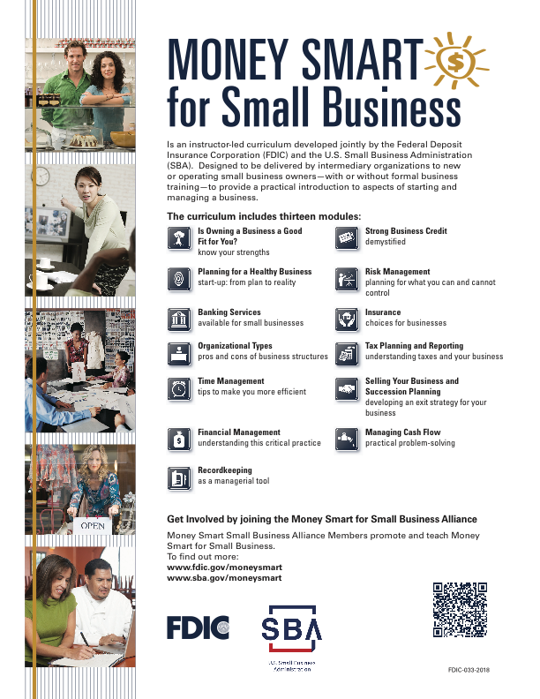
Learn More
Financial and Credit Education
Find training or counseling at www.sba.gov or www.fdic.gov/moneysmart
Reports on accounts and transactions
Online; downloadable in various formats
Compatible with accounting software
For personal and business finances

Slide 23

Tips for Reconciling Accounts
Section I:
Additional Banking Services
Tips for Reconciling Accounts
Reconcile accounts monthly at a minimum!
  Work with your bank to address discrepancies or suspicious activity immediately.
  Verify the amounts paid for checks with the amounts you wrote them for.
  Retain reports from remote deposit scanner software.

Slide 24
Revisiting Exercise 1: Banking Service Needs
Go back to your list of banking services (page 11 in your Participant Guide) and look at the fictional bank fee schedule (page 16 of your Participant Guide).
Column 1: Add/review services needed now.
Column 2: Add/review services you may need for the next 6–24 months.

Slide 25
Key Points to Remember
Build banking relationships early on.
Choose a bank based on an assessment of its resources, including customer service, technology, and services for small businesses.
Ensure the ways to access your funds and transactions are secure.
Consider the features and risks associated with savings and checking accounts, and business debit cards.
Increase your business efficiency through banking services such as payroll, cash management, and merchant processing.
Reconcile accounts as a cybersecurity measure.

Slide 26
Key Points to Remember (continued)
Resources
Find financial and credit training at www.sba.gov or www.fdic.gov/moneysmart.
Tips marked with the star icon
Go back to Exercise 1 (What banking services do I need? What should I look for when searching for a bank?) as needed.

Slide 27

SECTION II: Financing Options and Sources
Financing Options
Financing Sources
Financing Readiness
  Five C’s of Credit
  Loan Readiness Checklist
  Understanding the Cost of Financing

Slide 28
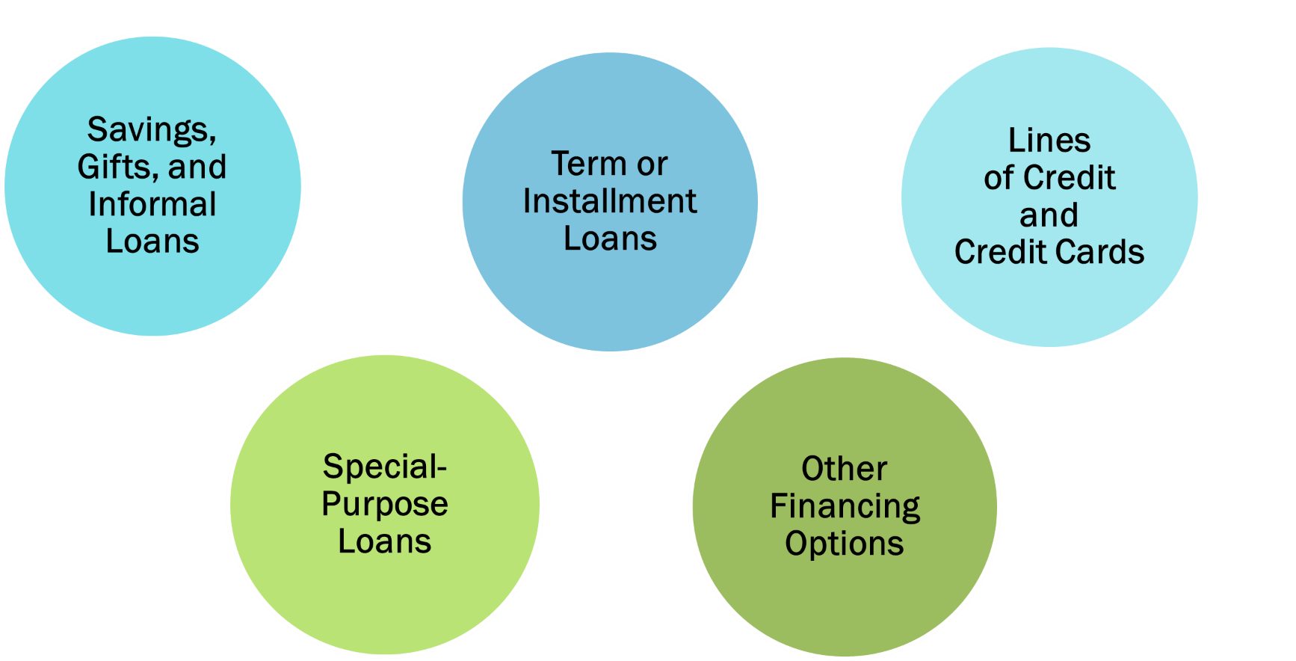
Financing Options

Slide 29
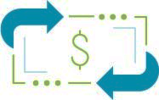
Financing Options: Savings, Gifts, and Informal Loans
No. 1 form of financing used by start-ups
Gifts may be counted as business capital*
Payments toward informal loans or investments by family, friends, or other individuals must be part of cash flow
Savings, Gifts, and Informal Loans
*Consult with an accountant.

Slide 30

Financing Options: Term or Installment Loans
Term or Installment Loans
Loan amount is
$1,500
Monthly payment is $120
Funds received once loan is approved (one disbursement)
Set amount and period of time
Repaid in installments with interest
Purpose: financing purchase of assets
Secured by asset to be purchased
New application required for additional funds
You will pay off in 15 months

Slide 31
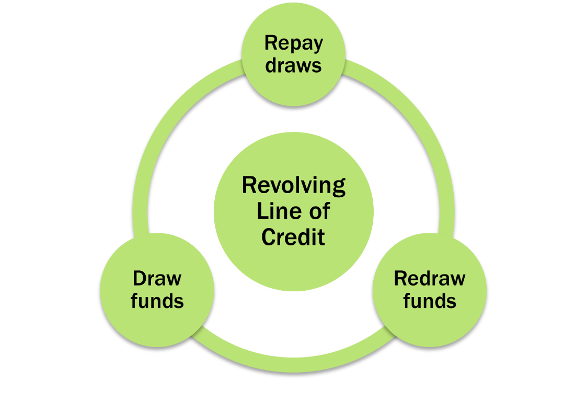
Financing Options: Lines of Credit
Lines
of Credit and
Credit Cards
Generally secured
Used to finance any business expenses
Requires annual credit review and renewal based on performance (length, tax returns, personal and business credit reports)
No lump-sum disbursement at opening
Monthly payments based on outstanding balance

Slide 32
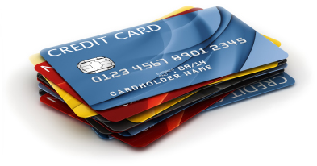
Financing Options: Business Credit Cards
Lines
of Credit and
Credit Cards
  *Liability for unauthorized use of credit cards can be greater for business credit cards than for consumer cards.
Requires full payment of balance at the end of the grace period (month) to avoid paying interest
Rarely reported to consumer credit bureaus unless account is delinquent
Can be issued for various authorized users*

Slide 33





Financing Options: Special Purpose Loans
Agricultural: for crops, livestock, or farm machinery
Manufacturing: for the equipment needs of manufacturing companies
Loan guarantee programs for veterans and military members
Loan guarantee programs exporters
Disaster loans for small businesses affected by natural disasters
Special
Purpose Loans

Slide 34





Other Financing Options
Leasing: helpful to test leased equipment (maintenance cost may be included);
lifetime costs higher than buying
Financing inventory: loan secured by inventory; usually used to meet fluctuating seasonal cash needs
Factoring:* selling accounts receivable at a discount to third parties
Credit card sale loans or merchant cash advances: upfront funds in exchange for a portion of future merchant processing revenue
Financing receivables:* advances on credit specifically secured by accounts receivable
*Mostly available to larger businesses.
Other Financing Options

Slide 35

Government Programs for Small Businesses
SBA Guaranteed Lending Programs
Participating lenders make and service term loans and lines of credit for which the SBA extends a guarantee of repayment.
Guarantee allows lenders to approve loans they would not otherwise be able to make.
The SBA Microloan Program provides direct loans and grants to eligible nonprofit microlenders to make loans of up to $50,000.
  www.sba.gov

Slide 36
Online Government Resources
  U.S. Department of Agriculture: grants, loans, and loan guarantees
  www.rd.usda.gov
  U.S. Department of the Treasury: grants to support small business lenders and technical assistance providers
  www.treasury.gov
  U.S. Department of Commerce’s Minority Business Development Agency: technical assistance to entrepreneurs through a national network
  www.mbda.gov

Slide 37
Additional Government SBA Programs
State and local governments operate their own programs to foster entrepreneurship in underserved communities.
Local and federal government agencies usually have an Office of Small and Disadvantaged Business Utilization, which helps small businesses get government contracts.

Slide 38
The Spectrum of Financing Options and Sources
Section II:
Financing Options and Sources
Aspiring entrepreneurs and emerging
businesses may rely heavily on self-financing, gifts, and individual investors, among other alternative financing options.
As small businesses grow and mature, they may access a mix of larger loans, lines of credit, and alternative financing
from traditional and nontraditional sources.
Most established and successful businesses have access to loans, lines of credit, investments, and financing
alternatives from traditional sources.
The slide shows a graph of financing options, traditional to non-traditional, on the y-axis and lending sources, non-traditional to traditional, on the x-axis. A label above the graph shows an arrow pointing left to right, labeled age/growth of business, corresponding to the x-axis or lending sources starting at non-traditional and moving to traditional.
Age/Growth of Business
Aspiring entrepreneurs and emerging
businesses may rely heavily on self-
financing, gifts, and individual investors,
among other alternative financing options.
As small businesses grow and mature,
they may access a mix of larger loans,
lines of credit, and alternative financing
from traditional and nontraditional sources.
Financing Options
Traditional Nontraditional
Most established and successful
businesses have access to loans, lines of
credit, investments, and financing
alternatives from traditional sources.
Lending Sources
Nontraditional Traditional

Slide 39
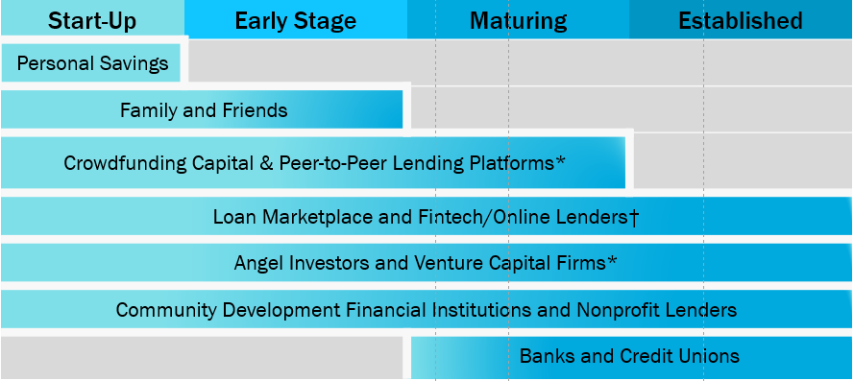
Financing Sources by Stage of Business
Section II:
Financing Options and Sources
The table shows the availability of various financing sources to a small business from start-up through early stage, maturation, and establishment. Source availability is indicated as follows.
Start-up: Personal savings, family and friends, crowdfunding capital and peer-to-peer lending platforms, loan marketplaces and Fintech or Online Lenders, angel investors and venture capital firms, and community development financial institutions and nonprofit leaders.
These resources continue through the business’s development, with personal savings dropping off after start-up, family and friends dropping off after the early stage, and crowdfunding capital and peer-to-peer lending platforms fading out during maturation. Funding from banks and credit unions becomes available after the early-stage period and continues through establishment.
  This is a sample representation of general financing progression for small businesses. Financing options and sources are available to some businesses at all stages. Every situation is different.
  *More information: U.S. Securities and Exchange Commission www.sec.gov
  †Analyze offers carefully based on terms, conditions, and reputation.

Slide 40

Exercise 2:
Small Business Financing Checklist
Section II:
Financing Options and Sources
Go to page 27 in your Participant Guide.
As a group, complete the checklist to help Rosa and Albert. Make additional assumptions as needed.
Complete the checklist individually as it applies to your business. Come back to the list after the training if you are not currently considering financing.

Slide 41
Improving Your Chances of Getting a Business Loan
Strengthening your personal and business credit history
Separating personal and business finances
Understanding the Five C’s of Credit
Building banking relationships

Slide 42

Improving Your Chances of Getting a Business Loan (continued)
Personal and Business Credit History
Personal credit relevant even if you have business credit history
Credit scores used to assess whether to extend credit, determine how much credit, and establish interest rate
Resources if you don’t have credit or need to rebuild your personal and business credit: www.consumerfinance.gov and www.sba.gov

Slide 43

Improving Your Chances …
Keep business and personal transactions separate
Avoid comingling
Maintain accurate bookkeeping*
Consult with a tax advisor
Remember Albert
  *Follow a proper protocol to transfer funds (ask your bank about how to generate a record of activity).

Slide 44
Improving Your Chances (continued)
The Five C’s of Credit:
Capacity: ability to repay a loan
Collateral: security to repay the loan
Credit History: credit performance of the owner(s) and the business
Conditions: terms of loan and business environment
Character: integrity, reputation, references
How do you self-rate on each C?

Slide 45
Exercise 3: Loan Readiness Checklist
Section II:
Financing Options and Sources
Go to page 36 in your Participant Guide.
As a group, complete the checklist to help Rosa and Albert. Make additional assumptions as needed.
Complete the checklist individually as it applies to your own business. Come back to the list after the training if you are not currently considering a loan.

Slide 46
Key Points to Remember
Types of financing include your own savings.
Understanding the features of different loan products helps you evaluate financing options.
You may qualify for government programs, depending on the purpose of the loan and other characteristics.
You should evaluate the benefits and risks of nonbank financing.

Slide 47
More Key Points
Improve your chances of getting a loan by:
  Understanding personal and business credit histories
  Strategically developing the Five C’s of Credit
  Maintaining separate personal and business records
  Preparing before contacting a lender
Resources
  References to government resources
  Small Business Financing Checklist
  Loan Readiness Checklist

Slide 48

SECTION III: Avoiding Fraud and Scams
Businesses need to avoid fraud and scams.
Banks can help.* Ask about the following:
  Secure access protocols
  Tips to avoid forged checks
  Protecting business debit cards
  Protocols on reconciling accounts
*Regulated financial institutions are subject to customer information security and privacy rules.

Slide 49
Resources by government agencies to help you avoid fraud and scams
Federal Bureau of Investigation
Business Email Compromise: scam targeted to companies that perform wire-transfer payments
Data Breach: leak or spill of sensitive, protected, or confidential information
Denial of Service: interruption of authorized users’ access their own systems
Email Account Compromise: scam to request payments to fraudulent locations
Malware/Scareware: software intended to disable computer systems
Phishing/Spoofing: forged or fake electronic documents
Ransomware: payments demanded to access company’s proprietary data
www.fbi.gov key word “small business”

Slide 50
Resources by government agencies (continued)
Federal Trade Commission
Division of Consumer and Business Education works to help you learn how to avoid scams
Common scams targeted to small businesses:
  Pay for supplies that were not ordered
  Donate to fake charities
  Malware
  Fake home-based business opportunities
Resources:
  Publications and blogs with tips to avoid scammers
  Videos, workshops, and guidance on getting credit, fintech, cybersecurity
  www.ftc.gov key word “small business”

Slide 51

Summary
What final questions do you have?
What have you learned?
How would you evaluate the training?

Slide 52
Post Survey and Evaluation
If you have not already done so, assess what your knowledge on this topic was before you participated in this class.
Assess your knowledge on this topic after taking this class.
Complete the Evaluation Form. Your feedback is helpful!
Return both forms to the instructor before you leave. Thank you!

