Slide 1
Planning for a Healthy Business
For a Small Business
Updated: 09-2016

Slide 2

Pre-Test
In your Participant Guide
Locate the Pre- and Post-Test Form at the back of your Participant Guide.
Complete the BEFORE Training column to assess your knowledge on this topic before participating in this class.

Slide 3
Agenda
Welcome, Pre-Test, Agenda, and Learning Objectives
Case Study: Sophia’s Planning Process
Introductions: Where are you in your planning process?
Introduction to the 4-Step Planning Model
Summary, Post-Test, Evaluation

Slide 4
Learning Objectives
Explain how an evolving planning process can help you make key decisions as business owners.
Describe how to convert a vague idea into a resource plan.
Explain the importance of a healthy personal credit score and healthy relationships with lenders.
Describe how a business plan helps motivate stakeholders to understand and support your business ideas.
Explain the benefits of creating a day-to-day action plan for running a small business.

Slide 5
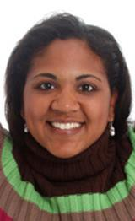
Introducing Sophia
I have a great idea! Now what?
See page 4 in your Participant Guide.
How can Sophia make her new cell phone repair business a success?
She will complete four planning steps over a two-year period.
As her business grows, her planning approaches will change.
As we review Sophia’s planning process, relate the four planning steps to your business

Slide 6

Where Are YOU in Your Planning?
Complete the worksheet on page 5 of your Participant Guide.
For each planning stage, record if you have completed it, if you are working on it, or if you have not yet started.
There are no wrong answers.
You will introduce yourself and share your planning stage.

Slide 7
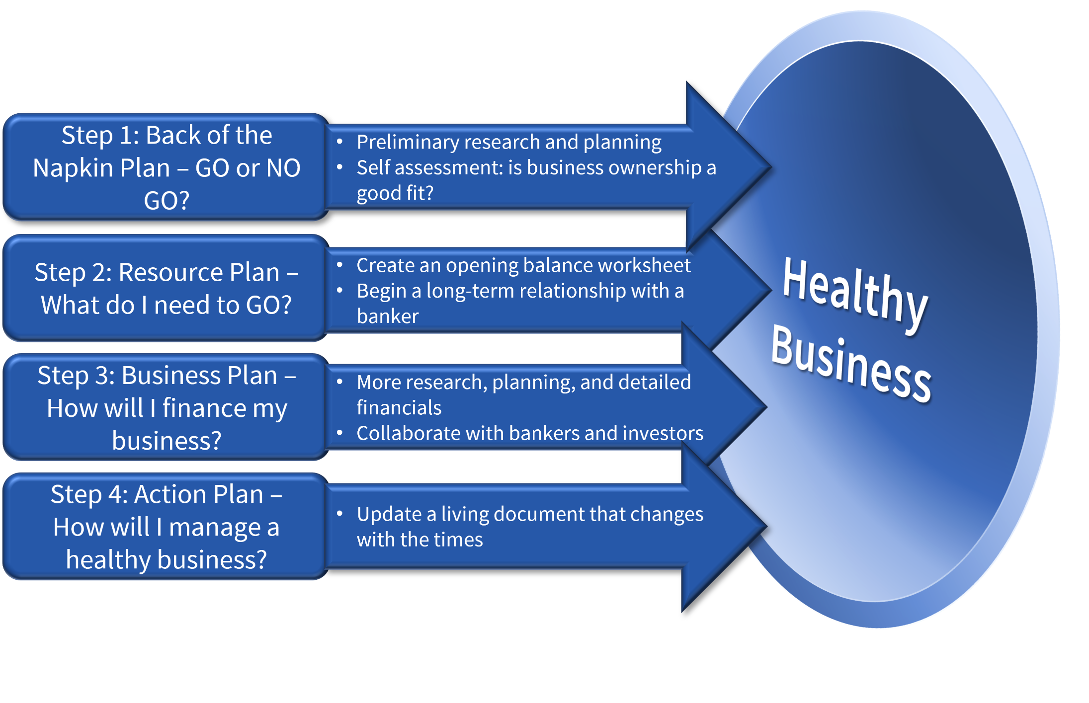
The 4-Step Planning Model
See page 6 in your Participant Guide.
Step 1: Back of the Napkin Plan – GO or NO GO?
Preliminary research and planning
Self assessment: is business ownership a good fit?
Step 2: Resource Plan – What do I need to GO?
Create an opening balance worksheet
Begin a long-term relationship with a banker
Step 3: Business Plan – How will I finance my business?
More research, planning, and detailed financials
Collaborate with bankers and investors
Step 4: Action Plan – How will I manage a healthy business?
Update a living document that changes with the times
Notes:
Note: There is a text box under the “Healthy Business” target that contains the text in the graphic, which is a picture, so the text is integrated with the shapes and not readable by a screen reader. This hidden text will be read by a screen reader for users with impaired vision.

Slide 8
Sophia’s Planning Process
This is an example. Your business process and timing may differ.
Business Growth
Action Plan
Business Plan / Improve Credit Score
Resource Plan
Back of the Napkin Plan
Year One
Sophia works full time at her day job.
Year Two
Sophia works part time at her job and part time for herself.
Sophia starts to work full time for herself.

Slide 9
Step 1: The Back-of-the-Napkin Plan
Sophia’s Back-of-the-Napkin Plan
Fix smartphones, tablets, … and appliances? (Maybe later?)
What is my credit score?
Do I need a website?
Who is my competition?
Who can help me find answers?
Am I ready for all this?

Slide 10
Step 1: Key Questions
See page 7 in your Participant Guide for some questions to answer at the beginning of the planning process.
What benefits (monetary and non-monetary) do I want to get from my business?
What size business do I need to build to achieve those benefits?
Have I identified a real business opportunity on which I can capitalize?
What assets do I need to purchase, rent, or lease? Who will I need to hire?
DO YOUR HOMEWORK

Slide 11
Step 2: Sophia’s Resource Plan
See pages 8 – 9 in your Participant Guide for some questions to answer at the beginning of the planning process.
Sophia estimates start-up costs for her first six months of business will be:
Expense | Cost
Space, equipment, and supplies | $18, 250
Skill development | 1,100
Staff (accountant and bookkeeper) | 1,200
Other (insurance and taxes) | 450
Estimated total | $21,000
Note: Living expenses are not included in a resource plan.

Slide 12
Step 2: The Resource Plan, continued
See the bottom of page 9 in your Participant Guide.
Expense | Cost
Sophia’s estimated start-up costs | $21,000
Sophia’s share (owner equity) | -7,000
What Sophia needs to raise | $14,000

Slide 13
Step 2: Resource Planning Ideas
Interview stakeholders, competitors, and other business owners for ideas.
Ideal locations
Locating discounted equipment and supplies
Pros and cons of buying in bulk (too much inventory affects cash flow)
Fair wages and benefits for employees
Federal, state, local, and sales taxes
Insurance
Pay for services (such as website design and hosting): pay more up front or pay higher monthly installments?
Am I ready to go on to the next step?

Slide 14

Step 3: The Business Plan
See pages 13 – 14 in your Participant Guide.
Tells a story that makes your idea come alive
Convinces others to make a stake in you
Projects three years into future
Clearly outlines business development plans in financial terms

Slide 15
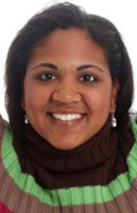
Step 3: Sophia’s Business Plan
Sophia and her family worked hard to raise her credit score.
Sophia met with a banker several times to get feedback and advice.
She took a class on business plan writing.
Sophia shared her plan with family and friends.
This process took time … and it paid off! Family and friends funded her start-up costs!

Slide 16

Sources of Financial Support
See page 15 in your Participant Guide.
Angel investors
Bootstrapping
Crowdsourcing
Friends and family members
Incubators
Local and state economic development organizations
Peer-to-peer lending
Small business loans
Venture capital

Slide 17

What does it mean to be strategic?
If you want to meet up with this sailboat, which direction would you steer?
Plan for the future
Plan for change
Learn from the past (including mistakes)
Minimize risk
An action plan helps you stay strategic

Slide 18
Step 4: Sophia’s Action Plan
See page 16 in your Participant Guide. These goals are SMART.
SMART Goals | Tasks | Success Criteria | Time Frame | Resources
Achieve an average monthly customer count of 500 within three months | Advertise in Business Journal Increase social media outreach Identify effective marketing opportunities | 400 customers in month 1 450 in month 2 500 in month 3 | September | $300 for ad Flyers in college common areas and coffee shops Website upgrade
Reduce rental costs by 10% by the end of this year | Negotiate terms with landlord Work with lawyer to draw up a contract | 2-year lease = 10% rent reduction | December 31 | Legal fees? Find out how much.

Slide 19

SMART Goals
Specific: State the goal precisely.
Measurable: Good measurements let you know when a goal is completed.
Attainable: Resources needed to complete the goal are within your reach.
Relevant: The goal is applicable to your business.
Time-based: The goal has a completion date or time frame.

Slide 20

Summary: Key Points
I can do this!
There is more than one way to plan.
The planning process helps refine your ideas and prevent errors.
Types of plans need to change as your business needs change.
Make time to write a business plan.
Engage stakeholders in the process.
Even when you get the investments you need, you need to plan strategically to ensure a healthy business.

Slide 21
Summary: Benefits and Risks
Benefits of Planning
Risks of Not Planning
Know where you are— and where you are going
Save time and money
Ask great questions
Develop stakeholders in the process
Make logical decisions
Measure progress on tangible goals
Focus on finances
Wasted time and money
You do too much (and miss opportunities to delegate)
Risk “burn out”
Confuse or alienate investors
Fail to do the math or to quantify “success” in practical business terms

Slide 22

Summary
What final questions do you have?
What have you learned?
How would you evaluate the training?

Slide 23
Pre-Post Test and Evaluation
In your Participant Guide
If you have not already done so, assess what your knowledge on this topic was before you participated in this class.
Assess your knowledge on this topic
after taking this class.
Complete the Evaluation Form. Your feedback is helpful!
Return both forms to the instructor before you leave. Thank you!

