Slide 1


Module 12: Making Housing Decisions
Module 12
Making Housing Decisions
September 2018

Slide 2
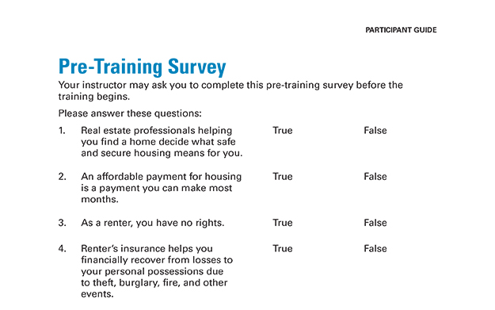
Pre-Training Survey See page 43 in your Participant Guide

Slide 3

Section 1: What Are My Options?
Section 1
What Are My Options?
See page 3 in your Participant Guide

Slide 4
Section 1: Key Takeaway
There are different types of housing. To help prioritize your options, start by defining what safe and secure housing means to you.

Slide 5
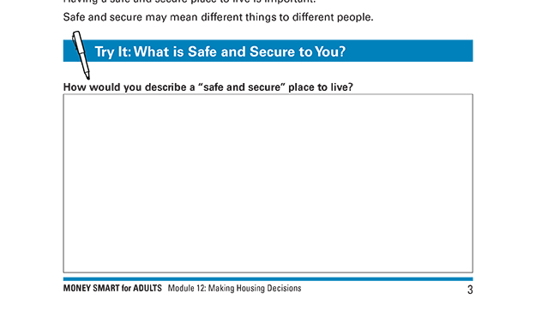
Try It: What is Safe and Secure to You? See page 3 in your Participant Guide

Slide 6
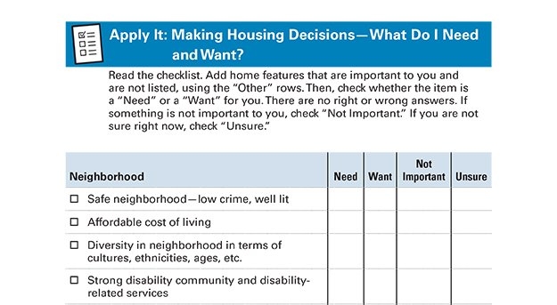
Apply It: Making Housing Decisions— What Do I Need and Want? See page 4 in your Participant Guide

Slide 7
Renting or Buying
Factors to Consider

Slide 8
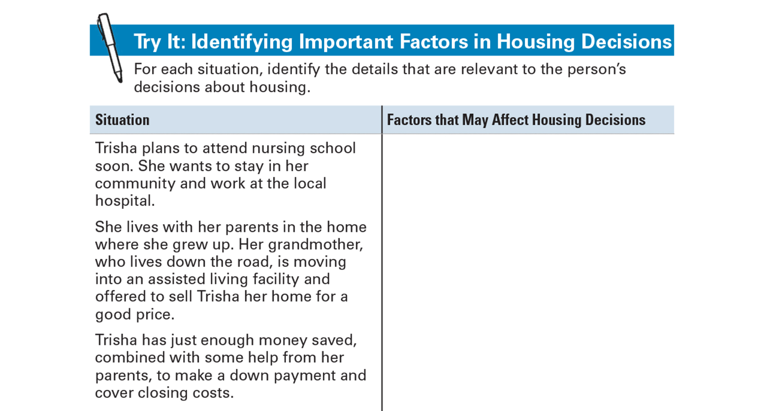
Try It: Identifying Important Factors in Housing Decisions See page 7 in your Participant Guide

Slide 9
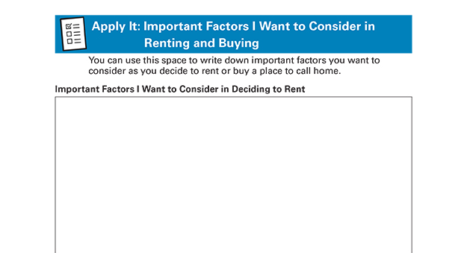
Apply It: Important Factors I Want to Consider in Renting or Buying See page 9 in your Participant Guide

Slide 10
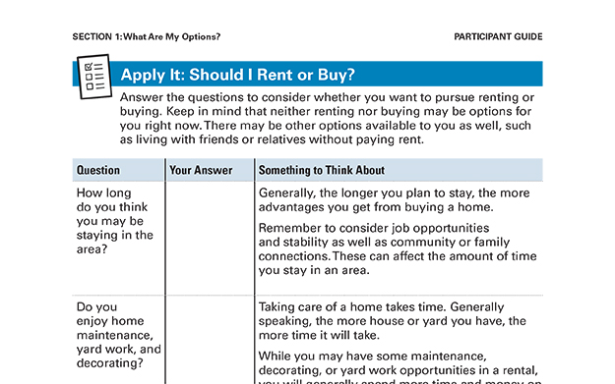
Apply It: Should I Rent or Buy? See page 10 in your Participant Guide

Slide 11
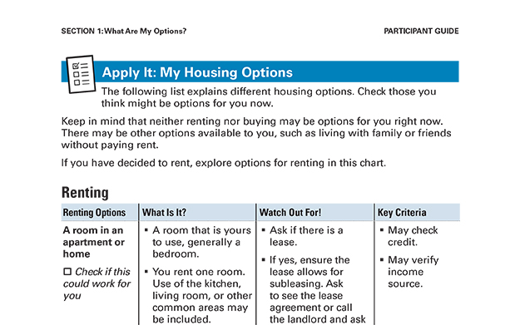
Apply It: My Housing Options See page 14 in your Participant Guide

Slide 12
Options for Renting May Include
Room in an apartment or home
Apartment
House
Privately owned, subsidized housing
Public housing

Slide 13
Options for Buying May Include
Single family house, modular home, or townhouse
Condominium
Cooperative (Co-op)
Manufactured or mobile home

Slide 14
Section 1: Remember the Key Takeaway
There are different types of housing. To help prioritize your options, start by defining what safe and secure housing means to you.

Slide 15

Section 2: What Can I Afford?
Section 2
What Can I Afford?
See page 19 in your Participant Guide

Slide 16
Section 2: Key Takeaway
An affordable payment for housing is one you can reliably make each month.

Slide 17

Housing Costs: What Is Affordable?
Only you can decide what is affordable for you
Landlords and mortgage lenders cannot

Slide 18
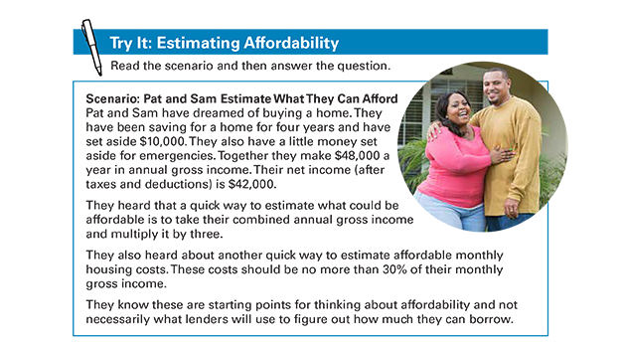
Try It: Estimating Affordability See page 20 in your Participant Guide

Slide 19

Method 1
Gross income = income before taxes and other deductions are taken out

Slide 20
Method 1: Answer for Pat and Sam
Take their annual gross income:
$48,000 per year
Then multiply by 3: $48,000 x 3
Answer = $144,000
May be helpful when looking for houses to buy
Not helpful to estimate affordable monthly payment

Slide 21

Method 2
Monthly housing costs include items such as rent or mortgage payments, insurance, utilities, maintenance, repairs
May not be realistic or helpful

Slide 22
Method 2: Answer for Pat and Sam
Take their annual gross income:
$48,000 per year
Then divide by 12 months in a year: $48,000 ÷ 12 = $4,000
Then multiply by 0.30: $4,000 x 0.30
Answer: $1,200 per month

Slide 23
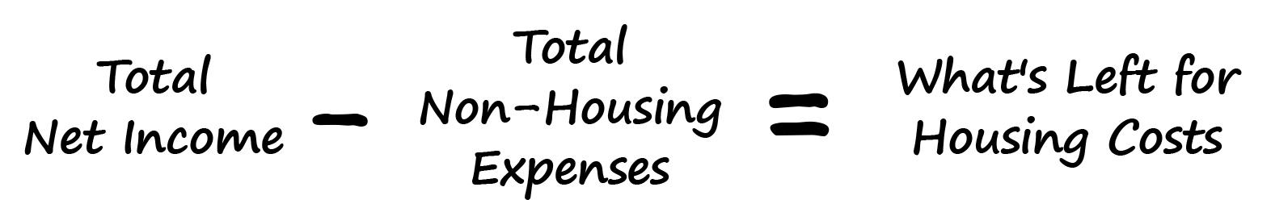
Method 3
What’s left for housing?
Use a spending and saving plan

Slide 24
Pat and Sam’s Total Net Income
Item | Monthly Amount
Net (Take-Home) Pay Job 1 | $3,500 ($42,000 ÷ 12)
Their Total Net Income | $3,500
Remember: Divide Annual amount by 12 (months) to get Monthly amount

Slide 25
Pat and Sam’s Total Non-Housing Expenses
Item | Monthly Amount
Their Total Non-Housing Expenses | $2,360

Slide 26
Pat and Sam’s Comparison: What’s Left for Housing Costs?
Item | Monthly Amount
Their Total Net Income | $3,500
Their Total Non-Housing Expenses | $2,360
What’s Left for Housing Costs? | $1,140

Slide 27
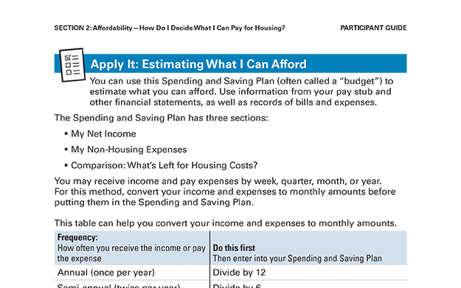
Apply It: Estimating What I Can Afford See page 25 in your Participant Guide

Slide 28
Section 2: Remember the Key Takeaway
An affordable payment for housing is one you can reliably make each month.

Slide 29

Section 3: What’s Next If I Decide to Rent?
Section 3
What’s Next If I Decide to Rent?
See page 30 in your Participant Guide

Slide 30
Section 3: Key Takeaway
Ways to protect yourself as a renter include reading and understanding your rental agreement or lease, getting renter’s insurance, and knowing your rights and responsibilities.

Slide 31
Steps to Renting
Figure out where you want to live
Figure out what kind of place you want to rent
Figure out what you can afford
Understand your credit and how this may affect what you can rent
Research options
Get your first month’s rent and deposits together
Read and understand your lease or rental agreement

Slide 32
Step 1: Figure Out Where You Want to Live
Safety and security
Public transportation
Distance to work, childcare, medical services, other needed services and supportive people
Quality of schools
Access to parks or playgrounds
Accessibility features for people with disabilities
Anything else that is important to you

Slide 33
Step 2: Figure Out What Kind of Place You Want to Rent
Use Apply It: My Housing Options from Section 1, page 14, in your Participant Guide

Slide 34
Step 3: Figure Out What You Can Afford
Use Apply It: Estimating What I Can Afford from Section 2, page 25, in your Participant Guide

Slide 35
Step 4: Understand Your Credit and How This May Affect What You Can Rent
Landlords will likely look at your credit reports and your credit reports
Get and review your credit reports at www.annualcreditreport.com or call toll-free 1-877-322-8228

Slide 36
Low Credit Scores or Credit Reports with Negative Information
Be prepared to:
Spend more time looking for an apartment
Have fewer choices of apartments
Pay a larger deposit
Get a letter of guarantee or someone to cosign
Find roommates to live with you
Reconsider your decision to rent

Slide 37
Step 5: Research Options
Do this yourself
Search the Internet
Look at rentals in a newspaper
Use a real estate agent
Explore any other local resources to help you find rentals

Slide 38
Step 6: Get Your First Month’s Rent and Deposits Together
You may have to:
Pay the first month’s rent before you move in
Pay a security deposit before you move in
Amount will vary
Returned after you move out if you met the terms of the lease
Pay other fees upfront
Prove you purchased renter’s insurance

Slide 39
Step 7: Read and Understand Your Lease or Rental Agreement
Agreement between you and the landlord or property owner
Very important

Slide 40
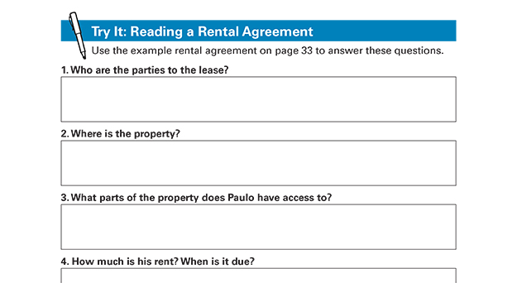
Try It: Reading a Rental Agreement See page 32 in your Participant Guide

Slide 41
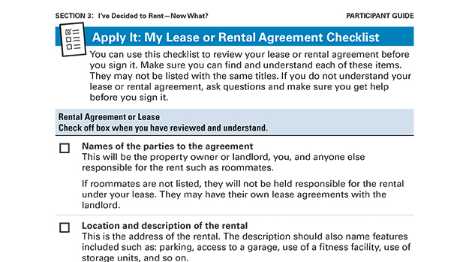
Apply It: My Lease or Rental Agreement Checklist See page 35 in your Participant Guide

Slide 42

Renter’s Insurance
Could you afford to replace your personal property?
If a visitor were injured at your residence, could you afford to pay the expenses resulting from the injury?

Slide 43
Purpose of Renter’s Insurance
Financial recovery from losses
Hazards and disasters are “named perils”
Actual costs or replacement costs
Limited or no coverage for some items
Financial protection from claims of injury
May be required to purchase it
Widely available
Costs vary -- Shop around

Slide 44
Your Rights as a Renter
The Fair Housing Act prohibits housing-related discrimination based on:
Race
Color
National origin
Religion
Sex
Disability
Presence of children
Housing must meet health and safety codes

Slide 45
Reasonable Modifications
Resident with a disability can make and pay for reasonable modifications
Structural modification to allow full enjoyment of the housing and related facilities
Examples:
Widening a doorway
Lowering kitchen cabinets
Replacing flooring

Slide 46
Reasonable Accommodations
Housing provider makes reasonable accommodations
Change in rules, policies, practices, or services so a person with a disability will have an equal opportunity to use and enjoy a dwelling unit or common space
Example:
Reserved parking near entrance

Slide 47
Get Help
If you think your rights have been or are being violated, get help:
Department of Housing and Urban Development website at www.hud.gov
Local housing authority
HUD-approved housing counseling agency
Legal aid
An attorney

Slide 48
Section 3: Remember the Key Takeaway
Ways to protect yourself as a renter include reading and understanding your rental agreement or lease, getting renter’s insurance, and knowing your rights and responsibilities.

Slide 49
Take Action See page 40 in your Participant Guide
What will I do?
How will I do it?
Will I share my plans with anyone? If so, who?
Visit fdic.gov/education to learn more

Slide 50

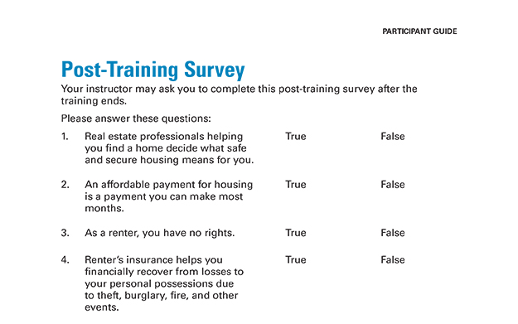
Post-Training Survey See page 45 in your Participant Guide

