Slide 1


Module 11: Protecting Your Identity and Other Assets
Module 11
Protecting Your Identity and Other Assets
September 2018

Slide 2
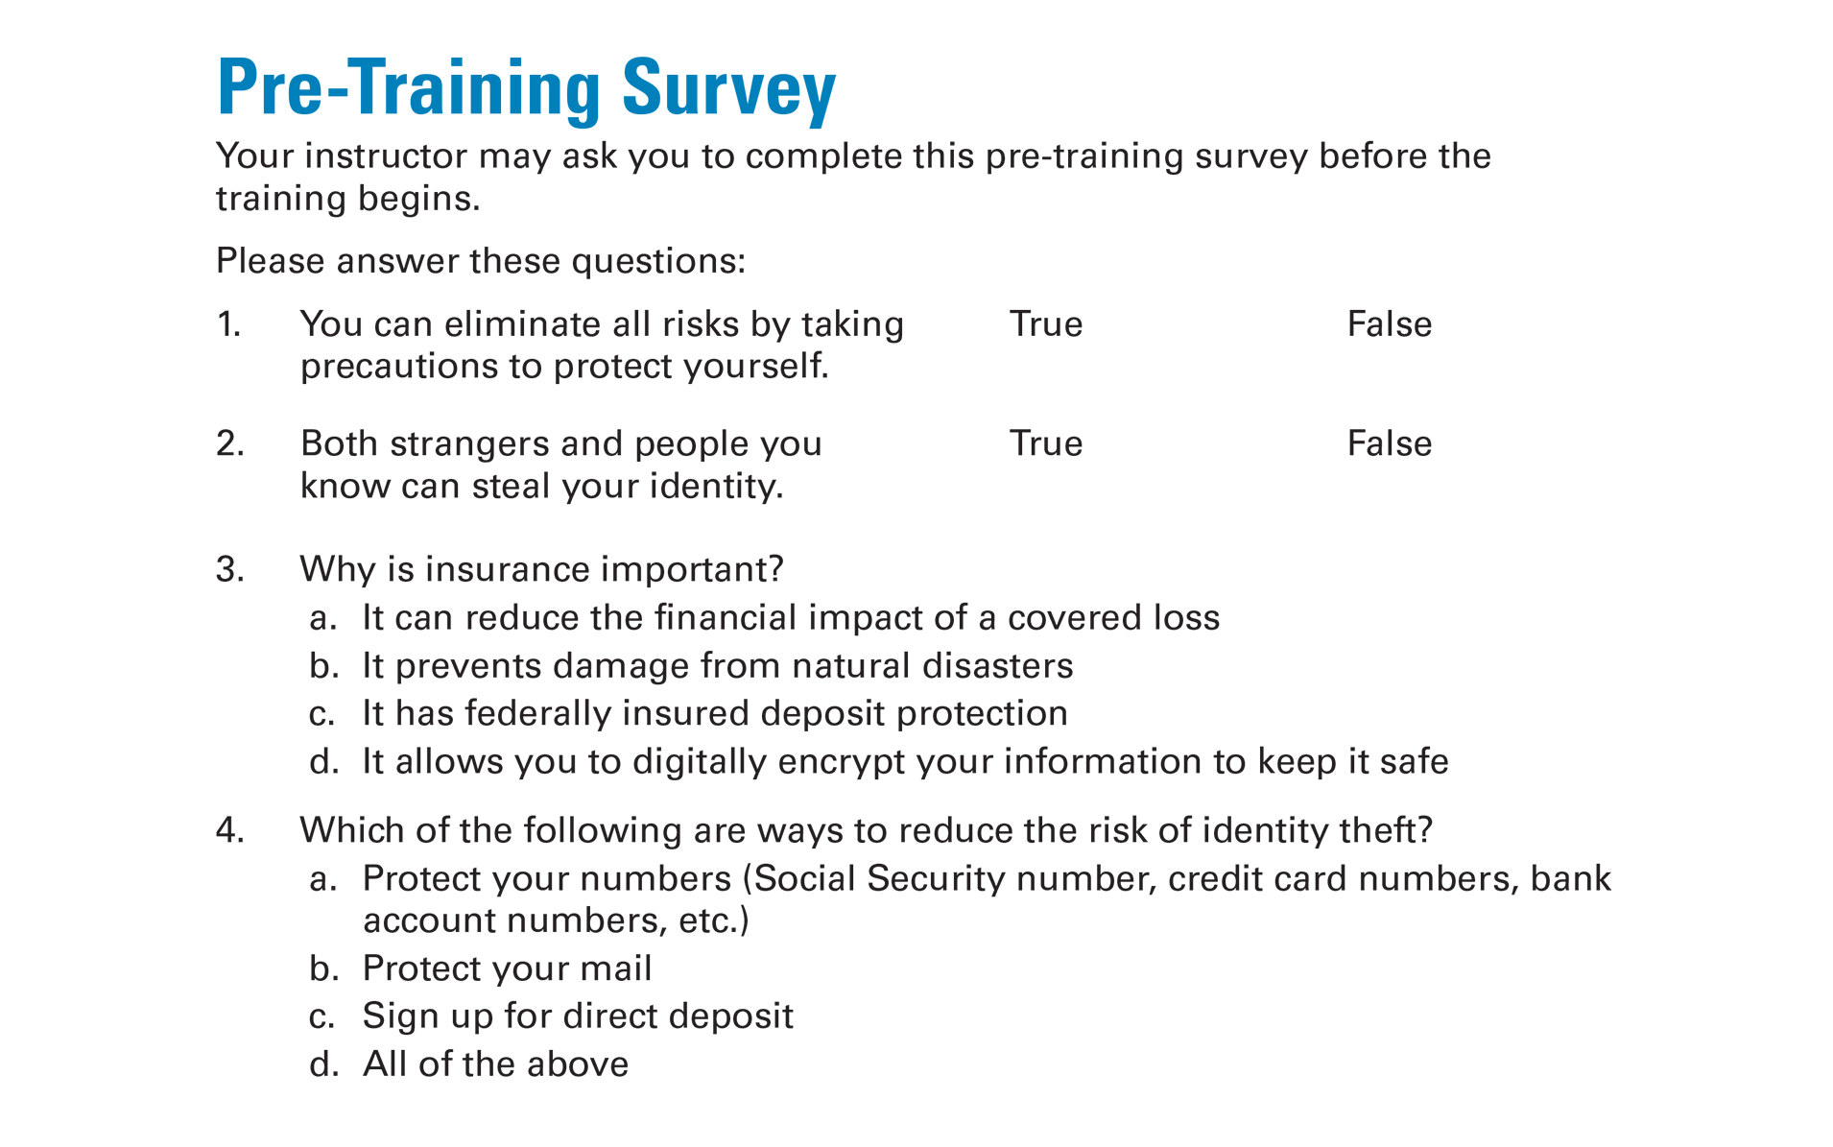
Pre-Training Survey
See page 21 in your Participant Guide

Slide 3
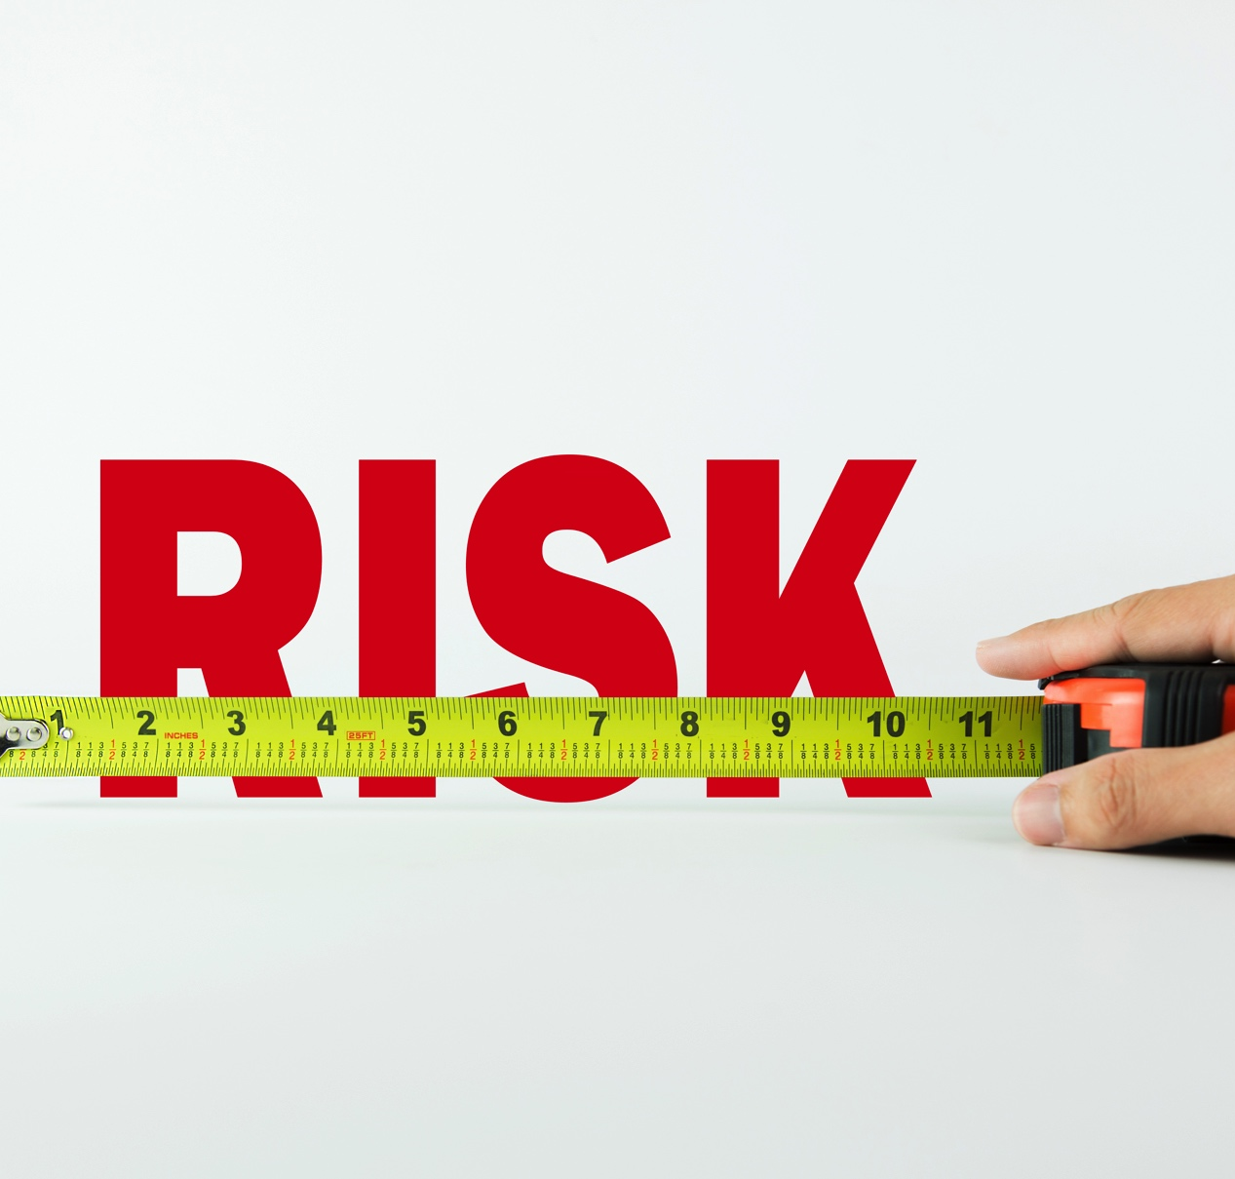
Section 1: Risks to Your Assets
Section 1
Risks to
Your Assets
See page 3 in your Participant Guide

Slide 4
Section 1: Key Takeaway
Being aware of risks to your assets prepares you to take steps to reduce those risks.

Slide 5
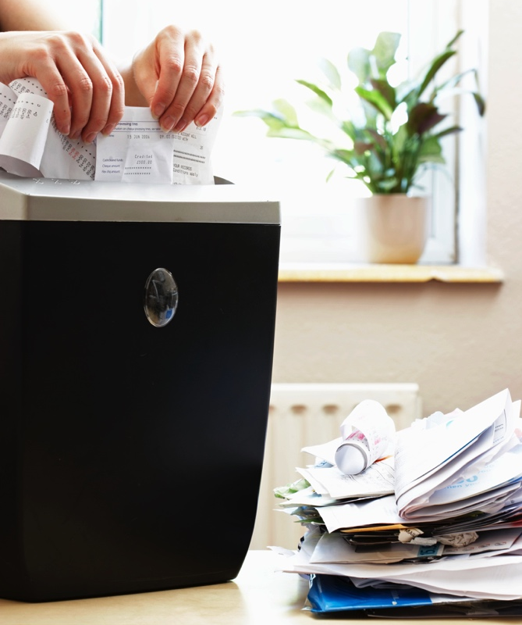
Assets and Risks
Asset: something you own that has value
Risk: potential for harm
You can protect the value of your
assets by taking steps to reduce
risks
Asset =
Something you own
that has value
Risk =
Potential for Harm

Slide 6
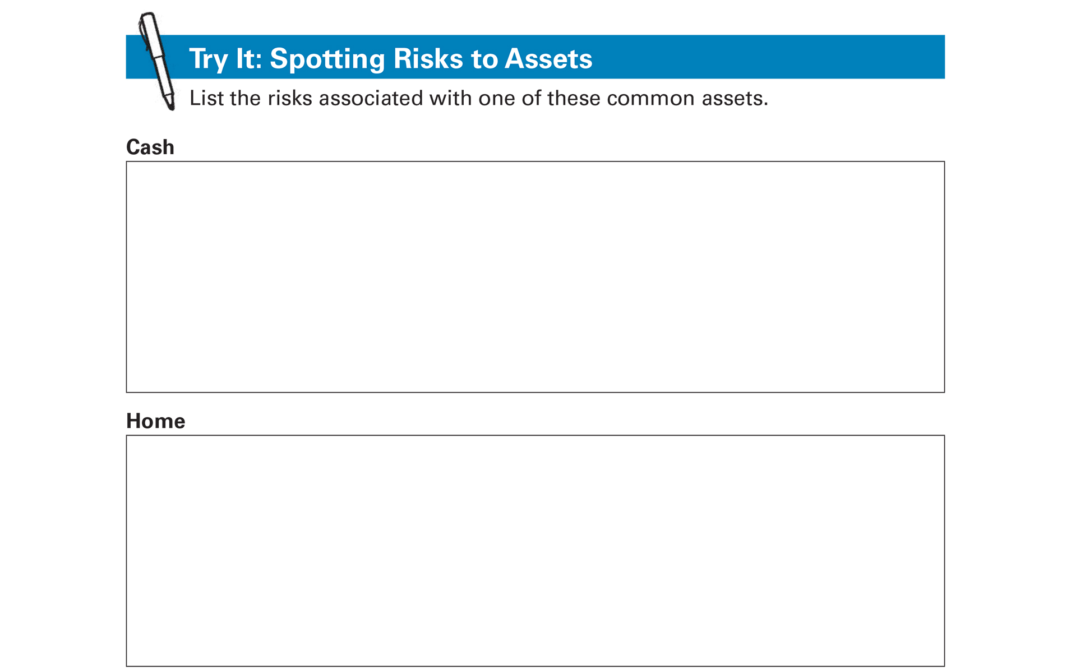
Try It: Spotting Risks to Assets
See page 4 in your Participant Guide

Slide 7
Reducing Risks to Your Assets
*You cannot eliminate all risks*
*You can reduce some of them*
Make informed choices that anticipate risks
Be careful with personal information
Know your rights and responsibilities
Get insurance

Slide 8
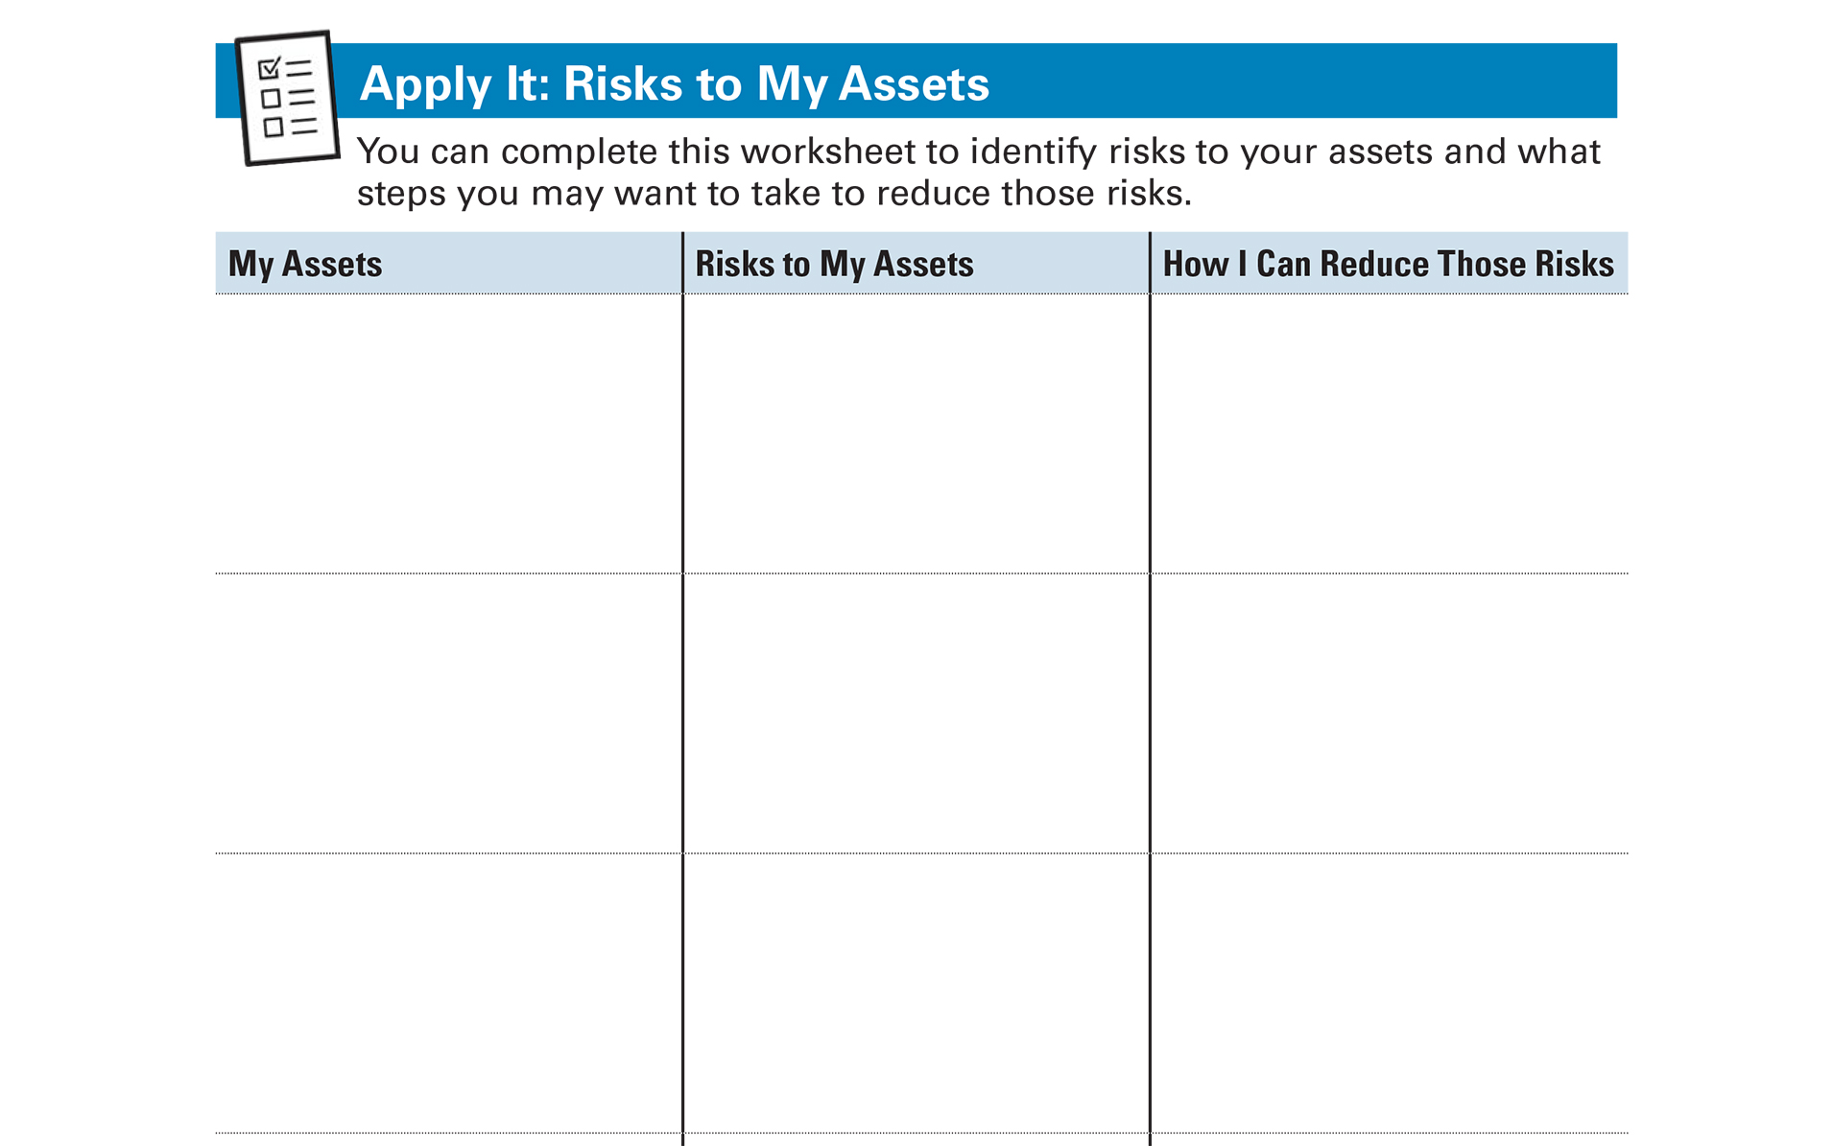
Apply It: Risks to My Assets
See page 5 in your Participant Guide

Slide 9
Section 1: Remember the Key Takeaway
Being aware of risks to your assets prepares you to take steps to reduce those risks.

Slide 10

Section 2: Identity Theft and Fraud
Section 2
Identity Theft and Fraud
See page 6 in your Participant Guide

Slide 11
Section 2: Key Takeaway
You can reduce your risk of identity theft. Help is available if it happens
to you.

Slide 12
Identity Theft Basics
Your identity is an asset
Identity theft is:
  A crime that happens when someone uses a person’s identifying information without authority

Slide 13
What Do We Mean by Identity?
Documents that have information about identity
    What are some examples?
Other information thieves can use to impersonate someone
    What are some examples?

Slide 14
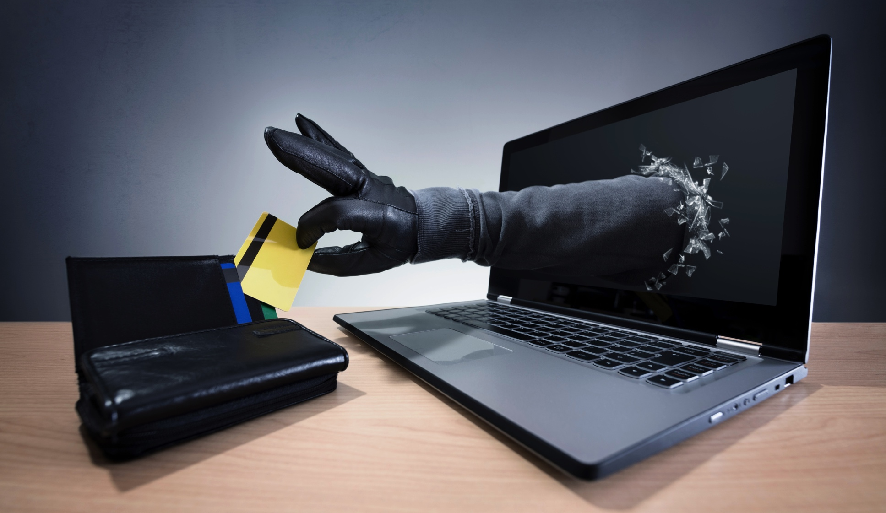
How Could You Be Harmed?

Slide 15
Ways Criminals Can Steal Your Identity
Phishing – trick you into giving personal information, often through email
  Vishing – phishing by phone
  Smishing – phishing by text messages
Spear phishing – targeted phishing
Pharming – fake websites
Skimming – stealing credit card or debit card numbers
Social media scamming

Slide 16
Warning Signs of Identity Theft
Withdrawals you didn’t make
Missing bills and statements
Merchants refusing your checks
Credit card transactions not going through

Slide 17
More Warning Signs of Identity Theft
Letters about accounts you didn’t open
Emails about purchases you didn’t make
Statements for credit cards you don’t have
Debt collectors calling about debts that aren’t yours
Passwords or user names not working

Slide 18
Additional Warning Signs
Unfamiliar accounts on your credit reports
Medical bills for services you didn’t receive
Health records for conditions you don’t have
Multiple tax returns or inaccurate tax records
Notification about a data breach

Slide 19
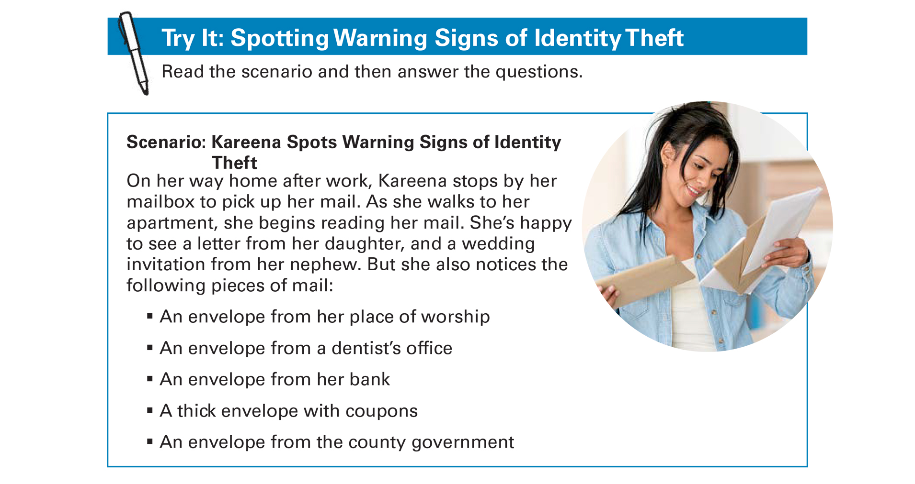
Try It: Spotting Warning Signs of
Identity Theft
See page 9 in your Participant Guide

Slide 20
Steps to Minimize Identity Theft
Guard your personal information
Don’t respond to unsolicited requests
Protect your mail
Sign up for direct deposit
Clean up your financial trash
Review your financial accounts regularly and carefully

Slide 21
More Steps to Minimize Identity Theft
Beware of identity theft on the Internet
Protect your devices
Review your credit reports at least once every 12 months at www.annualcreditreport.com
Keep your important documents secure
Beware of disaster-related scams
Read scam alerts

Slide 22
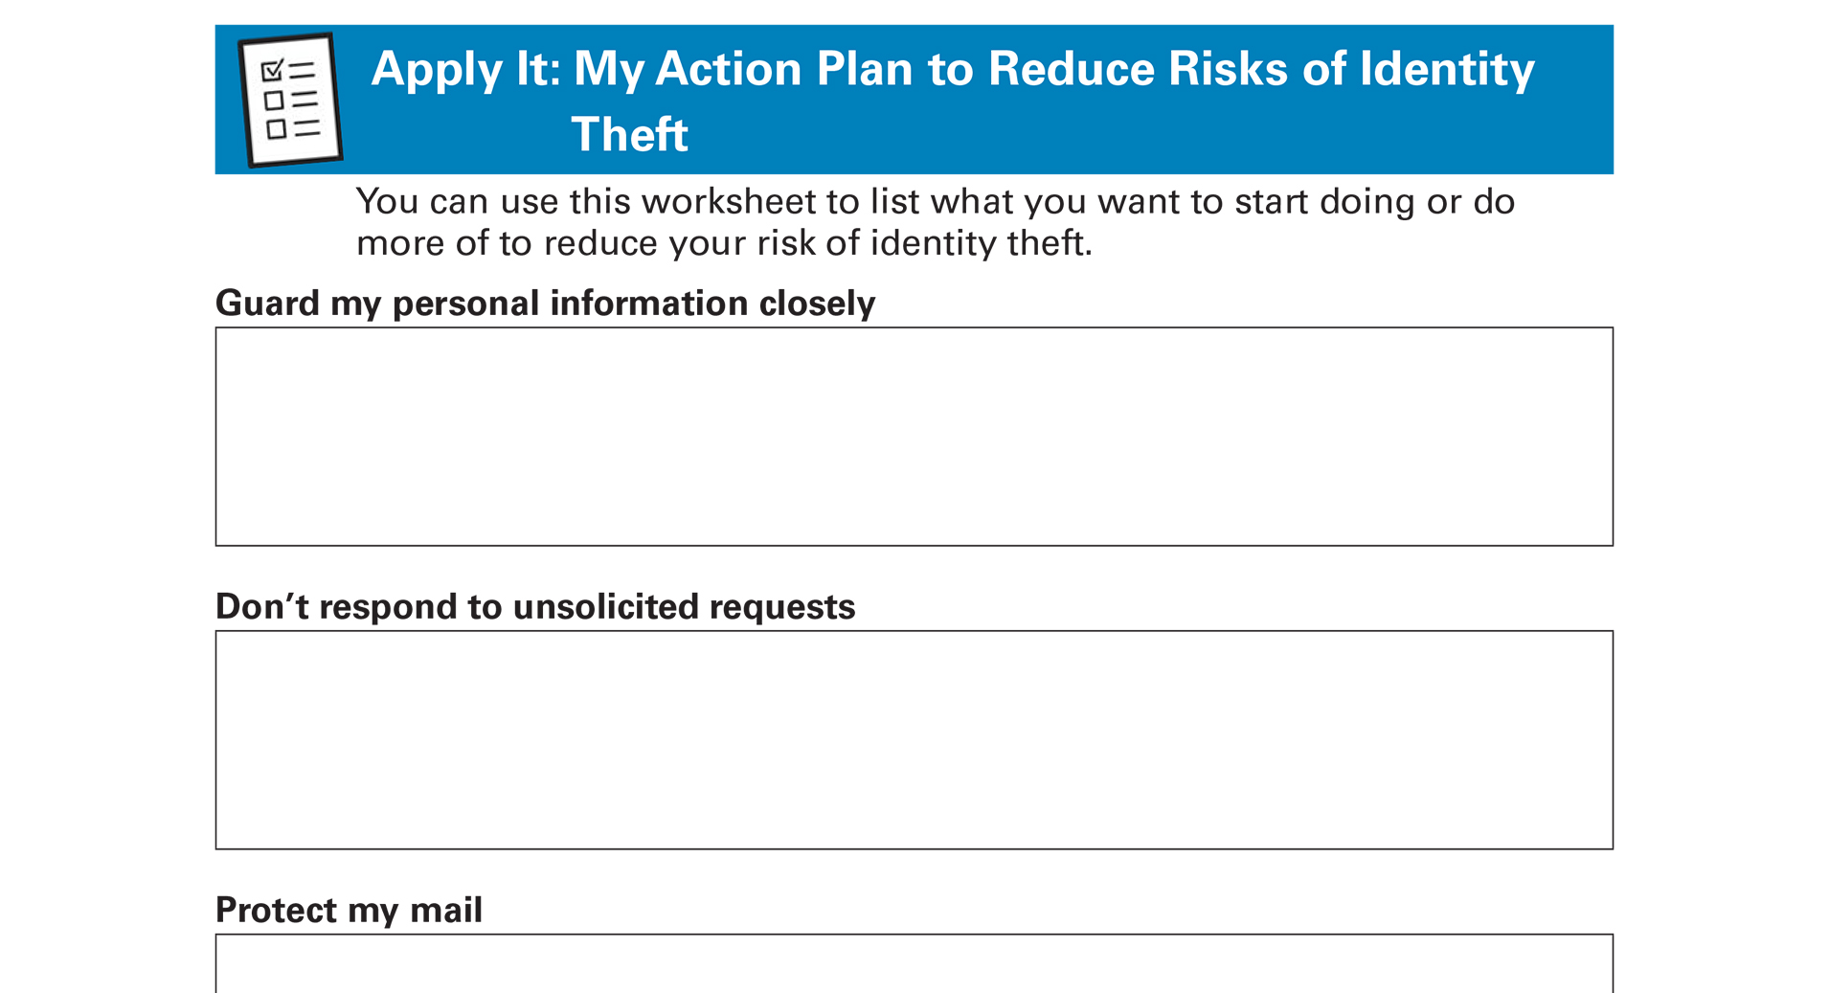
Apply It: My Action Plan to Reduce Risks of
Identity Theft
See page 11 in your Participant Guide

Slide 23
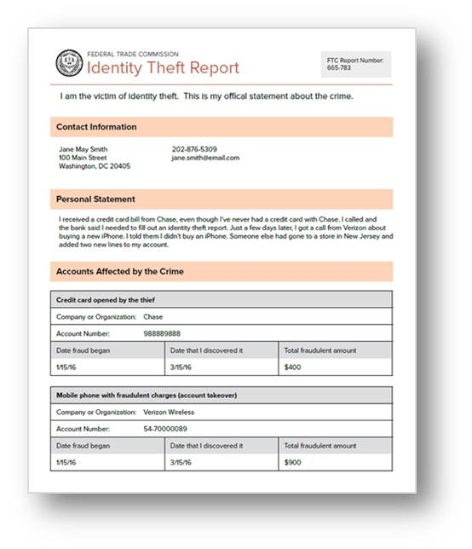
Reporting Identity Theft and Getting Help
Create an identity theft report
Visit IdentityTheft.gov for more information

Slide 24
If Your Identity Has Been Stolen
Work with credit reporting agencies to respond to the theft
  Place a free fraud alert on your credit reports -- initial or extended
  Dispute inaccurate information
  Consider placing a free credit freeze too

Slide 25
Communicate with Your Creditors and
Debt Collectors
Alert them about fraudulent accounts
Get copies of documents related to the theft of your identity
Ask them to stop contacting you about fraudulent accounts
Get written information about fraudulent accounts

Slide 26
You Have Other Federal Rights
See IdentityTheft.gov
You generally have limited liability for fraudulent debts and accounts caused by identity theft
Go to USA.gov to learn about your rights in a data breach

Slide 27
Section 2: Remember the Key Takeaway
You can reduce your risk of identity theft. Help is available if it happens to you.

Slide 28
Section 3: Insurance and Record-Keeping
Section 3
Insurance and Record-Keeping
See page 15 in your Participant Guide

Slide 29
Section 3: Key Takeaway
Insurance provides protection from financial loss. Keep accurate records of your assets and any damages to your property.

Slide 30

How Insurance Works
Reduces the financial impact of a loss or event covered by the insurance policy
Helps protect you from financial catastrophe

Slide 31
Key Terms
Insurance premium
Covered loss
Coverage limit
Deductible

Slide 32
More Key Terms
Copayment
Coinsurance
Exceptions or exclusions
Claim
Adjudication

Slide 33
Types of Insurance
Health insurance
Long term care insurance
Dental insurance
Vision insurance
Disability insurance
Life insurance
Pet insurance

Slide 34
More Types of Insurance
Identity theft insurance
Vehicle insurance
Renter’s insurance
Homeowners insurance
Flood insurance

Slide 35
Getting Insurance
Depends on your individual circumstances
Purchase it to manage risks to your assets
Consider it for things that could happen and cause serious financial harm
Some insurance is required by law
Periodically review your coverage and shop around

Slide 36
Shop Around
Review state-specific information
Check out insurance companies
Ask about discounts
Compare several quotes
Consider tradeoff between deductibles, coinsurance, coverage limits, and premiums

Slide 37
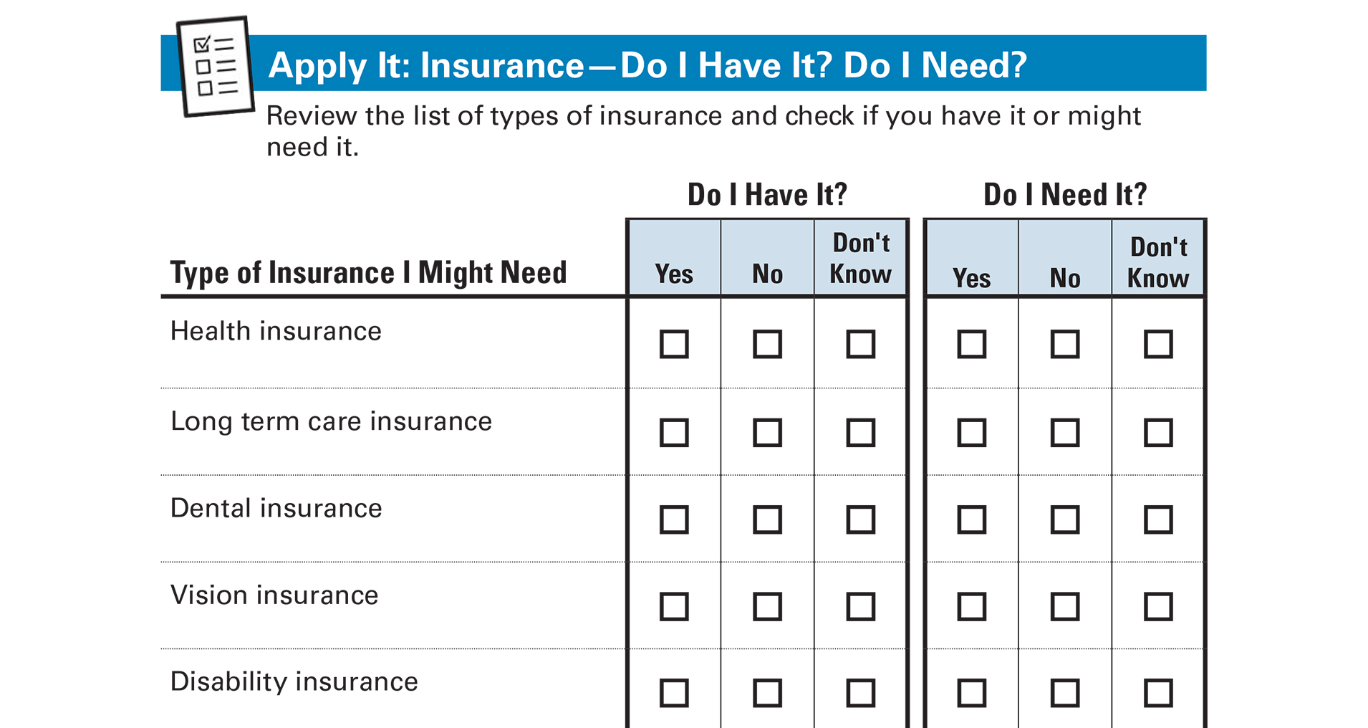
Apply It: Insurance ⎯ Do I Have It?
Do I Need It?
See page 17 in your Participant Guide

Slide 38
Keeping Accurate Records
Important part of making sure insurance adequately covers your risks
Create and maintain a list of your assets
Document any damages and save receipts for related expenses
File claims as soon as possible

Slide 39
Section 3: Remember the Key Takeaway
Insurance provides protection from financial loss. Keep accurate records of your assets and any damages to your property.

Slide 40
Take Action
See page 19 in your Participant Guide
What will I do?
How will I do it?
Will I share my plans with anyone? If so, who?
Visit fdic.gov/education to learn more

Slide 41

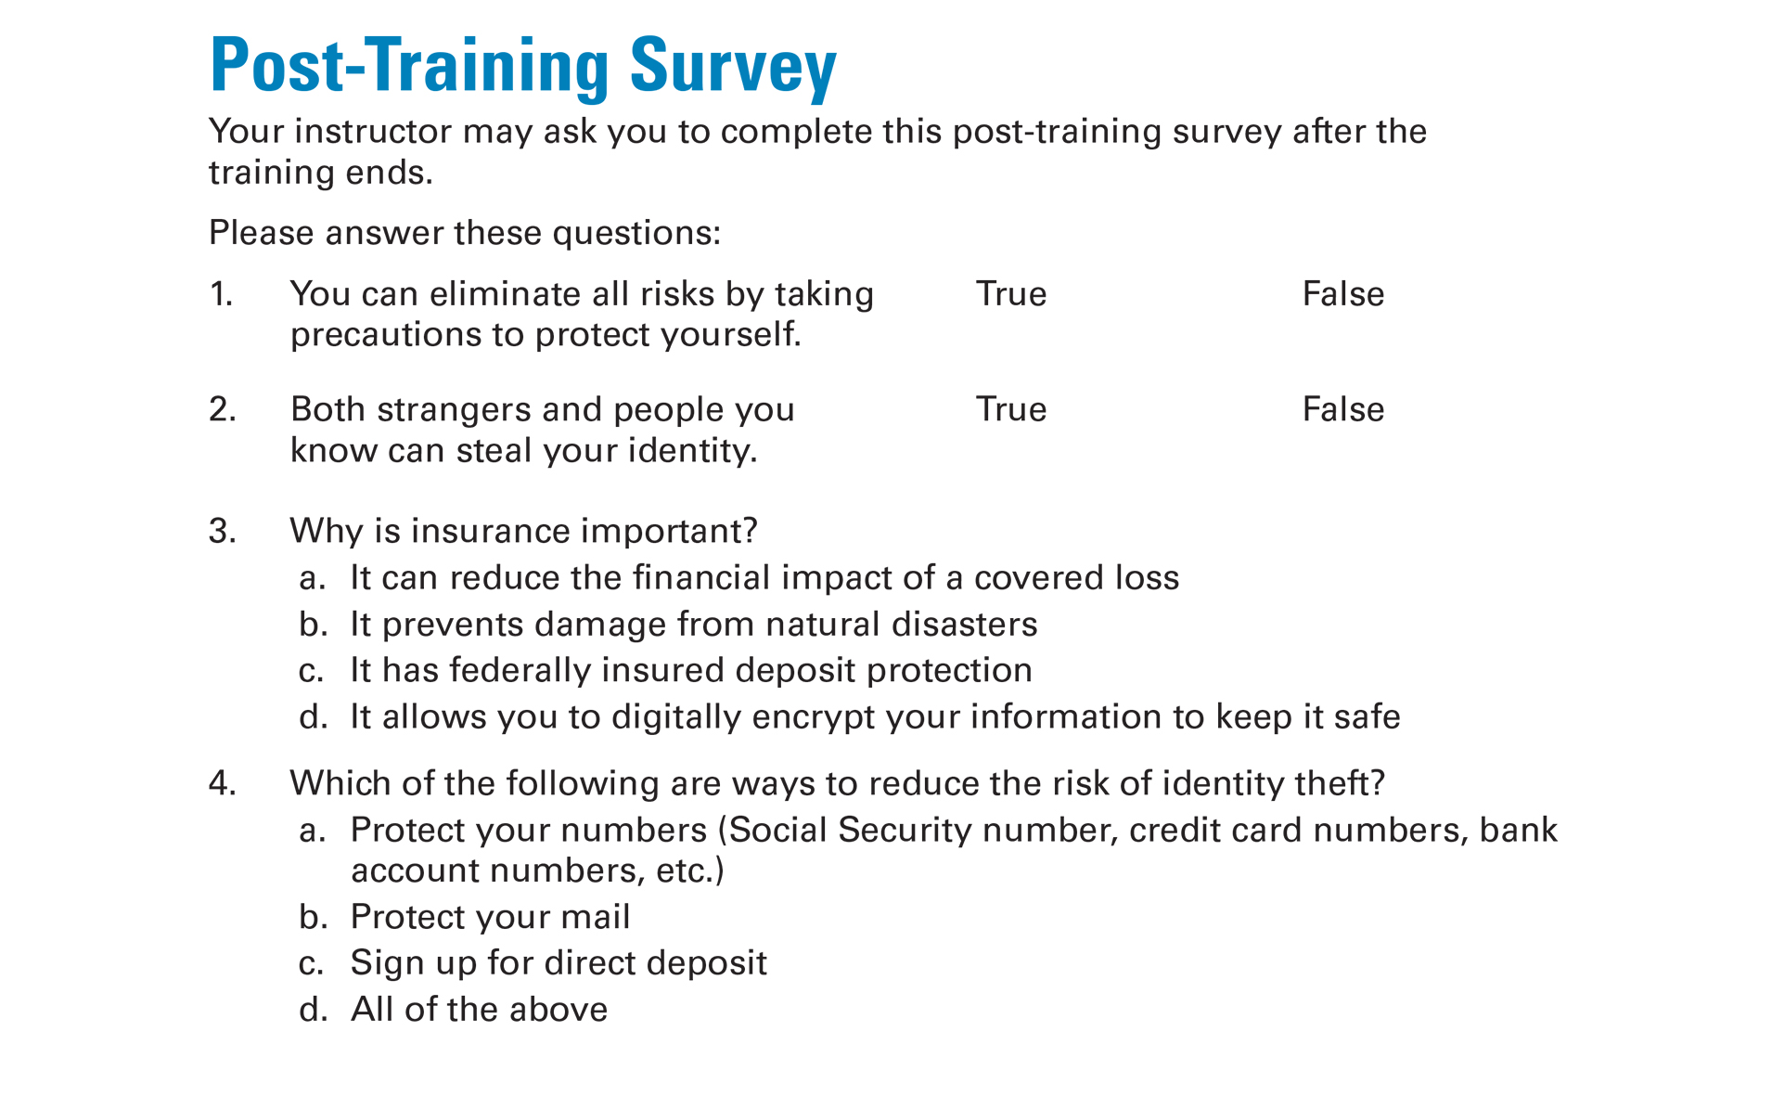
Post-Training Survey
See page 23 in your Participant Guide

