Slide 1


Module 10: Building Your Financial Future
Module 10
Building Your Financial Future
September 2018

Slide 2
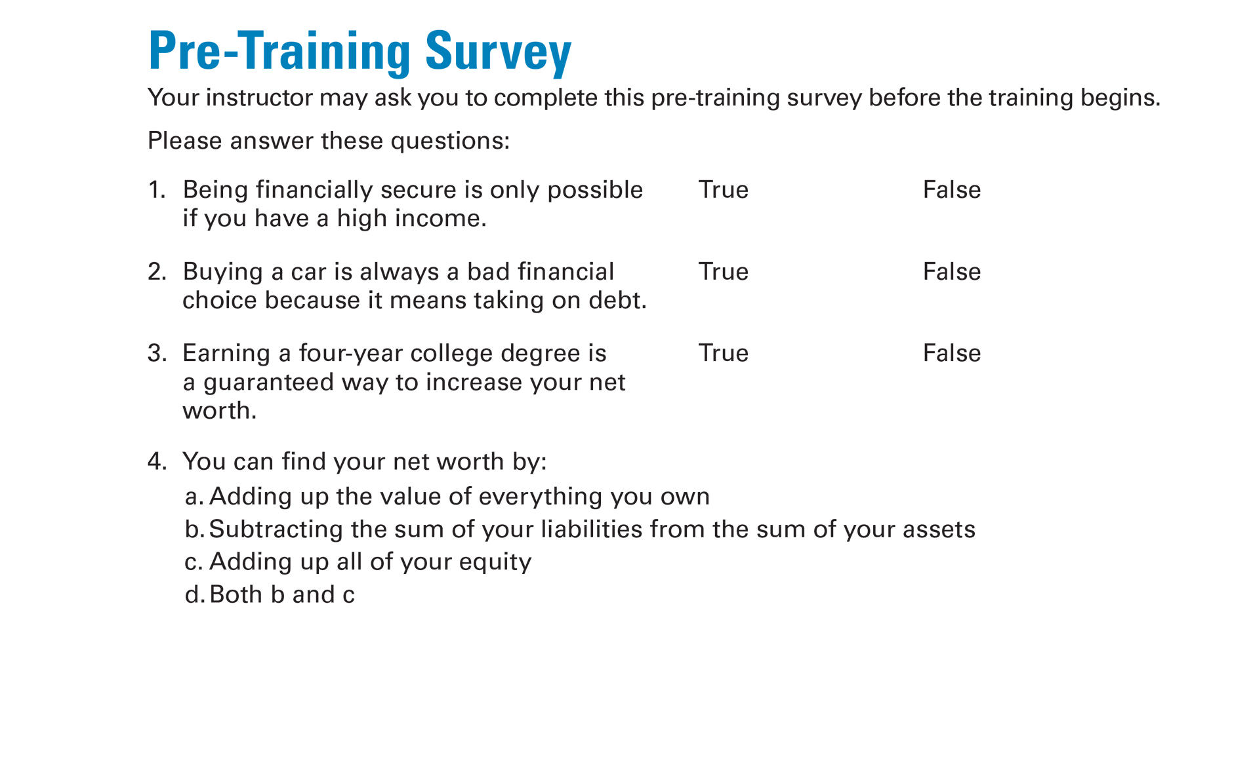
Pre-Training Survey See page 31 in your Participant Guide

Slide 3

Section 1: Assets and Asset-Building
Section 1
Assets and Asset-Building
See page 3 in your Participant Guide

Slide 4
Section 1: Key Takeaway
Assets can lead to
wealth and
financial security.

Slide 5
What is an Asset?
Something you own that has value
Three types of assets:
Physical
Financial
Productive
Value determined based on type of asset

Slide 6
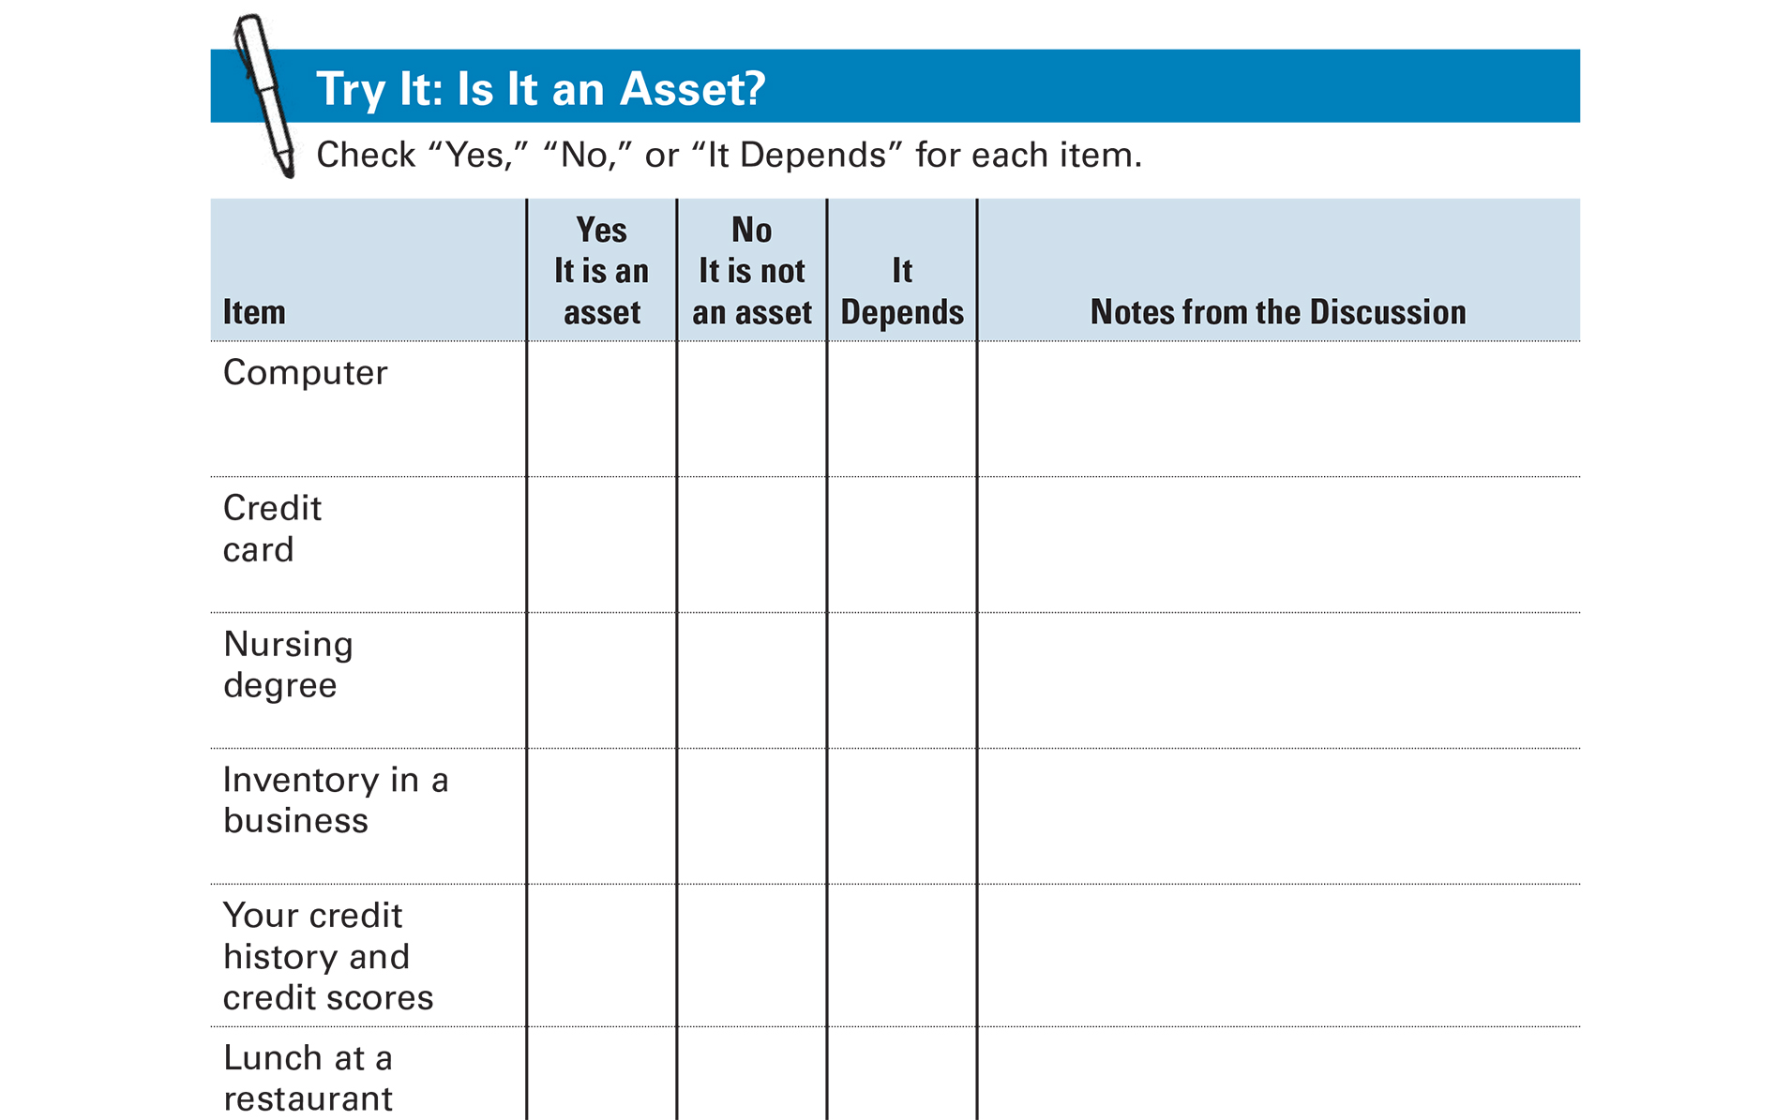
Try It: Is It an Asset? See page 5 in your Participant Guide

Slide 7
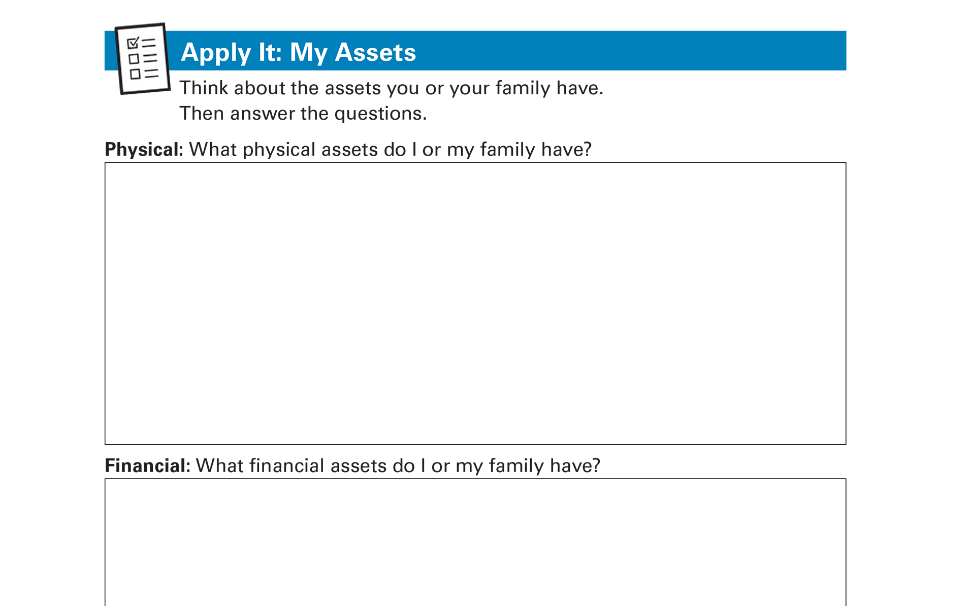
Apply It: My Assets See page 6 in your Participant Guide

Slide 8
Benefits of Asset-Building
Financial security: income and assets
Foundation for your financial future
Essential to achieving long-term financial stability and growing wealth

Slide 9
Owning Assets
Creates a “buffer” to handle emergencies
Helps you reach your goals
Increases your options
Helps you earn more income
Inspires you to look to the future
Reduces stress

Slide 10
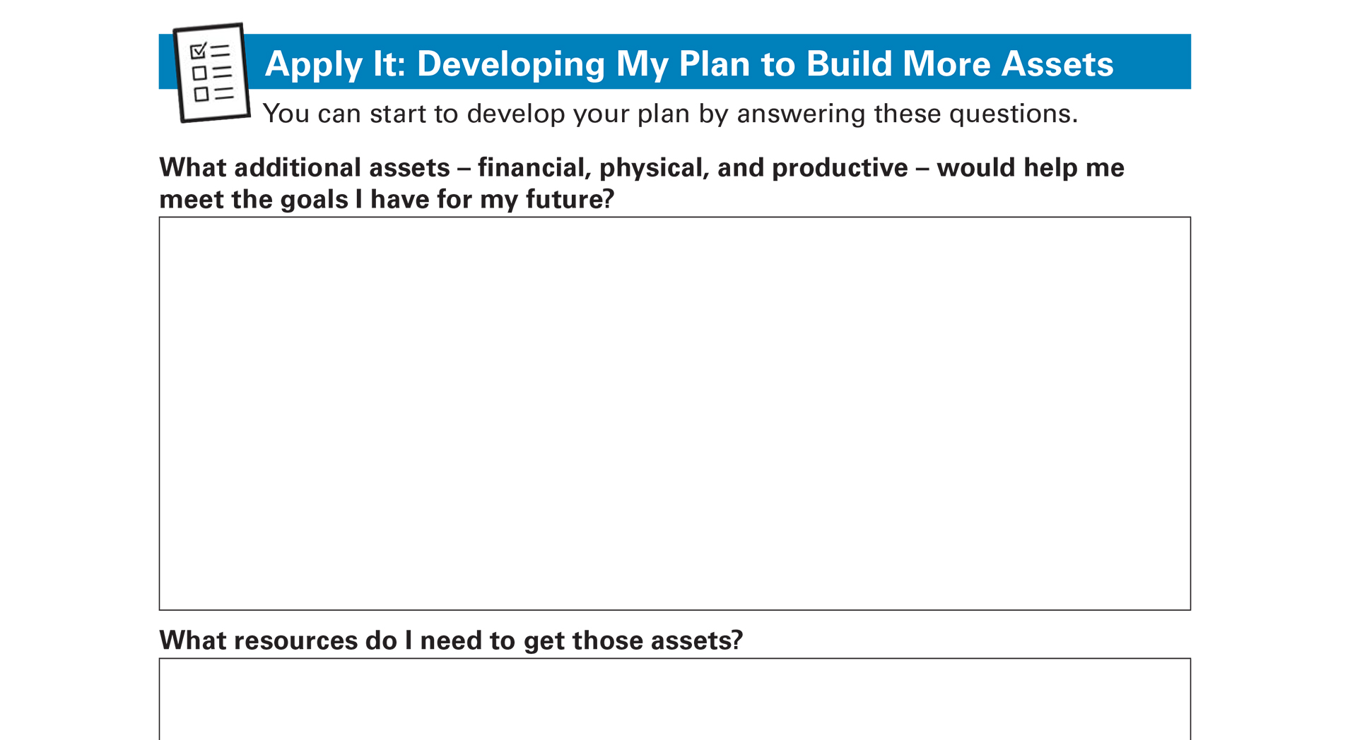
Apply It: Developing My Plan to Build More Assets See page 8 in your Participant Guide

Slide 11
Section 1: Remember the Key Takeaway
Assets can lead to wealth and financial security.

Slide 12
Section 2: How Assets Create a Financial Foundation
Section 2
How Assets Create a Financial Foundation
See page 10 in your Participant Guide

Slide 13
Section 2: Key Takeaway
Net worth is a good measure of your financial stability. Calculate your net worth by subtracting your liabilities (money you owe others) from your assets.

Slide 14
Assets, Liabilities, and Equity
Asset
Something you own that has value
Liability
Something you owe others, usually money
Equity
The value of an asset minus the liability related to that asset
Equity
Value of Asset
-
Related Liability
=

Slide 15
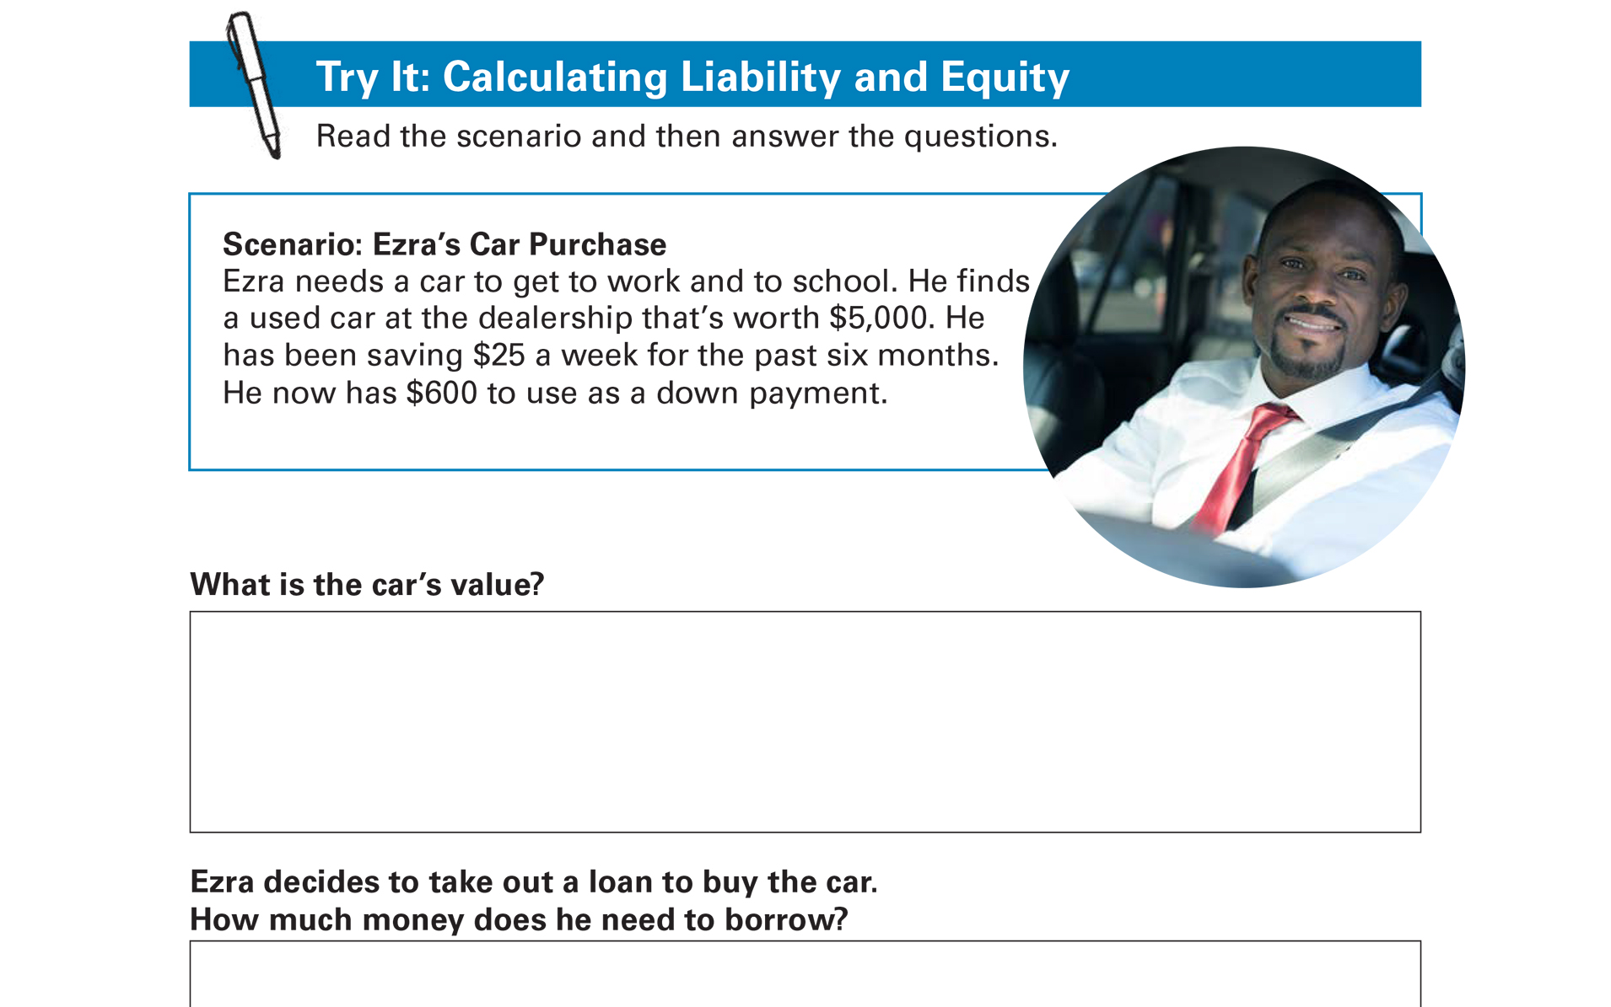
Try It: Calculating Liability and Equity See page 11 in your Participant Guide

Slide 16
Net Worth
Measure of financial wealth
Equals assets minus liabilities
Also equals equity from all your assets added together
Net Worth
=
Assets
-
Liabilities

Slide 17
Value of Net Worth
Positive net worth = a financial cushion
Zero or negative net worth = no financial cushion
Calculating Net Worth:
Step 1: List assets and calculate Total Assets
Step 2: List liabilities and calculate Total Liabilities
Step 3: Calculate Total Assets minus Total Liabilities

Slide 18
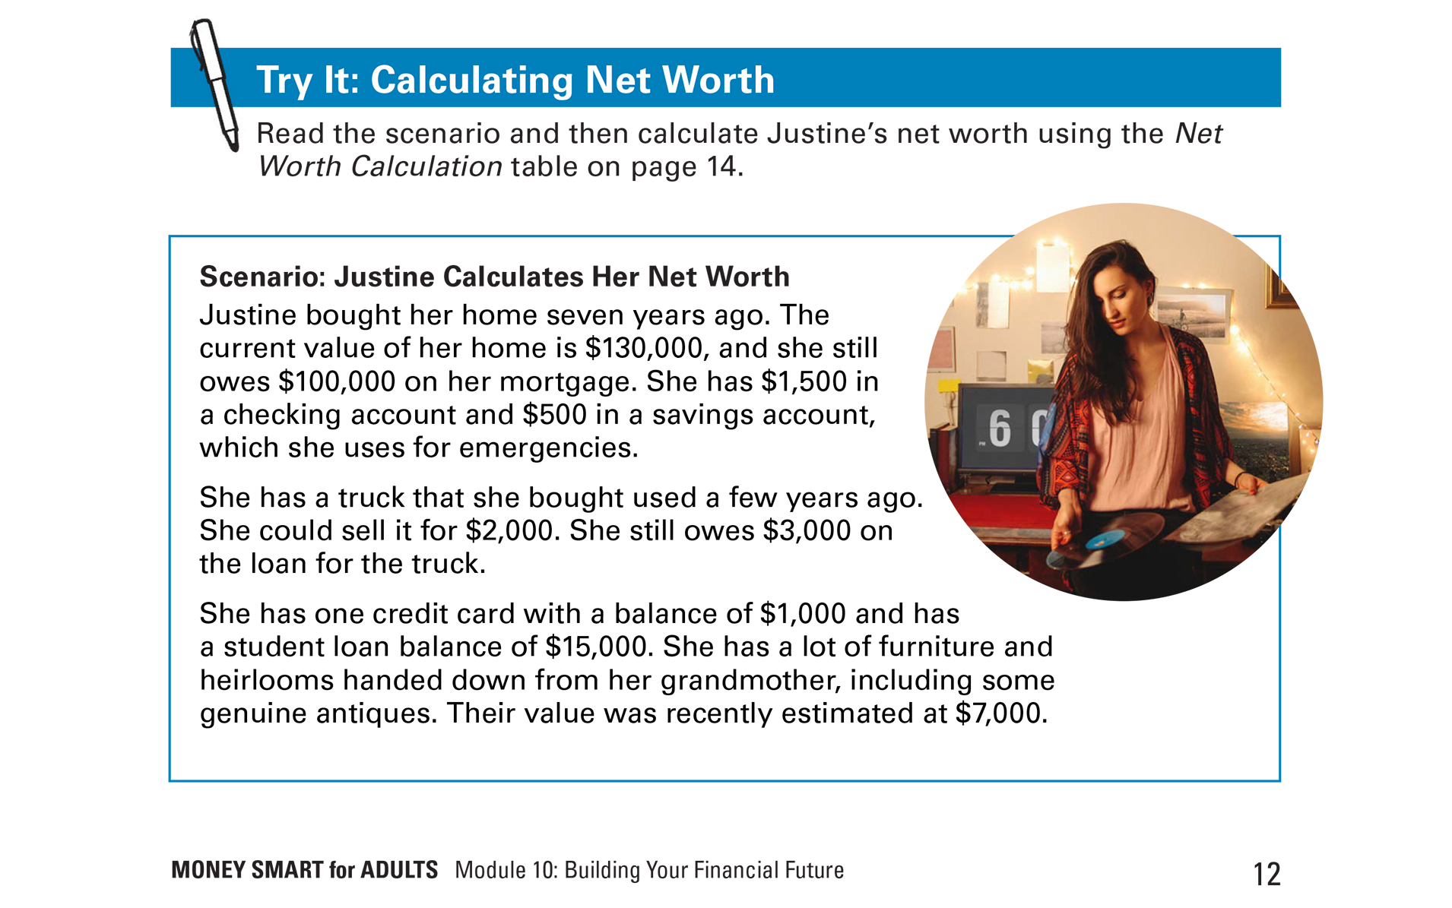
Try It: Calculating Net Worth See page 12 in your Participant Guide

Slide 19
Justine’s Net Worth
Items | Value
Total Assets (from bottom row of the Assets table) | $141,000
Total Liabilities (from bottom row of the Liabilities table ) | $119,000
Net Worth (Total Assets minus Total Liabilities) | $22,000
The answer is $22,000

Slide 20
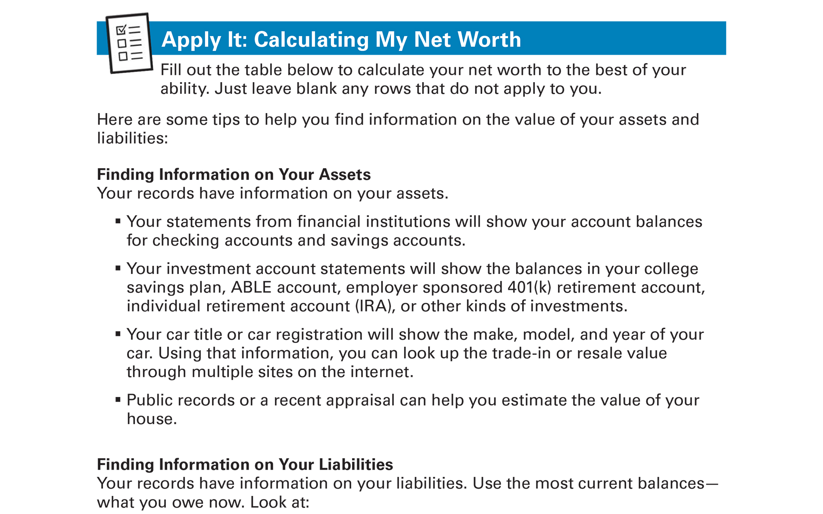
Apply It: Calculating My Net Worth See page 15 in your Participant Guide

Slide 21

Changing Your Net Worth
Increase Your Assets
Decrease Your Liabilities
OR……Do Both
What are some specific ways people can increase their net worth?

Slide 22
Ways to Increase Your Net Worth
Spend less than you make
Buy less than you can afford
Save money
Use employer programs
Use debt responsibly
Pay down your debts
Explore public benefits
Claim tax credits
Shop around
Build more assets

Slide 23
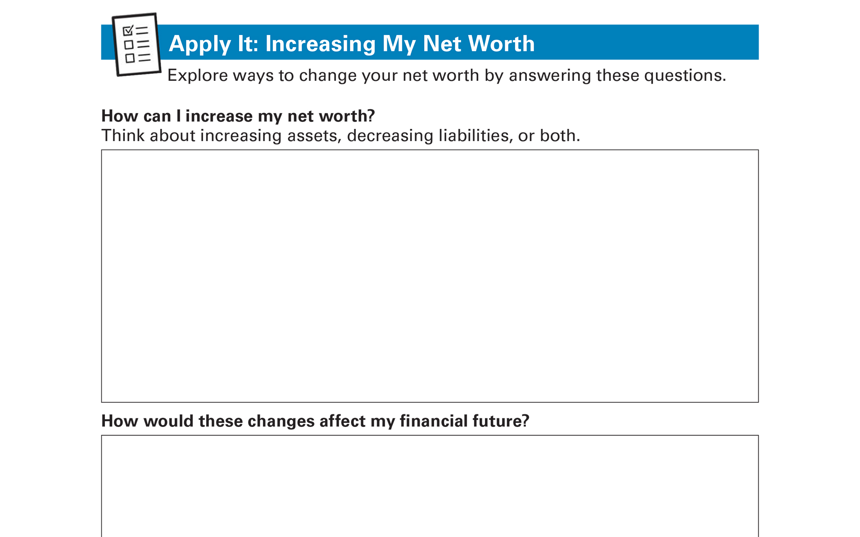
Apply It: Increasing My Net Worth See page 19 in your Participant Guide

Slide 24
Section 2: Remember the Key Takeaway
Net worth is a good measure of your financial stability. Calculate your net worth by subtracting your liabilities (money you owe others) from your assets.

Slide 25

Section 3: Cars as Assets
Section 3
Cars as Assets
See page 20 in your Participant Guide

Slide 26
Section 3: Key Takeaway
A car can be a productive asset when it helps you get other assets. Plan ahead to get a car you can afford with as little debt as possible.

Slide 27
Cars Can Be Productive Assets
Safe and reliable transportation is part of financial security
May increase choice of jobs or access to medical services, education, child care or elder care
Does owning a car always make you better off financially?

Slide 28
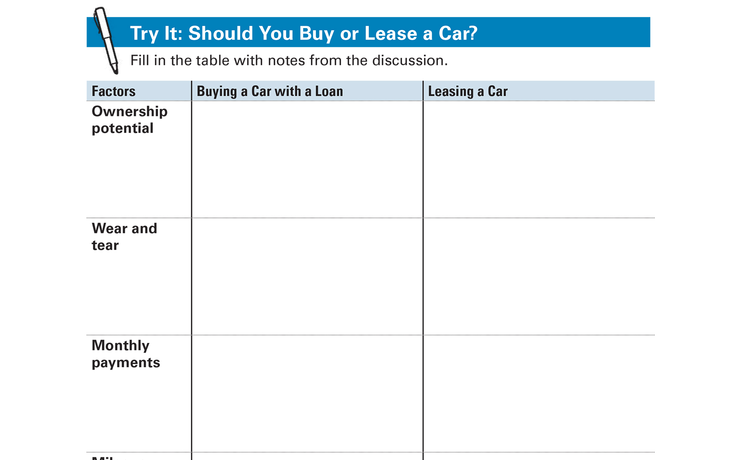
Try It: Should You Buy or Lease a Car? See page 22 in your Participant Guide

Slide 29
How Much Car Can You Afford?
No precise formula
Guidelines and questions can help
Start with your spending and saving plan
Remember to include costs for:
Insurance
Maintenance and repairs
Gas/Other fuel
Title and registration fees

Slide 30

Tips for Getting a Car Loan
Review your credit reports in advance at Annualcreditreport.com
Get pre-approved for a loan
Shop around
Keep good records of your loan quotes
Leave car at dealership until loan is final

Slide 31
Section 3: Remember the Key Takeaway
A car can be a productive asset when it helps you get other assets. Plan ahead to get a car you can afford with as little debt as possible.

Slide 32

Section 4: Training and Education as Assets
Section 4
Training and Education as Assets
See page 24 in your Participant Guide

Slide 33
Section 4: Key Takeaway
Training and education can be productive assets when they give you a strong chance of securing a better career or a higher paying job. Plan ahead to pay for them with as little debt as possible.

Slide 34
Training and Education Can Be Productive Assets
Can lead to higher wages
Can be:
Important part of asset-building strategy
Smart investment toward meeting goals
Many paths to higher pay and great careers

Slide 35
Types of Educational Experiences and Institutions
On-the-job training
Apprenticeships
Vocational or career and technical schools
Community colleges
Four-year colleges
Military
Job Corps, AmeriCorps, Peace Corps

Slide 36
Pursuing Education and Training
May need to invest your own resources, such as time and money
May need student loans
Opportunity cost:
Time spent in school may be time not spent earning money

Slide 37
Training or Education is Not Always a Smart Investment
It depends on the school, training program, record of job placement, cost, and related items
This doesn’t mean you shouldn’t pursue training or education
Make informed choices

Slide 38
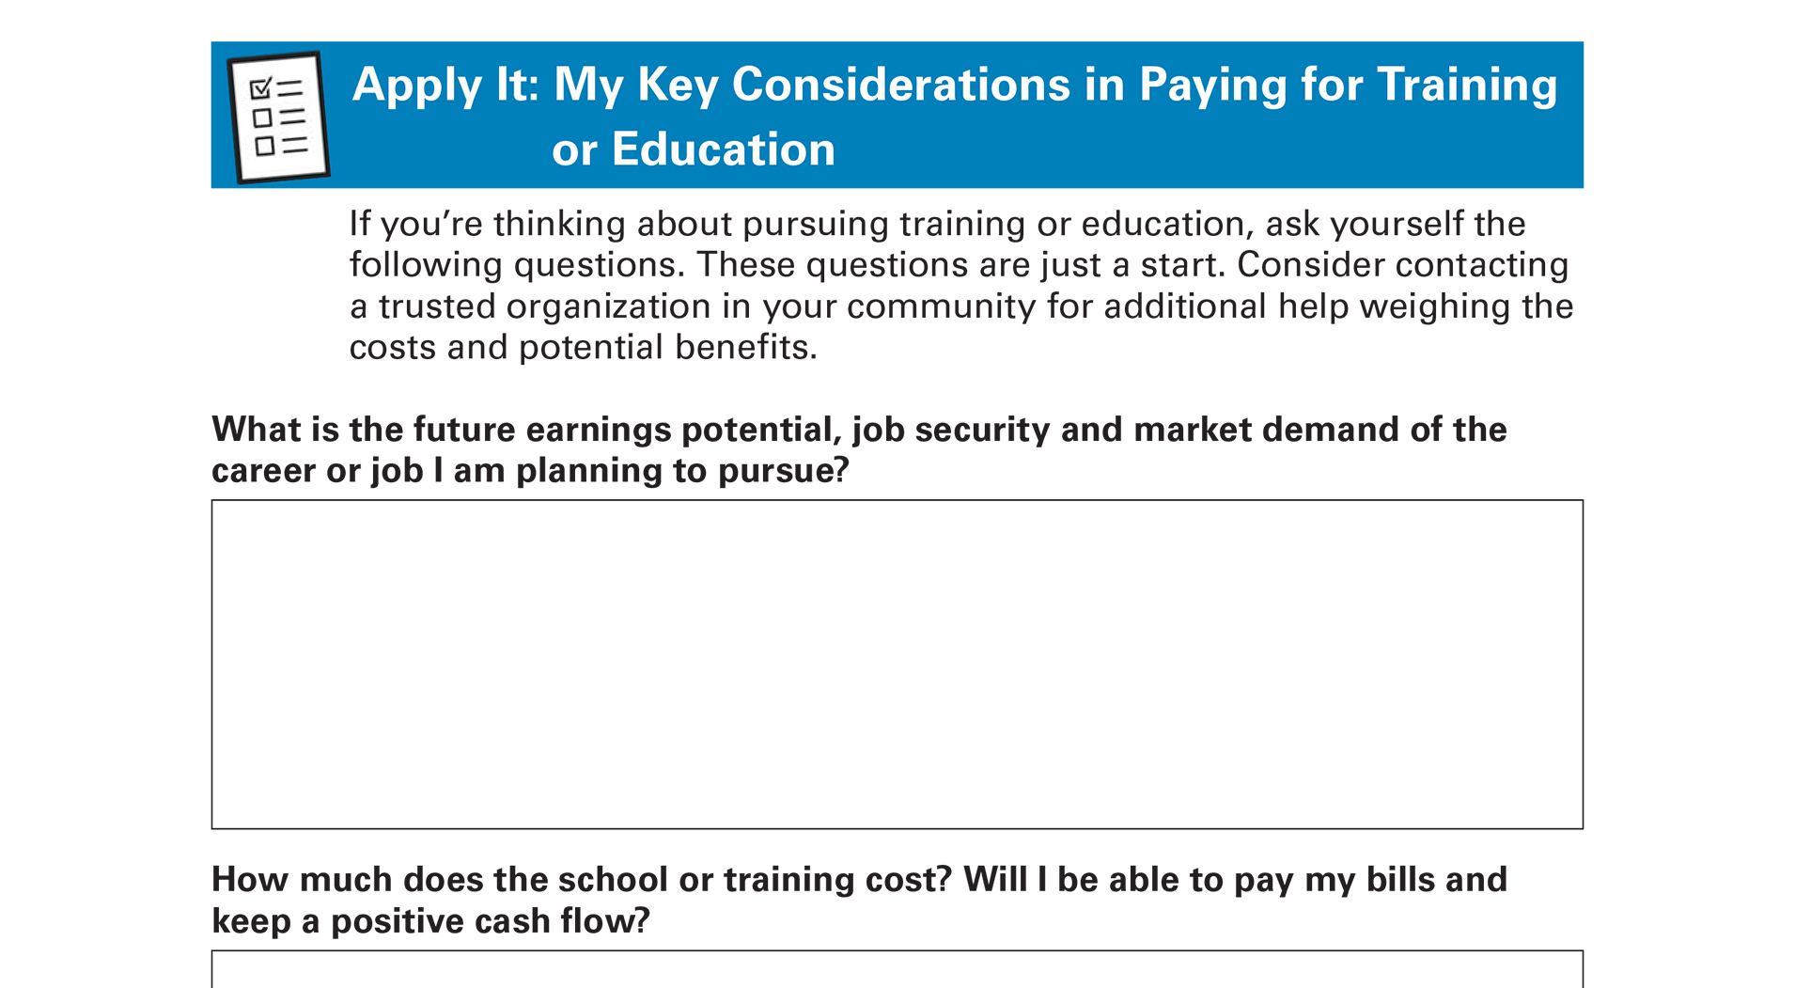
Apply It: My Key Considerations in Paying for Training or Education See page 25 in your Participant Guide

Slide 39
Ways to Pay
Ask for help from friends and family
Save money now or use saved money
Work while attending school
Apply for scholarships and grants
Ask for help from your employer
Borrow money using student loans
Combination of above

Slide 40
Scholarships and Grants
Scholarships: Most are merit-based
Awarded to students with certain qualities, such as academic or athletic ability
Usually competitive
Grants: Most are need-based
Usually awarded based on financial situation
May be competitive

Slide 41
Saving Money for Training or Education
529 Plans
Help save money for future education costs
Rules vary by state
ABLE Accounts (529A Plans)
For individuals of any age with significant disabilities that began before 26th birthday
Can use funds for education

Slide 42
Student Loans
Two kinds: federal and private
You don’t have to borrow maximum amount offered to you
Only borrow what you need
Total student debt
<
Starting annual salary
Source: Bureau of Consumer Financial Protection

Slide 43
Federal Student Loans
Offered by federal government
Usually have lower interest rates and offer better repayment terms, benefits, and options than private student loans
Generally, repayment starts after student leaves school

Slide 44
Free Application for Federal Student Aid (FAFSA)
Complete FAFSA to be considered for federal loans, work study, and grants
Use www.fafsa.gov or FAFSA mobile app
Check deadlines and apply early
Carefully review Student Aid Report
Respond immediately to legitimate requests for information

Slide 45
Paying Back Student Loans
Important to pay them back on time
Federal student loans are not automatically discharged by bankruptcy
Non-payment can possibly result in:
Referral to debt collection agency, drop in credit scores, wages withheld (garnishment)
Before getting a student loan, understand its terms and your options for repayment

Slide 46
Contact Your Loan Servicer
You may be able to restructure your payments to be more affordable
For more information, including options for repayment of federal student loans, visit: www.studentaid.gov

Slide 47
Section 4: Remember the Key Takeaway
Training and education can be productive assets when they give you a strong chance of securing a better career or a higher paying job. Plan ahead to pay for them with as little debt as possible.

Slide 48
Take Action See page 29 in your Participant Guide
What will I do?
How will I do it?
Will I share my plans with anyone? If so, who?
Visit fdic.gov/education to learn more

Slide 49

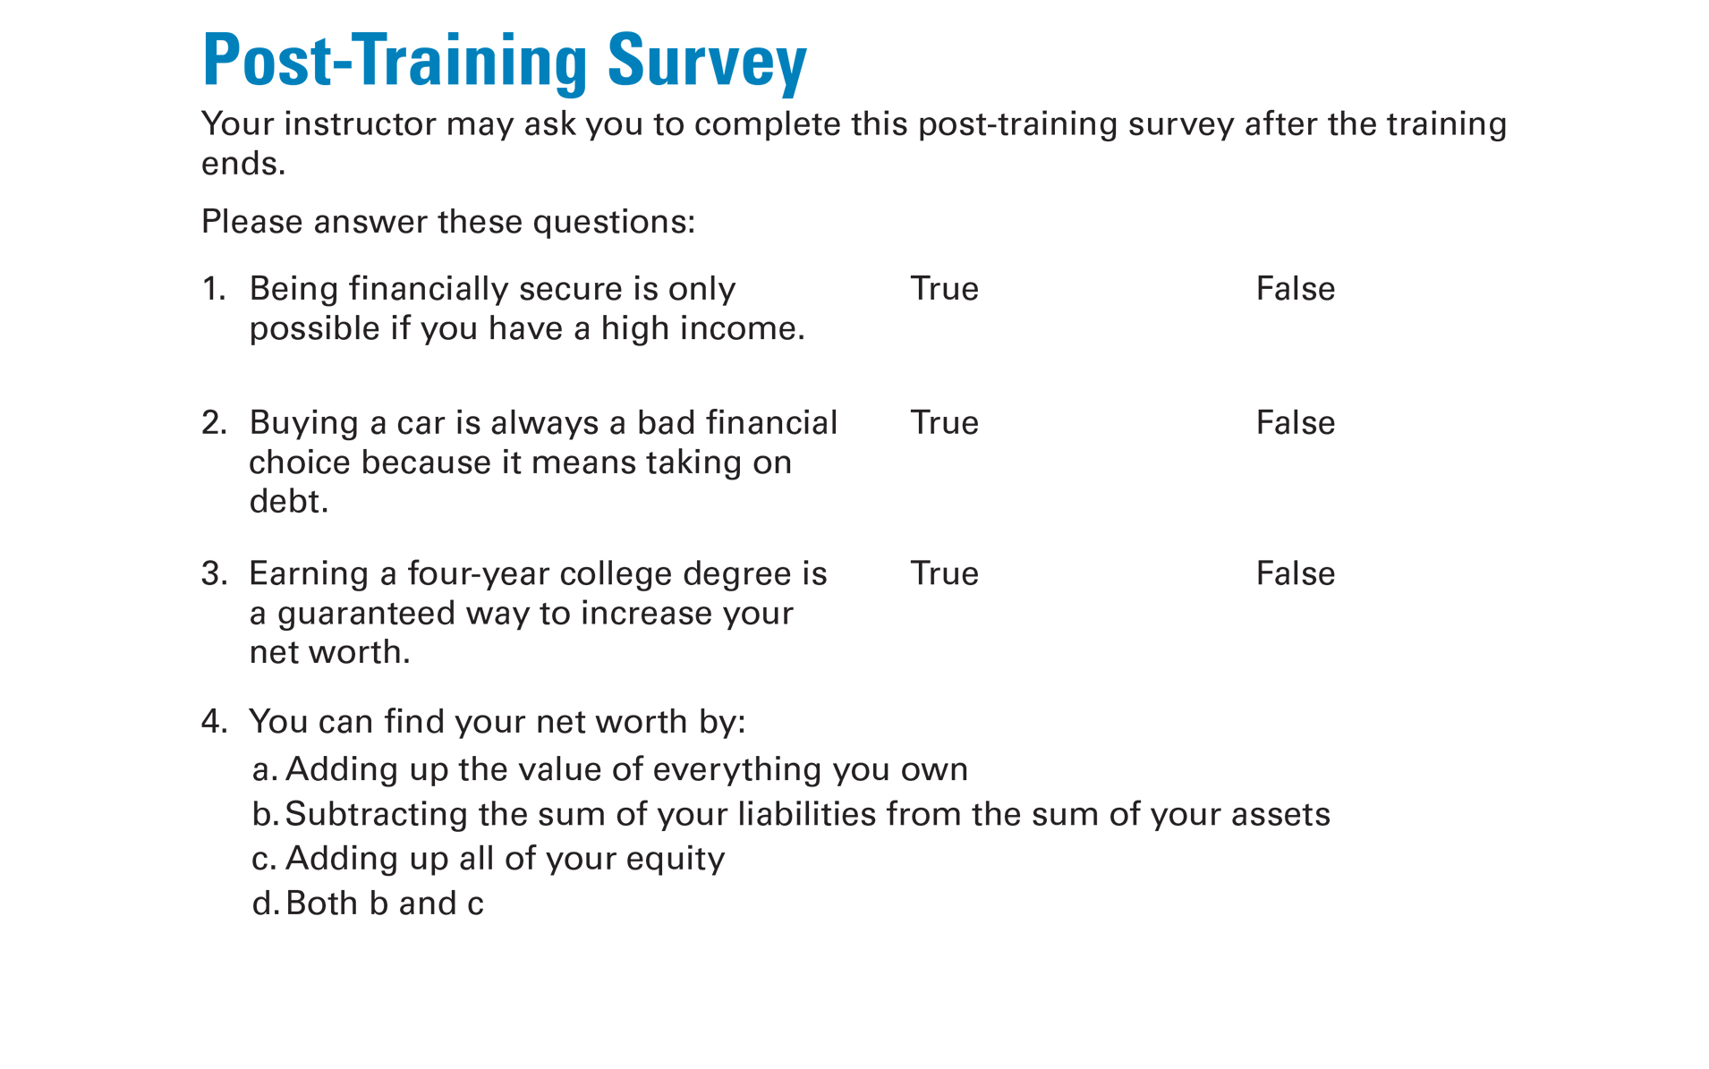
Post-Training Survey See page 33 in your Participant Guide

