Slide 1


Module 9 Using Credit Cards
Module 9
Using Credit Cards
September 2018

Slide 2
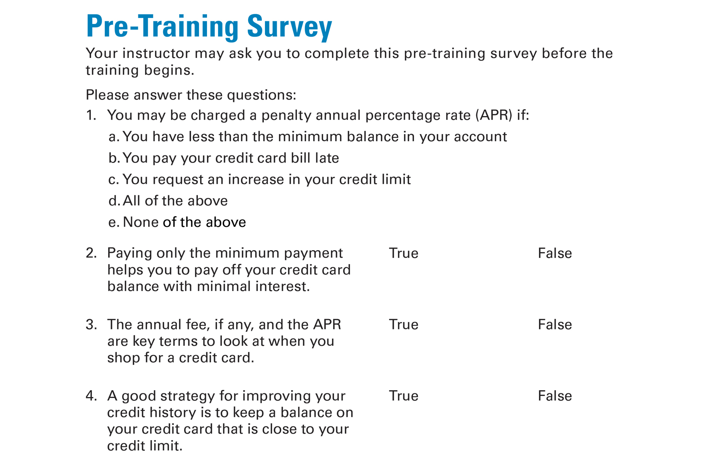
Pre-Training Survey See page 23 in your Participant Guide

Slide 3

Section 1: How Credit Cards Work
Section 1
How Credit Cards Work
See page 3 in your Participant Guide

Slide 4
Section 1: Key Takeaway
Know how credit cards work so you can more effectively shop around for one that meets your needs.

Slide 5
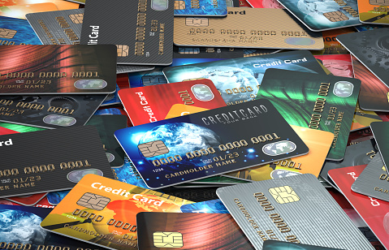
What Do You Know About Credit Cards?

Slide 6
What is a Credit Card?
Revolving line of credit
Convenient way to buy goods and services
Buy now, pay later
Limit on how much you can borrow (credit limit or credit line)
Must pay at least a portion of the bill every billing cycle (minimum payment)

Slide 7
Important Financial Tool
Can build evidence you are creditworthy
Can help you pay for emergency expenses
Convenient option for purchases online or by phone
Right to dispute erroneous credit card charges
Right to dispute certain charges for goods and services that weren't delivered as agreed

Slide 8
Cards That Are Not Credit Cards
Charge cards
Prepaid cards (also known as stored value cards)
Debit cards

Slide 9
Truth in Lending Disclosure
Credit card rates and fees vary greatly
Federal Truth in Lending Act or TILA disclosure
Written disclosure
Creditors must give it to prospective credit card customers
Contains important rate and fee information

Slide 10
Rates and Fees
Annual Percentage Rate (APR)
Cost of credit expressed as a yearly rate
Penalty APR
Increased rate if you don’t pay bill on time
Interest Rates
Fixed or Variable

Slide 11
Low Introductory APRs
Teaser rates
Last for a limited time, at least six months
For example:
0% interest on purchases for 15 months
Then, variable APR of 15.49% to 25.49%

Slide 12
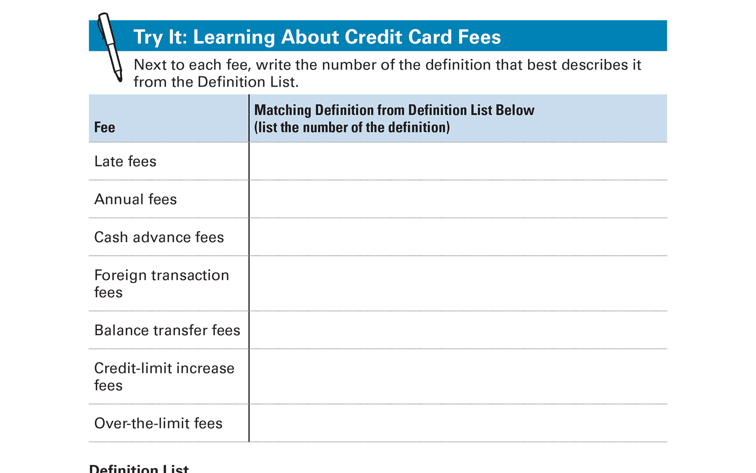
Try It: Learning About Credit Card Fees See page 6 in your Participant Guide

Slide 13
Rewards
Examples: rebates, points, airline miles
Know how to qualify
Understand how to maintain rewards
Will rewards cause you to overspend?
Consider fees when you look at rewards
Shop around

Slide 14
Other Important Terms: Credit Limit
Maximum credit you can use
Each creditor has its own standards
May consider your:
Credit history
Current income
Outstanding debt

Slide 15
Grace Period
Time between when your statement is issued and when your payment is due
Creditors do not have to give a grace period

Slide 16
Balance Computation Method
How interest on your account is calculated
There are different methods
Cardholder agreement will include which method is used
Average daily balance method is one method

Slide 17
Other Features, Products, and Services
Customer service features
Additional features for free
Example: extended warranty
Additional products/services for a fee
Examples: Payment protection, credit monitoring

Slide 18
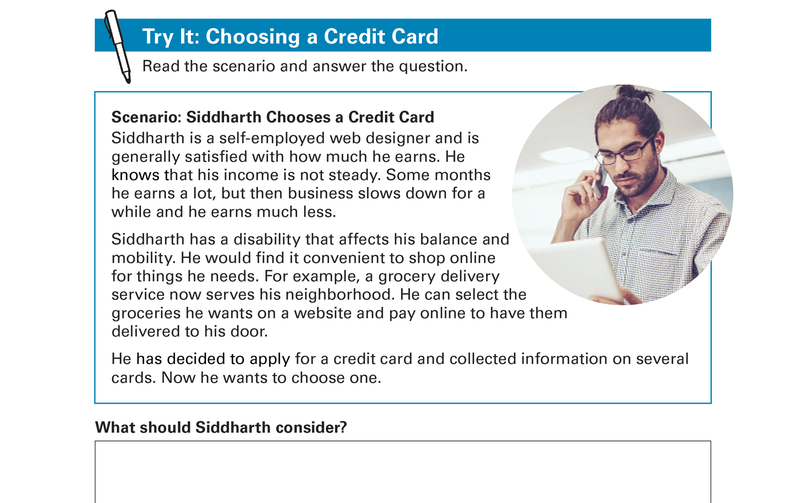
Try It: Choosing a Credit Card See page 8 in your Participant Guide

Slide 19
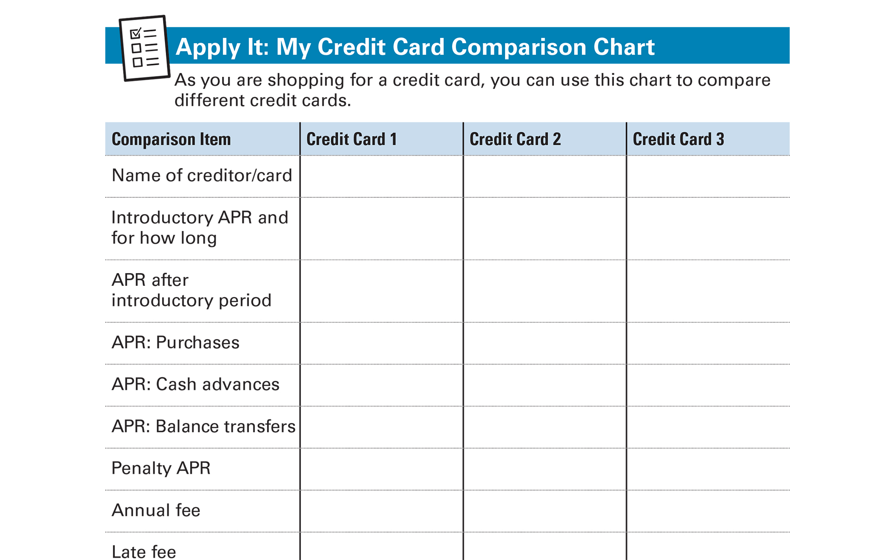
Apply It: My Credit Card Comparison Chart See page 9 in your Participant Guide

Slide 20
Unsecured and Secured Credit Cards
Unsecured credit cards – no collateral
Secured credit cards – require collateral
Keep money (collateral) in a dedicated deposit account; may be equal to card’s credit limit
If you pay balance regularly by due date, you generally can improve your credit history and scores
Usually easier to qualify for than unsecured cards

Slide 21
Secured Credit Cards
Typically have lower credit limits
Some people apply for secured credit cards if they are unable to get unsecured cards
It can help them build their credit history

Slide 22
Applying for a Credit Card
Several options to find credit card offers
Financial institutions and retail stores
Card comparison websites
Offers received in the mail
Opting out of pre-screened offers:
1-888-5-OPTOUT (567-8688)
www.optoutprescreen.com

Slide 23
Key Terms in Application Process
Credit Card Applicant
Creditor
Individual Credit
Joint Credit
Authorized User

Slide 24
Section 1: Remember the Key Takeaway
Know how credit cards work so you can more effectively shop around for one that meets your needs.

Slide 25

Section 2: Managing Your Credit Card
Section 2
Managing Your Credit Card
See page 12 in your Participant Guide

Slide 26
Section 2: Key Takeaway
Credit cards can be convenient, but manage them carefully to keep costs down and avoid damage to your credit.

Slide 27
Reading a Credit Card Statement
Account Billing Cycle | Time Period Covered by Statement
Account Summary | Previous Balance
 | New Balance
 | Credit Limit
 | Credit Available
Payment Information | New Balance
 | Minimum Payment Due
 | Payment Due Date
 | Late Payment Warning
 | Total Minimum Payment Warning

Slide 28
More Items on a Credit Card Statement
Credit Counseling Statement
Notice of Interest Rate Changes
Transactions or Account Activity
Transactions, finance charges, annual fee and interest totals
Interest Charge Calculation

Slide 29
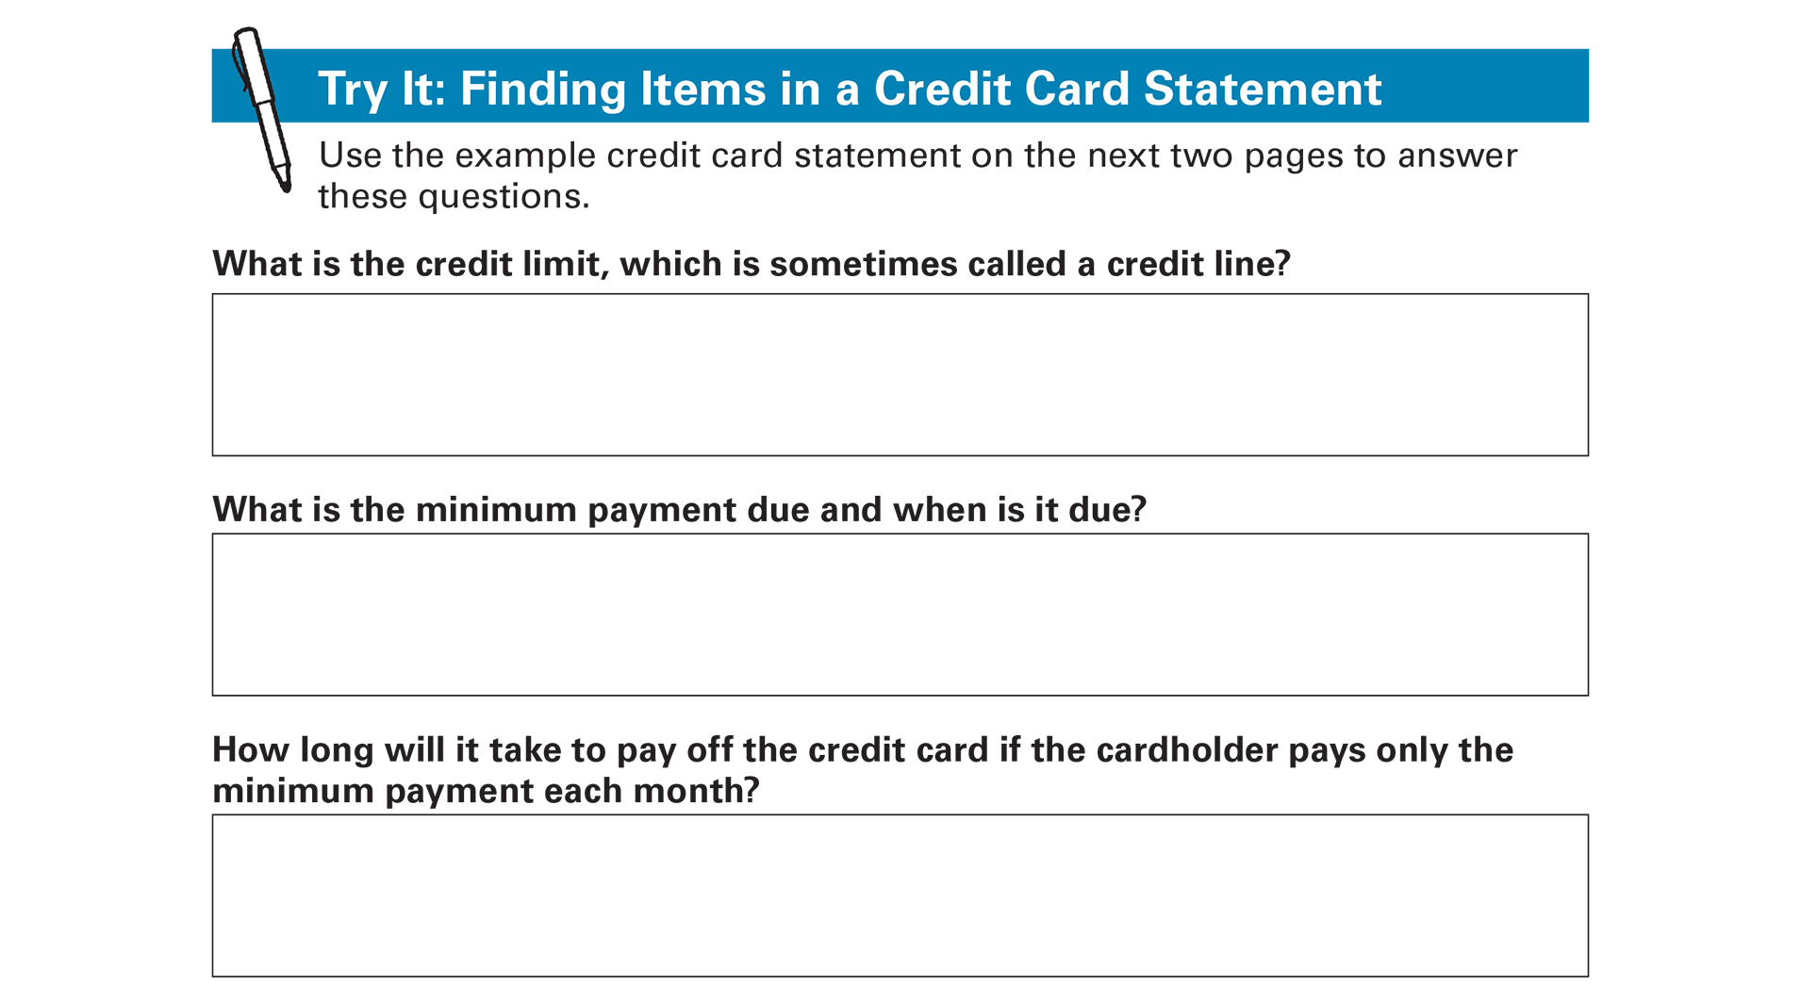
Try it: Finding Items in a Credit Card Statement See page 13 in your Participant Guide

Slide 30
Steps to Managing Your Credit Card
Keep good records
Check statements for mistakes
Pay on time and at least minimum due
Understand impact of different payment strategies
Try to limit what you owe compared to your credit limit

Slide 31
Paying Only the Minimum Payment
Item | Price | Credit Card APR | Interest Paid | How Much You Really Pay for the Item | Total Years to Pay Off
TV | $500 | 18% | $132 | $632 | 3
Repair | $1,000 | 18% | $863 | $1,863 | 8
Furniture | $2,500 | 18% | $5,363 | $7,863 | 23
All figures are rounded to the nearest dollar.
APR is the Annual Percentage Rate.

Slide 32
Paying More than Minimum Payment
Original Balance | Credit Card APR | Monthly Payments | Total Years to Pay Off | Interest Paid | Total Amount Paid
$2,500 | 18% | Only the Minimum Payment | 23 | $5,363 | $7,863
$2,500 | 18% | Minimum Payment + $24 | 4 | $1,025 | $3,525
$2,500 | 18% | Minimum Payment + $41 | 3 | $754 | $3,254
All figures are rounded to the nearest dollar.
APR is the Annual Percentage Rate.

Slide 33
How Payments Are Applied to Your Balance
Minimum payment
Creditor chooses how to apply to balance
Often applied to portion of balance with lowest interest rate
Amounts over minimum payment
Generally applied to portion of balance with the highest interest rate

Slide 34
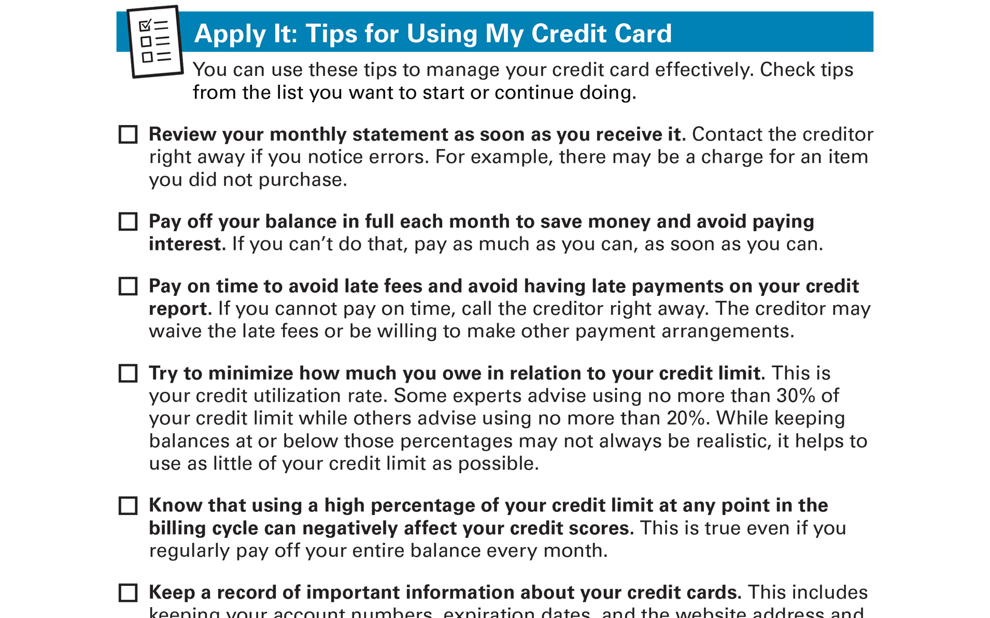
Apply It: Tips for Using My Credit Card See page 18 in your Participant Guide

Slide 35
Section 2: Remember the Key Takeaway
Credit cards can be convenient, but manage them carefully to keep costs down and avoid damage to your credit.

Slide 36
Take Action See page 20 in your Participant Guide
What will I do?
How will I do it?
Will I share my plans with anyone? If so, who?
Visit fdic.gov/education to learn more

Slide 37

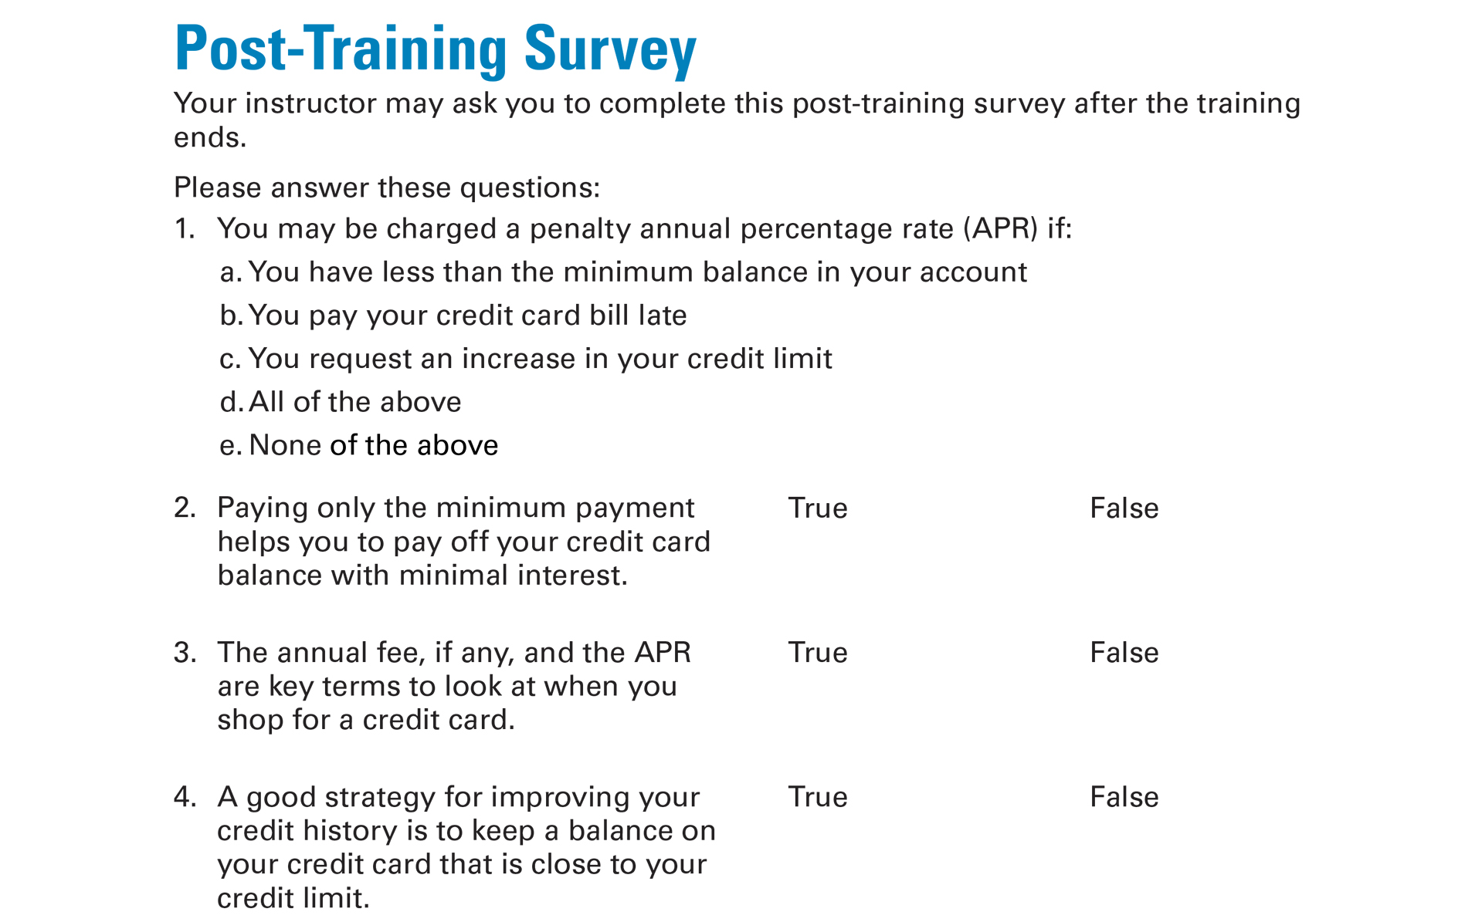
Post-Training Survey See page 25 in your Participant Guide

